Slide 1

2024년 6월 26일
Basics of Neural Network
홍익대학교 컴퓨터공학과
C135283 이수현

Slide 2
Contents
A single neuron
Basic terminology: weight, bias, activation function
Neural Network layer
Fully-connected Layer, Convolution Layer
Pooling, Normalization
CNN ( Convolutional Neural Networks )
Alexnet, VGG-16, ResNet-50
Efficiency metrics
Latency and Throughput, Energy Consumption, Number of Parameters

Slide 3
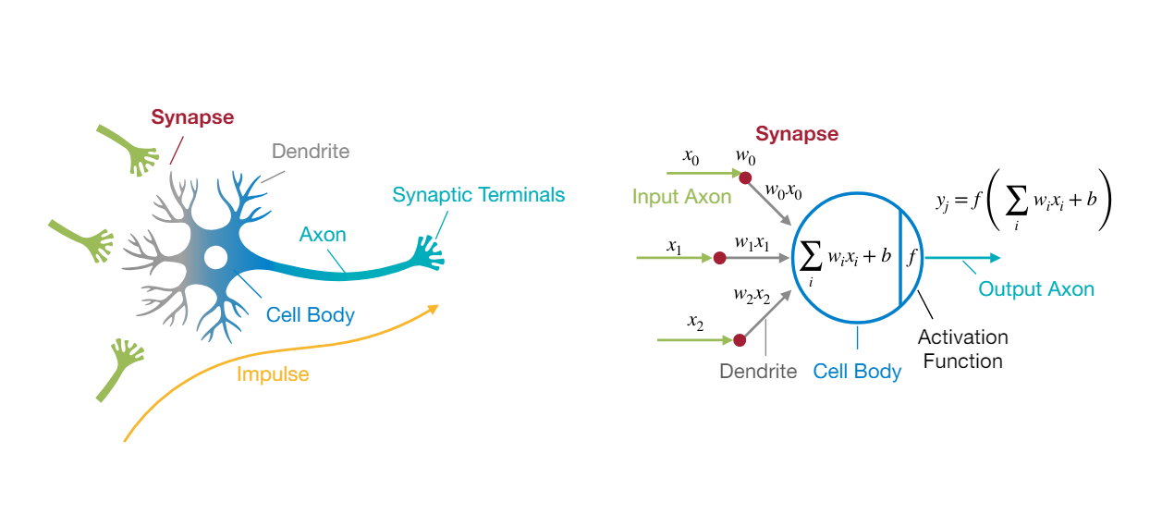
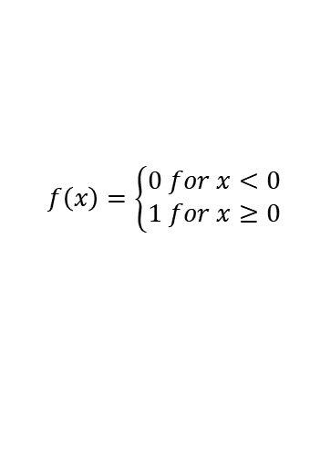
Artificial Neuron
Binary Step
1
0
-1
-10
0
10
$$f\left(x\right)=\left\{\begin{aligned}0 for x<0 \\ &1 for x≥0\end{aligned}\right.$$

Slide 4




Deep Neural Network
입력 층
$$x_{0}$$
$$x_{1}$$
$$x_{2}$$
은닉 층
$$y_{0}$$
출력 층

Slide 5
Back Propagation 역전파
순전파
입력 데이터가 레이어를 통과하면서 최종 출력을 생성하는 과정
역전파
네트워크의 예측 값과 실제 값 간의 오차를 계산
역방향으로 각 층을 거치면서 각 연결이 오차에 기여한 정도 측정
경사 하강법
오차함수의 낮은 지점을 찾아가는 최적화 방법
이 오차가 감소하도록 가중치와 편향을 조정
이 경사 하강법 -> 기울기(gradient)가 필요한데 계단 함수는 없음.

Slide 6
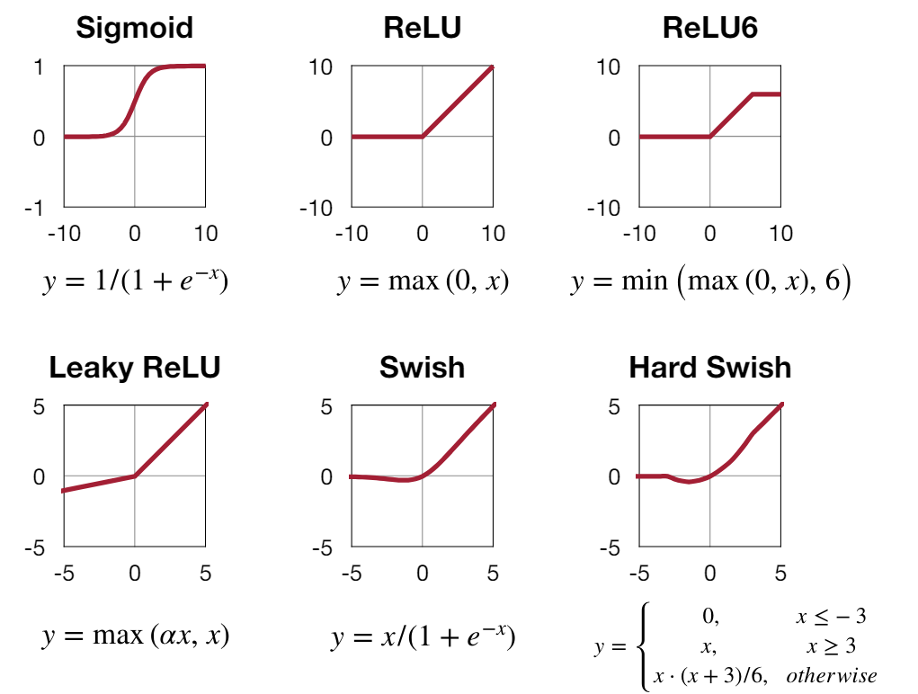
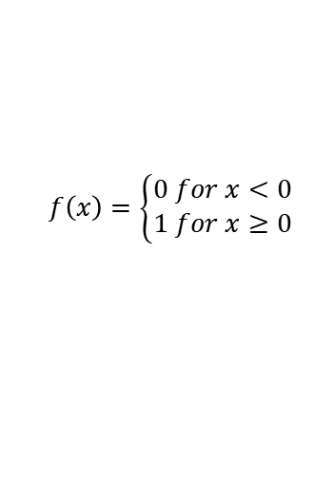
Activation Functions
Binary Step
1
0
-1
-10
0
10
$$f\left(x\right)=\left\{\begin{aligned}0 for x<0 \\ &1 for x≥0\end{aligned}\right.$$

Slide 7
Neural Network Layers
Fully-Connected Layer
Convolution Layer
Pooling Layer
Normalization Layer

Slide 8








Fully-Connected Layer 완전연결층
출력 뉴런은 모든 입력 뉴런에 연결
1D input
= linear layer, dense layer
$$x_{0}$$
$$x_{1}$$
$$x_{2}$$
$$x_{3}$$
$$x_{4}$$
$$y_{0}$$
$$y_{1}$$
$$y_{2}$$

Slide 9
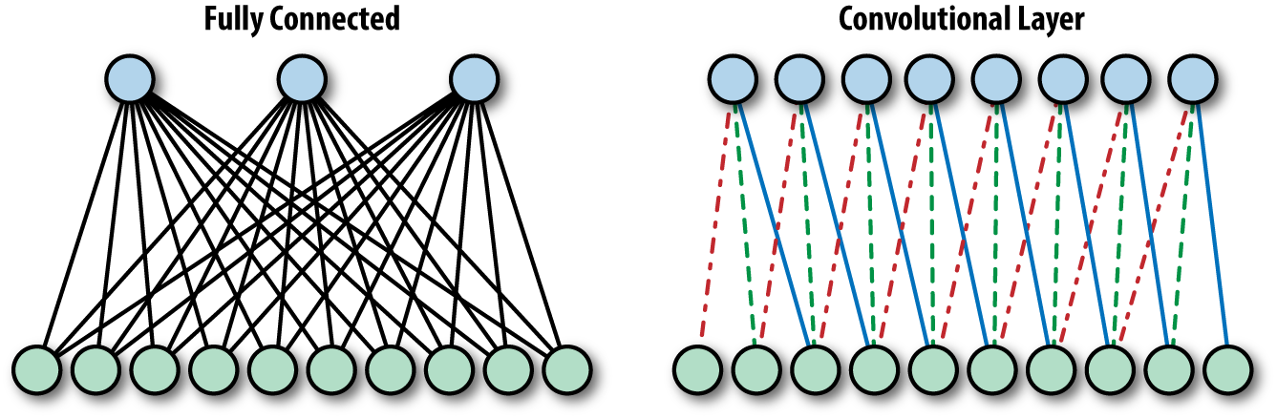
Convolution Layer 합성곱 층
출력 뉴련은 수용장 안에 있는 입력 뉴런에 연결

Slide 10
Convolution Layer
2D input
1 | 0 | 1 | 0 | 1
0 | 0 | 1 | 0 | 1
1 | 1 | 1 | 1 | 1
1 | 0 | 0 | 1 | 0
0 | 1 | 1 | 1 | 0
0 | 1 | 2
3 | 4 | 5
6 | 7 | 8
28

Slide 11
Padding
0 | 0 | 0 | 0 | 0 | 0 | 0
0 | 1 | 0 | 1 | 0 | 1 | 0
0 | 0 | 0 | 1 | 0 | 1 | 0
0 | 1 | 1 | 1 | 1 | 1 | 0
0 | 1 | 0 | 0 | 1 | 0 | 0
0 | 0 | 1 | 1 | 1 | 0 | 0
0 | 0 | 0 | 0 | 0 | 0 | 0
4 | 16
0 | 1 | 2
3 | 4 | 5
6 | 7 | 8

Slide 12
Stride(2)
2
1 | 0 | 1 | 0 | 1
0 | 0 | 1 | 0 | 1
1 | 1 | 1 | 1 | 1
1 | 0 | 0 | 1 | 0
0 | 1 | 1 | 1 | 0
0 | 1 | 2
3 | 4 | 5
6 | 7 | 8
28 | 31

Slide 13
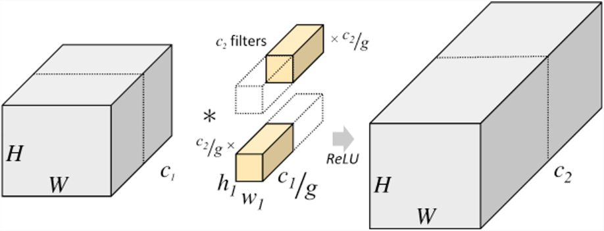
Grouped Convolution Layer

Slide 14
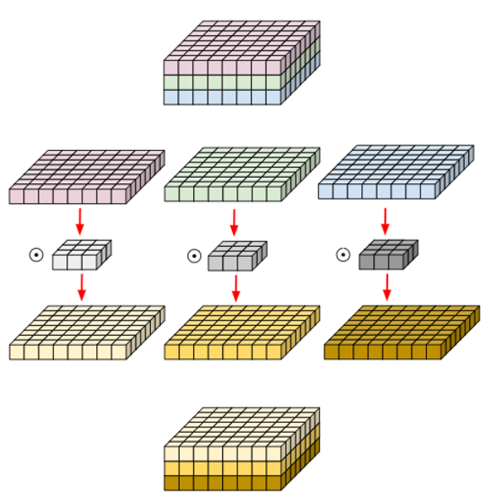
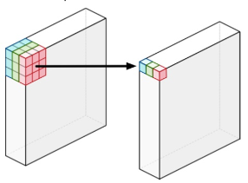
Depthwise Convolution Layer

Slide 15
Pooling Layer
Downsample
Max-pooling
5 | 7
8 | 3
5 | 0 | 1 | 7
2 | 1 | 3 | 5
0 | 2 | 3 | 1
2 | 8 | 1 | 3
Average-pooling
2 | 4
3 | 2

Slide 16
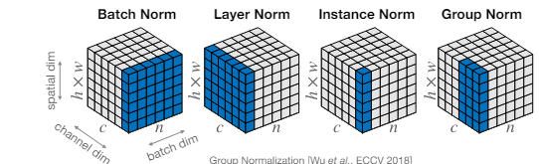
Normalization Layer
0~1 사이의 값들로 모든 데이터의 스케일을 동일하게 정규화

Slide 17
Popular CNN architectures
AlexNet
VGG-16
ResNet-50
MobileNetV2

Slide 18
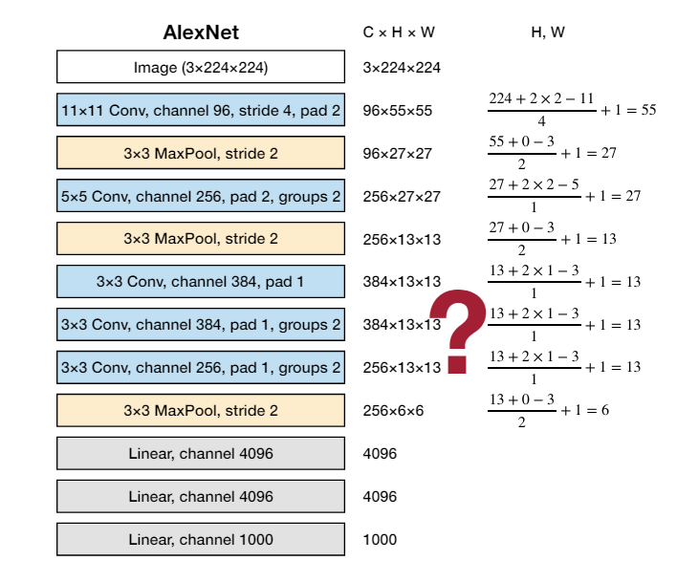
AlexNet
ImageNet Classification with Deep Convolutional Neural Networks [Krizhevsky et al., NeurIPS 2012]

Slide 19
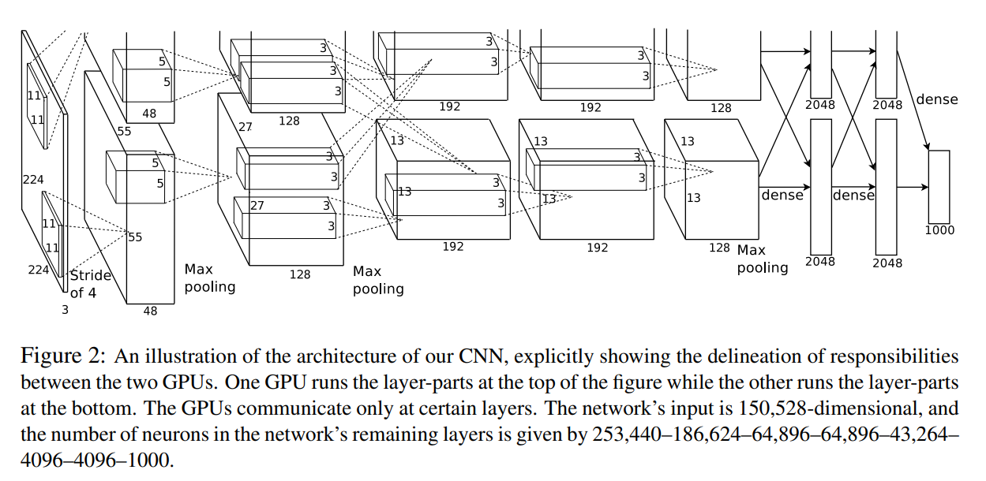
AlexNet
ImageNet Classification with Deep Convolutional Neural Networks [Krizhevsky et al., NeurIPS 2012]

Slide 20
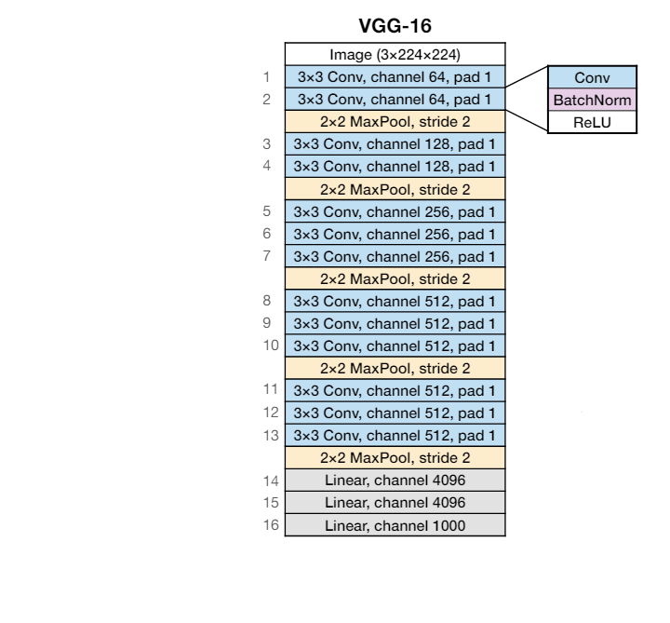
VGG-16
Very Deep Convolutional Networks for Large-Scale Image Recognition [Simonyan et al., ICLR 2015]

Slide 21
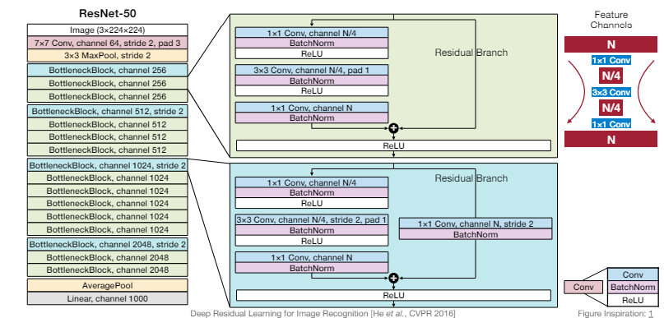
ResNet-50

Slide 22
Efficiency Metrics
Latency and Throughput
Energy Consumption
Number of Parameters
Model Size
Number of Activations
Number of Multiply-Accumulate Operations
OP, FLOP
Memory-related
Computation-related

Slide 23
Metrics(1)
Latency: delay for a specific task
Throughput: rate at which data is processed
Energy consumption: data movement

Slide 24
Metrics(2) - memory-related
Number of Parameters: # of elements in the weight tensors
Model Size = Storage for the weights (MB, KB..)
= #parameters*bit width
AlexNet = 61M parameters
If all weights stored with 32-bit #s.
Model size = 61M * 4 Bytes = 224 MB
Number of Activations:

Slide 25
Metrics(3) – computation-related
Number of Multiply-Accumulate Operations
MAC
a <- a + b*c
Matrix-Vector Multiplication (MV)
MACs = m*n
General Matrix-Matrix Multiplication (GEMM)
MACs = m*n*k

Slide 26
Metrics(4) – computation-related
Number of OP, FLOP
OP: operation
OPS: operations per second
FLOP: floating point operation
FLOPS: FLOP per second

