Slide 1

2024년 4월 15일
Hamming Code
홍익대학교 컴퓨터공학과
C4110705 여인국

Slide 2
Contents
Hamming Code
Hamming Code Experiment

Slide 3
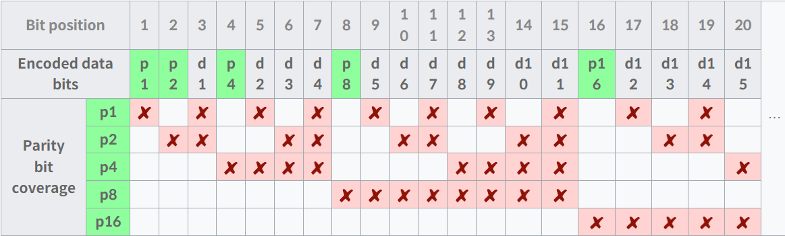
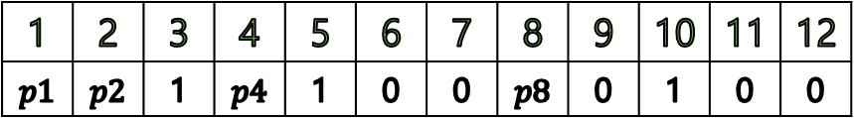
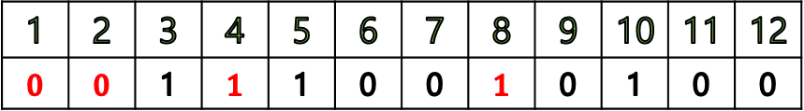
Hamming Code
Encoding
1 | 2 | 3 | 4 | 5 | 6 | 7 | 8
1 | 1 | 0 | 0 | 0 | 1 | 0 | 0
Ex:
Data by Hamming Code
1 | 2 | 3 | 4 | 5 | 6 | 7 | 8 | 9 | 10 | 11 | 12
$$p1$$ | $$p2$$ | 1 | $$p4$$ | 1 | 0 | 0 | $$p8$$ | 0 | 1 | 0 | 0
Ex:
1 | 2 | 3 | 4 | 5 | 6 | 7 | 8 | 9 | 10 | 11 | 12
$$0$$ | $$0$$ | 1 | $$1$$ | 1 | 0 | 0 | $$1$$ | 0 | 1 | 0 | 0
Ex:

Slide 4
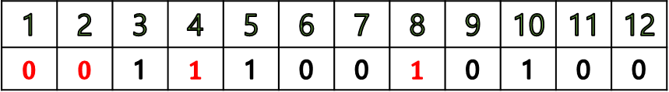
Hamming Code
Encoding
1 | 2 | 3 | 4 | 5 | 6 | 7 | 8 | 9 | 10 | 11 | 12
$$0$$ | $$0$$ | 1 | $$1$$ | 1 | 0 | 0 | $$1$$ | 0 | 1 | 0 | 0
Ex:
p1
1 * 1 * 0 * 0 * 0 = 0
p2
1 * 0 * 0 * 1 * 0 = 0
p4
1 * 0 * 0 * 0 = 1
p8
0 * 1 * 0 * 0 = 1
※참고
* : XOR 연산

Slide 5
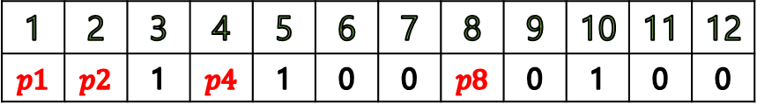

Hamming Code
Decoding
1 | 2 | 3 | 4 | 5 | 6 | 7 | 8 | 9 | 10 | 11 | 12
$$p1$$ | $$p2$$ | 1 | $$p4$$ | 1 | 0 | 0 | $$p8$$ | 0 | 1 | 0 | 0
Ex:
p1
$p1$ * 1 * 1 * 0 * 0 * 0 = 0
p2
$p2$ * 1 * 0 * 0 * 1 * 0 = 0
p4
$p4$ * 1 * 0 * 0 * 0 = 1
p8
$p8$ * 0 * 1 * 0 * 0 = 1
※참고
* : XOR 연산

Slide 6

Hamming Code
Decoding
1 | 2 | 3 | 4 | 5 | 6 | 7 | 8 | 9 | 10 | 11 | 12
$$0$$ | $$0$$ | 1 | $$1$$ | 1 | 0 | 0 | $$1$$ | 0 | 1 | 0 | 0
Ex:
p1
0 * 1 * 1 * 0 * 0 * 0 = 0
p2
0 * 1 * 0 * 0 * 1 * 0 = 0
p4
$1$ * 1 * 0 * 0 * 0 = 0
p8
$1$ * 0 * 1 * 0 * 0 = 0
※참고
* : XOR 연산
P1p2p4p8 = $0000_{(2)}$ = $0_{(10)}$

Slide 7
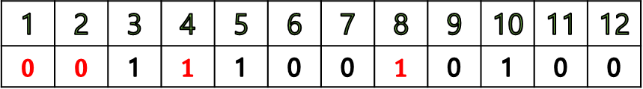

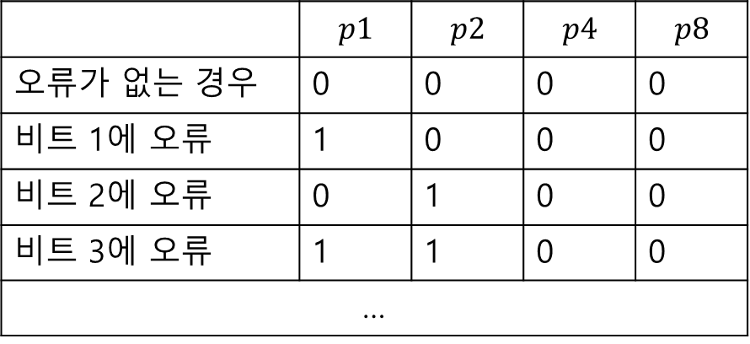
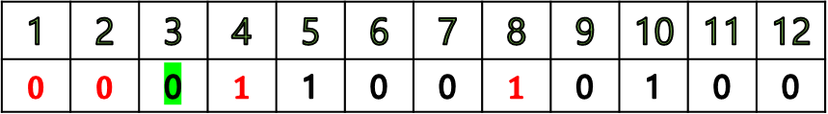
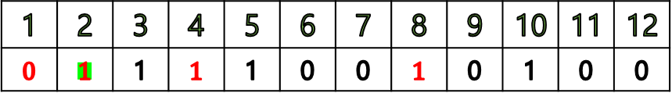
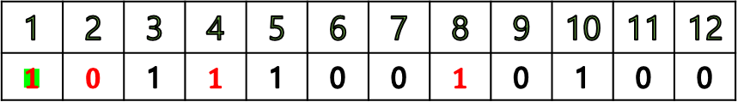
Hamming Code
Decoding
오류X, 전송 Data
 | $$p1$$ | $$p2$$ | $$p4$$ | $$p8$$
오류가 없는 경우 | 0 | 0 | 0 | 0
비트 1에 오류 | 1 | 0 | 0 | 0
비트 2에 오류 | 0 | 1 | 0 | 0
비트 3에 오류 | 1 | 1 | 0 | 0
…
1 | 2 | 3 | 4 | 5 | 6 | 7 | 8 | 9 | 10 | 11 | 12
$$0$$ | $$0$$ | 1 | $$1$$ | 1 | 0 | 0 | $$1$$ | 0 | 1 | 0 | 0
비트 1 오류
1 | 2 | 3 | 4 | 5 | 6 | 7 | 8 | 9 | 10 | 11 | 12
$$1$$ | $$0$$ | 1 | $$1$$ | 1 | 0 | 0 | $$1$$ | 0 | 1 | 0 | 0
비트 3 오류인 경우의 parity bits
p1
0 * 0 * 1 * 0 * 0 * 0 = 1
p2
0 * 0 * 0 * 0 * 1 * 0 = 1
p4
$1$ * 1 * 0 * 0 * 0 = 0
p8
$1$ * 0 * 1 * 0 * 0 = 0
비트 2 오류
1 | 2 | 3 | 4 | 5 | 6 | 7 | 8 | 9 | 10 | 11 | 12
$$0$$ | $$1$$ | 1 | $$1$$ | 1 | 0 | 0 | $$1$$ | 0 | 1 | 0 | 0
비트 3 오류
1 | 2 | 3 | 4 | 5 | 6 | 7 | 8 | 9 | 10 | 11 | 12
$$0$$ | $$0$$ | 0 | $$1$$ | 1 | 0 | 0 | $$1$$ | 0 | 1 | 0 | 0

Slide 8
Hamming Code Experiment
Conditions
128b message / 8b parity → 136b codeword
짝수 패리티
1. Encoder
1.1. 입력: 128-bit message (예: input wire [127:0] din)
1.2. 출력: 8-bit parity (예: output wire [ 7:0] ecc)
2. Decoder
2.1. 입력: 136-bit codeword (예: input wire [135:0] din_2)
2.2. 출력: 128-bit decoded message (예: output wire [127:0] dout)

Slide 9

Hamming Code Experiment
Encoding
p1
$p_{1}=2n−1 (n≥1)$
p2
→ $p_{2}=\left(2, 3\right)+4(n−1) (n≥1)$
p4
→ $p_{4}=\left(4,5,6,7\right)+8(n−1) (n≥1)$
p8
→ $p_{8}=\left(8,\sim ,15\right)+16(n−1) (n≥1)$
p16
→ $p_{16}=\left(16\sim 31\right)+32(n−1) (n≥1)$
p32
→ $p_{32}=\left(32\sim 63\right)+64(n−1) (n≥1)$
p64
→ $p_{64}=\left(64\sim 127\right)+128(n−1) (n≥1)$
p128
→ $p_{128}=\left(128\sim 255\right)+256(n−1) (n≥1)$
Parity bits 8개가 필요
→ 일정한 패턴이 존재

Slide 10
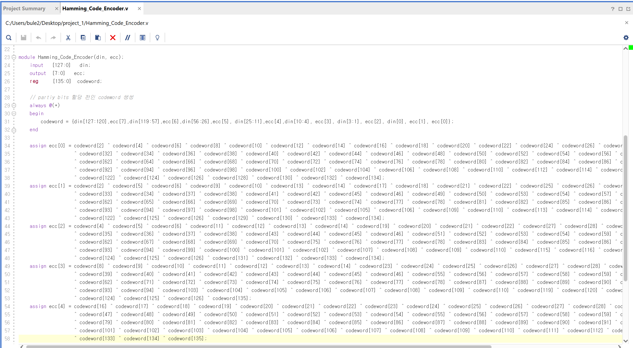
Hamming Code Experiment
Encoding

Slide 11
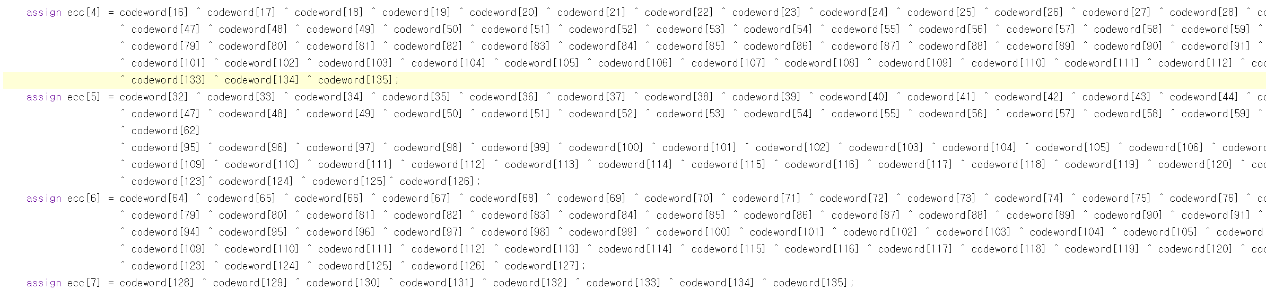
Hamming Code Experiment
Encoding

Slide 12
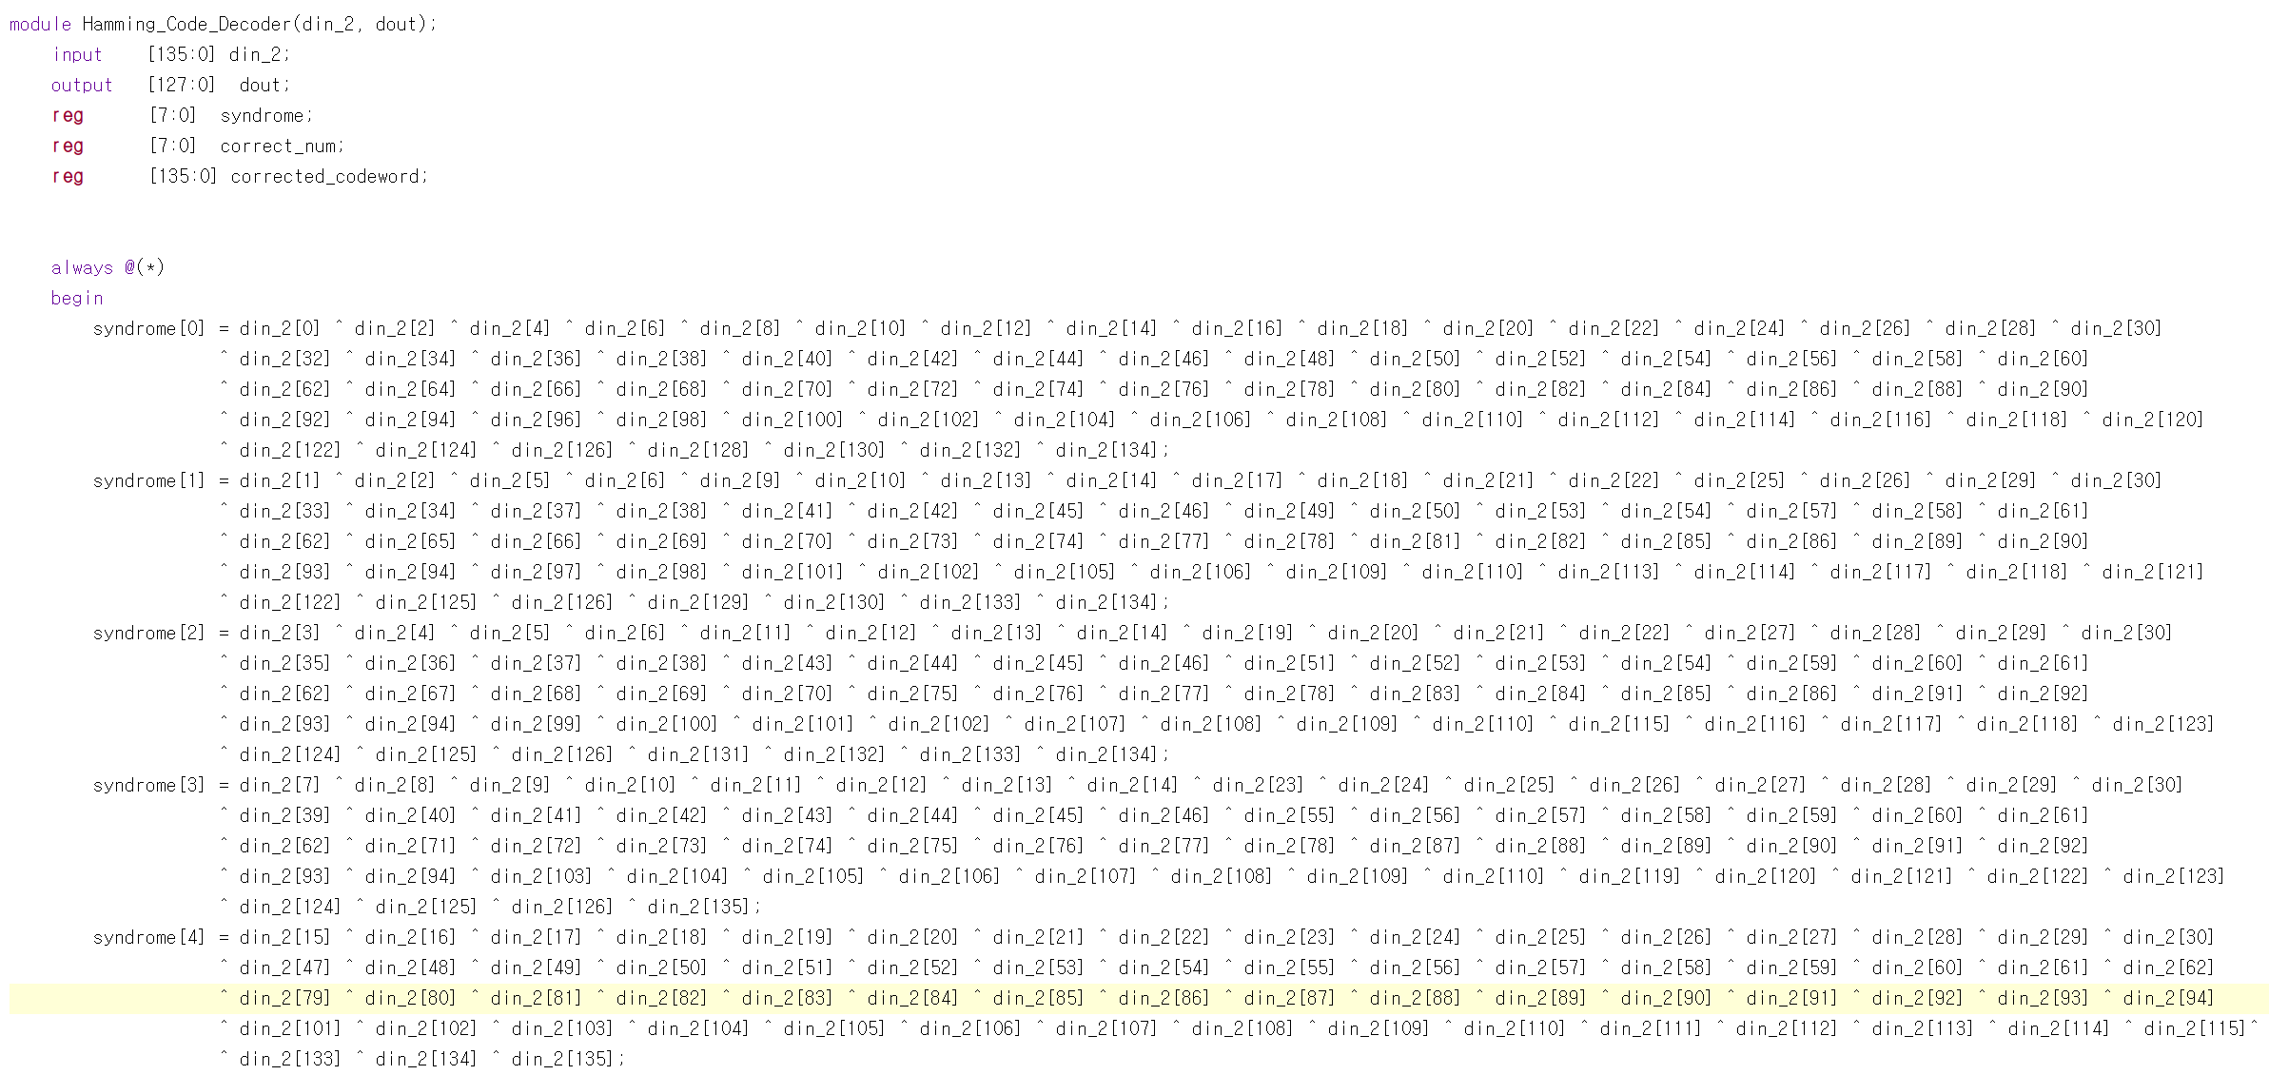
Hamming Code Experiment
Decoding

Slide 13
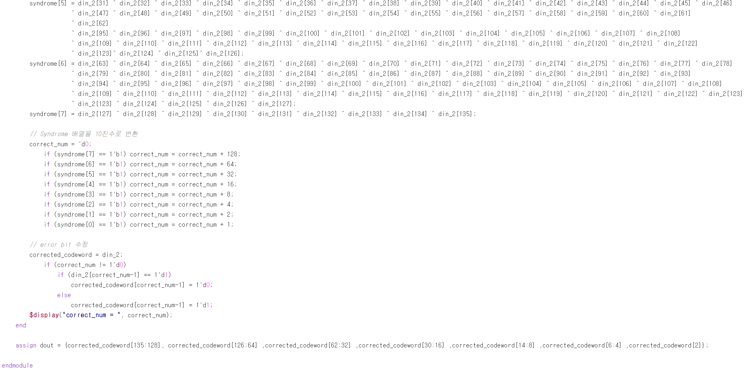
Hamming Code Experiment
Decoding

Slide 14
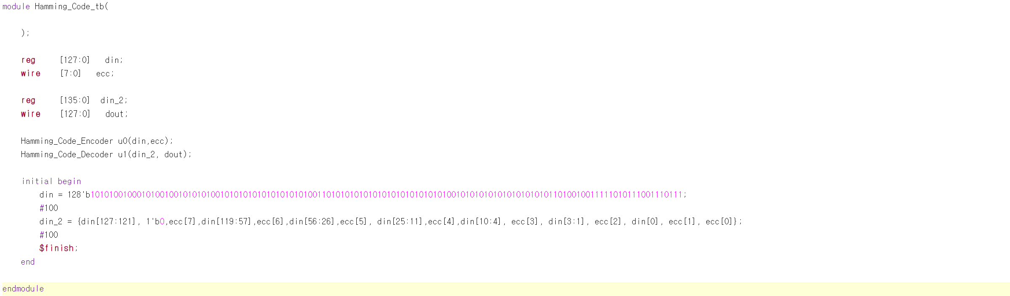
Hamming Code Experiment
Test Bench

Slide 15
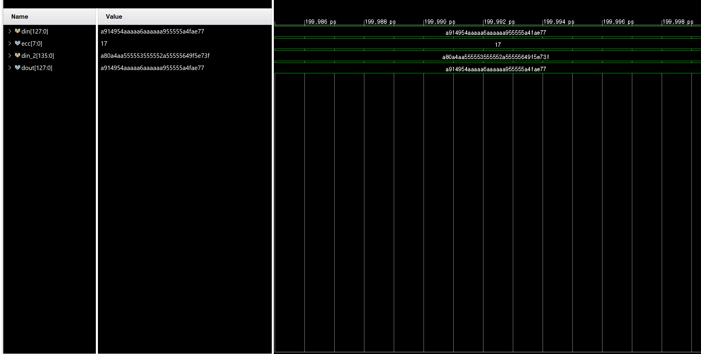
Hamming Code Experiment
Result

Slide 16
감사합니다

