Slide 1
BNN 구현
Sunghyun Lee, Suhak Lee
Department of Computer Engineering

Slide 2
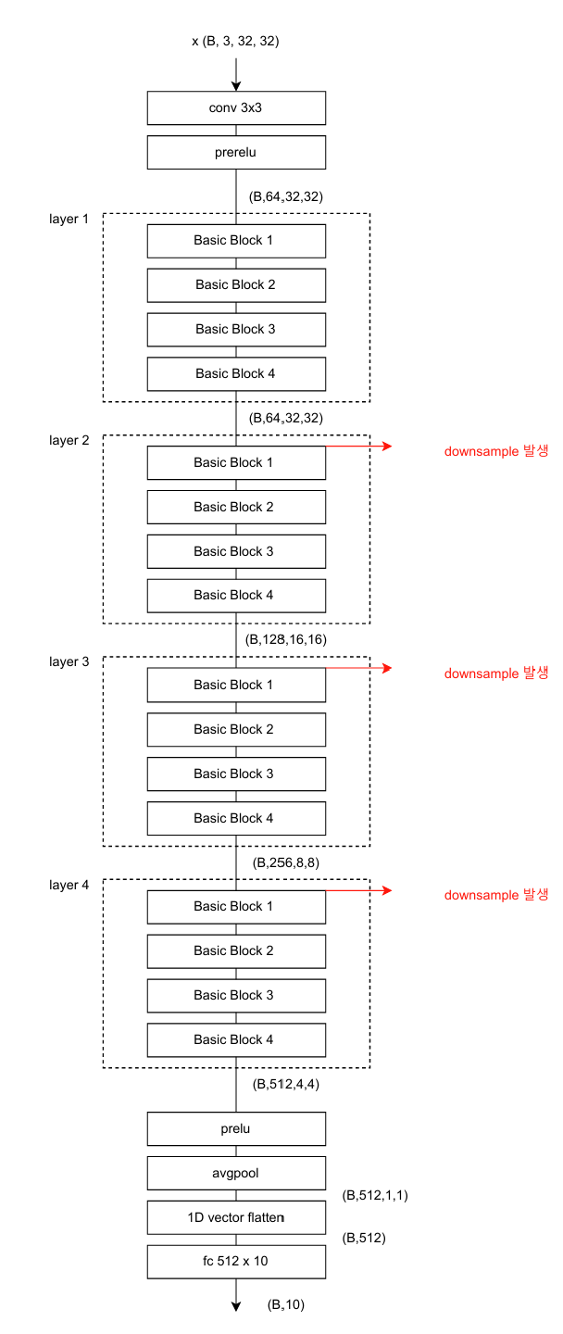
Xnor-Net
Xnor-Net 구조

Slide 3
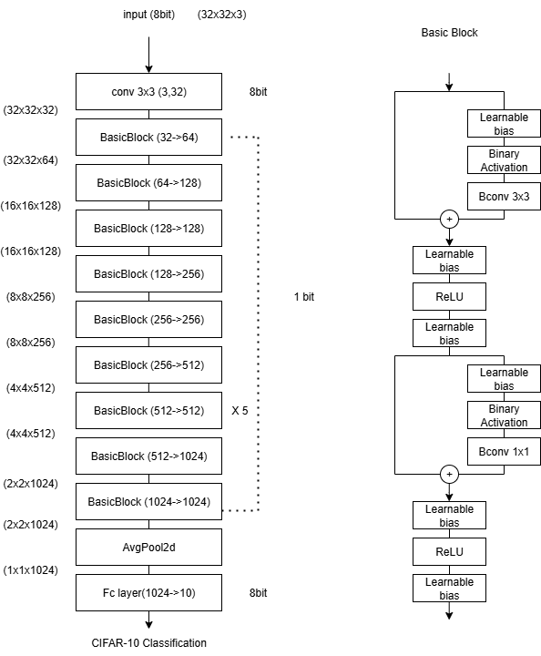
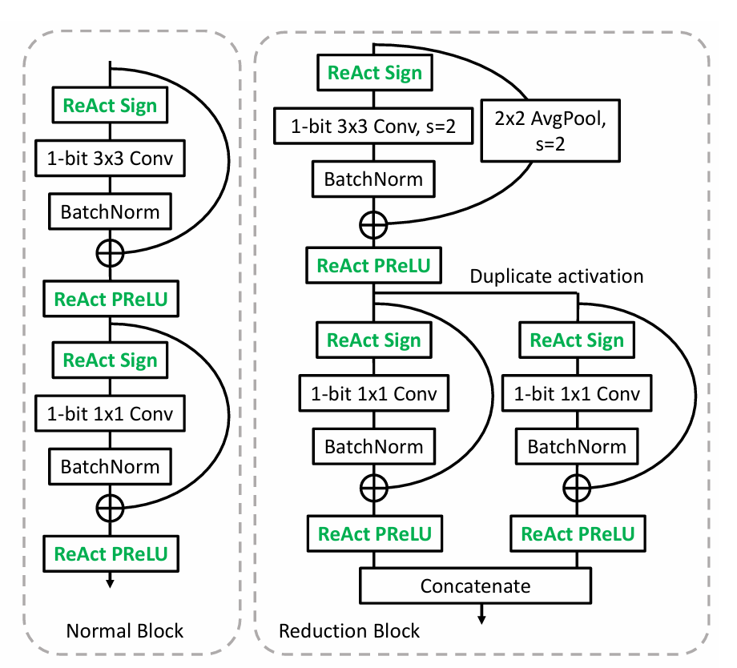
ReActNet
ReActNet: Towards Precise Binary Neural Network with Generalized Activation Functions

Slide 4
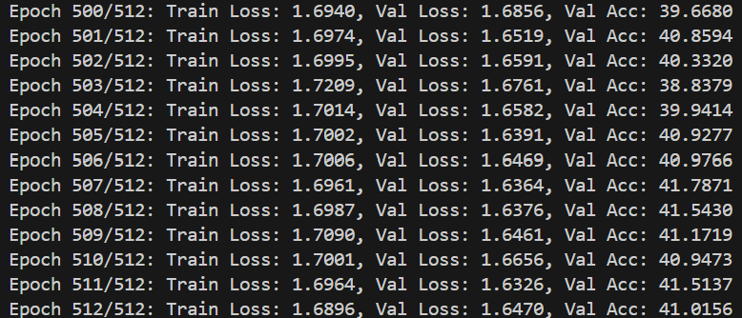
ReActNet Accuracy
Epoch 512/512
Train Loss: 1.6896 Val Loss : 1.6470 Val Acc: 41.0156%
https://github.com/leesunghyun1019/ReActNet_brevitas.git

