Slide 1
DNAS SNN in Tinyimagenet
2026년 05월 06일
Sunghyun Lee
Department of Computer Engineering

Slide 2
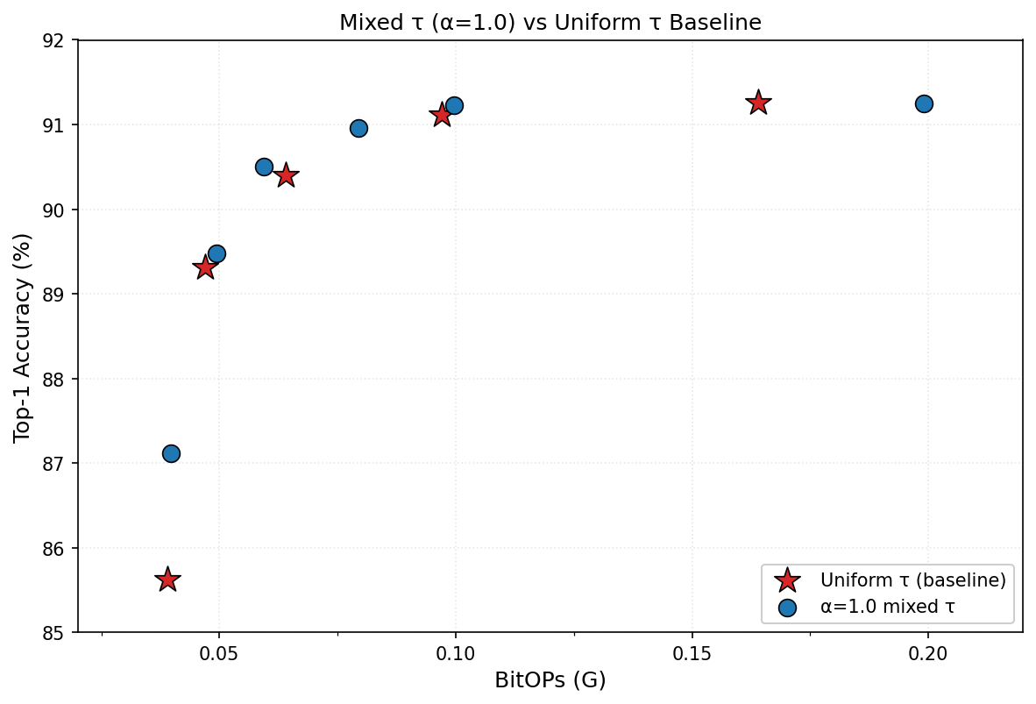





Goal
0.0795G
90.96%
0.0996G
91.23%
0.199G
91.25%
0.0594G
90.50%
$τ$=5
0.164G
91.26%
$τ$=4
0.097G
91.11%
0.0494G
89.48%
$τ$=3
0.064G
90.40%
$τ$=2
0.047G
89.31%
0.0398G
87.11%
$τ$=1
0.039G
85.62%
원하는 hardware constraint(Weight storage, BitOPs) 을 지정하면, 그 hardware constraint 이하의 최적의 레이어별 $τ$ 조합을 자동 탐색하는 DNAS framework

Slide 3
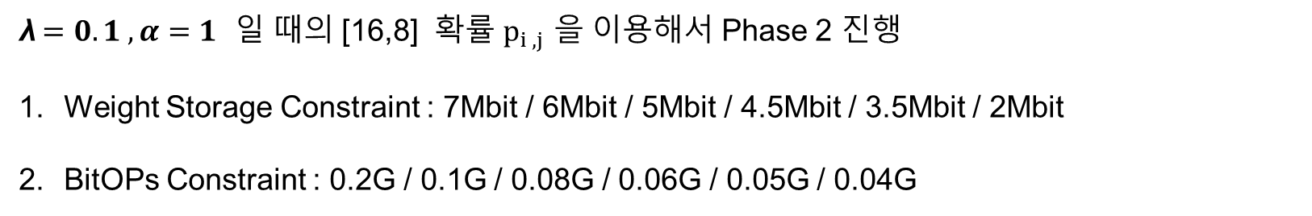
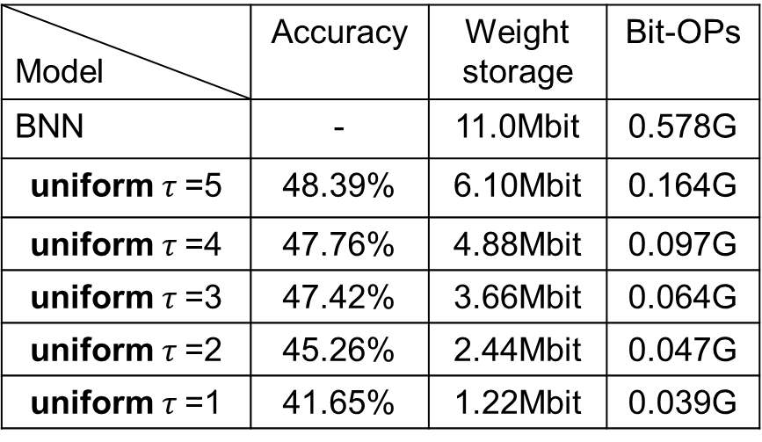
baseline
$$L = L_{acc} +λ[ α_{cost} × \hat{S} + (1−{ α}_{cost}) ×\hat{B}]$$
λ$=0.1 ,α=1$ 일 때의 [16,8] 확률 $p_{i ,j}$ 을 이용해서 Phase 2 진행
Weight Storage Constraint : 7Mbit / 6Mbit / 5Mbit / 4.5Mbit / 3.5Mbit / 2Mbit
BitOPs Constraint : 0.2G / 0.1G / 0.08G / 0.06G / 0.05G / 0.04G
Epoch :100
Model | Accuracy | Weight storage | Bit-OPs
BNN | - | 11.0Mbit | 0.578G
uniform $τ$=5 | 48.39% | 6.10Mbit | 0.164G
uniform $τ$=4 | 47.76% | 4.88Mbit | 0.097G
uniform $τ$=3 | 47.42% | 3.66Mbit | 0.064G
uniform $τ$=2 | 45.26% | 2.44Mbit | 0.047G
uniform $τ$=1 | 41.65% | 1.22Mbit | 0.039G

Slide 4
Phase 2 결과
$λ =0.1 ,α=1$
Hardware Constraint | Tau list | Accuracy | Weight storage | Bit-OPs
7Mbit | [5, 4, 6, 6, 6, 5, 6, 4, 6, 4, 5, 3, 4, 3, 2, 2] | 49.05% | 3.73Mbit | 0.191G
6Mbit
5Mbit
4.5Mbit
3.5Mbit | [5, 4, 6, 6, 6, 5, 6, 4, 6, 4, 5, 3, 4, 3, 2, 1] | 48.73% | 3.47Mbit | 0.191G
2Mbit | [5, 4, 6, 6, 6, 5, 6, 4, 5, 3, 2, 3, 1, 1, 1, 1] | 47.11% | 1.99Mbit | 0.183G
0.2G | [5, 4, 6, 6, 6, 5, 6, 4, 6, 4, 5, 3, 4, 3, 2, 2] | 49.05% | 3.73Mbit | 0.191G
0.1G | [4, 4, 4, 4, 5, 5, 4, 3, 5, 4, 4, 3, 4, 3, 2, 2] | 48.33% | 3.55Mbit | 0.099G
0.08G | [4, 3, 3, 3, 5, 4, 4, 3, 5, 4, 3, 3, 4, 3, 2, 2] | 48.12% | 3.46Mbit | 0.079G
0.06G | [3, 2, 2, 2, 4, 3, 3, 3, 5, 4, 2, 3, 4, 3, 2, 2] | 47.13% | 3.33Mbit | 0.0597G
0.05G | [2, 2, 2, 1, 3, 2, 2, 2, 4, 3, 3, 3, 4, 3, 2, 2] | 47.11% | 3.23Mbit | 0.0496G
0.04G | [1, 1, 1, 1, 2, 1, 1, 1, 2, 1, 2, 1, 2, 2, 2, 2] | 41.93% | 2.25Mbit | 0.0398G
Notes:
Loss을$λ =0.1 ,α=1$로 둔 상태에서 tau list , Accuracy, Weight Storage, BitOPs를 뽑았습니다.

Slide 5
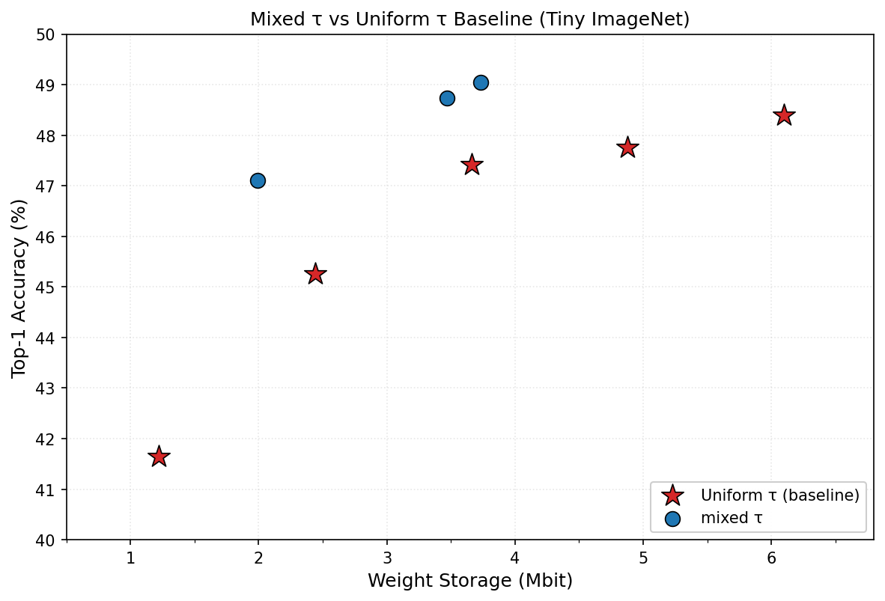
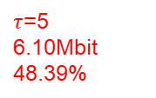
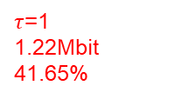
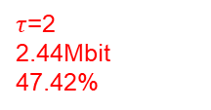
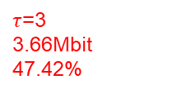
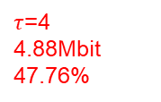
Weight Storage
3.73Mbit
49.05%
3.47Mbit
48.73%
1.99Mbit
47.11%
$τ$=5
6.10Mbit
48.39%
$τ$=4
4.88Mbit
47.76%
$τ$=3
3.66Mbit
47.42%
$τ$=2
2.44Mbit
47.42%
$τ$=1
1.22Mbit
41.65%

Slide 6
KV Cache

Slide 7
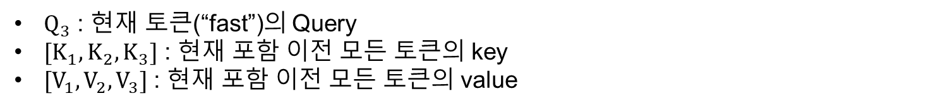
Attention
Time file fast <next>
: “fast” 다음 token 생성
$$Attention(Q_{3},K,V)=softmax(\frac{Q_{3}@{{[K}_{1},K_{2},K_{3}]}^{T}}{\sqrt{d}})[V_{1},V_{2},V_{3}]$$
$Q_{3}$ : 현재 토큰(“fast”)의 Query
${[K}_{1},K_{2},K_{3}]$ : 현재 포함 이전 모든 토큰의 key
$[V_{1},V_{2},V_{3}]$ : 현재 포함 이전 모든 토큰의 value
Notes:
"지금 fast 다음 토큰을 예측하는 상황"
"Q는 현재 토큰인 fast 것만 필요"
"근데 K, V는 이전 토큰들 것도 전부 필요 → 왜냐면 fast가 이전 문맥을 참고해야 하니까"
"이게 KV Cache가 필요한 이유"

Slide 8
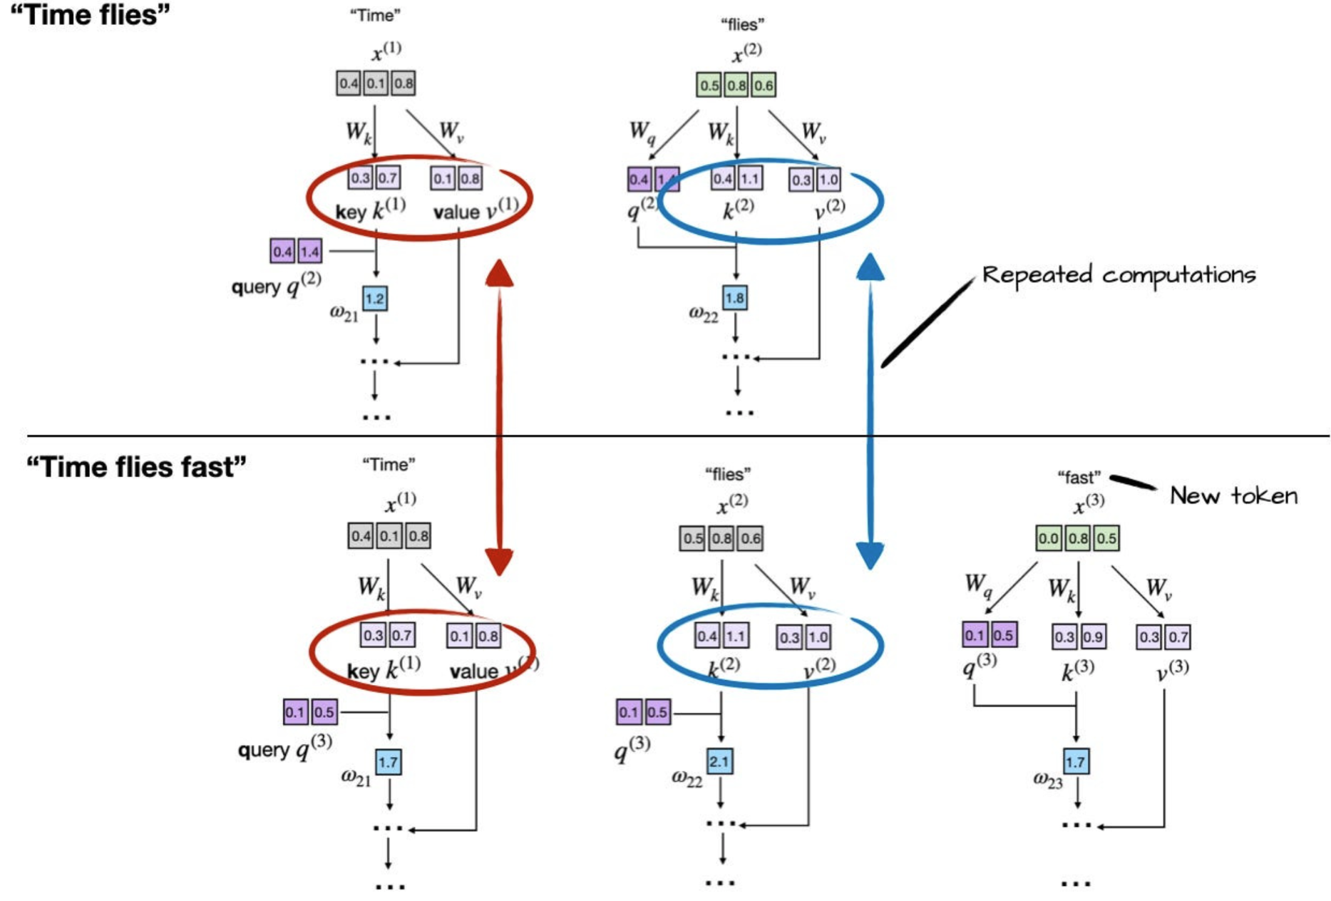
Without KV cache
$$Attention(Q_{3},K,V)=softmax(\frac{Q_{3}@{{[K}_{1},K_{2},K_{3}]}^{T}}{\sqrt{d}})[V_{1},V_{2},V_{3}]$$
Notes:
"빨간/파란 동그라미 보이죠?"
"이게 Repeated computations, 즉 중복 계산입니다"
"다음 슬라이드에서 이걸 어떻게 해결하는지 보겠습니다"

Slide 9
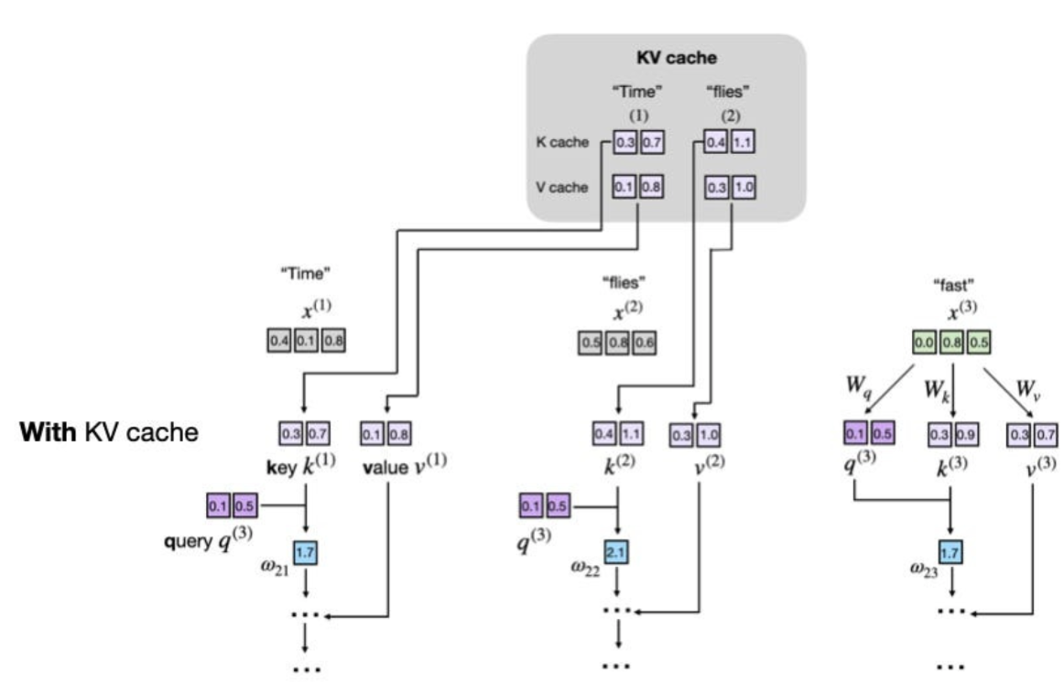
With KV cache
추론시 중간 단계에 계산된 key, value를 저장해두고 재사용

Slide 10

Step-by-Step Process
$$Attention(Q_{3},K,V)=softmax(\frac{Q_{3}@{{[K}_{1},K_{2},K_{3}]}^{T}}{\sqrt{d}})[V_{1},V_{2},V_{3}]$$
update input with the newly generated token
calculate attention using the cached K and V along with new values
newly generated token
Calculate and store inital KV values
Retrieve KV cache and add new values to them
new input
first generation
Token 1 : [K1, V1] -> Cache : [K1, V1]
Token 2 : [K2, V2] -> Cache : [K1, K2], [V1, V2]
Token 3 : [K3, V3] -> Cache : [K1, K2, K3], [V1, V2, V3]
...
Token n : [Kn,Vn] -> Cache : [K1, K2, ... , Kn] , [V1, V2, ... , Vn]

Slide 11
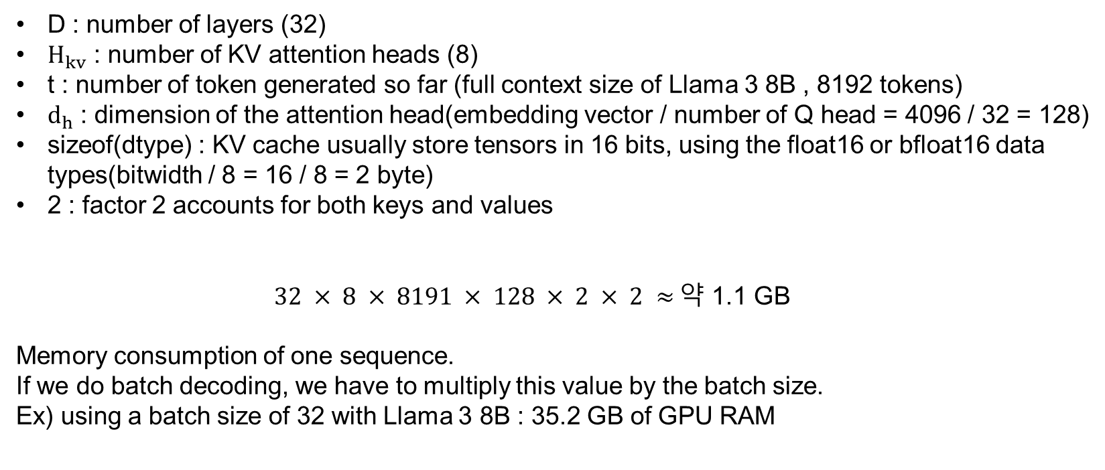
Memory Consumption of the KV cache
Example of Llama 3 8B
Comparative Characterization of KV Cache Management Strategies for LLM Inference
D : number of layers (32)
$H_{kv}$ : number of KV attention heads (8)
t : number of token generated so far (full context size of Llama 3 8B , 8192 tokens)
$d_{h}$ : dimension of the attention head(embedding vector / number of Q head = 4096 / 32 = 128)
sizeof(dtype) : KV cache usually store tensors in 16 bits, using the float16 or bfloat16 data types(bitwidth / 8 = 16 / 8 = 2 byte)
2 : factor 2 accounts for both keys and values
$32 × 8 × 8191 × 128 × 2 × 2 ≈$약 1.1 GB
Memory consumption of one sequence.
If we do batch decoding, we have to multiply this value by the batch size.
Ex) using a batch size of 32 with Llama 3 8B : 35.2 GB of GPU RAM
Notes:
8B는 80억개 파라미터 의미
Note: Llama 3 8B has 32 attention heads. However, thanks to grouped-query attention (GQA), only 8 attention heads are used for the keys and values.

