Slide 1
DNAS SNN(2)
2026년 05월 13일
Sunghyun Lee
Department of Computer Engineering

Slide 2
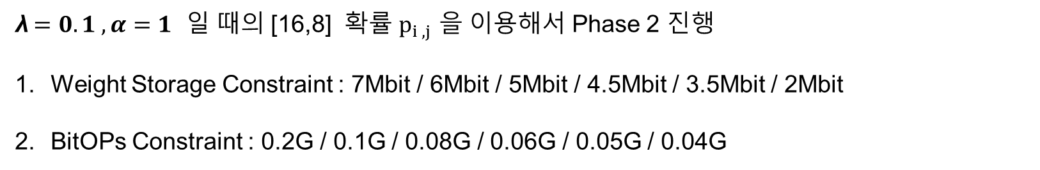
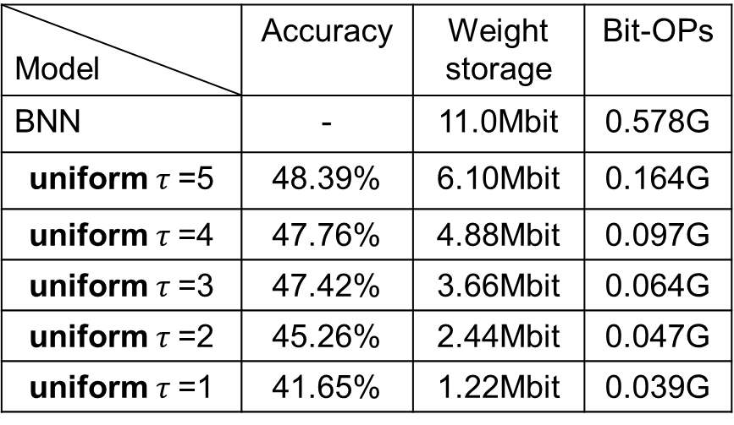
baseline
$$L = L_{acc} +λ[ α_{cost} × \hat{S} + (1−{ α}_{cost}) ×\hat{B}]$$
λ$=0.1 ,α=1$ 일 때의 [16,8] 확률 $p_{i ,j}$ 을 이용해서 Phase 2 진행
Weight Storage Constraint : 7Mbit / 6Mbit / 5Mbit / 4.5Mbit / 3.5Mbit / 2Mbit
BitOPs Constraint : 0.2G / 0.1G / 0.08G / 0.06G / 0.05G / 0.04G
Epoch :100
Model | Accuracy | Weight storage | Bit-OPs
BNN | - | 11.0Mbit | 0.578G
uniform $τ$=5 | 48.39% | 6.10Mbit | 0.164G
uniform $τ$=4 | 47.76% | 4.88Mbit | 0.097G
uniform $τ$=3 | 47.42% | 3.66Mbit | 0.064G
uniform $τ$=2 | 45.26% | 2.44Mbit | 0.047G
uniform $τ$=1 | 41.65% | 1.22Mbit | 0.039G

Slide 3
Phase 2 결과
$λ =0.1 ,α=1$
Hardware Constraint | Tau list | Accuracy | Weight storage | Bit-OPs
7Mbit | [5, 4, 6, 6, 6, 5, 6, 4, 6, 4, 5, 3, 4, 3, 2, 2] | 49.05% | 3.73Mbit | 0.191G
6Mbit
5Mbit
4.5Mbit
3.5Mbit | [5, 4, 6, 6, 6, 5, 6, 4, 6, 4, 5, 3, 4, 3, 2, 1] | 48.73% | 3.47Mbit | 0.191G
2Mbit | [5, 4, 6, 6, 6, 5, 6, 4, 5, 3, 2, 3, 1, 1, 1, 1] | 47.11% | 1.99Mbit | 0.183G
0.2G | [5, 4, 6, 6, 6, 5, 6, 4, 6, 4, 5, 3, 4, 3, 2, 2] | 49.05% | 3.73Mbit | 0.191G
0.1G | [4, 4, 4, 4, 5, 5, 4, 3, 5, 4, 4, 3, 4, 3, 2, 2] | 48.33% | 3.55Mbit | 0.099G
0.08G | [4, 3, 3, 3, 5, 4, 4, 3, 5, 4, 3, 3, 4, 3, 2, 2] | 48.12% | 3.46Mbit | 0.079G
0.06G | [3, 2, 2, 2, 4, 3, 3, 3, 5, 4, 2, 3, 4, 3, 2, 2] | 47.13% | 3.33Mbit | 0.0597G
0.05G | [2, 2, 2, 1, 3, 2, 2, 2, 4, 3, 3, 3, 4, 3, 2, 2] | 47.11% | 3.23Mbit | 0.0496G
0.04G | [1, 1, 1, 1, 2, 1, 1, 1, 2, 1, 2, 1, 2, 2, 2, 2] | 41.93% | 2.25Mbit | 0.0398G
Notes:
Loss을$λ =0.1 ,α=1$로 둔 상태에서 tau list , Accuracy, Weight Storage, BitOPs를 뽑았습니다.

Slide 4
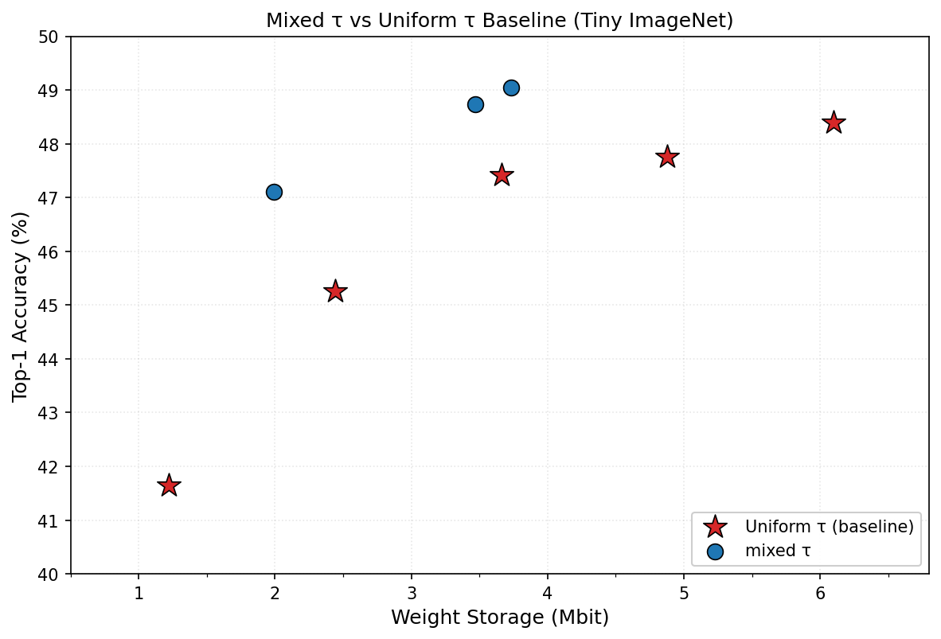
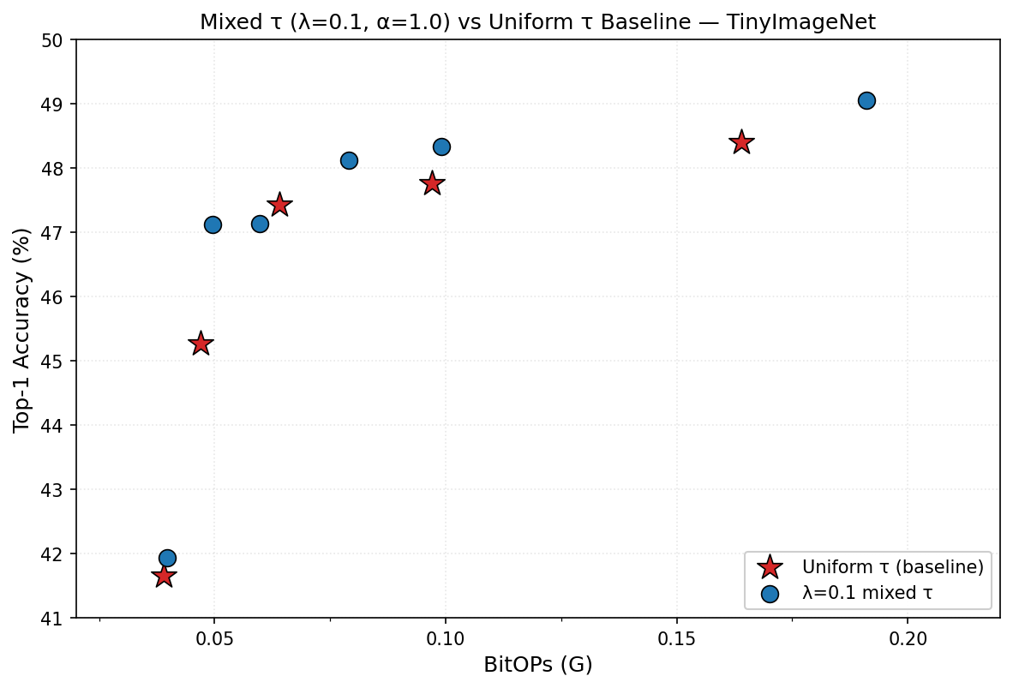
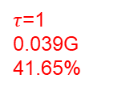
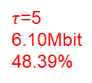
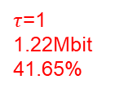
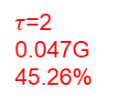
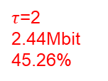
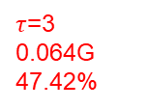
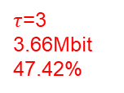
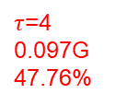
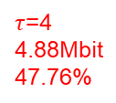
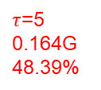
Weight Storage & BitOPs
3.47Mbit
48.73%
3.73Mbit
49.05%
0.191G
49.05%
0.079G
48.12%
0.099G
48.33%
1.99Mbit
47.11%
$τ$=5
6.10Mbit
48.39%
0.0597G
47.13%
$τ$=4
4.88Mbit
47.76%
$τ$=5
0.164G
48.39%
$τ$=3
3.66Mbit
47.42%
0.0496G
47.11%
$τ$=4
0.097G
47.76%
$τ$=3
0.064G
47.42%
$τ$=2
2.44Mbit
45.26%
$τ$=2
0.047G
45.26%
0.0398G
41.93%
$τ$=1
1.22Mbit
41.65%
$τ$=1
0.039G
41.65%

Slide 5
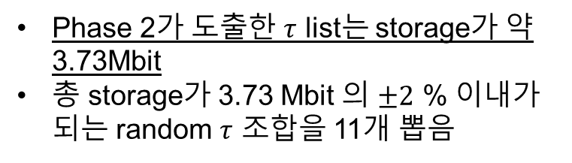
Random sample
Tau list | Accuracy | Weight storage
5 4 6 6 6 5 6 4 6 4 5 3 4 3 2 2 | 49.05% | 3.7278Mbit
4 8 6 5 3 6 4 2 8 1 3 6 1 2 5 2 | 46.81% | 3.7308Mbit
1 7 5 3 1 1 1 7 1 1 1 1 5 5 4 1 | 45.97% | 3.7309Mbit
7 7 7 3 2 4 4 6 1 8 4 1 7 3 1 2 | 48.12% | 3.7274Mbit
8 4 1 6 4 4 7 1 2 5 7 3 4 4 2 1 | 48.26% | 3.7215Mbit
3 5 6 1 8 7 8 7 1 2 1 4 3 3 2 4 | 48.76% | 3.7399Mbit
4 7 8 5 7 5 2 6 6 5 6 1 2 2 3 3 | 47.95% | 3.7186Mbit
1 2 5 1 1 2 1 3 5 4 2 6 2 2 1 6 | 46.66% | 3.7173Mbit
7 1 1 6 7 6 1 8 2 2 2 8 1 1 5 3 | 48.02% | 3.7155Mbit
7 5 1 2 7 3 1 1 4 1 6 3 7 5 1 1 | 47.73% | 3.7447Mbit
3 7 7 1 2 3 1 1 2 1 5 5 5 3 3 2 | 45.76% | 3.7146Mbit
2 4 5 1 1 1 1 3 2 2 1 5 5 5 3 1 | 46.97% | 3.7454Mbit
Phase 2가 도출한 $τ$ list는 storage가 약 3.73Mbit
총 storage가 3.73 Mbit 의 $±2$ % 이내가 되는 random $τ$ 조합을 11개 뽑음

