Slide 1
Mixed SNN
2026년 03월 18일
Sunghyun Lee
Department of Computer Engineering

Slide 2

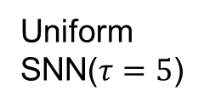
Goal
BNN
Uniform
SNN($τ=5$)
Proposed
(mixed SNN)
1.31
MB
0.73
MB
storage
(MB)
0.65MB
1.8x
1.12x
Imagenet1K
65.7
%
62.1
%
similar
Accuracy
(%)
$$≈$$
Sub-bit Neural Networks: Learning to Compress and Accelerate Binary Neural Networks

Slide 3





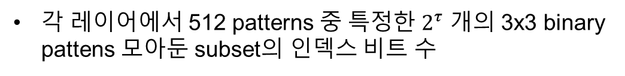
$$τ$$
index
CodeBook
0
…
compress
…
$$2^{τ}$$
512 ($2^{9})$ patterns
$$2^{τ}−2$$
$2^{τ}−1$
각 레이어에서 512 patterns 중 특정한 $2^{τ}$ 개의 3x3 binary pattens 모아둔 subset의 인덱스 비트 수
$2^{τ}$ patterns

Slide 4
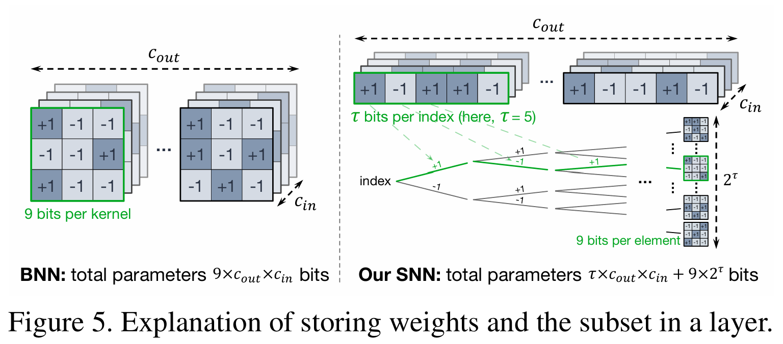
Compression
Sub-bit Neural Networks: Learning to Compress and Accelerate Binary Neural Networks

Slide 5
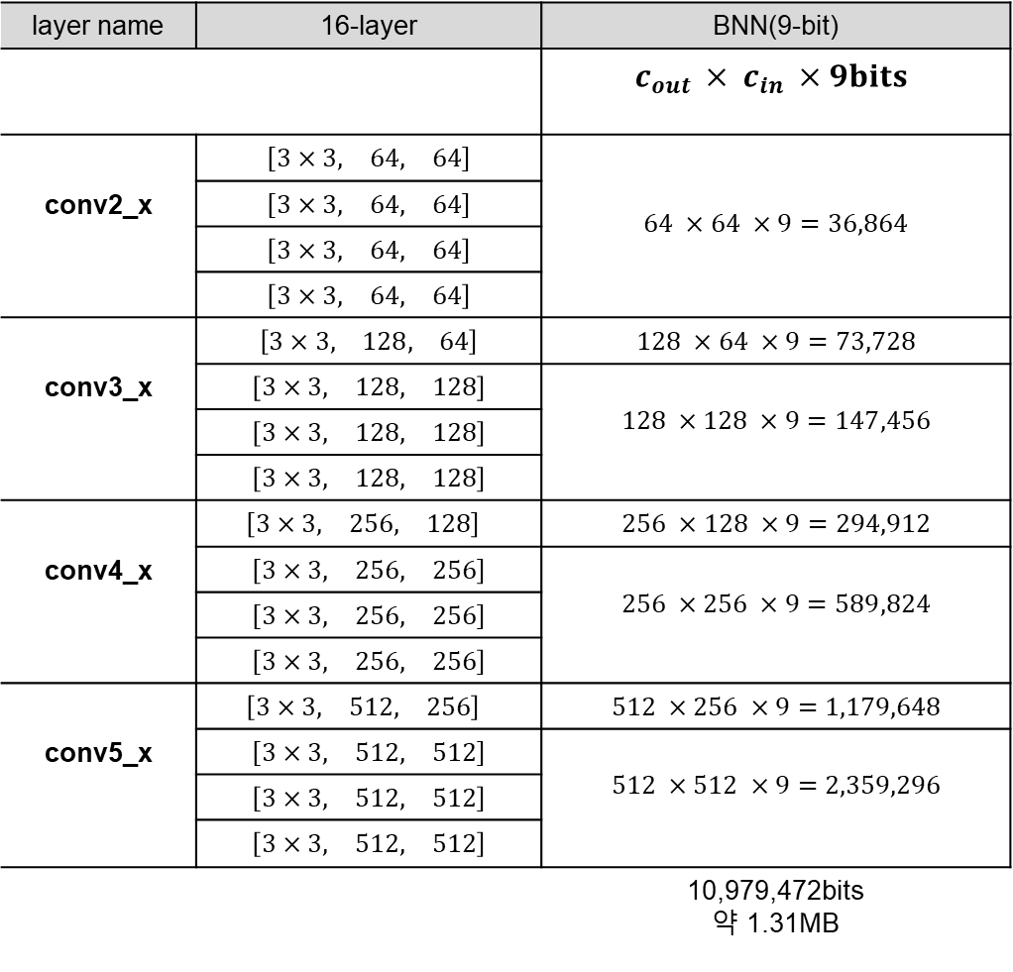
BNN
layer name | 16-layer | BNN(9-bit)
 |  | $$c_{out }× c_{in }×9bits$$
conv2_x | $$\left[\begin{matrix}3×3, & 64, & 64\end{matrix}\right]$$ | $$64 ×64 ×9=36,864$$
 | $$\left[\begin{matrix}3×3, & 64, & 64\end{matrix}\right]$$
 | $$\left[\begin{matrix}3×3, & 64, & 64\end{matrix}\right]$$
 | $$\left[\begin{matrix}3×3, & 64, & 64\end{matrix}\right]$$
conv3_x | $$\left[\begin{matrix}3×3, & 128, & 64\end{matrix}\right]$$ | $$128 ×64 ×9=73,728$$
 | $$\left[\begin{matrix}3×3, & 128, & 128\end{matrix}\right]$$ | $$128 ×128 ×9=147,456$$
 | $$\left[\begin{matrix}3×3, & 128, & 128\end{matrix}\right]$$
 | $$\left[\begin{matrix}3×3, & 128, & 128\end{matrix}\right]$$
conv4_x | $$\left[\begin{matrix}3×3, & 256, & 128\end{matrix}\right]$$ | $$256 ×128 ×9=294,912$$
 | $$\left[\begin{matrix}3×3, & 256, & 256\end{matrix}\right]$$ | $$256 ×256 ×9=589,824$$
 | $$\left[\begin{matrix}3×3, & 256, & 256\end{matrix}\right]$$
 | $$\left[\begin{matrix}3×3, & 256, & 256\end{matrix}\right]$$
conv5_x | $$\left[\begin{matrix}3×3, & 512, & 256\end{matrix}\right]$$ | $$512 ×256 ×9=1,179,648$$
 | $$\left[\begin{matrix}3×3, & 512, & 512\end{matrix}\right]$$ | $$512 ×512 ×9=2,359,296$$
 | $$\left[\begin{matrix}3×3, & 512, & 512\end{matrix}\right]$$
 | $$\left[\begin{matrix}3×3, & 512, & 512\end{matrix}\right]$$
 |  | 10,979,472bits 약 1.31MB
$$\left[\begin{matrix}kernel size, & output channel & input channel\end{matrix}\right]$$

Slide 6
BNN total parameters
model layer name | BNN
conv2_x | 147,456bits(0.0176MB)
conv3_x | 516,096bits(0.0615MB)
conv4_x | 2,064,384bits(0.2461MB)
conv5_x | 8,257,536bits(0.9844MB)
total | 10,979,472bits(1.31MB)

Slide 7
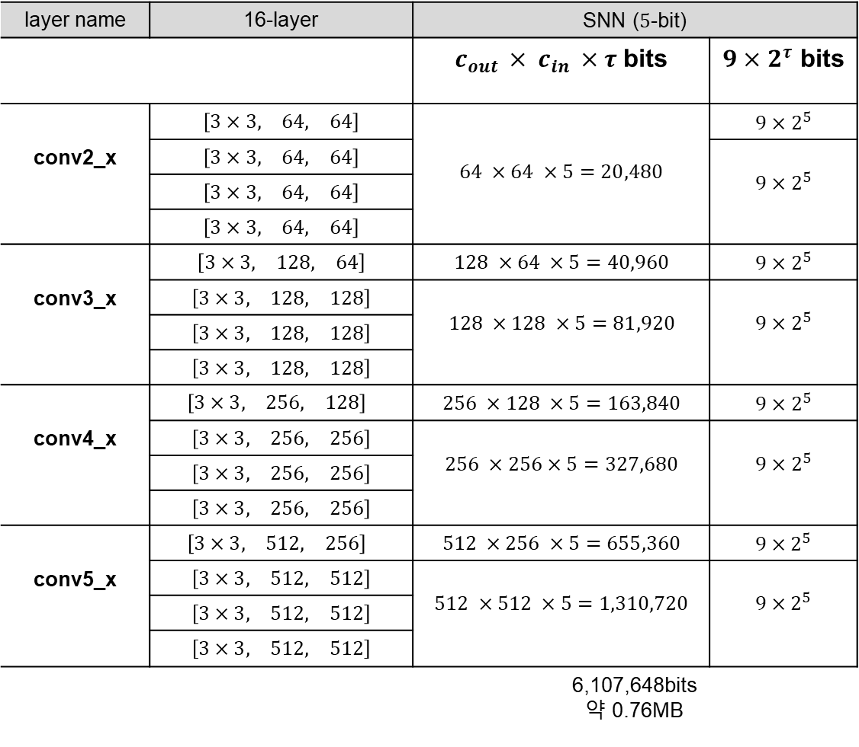
SNN($τ=5)$
layer name | 16-layer | SNN ($5$-bit)
 |  | $c_{out }× c_{in }×τ$bits | $9×2^{τ}$ bits
conv2_x | $$\left[\begin{matrix}3×3, & 64, & 64\end{matrix}\right]$$ | $$64 ×64 ×5=20,480$$ | $$9×2^{5}$$
 | $$\left[\begin{matrix}3×3, & 64, & 64\end{matrix}\right]$$ |  | $$9×2^{5}$$
 | $$\left[\begin{matrix}3×3, & 64, & 64\end{matrix}\right]$$
 | $$\left[\begin{matrix}3×3, & 64, & 64\end{matrix}\right]$$
conv3_x | $$\left[\begin{matrix}3×3, & 128, & 64\end{matrix}\right]$$ | $$128 ×64 ×5=40,960$$ | $$9×2^{5}$$
 | $$\left[\begin{matrix}3×3, & 128, & 128\end{matrix}\right]$$ | $$128 ×128 ×5=81,920$$ | $$9×2^{5}$$
 | $$\left[\begin{matrix}3×3, & 128, & 128\end{matrix}\right]$$
 | $$\left[\begin{matrix}3×3, & 128, & 128\end{matrix}\right]$$
conv4_x | $$\left[\begin{matrix}3×3, & 256, & 128\end{matrix}\right]$$ | $$256 ×128 ×5=163,840$$ | $$9×2^{5}$$
 | $$\left[\begin{matrix}3×3, & 256, & 256\end{matrix}\right]$$ | $$256 ×256×5=327,680$$ | $$9×2^{5}$$
 | $$\left[\begin{matrix}3×3, & 256, & 256\end{matrix}\right]$$
 | $$\left[\begin{matrix}3×3, & 256, & 256\end{matrix}\right]$$
conv5_x | $$\left[\begin{matrix}3×3, & 512, & 256\end{matrix}\right]$$ | $$512 ×256 ×5=655,360$$ | $$9×2^{5}$$
 | $$\left[\begin{matrix}3×3, & 512, & 512\end{matrix}\right]$$ | $$512 ×512 ×5=1,310,720$$ | $$9×2^{5}$$
 | $$\left[\begin{matrix}3×3, & 512, & 512\end{matrix}\right]$$
 | $$\left[\begin{matrix}3×3, & 512, & 512\end{matrix}\right]$$
 |  | 6,107,648bits 약 0.76MB
$$\left[\begin{matrix}kernel size, & output channel & input channel\end{matrix}\right]$$

Slide 8
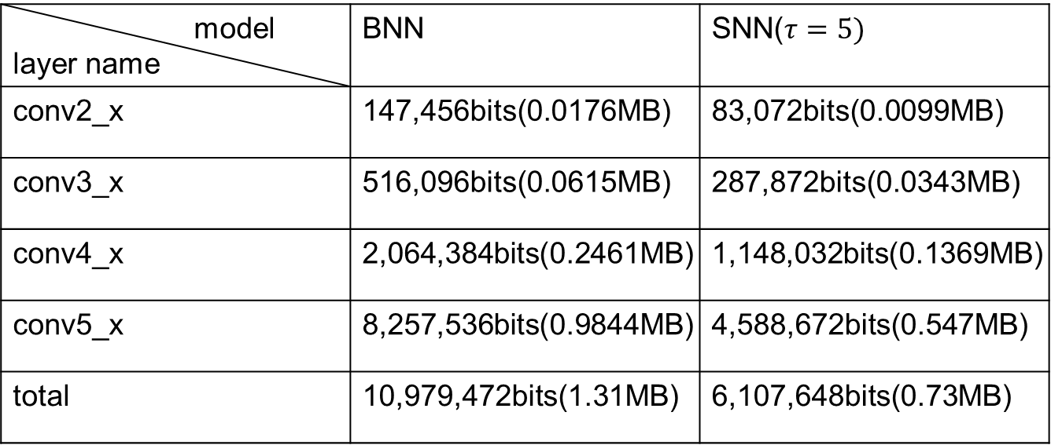
BNN & SNN total parameters
model layer name | BNN | SNN($τ=5)$
conv2_x | 147,456bits(0.0176MB) | 83,072bits(0.0099MB)
conv3_x | 516,096bits(0.0615MB) | 287,872bits(0.0343MB)
conv4_x | 2,064,384bits(0.2461MB) | 1,148,032bits(0.1369MB)
conv5_x | 8,257,536bits(0.9844MB) | 4,588,672bits(0.547MB)
total | 10,979,472bits(1.31MB) | 6,107,648bits(0.73MB)

Slide 9
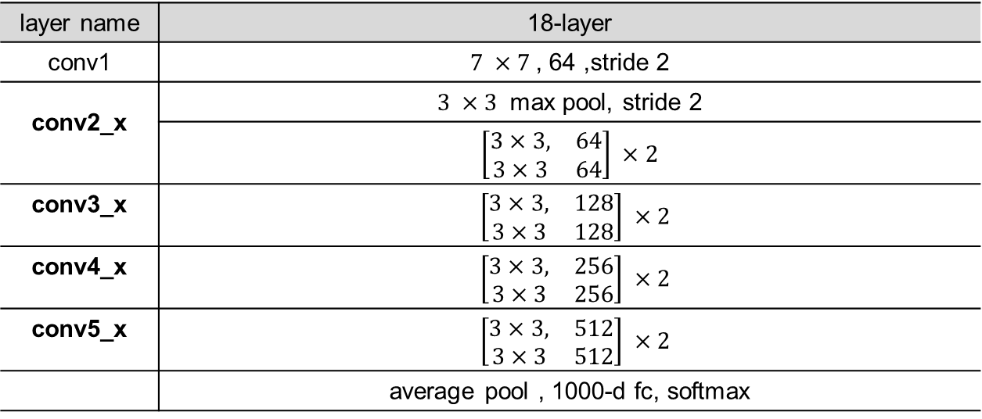
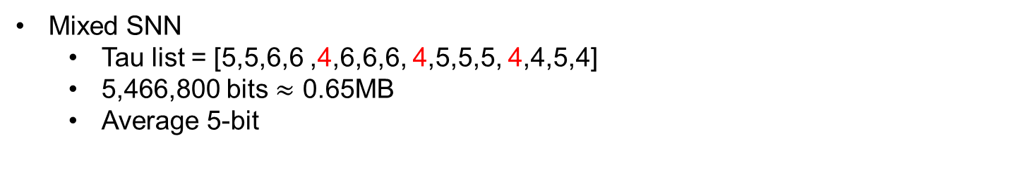
Mixed SNN
layer name | 18-layer
conv1 | $7 ×7$, 64 ,stride 2
conv2_x | $3 ×3$ max pool, stride 2
 | $$\left[\begin{matrix}3×3, & 64 \\ 3×3 & 64\end{matrix}\right] ×2$$
conv3_x | $$\left[\begin{matrix}3×3, & 128 \\ 3×3 & 128\end{matrix}\right] ×2$$
conv4_x | $$\left[\begin{matrix}3×3, & 256 \\ 3×3 & 256\end{matrix}\right] ×2$$
conv5_x | $$\left[\begin{matrix}3×3, & 512 \\ 3×3 & 512\end{matrix}\right] ×2$$
 | average pool , 1000-d fc, softmax
Clustering
conv3_1 , conv4_1, conv5_1 같이 Downsampling하는 layer은 clustering이 큼
conv5_x 이 전체적으로 clustering이 큼
Mixed SNN
Tau list = [5,5,6,6 ,4,6,6,6, 4,5,5,5, 4,4,5,4]
5,466,800 bits $≈$ 0.65MB
Average 5-bit

Slide 10
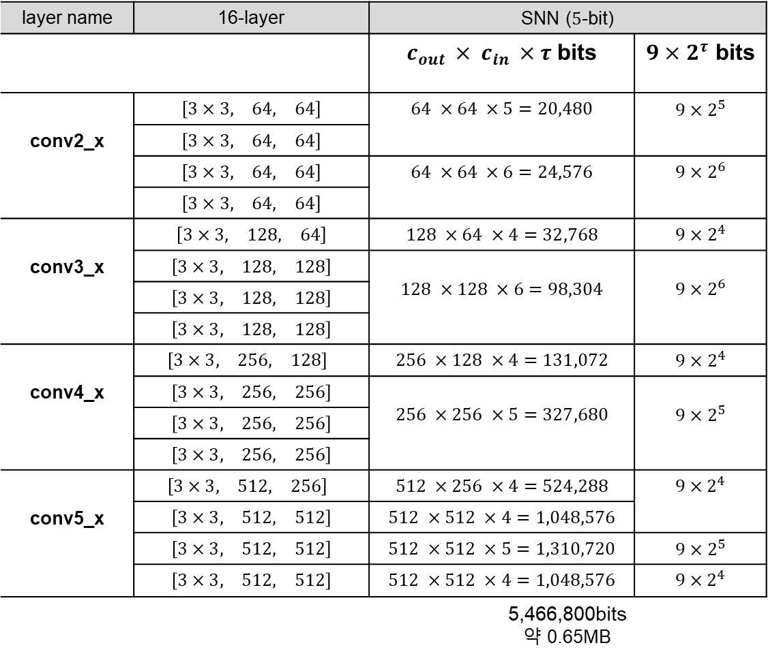
Mixed SNN
layer name | 16-layer | SNN ($5$-bit)
 |  | $c_{out }× c_{in }×τ$bits | $9×2^{τ}$ bits
conv2_x | $$\left[\begin{matrix}3×3, & 64, & 64\end{matrix}\right]$$ | $$64 ×64 ×5=20,480$$ | $$9×2^{5}$$
 | $$\left[\begin{matrix}3×3, & 64, & 64\end{matrix}\right]$$
 | $$\left[\begin{matrix}3×3, & 64, & 64\end{matrix}\right]$$ | $$64 ×64 ×6=24,576$$ | $$9×2^{6}$$
 | $$\left[\begin{matrix}3×3, & 64, & 64\end{matrix}\right]$$
conv3_x | $$\left[\begin{matrix}3×3, & 128, & 64\end{matrix}\right]$$ | $$128 ×64 ×4=32,768$$ | $$9×2^{4}$$
 | $$\left[\begin{matrix}3×3, & 128, & 128\end{matrix}\right]$$ | $$128 ×128 ×6=98,304$$ | $$9×2^{6}$$
 | $$\left[\begin{matrix}3×3, & 128, & 128\end{matrix}\right]$$
 | $$\left[\begin{matrix}3×3, & 128, & 128\end{matrix}\right]$$
conv4_x | $$\left[\begin{matrix}3×3, & 256, & 128\end{matrix}\right]$$ | $$256 ×128 ×4=131,072$$ | $$9×2^{4}$$
 | $$\left[\begin{matrix}3×3, & 256, & 256\end{matrix}\right]$$ | $$256 ×256 ×5=327,680$$ | $$9×2^{5}$$
 | $$\left[\begin{matrix}3×3, & 256, & 256\end{matrix}\right]$$
 | $$\left[\begin{matrix}3×3, & 256, & 256\end{matrix}\right]$$
conv5_x | $$\left[\begin{matrix}3×3, & 512, & 256\end{matrix}\right]$$ | $$512 ×256 ×4=524,288$$ | $$9×2^{4}$$
 | $$\left[\begin{matrix}3×3, & 512, & 512\end{matrix}\right]$$ | $$512 ×512 ×4=1,048,576$$
 | $$\left[\begin{matrix}3×3, & 512, & 512\end{matrix}\right]$$ | $$512 ×512 ×5=1,310,720$$ | $$9×2^{5}$$
 | $$\left[\begin{matrix}3×3, & 512, & 512\end{matrix}\right]$$ | $$512 ×512 ×4=1,048,576$$ | $$9×2^{4}$$
 |  | 5,466,800bits 약 0.65MB
Tau list = [5,5,6,6 ,4,6,6,6, 4,5,5,5, 4,4,5,4]

Slide 11
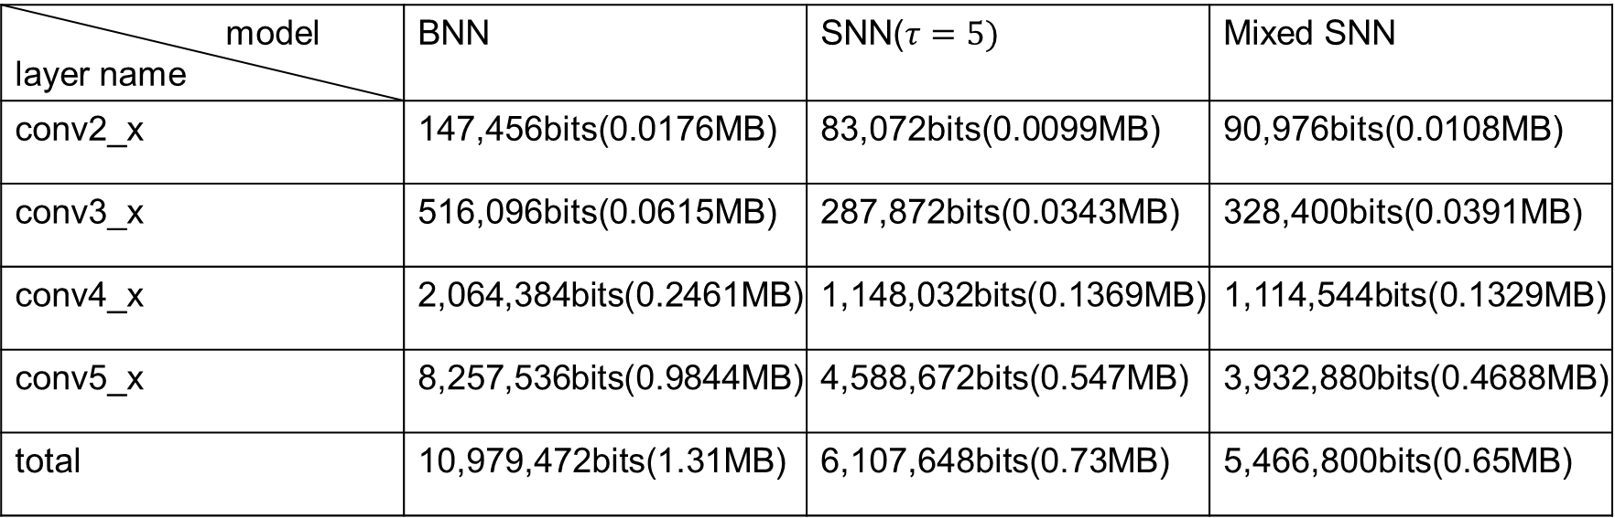
Total parameters of three models
model layer name | BNN | SNN($τ=5)$ | Mixed SNN
conv2_x | 147,456bits(0.0176MB) | 83,072bits(0.0099MB) | 90,976bits(0.0108MB)
conv3_x | 516,096bits(0.0615MB) | 287,872bits(0.0343MB) | 328,400bits(0.0391MB)
conv4_x | 2,064,384bits(0.2461MB) | 1,148,032bits(0.1369MB) | 1,114,544bits(0.1329MB)
conv5_x | 8,257,536bits(0.9844MB) | 4,588,672bits(0.547MB) | 3,932,880bits(0.4688MB)
total | 10,979,472bits(1.31MB) | 6,107,648bits(0.73MB) | 5,466,800bits(0.65MB)

Slide 12
CIFAR10
SNN(5-bit) vs Mixed SNN(Tau list = [5,5,6,6 ,4,6,6,6, 4,5,5,5, 4,4,5,4] )
Model | Top-1 | Top-5
SNN(5-bit) | 91.93% | 99.11%
Mixed SNN(Average 5-bit) | 91.78% | 99.10%

Slide 13
Tiny imagenet
SNN(5-bit) vs Mixed SNN(Tau list = [5,5,6,6 ,4,6,6,6, 4,5,5,5, 4,4,5,4] )
Model | Top-1 | Top-5
SNN(5-bit) | 49.10% | 72.85%
Mixed SNN(Average 5-bit) | 48.99% | 72.46%

Slide 14
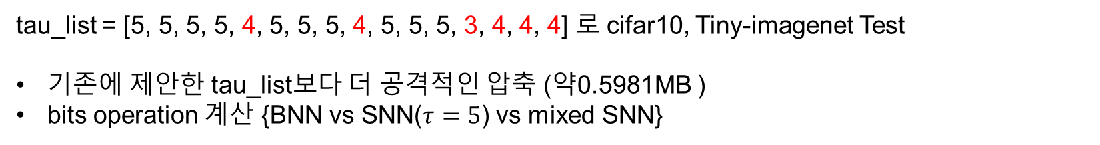
To do
tau_list = [5, 5, 5, 5, 4, 5, 5, 5, 4, 5, 5, 5, 3, 4, 4, 4] 로 cifar10, Tiny-imagenet Test
기존에 제안한 tau_list보다 더 공격적인 압축 (약0.5981MB )
bits operation 계산 {BNN vs SNN($τ=5$) vs mixed SNN}

