Slide 1
SAM
2025년 1월 6일
C135283 이수현 컴퓨터공학과

Slide 2
Content
What is SAM?
Problem
Knowledge Distillation
Recent Works
1) MobileSAM (Jun 2023, cited 302)

Slide 3
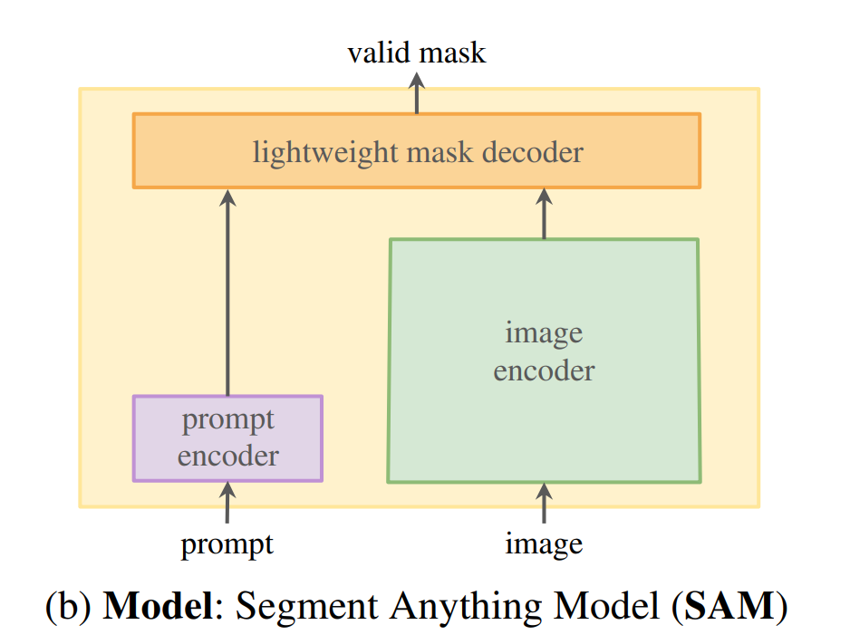
What is SAM?
Segment Anything Model
Purpose: 이미지 데이터를 사용하는 ChatGPT
Task: Prompt Segmentation
입력 이미지에서 Prompt가 설명하는 객체를 추출
Model: Prompt Encoder + Image Encoder → Mask Decoder → mask
Data: SA-1B (1+ billion masks)

Slide 4
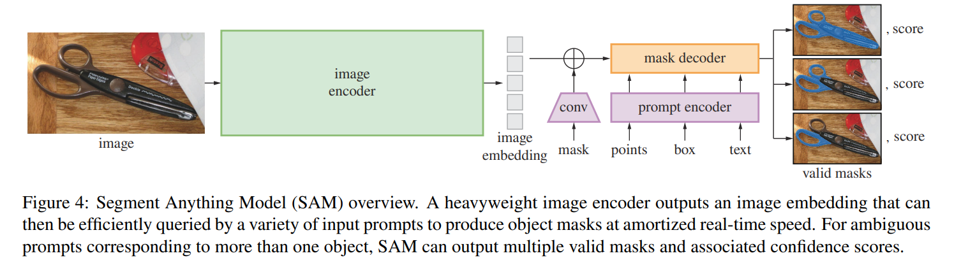
SAM Model Structure
Encoder 산출물은 입력 이미지에 대한 특징이 포함된 표현 벡터
Self attention (prompt)
Cross attention (prompt↔image)
사전 학습된 MAE 사용
Positional embedding

Slide 5
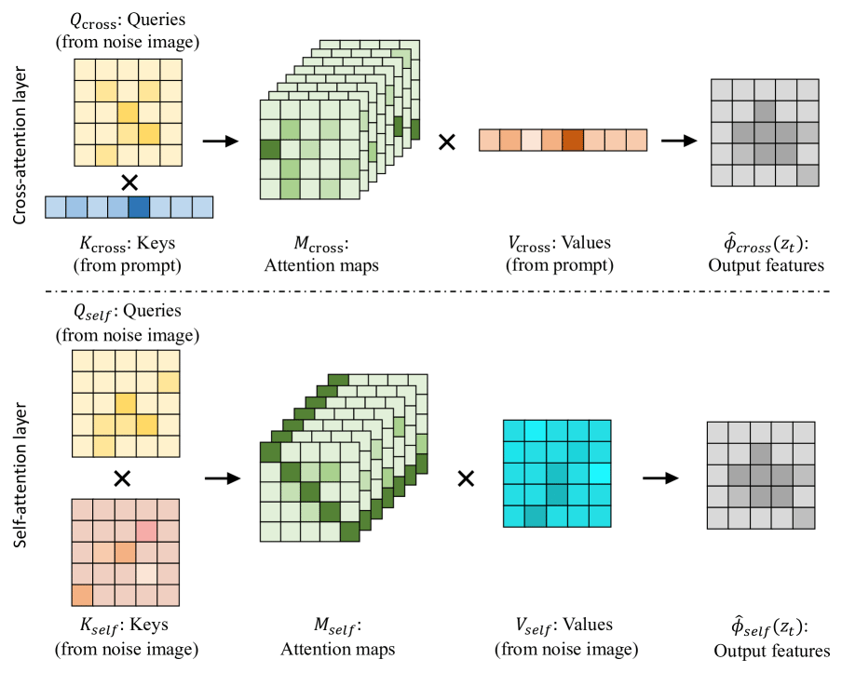
Cross Attention

Slide 6
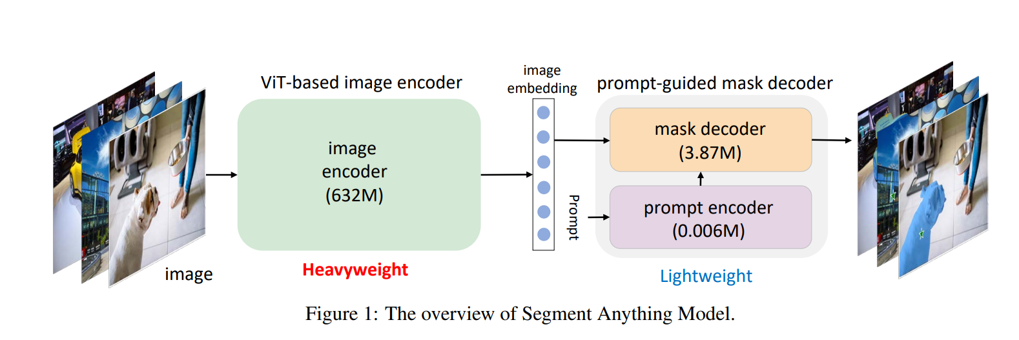
Problem
1) Heavy image encoder
Light encoder로 대체
FASTER SEGMENT ANYTHING: TOWARDS LIGHTWEIGHT SAM FOR MOBILE APPLICATIONS

Slide 7
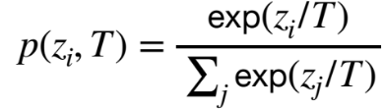
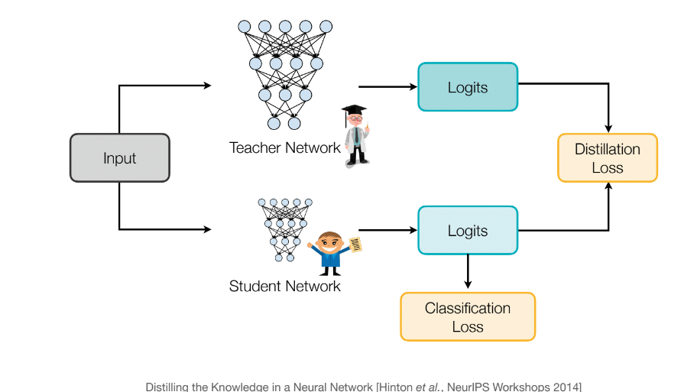
Knowledge Distillation
Transfer teacher knowledge to student
Softmax Function
logits
Temperature
Learning from teacher’s
soft prediction
Learning from correct label

Slide 8
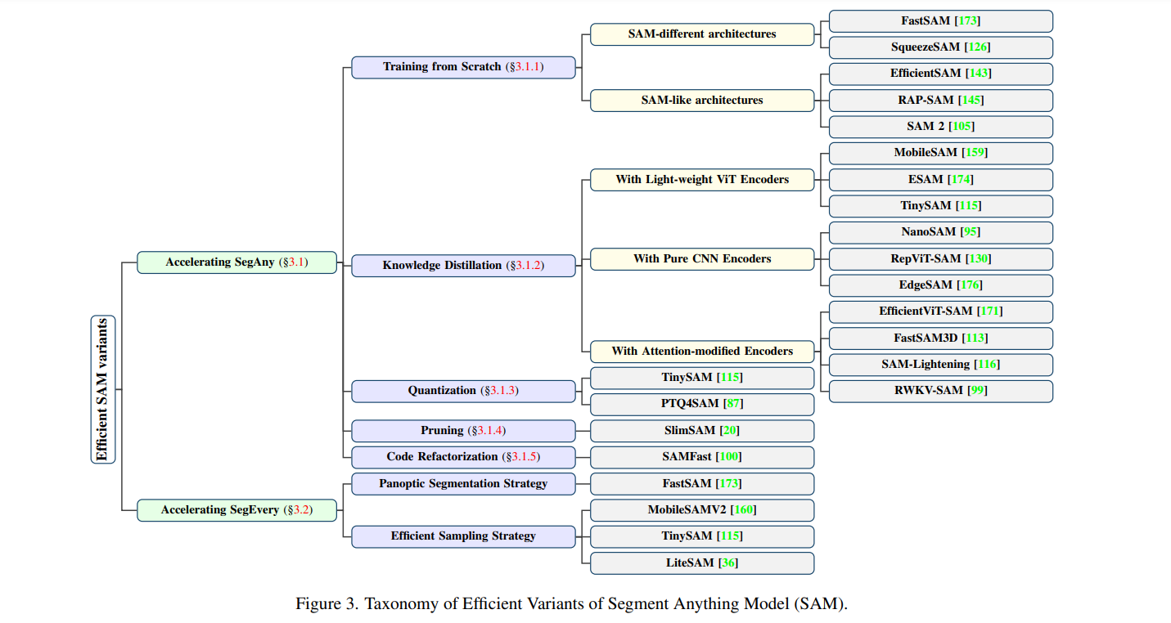
Efficient Variants of SAM

Slide 9
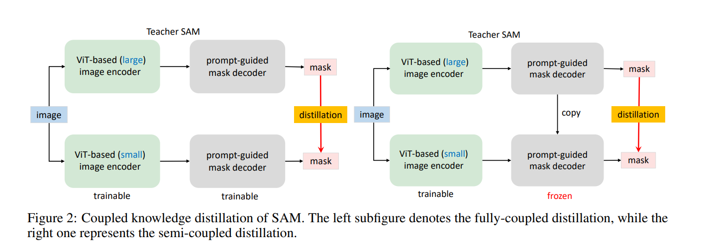
MobileSAM FASTER SEGMENT ANYTHING: TOWARDS LIGHTWEIGHT SAM FOR MOBILE APPLICATIONS

Slide 10
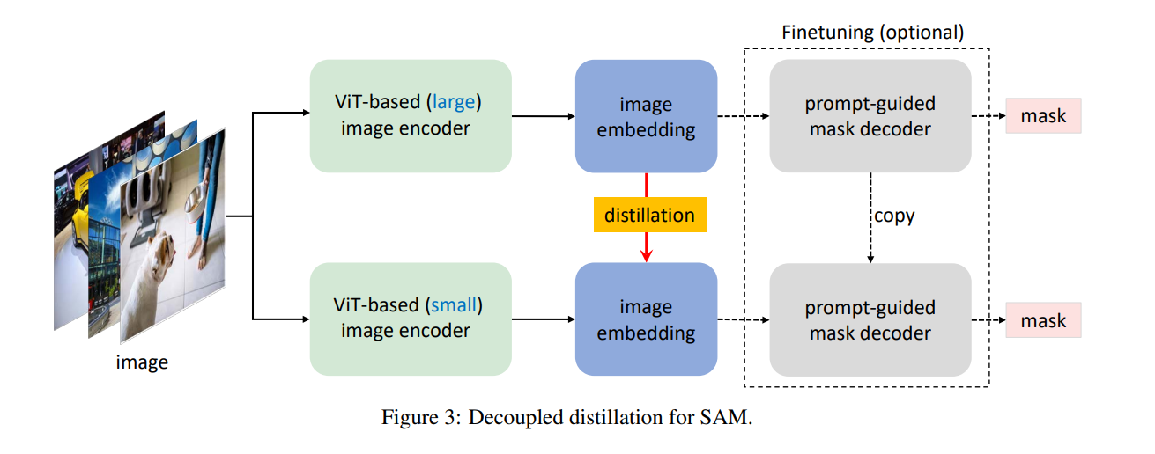
MobileSAM FASTER SEGMENT ANYTHING: TOWARDS LIGHTWEIGHT SAM FOR MOBILE APPLICATIONS

