Slide 1
PIM Architecture
2024년 9월 9일
B815133 이성현
전자전기공학부
Source: Optimizing Weight Mapping and Data Flow for Convolutional Neural Networks on RRAM

Slide 2
목차
Review SRAM accelerator
Partition Scheme
A Novel mapping method
Data Flow to Maximize IFM Reuse
PIM Architecture

Slide 3
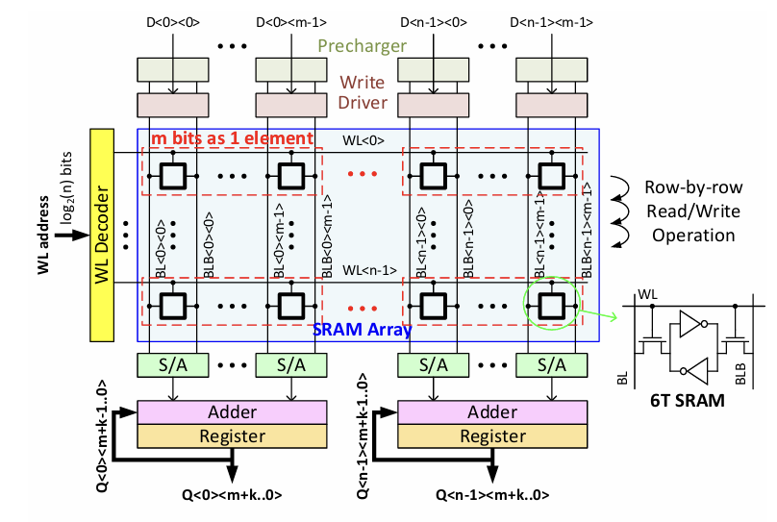
Review SRAM accelerator
Multiple SRAM cells(m cells) as one synaptic weight element along the row
The read(weighted sum) and write(weight update) operation are row-by-row based
One adder and register pair for row-by-row summation
In write operation, all the cells on the row can be updated at the same time
Source: Partition SRAM and RRAM based Synaptic Arrays for Neuro-inspired Computing

Slide 4
Review SRAM accelerator(Example)
Precharger
Layer i
Layer i+1
Write Driver
WL Decoder
m bits as 1 element
W41
O[1]
IN[1]
W11
W11
IN[1]
O[2]
W12
IN[2]
W42
O[3]
W12
IN[2]
O[4]
S/A
S/A
S/A
S/A
IN[2]*W12
IN[2]*W42
n =4
IN[1]*W41
IN[1]*W11
Adder
Adder
IN[1]*W11+IN[2]*W12=O[1]
Register
Register
O[1]
O[4]

Slide 5
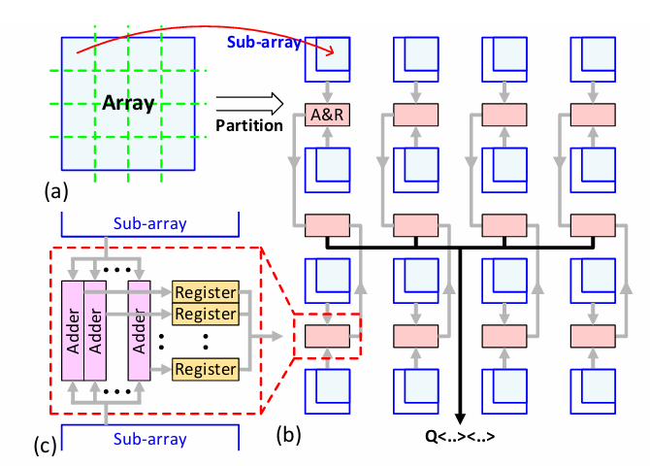
Partition Scheme
Partition the large array core into NxN small arrays in a hierarchical fashion
In write operation, weight elements in different sub-arrays can be updated in parallel
In read operation, they are computed in parallel but the results from all sub-arrays must be collected and summed up
Use multi-stage adders and registers to obtain the final weighted sum
Source: Partition SRAM and RRAM based Synaptic Arrays for Neuro-inspired Computing

Slide 6
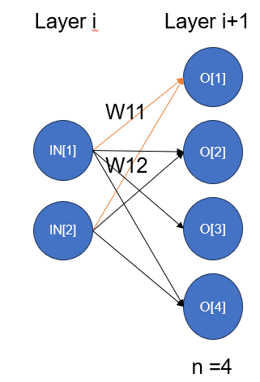
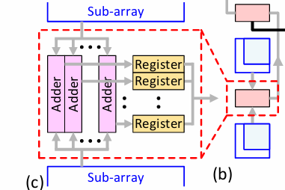




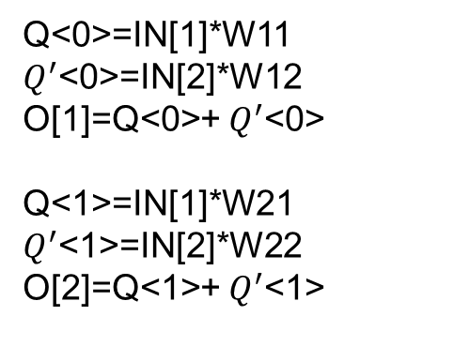
Partition Scheme(Example)
Q<0~n>
Q<0>
Q<1>
Q<n>
O[1~n]
Q<0>=IN[1]*W11
$Q^{′}$<0>=IN[2]*W12
O[1]=Q<0>+ $Q^{′}$<0>
Q<1>=IN[1]*W21
$Q^{′}$<1>=IN[2]*W22
O[2]=Q<1>+ $Q^{′}$<1>
$Q^{′}$<0>
$Q^{′}$<1>
$Q^{′}$<n>
$Q^{′}$<0~n>

Slide 7
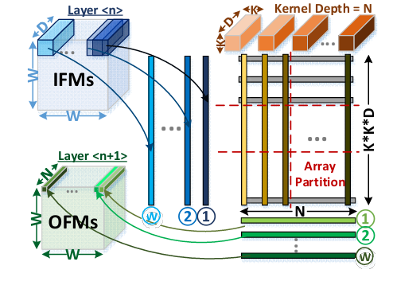
A basic mapping method
One 3D kernel with size KxKxD could be unrolled to a long vertical column which length equals to KxKxD
N vertical columns in total
To get the OFMs, at first cycle, a part of IFMs(dark blue cube) will be multiplied with each 3D kernels
The result will be first elements in every OFM(light green row in size 1x1xN)

Slide 8
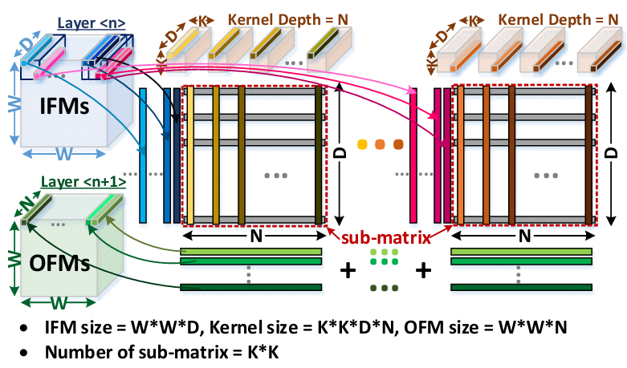
A Novel Weight Mapping Method
Map the weights at different spatial location of each kernel into different sub-matrices
KxK sub-matrices are needed for the KxK kernels
Each sub-matrix can be represented by a group of sub-arrays

Slide 9
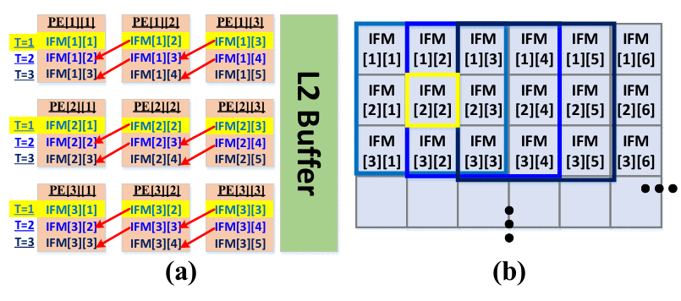
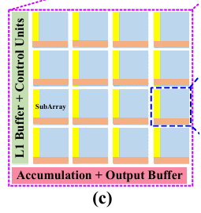
Data Flow to Maximize IFM Reuse
Processing element(PE) consists of a group of sub-arrays with the necessary inputs, output buffers, accumulation modules and L1 Buffer
Maximize the reuse of input data
PE

Slide 10
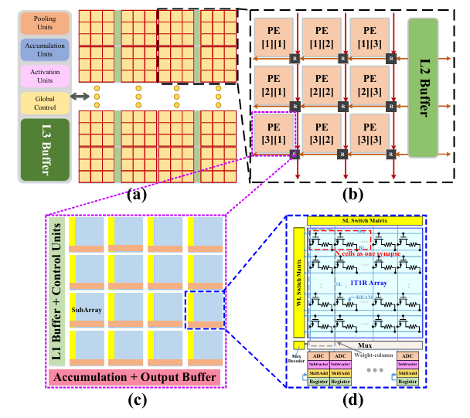
PIM Architecture
PIM contains multiple tiles, accumulation units, pooling and activation units, L3 buffer and the global control
Tile contains multiple PEs with routers and L2 buffer
Conclusion
A small amount of bits will be visited in buffers
Efficient latency and energy consumption

