Slide 1
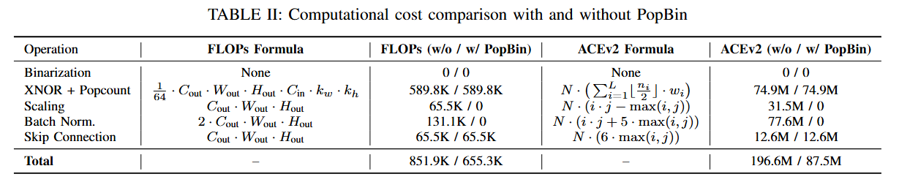

Slide 2
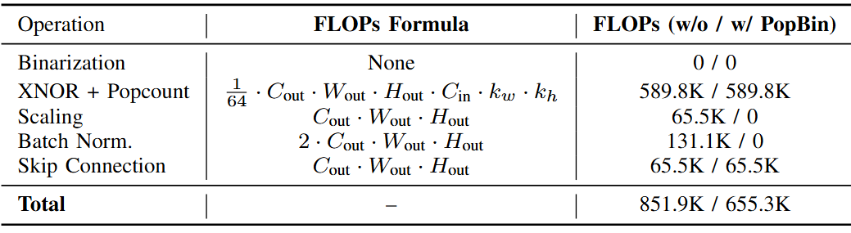
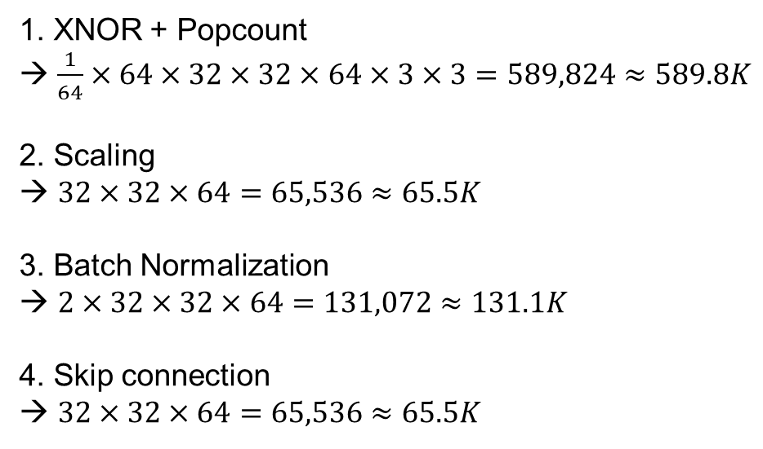
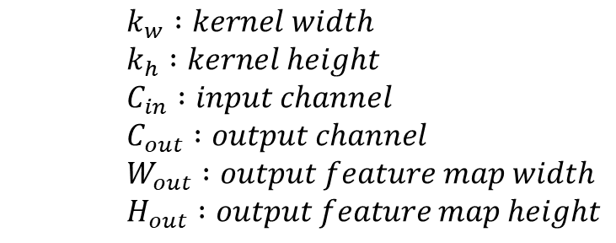
1. XNOR + Popcount
$\frac{1}{64}×64×32×32×64×3×3=589,824≈589.8K$
2. Scaling
→ $32×32×64=65,536≈65.5K$
3. Batch Normalization
$2×32×32×64=131,072≈131.1K$
4. Skip connection
→ $32×32×64=65,536≈65.5K$
$k_{w} :kernel width$
$k_{h} :kernel height$
$C_{in} :input channel$
$C_{out} :output channel$
$W_{out} :output feature map width$
$H_{out} :output feature map height$

Slide 3
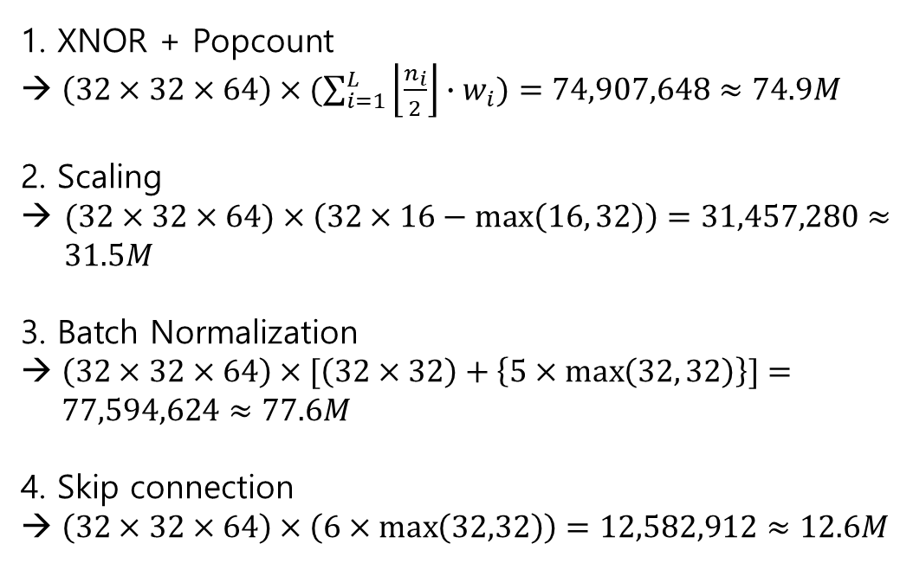
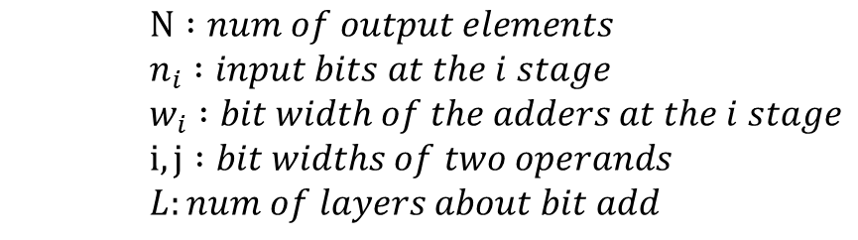
1. XNOR + Popcount
$\left(32×32×64\right)×(\sum_{i=1}^{L}{\left\lfloor \frac{n_{i}}{2}\right\rfloor ∙w_{i}})=74,907,648≈74.9M$
2. Scaling
→ $(32×32×64)×\left(32×16−\max\left(16, 32\right)\right)=31,457,280≈ 31.5M$
3. Batch Normalization
$\left(32×32×64\right)×[\left(32×32\right)+\left\{5×\max\left(32, 32\right)\right\}]=77,594,624≈77.6M$
4. Skip connection
$\left(32×32×64\right)×\left(6×\max\left(32,32\right)\right)=12,582,912≈12.6M$
$N :num of output elements$
$n_{i} :input bits at the i stage$
$w_{i} :bit width of the adders at the i stage$
$i, j :bit widths of two operands$
$L:num of layers about bit add$

Slide 4
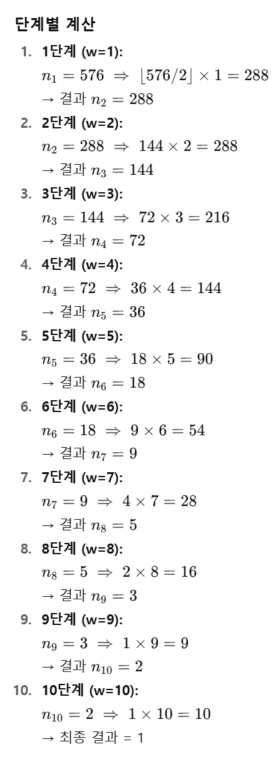




:1bit
576 bits
$$⋮$$
$$⋮$$
$$⋮$$
$$⋮$$
10 bits

Slide 5
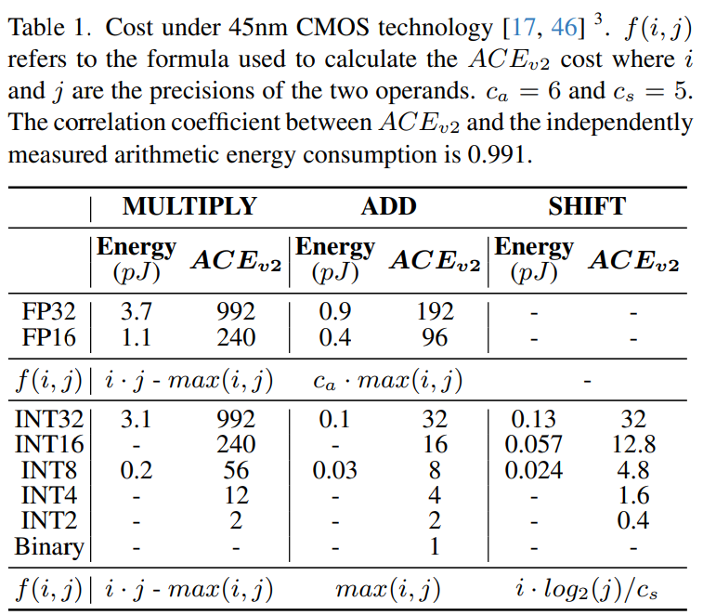
출처: M. Neseem, C. McCullough, R. Hsin, C. Leichner, S. Li, I. S. Chong,A. Howard, L. Lew, S. Reda, V.-M. Rautio et al., “Pikelpn: Mitigatingoverlooked inefficiencies of low-precision neural networks,” in Proceed-ings of the IEEE/CVF Conference on Computer Vision and PatternRecognition, 2024, pp. 15 996–16 005.

Slide 6
