Slide 1
NeuroSim
2024년 8월 14일
홍익대학교 컴퓨터공학과
C135283 이수현

Slide 2

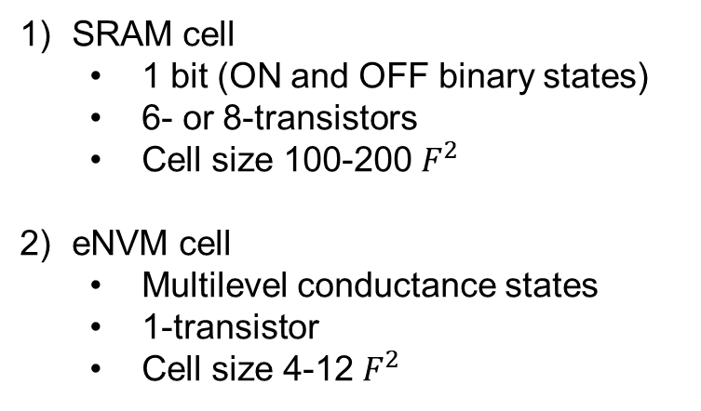










Crossbar Array
One-layer NN
Weight Store (single synapse)
$$V_{1}$$
$$V_{2}$$
$$V_{3}$$
SRAM cell
1 bit (ON and OFF binary states)
6- or 8-transistors
Cell size 100-200 $F^{2}$
eNVM cell
Multilevel conductance states
1-transistor
Cell size 4-12 $F^{2}$
Input layer
$$G_{}$$
$$G_{}$$
$G_{}$
$$G_{}$$
$$G_{}$$
$$G_{}$$
Output layer
$$I_{1}$$
$$I_{2}$$

Slide 3
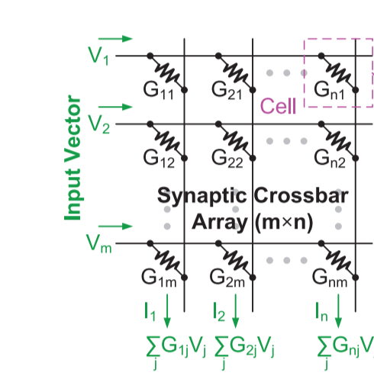
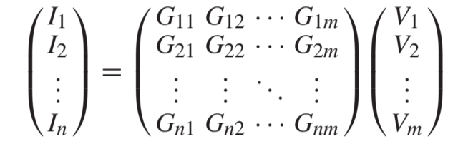







Crossbar Array
Weighted sum operation in an eNVM-based synaptic crossbar array structure
One-layer NN
Input layer
$$V_{1}$$
$$V_{2}$$
$$V_{3}$$
$$G_{11}$$
$$G_{21}$$
$$G_{12}$$
$$G_{22}$$
$$G_{13}$$
$$G_{23}$$
Output layer
$$I_{1}$$
$$I_{2}$$
$$I_{1}=G_{11}∗V_{1}+G_{12}∗V_{2}+G_{13}∗V_{3}$$

Slide 4
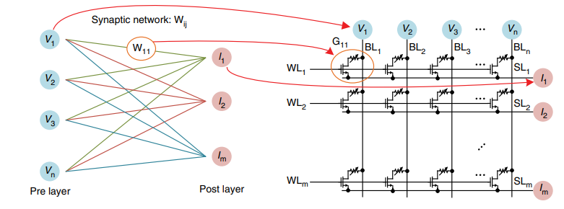
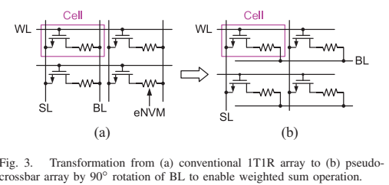
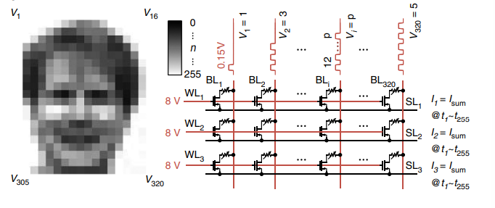
1T1R array - crossbar
example
Problem of Crossbar Array: cells are not isolated
→ add cell selection transistor
row-by-row
operation
conventional 1T1R
Wang, Jingyu & Zhu, Ying & Zhu, Liqiang & Chen, Chunsheng & Wan, Qing. (2022). Emerging Memristive Devices for Brain-Inspired Computing and Artificial Perception. Frontiers in Nanotechnology. 4. 940825. 10.3389/fnano.2022.940825.

Slide 5
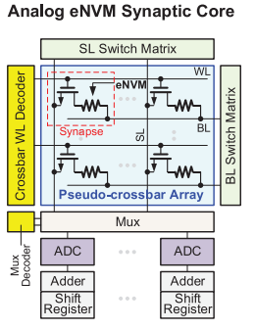
1T1R array – pseudo crossbar
Problem of Conventional 1T1R:
→ can’t do weight-sum operation

Slide 6
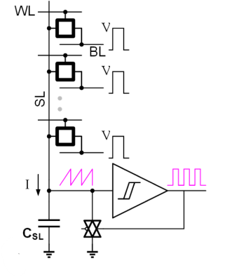
Analog-to-digital converter (ADC)
Integrate analog column current
Convert to spikes or digital outputs

Slide 7
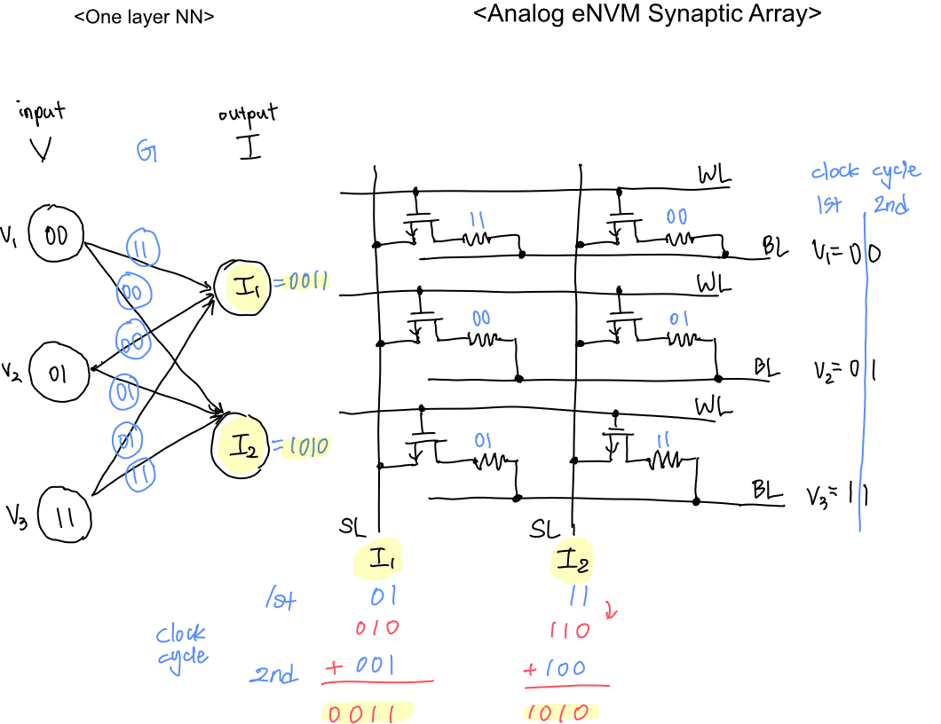
Example

Slide 8
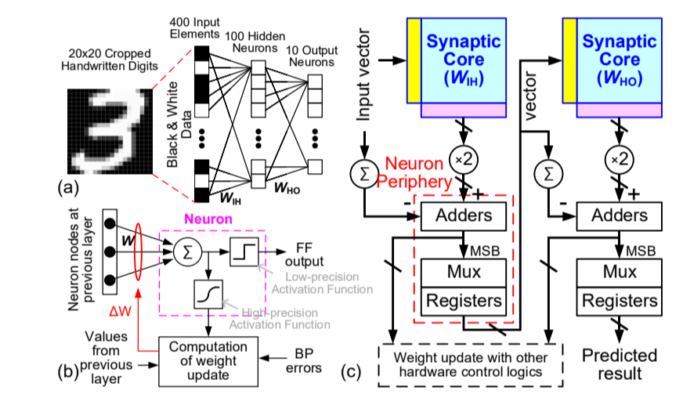
Example

