Slide 1

2024년 7월 03일
Pruning and Sparsity (1)
홍익대학교 컴퓨터공학과
B835298 이수학

Slide 2
Contents
Neural Network Pruning
Neural Network Pruning - Granualrities
Neural Network Pruning - Criteria
Pruning Ratio

Slide 3
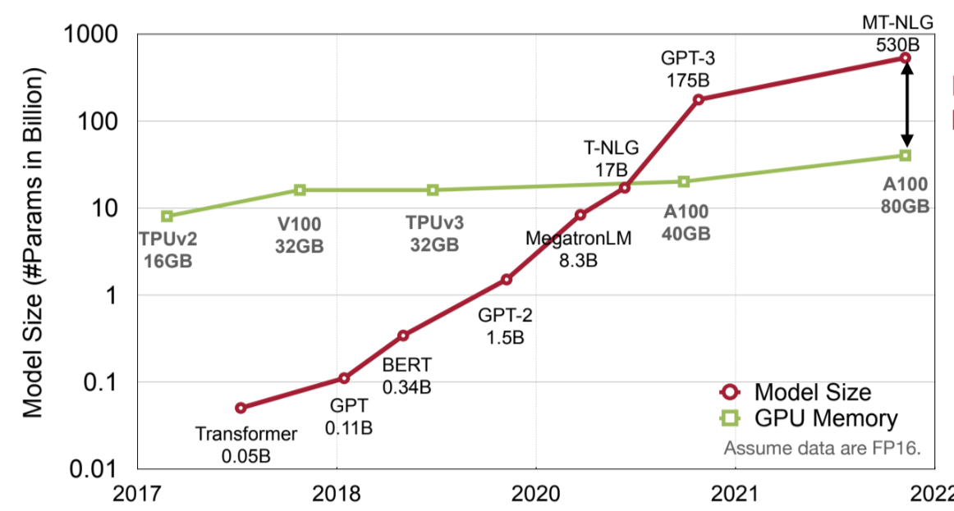
0. 배경

Slide 4
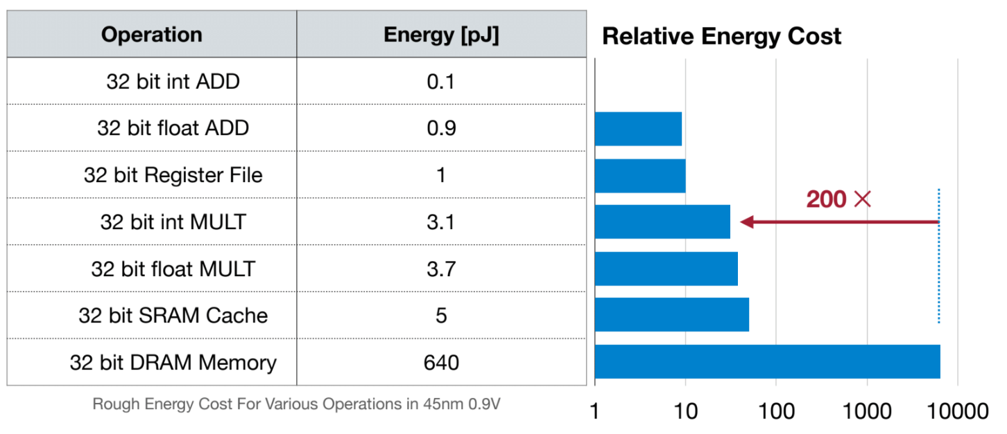
0. 배경

Slide 5
1. Neural Network Pruning
Before pruning
Dense NN
After pruning
Sparse NN
pruning
synapses, neurons 감소

Slide 6


1. Neural Network Pruning
Before pruning
Dense NN
After pruning
Sparse NN
pruning
synapses, neurons 감소

Slide 7
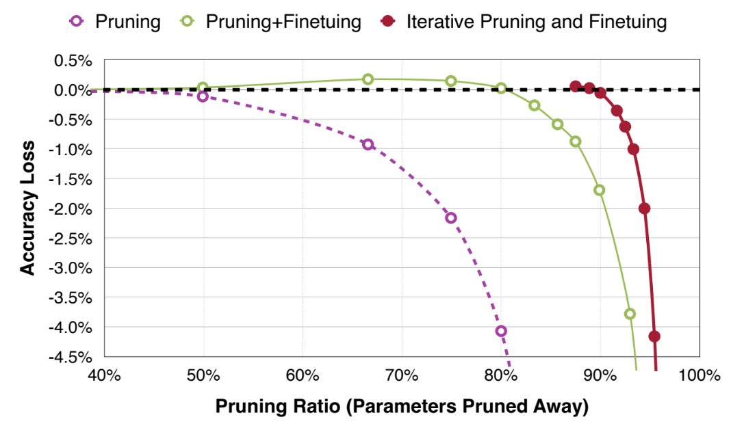
1. Neural Network Pruning

Slide 8







1. Neural Network Pruning
Formulate the Pruning
$$X$$
$$X$$
$$arg min L(x; W_{p})$$
$$W_{p}$$
W : 기존 weight
$$W_{p}$$
: pruning 후의 weight
L : Loss function
x : input
$$||W_{p}||_{0} <N$$
N : target non-zero의 수
(Non-zero weight의 최대 수)
$$arg min L(x; W)$$
$$arg min L(x; W_{p})$$
$$w$$
$$W_{p}$$
$$s.t. ||W_{p}||_{0} ≤N$$

Slide 9
2. Neural Network Pruning - Granualrities
Granularity - 어떤 패턴으로 Neural Network를 프루닝해야하는가
Structured 부터 Non-Structured까지 다양한 수준에서 프루닝 적용 가능

Slide 10
2. Neural Network Pruning - Granualrities
2D weight matrix
Preserved
Pruned
Fine-grained/Unstructured
More flexible pruning index choice
accelerate 가 어려움(irregular)
Coarse-grained/Structured
Less flexible pruning index choice
accelerate 가 쉬움(regular)

Slide 11





2. Neural Network Pruning - Granualrities
Preserved
Pruned
$$k_{h}=3$$
$$c_{o}=3$$
Convolutional Layers
$$k_{w}=3$$
$$c_{o} , c_{i }, k_{h} , k_{w}$$
$$c_{i}=2$$
Irregular
regular
Fine-grained
Pruning
Pattern-based
Pruning
Vector-level
Pruning
Kernel-level
Pruning
Channel-level
Pruning

Slide 12
2. Neural Network Pruning - Granualrities
Pattern-Based Pruning - N:M sparsity
- N개의 elements중 M개가 pruned
- ex) 2:4 sparsity (4개의 elements 당 2개만 non-zero)
non-zero 2-bit
values indices
Dense Matrix
2:4 sparse Matrix
Compressed Matrix

Slide 13
3. Neural Network Pruning - Criteria
Criterion - 어떤 synapses/neurons를 pruning 해야하는가?
-> Neural Network Model에서 parameter를 제거 시, less important parameter를 제거!

Slide 14

3. Neural Network Pruning - Criteria
Magnitude-based Pruning
Weight의 절댓값이 크면 클수록 중요성이 높다고 판단
- Element-wise Pruning
$$Importance = |W|$$
3 | -2
1 | -5
L1-norm
Element-wise
|3| | |-2|
|1| | |-5|
3 | 2
1 | 5
3 | 0
0 | -5
Weight
Importance
Pruned Weight

Slide 15






3. Neural Network Pruning - Criteria
Magnitude-based Pruning
$$Importance = \sum_{i∈S}{|w_{i}|}$$
- row-wise Pruning (L1-norm magnitude)
3 | -2
1 | -5
L1-norm
Row-wise
|3| + |-2|
|1| + |-5|
5
6
0 | 0
1 | -5
Weight
Importance
Pruned Weight
$$Importance = \sqrt{\sum_{i∈S}{{|w_{i}|}^{2}}}$$
- row-wise Pruning (L2-norm magnitude)
3 | -2
1 | -5
L2-norm
Row-wise
$$\sqrt{13} = \sqrt{{|3|}^{2}+{|-2|}^{2}}$$
$$\sqrt{13}$$
0 | 0
1 | -5
$$\sqrt{26} = \sqrt{{|1|}^{2}+{|-5|}^{2}}$$
$$\sqrt{26}$$
Weight
Importance
Pruned Weight

Slide 16

3. Neural Network Pruning - Criteria
Scaling-based Pruning
Channel
Scaling Factor
Activation
Channel
Scaling Factor
Activation
Weight
Weight
Filter 0
1.17
Channel 0
Filter 0
1.17
Channel 0
Filter 1
0.10
Channel 1
Filter 3
0.82
Channel 3
.
.
.
.
.
.
.
.
.
Filter 2
0.29
Channel 2
Filter 3
0.82
Channel 3
Filter N-1
0.56
Channel N-1
.
.
.
.
.
.
.
.
.
Filter N-1
0.56
Channel N-1
$$z_{0}=γ\frac{z_{i}-μ_{Β}}{\sqrt{σ_{Β}^{2}+ε}}+β$$

Slide 17




3. Neural Network Pruning - Criteria
Second-based Pruning
$$δL=L(x; W) - L(x; W_{p} = W - δW) = \sum_{i}{g_{i}δw_{i}}+\frac{1}{2}\sum_{i}{h_{ii}δw_{i}^{2}}+\frac{1}{2}\sum_{i≠j}{h_{ii}δw_{i}δw_{j}+O(||δW||^{2})}$$
$$g_{i}=\frac{dL}{dw_{i}}, { h}_{i,j}=\frac{d^{2}L}{dw_{i}dw_{j}}$$
$$δL_{i}=L(x; W) - L(x; W_{p} | w_{i}=0)≈\frac{1}{2}h_{ii}w_{i}^{2}$$
$$h_{ii}=\frac{d^{2}L}{dw_{i}dw_{j}}$$
, where
$$importance_{w_{i}}=|δL_{i}| = \frac{1}{2}h_{ii}w_{i}^{2}$$

Slide 18
3. Neural Network Pruning - Criteria
Selection of Neurons to Prune
less useful한 뉴론이 removed 되면 될 수록, pruned Neural Network의 성능이 더 좋아짐
Weight Matrix
Neuron Pruning
in Linear Layer
Channel Pruning
in Convolutional Layer

Slide 19



3. Neural Network Pruning - Criteria
Percentage-of-Zero-Based Pruning
APoZ(Average Percentage of Zero activations)
Width = 4
Width = 4
0
0.1
0.5
1
0.1
0.5
0
0
0
0
0.8
0
0.5
0
0.2
0.1
0.1
0.5
0
0
0
0.8
0.1
0
1.2
0.6
0.3
0.2
0.2
0.3
0
1
0.7
0
0.6
0.1
0
0.2
1.2
0
0
0.8
0
1
0.2
0
0
0.3
Height
= 4
Height
= 4
0
0.5
0
0.3
0.1
0
0
0.5
1.2
1
0
0.2
1.2
0
0.2
0.3
0.1
0
0.1
1.0
0
0.4
0
0.5
0.2
0
0
0.8
0.1
0.6
0.7
0.1
0.5
0
0.3
0.5
0.2
0.4
0
0
0.2
0
1.0
0
0.2
0
0.3
0
Channel = 3
Channel = 3
Batch = 2
$$=\frac{5+6}{2*4*4}=\frac{11}{32}$$
$$=\frac{5+7}{2*4*4}=\frac{12}{32}$$
$$=\frac{6+8}{2*4*4}=\frac{14}{32}$$
Channel 0
Channel 1
Channel 2

Slide 20









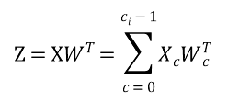
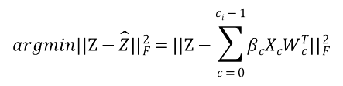


3. Neural Network Pruning - Criteria
Regression-based Pruning
$$c_{i}$$
$$c_{o}$$
$$c_{o}$$
$$Z=XW^{T}=\sum_{c=0}^{c_{i}-1}{X_{c}W_{c}^{T}}$$
$$b$$
$$b$$
$$c_{i}$$
$$X$$
$$W^{T}$$
$$Z$$
$$argmin||Z-\hat{Z}||_{F}^{2}=||Z-\sum_{c=0}^{c_{i}-1}{β_{c}X_{c}W_{c}^{T}||_{F}^{2}}$$
$$c_{i}$$
$$c_{o}$$
$$c_{o}$$
$$||β||_{0}≤N_{c}$$
$$b$$
$$b$$
$$c_{i}$$
$$^$$
$$Z$$
$$X_{p}$$
$$W_{P}^{T}$$

