Slide 1
2024/12/31
Bin-Count Network
Hyungdong Park, Inguk Yeo
Department of Computer Engineering

Slide 2
Contents
Baseline Model
ReActNet-18
Implementing binarized counting in hardware architectures
- Benefits of binarized counting on hardware
Binarized counting techniques
PTQ-binarized counting
Simple QAT-binarized counting
QAT-binarized counting

Slide 3

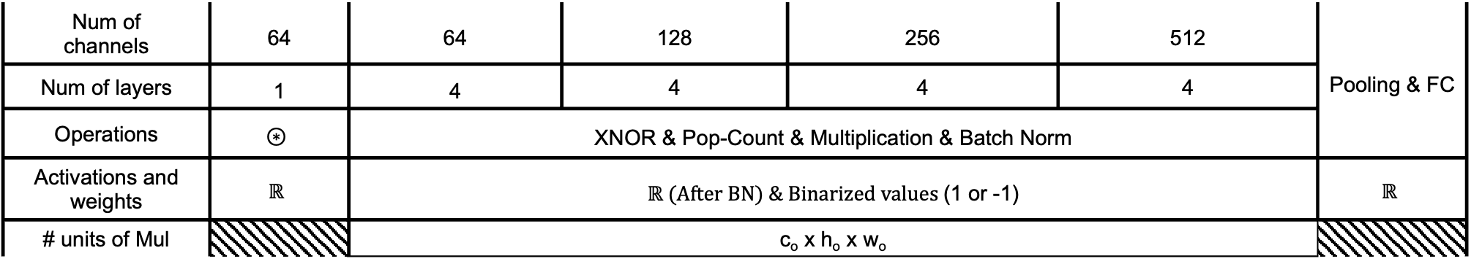



Progress
- ReActNet-18 with CIFAR-10 using XNOR & Pop-count
k
k
h_{i}
c_{i}
h_{o}
w_{i}
w_{o}
c_{i}
c_{o}
XNOR
$$≤num of$$
$$channel × 9$$
Batch Norm
$$⋮$$
$$⋮$$
Pop-count
$$× Scaling factor$$
$$⋯$$
$$⋯$$
Num of channels | 64 | 64 | 128 | 256 | 512 | Pooling & FC
Num of layers | 1 | 4 | 4 | 4 | 4
Operations | $$⊛$$ | XNOR & Pop-Count & Multiplication & Batch Norm
Activations and weights | $$ℝ$$ | $ℝ (After BN) \& Binarized values$(1 or -1) |  |  |  | $$ℝ$$
# units of Mul |  | c_{o} x h_{o} x w_{o}

Slide 4
Implementing binarized counting on baseline model

Slide 5











Progress
- Hardware computations for ReActNet-18 (our baseline model)
16 bits
(Scaling factor)
16 bits
16 bits
N
$$⊙$$
$$=$$
$$×$$
$$⋰$$
$$⋰$$
$$⋰$$
$$⋰$$
$$⋯$$
$$⋯$$
$$⋯$$
3
3
$$popcount$$
3
3
Operations | $$Xnor (⊙)$$ | $$Popcount$$ | $$Integer multiplication \& Bit shift$$
# operations | $$N × 3^{2}$$ | $$\left(N × 3^{2}\right)−1$$ | $$1 Integer multiplication \& 1 Bit shift$$

Slide 6
Progress
- Hardware computations for our model
16 bits
(Scaling factor)
16 bits
16 bits
N
$$⊙$$
$$=$$
$$⋰$$
$$⋰$$
$$⋰$$
$$⋰$$
$$⋯$$
$$⋯$$
$$⋯$$
3
3
$$popcount$$
3
3
Operations | $$Xnor (⊙)$$ | $$Popcount$$ | $$None$$
# operations | $$N × 3^{2}$$ | $$\left(N × 3^{2}\right)−1$$ | $$None$$

Slide 7


Progress
- Overview of bin-count network with CIFAR-10
k
k
h_{i}
c_{i}
h_{o}
w_{i}
w_{o}
c_{i}
c_{o}
XNOR
$$≤num of$$
$$channel × 9$$
Sign
$$1 or −1$$
Batch Norm
Pop-count
$$⋮$$
$$⋮$$
$$× Scaling factor$$
$$⋯$$
$$⋯$$
$$⋯$$
$$⋯$$
Num of channels | 64 | 64 | 128 | 256 | 512 | Pooling & FC
Num of layers | 1 | 4 | 4 | 4 | 4
Operations | $$⊛$$ | XNOR & Pop-Count & Multiplication & Batch Norm
Activations and weights | $$ℝ$$ | $ℝ (After BN) \& Binarized values$(1 or -1) |  |  |  | $$ℝ$$
# units of Mul |  | None

Slide 8
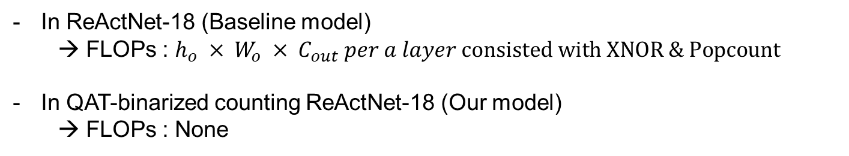

Progress
- Benefits for QAT-binarized counting
$$∗scaling factor$$
In ReActNet-18 (Baseline model)
FLOPs : $h_{o} × W_{o} × C_{out} per a layer consisted with XNOR \& Popcount$
In QAT-binarized counting ReActNet-18 (Our model)
→ FLOPs : None

Slide 9
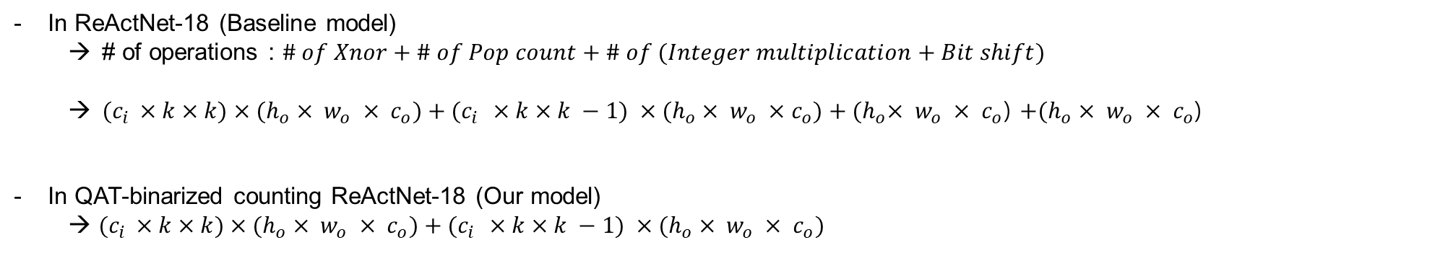
Progress
- Benefits for QAT-binarized counting
$$∗scaling factor$$
In ReActNet-18 (Baseline model)
# of operations : $\# of Xnor+\# of Pop count+\# of (Integer multiplication+Bit shift)$
$(c_{i }×k×k)×{(h}_{o} × w_{o} × c_{o})+(c_{i }×k×k −1) ×{(h}_{o} × w_{o} ×c_{o})+{(h}_{o}× w_{o} × c_{o}$) ${+(h}_{o}× w_{o} × c_{o}$)
In QAT-binarized counting ReActNet-18 (Our model)
→ $(c_{i }×k×k)×{(h}_{o} × w_{o} × c_{o})+(c_{i }×k×k −1) ×{(h}_{o} × w_{o} × c_{o})$

Slide 10
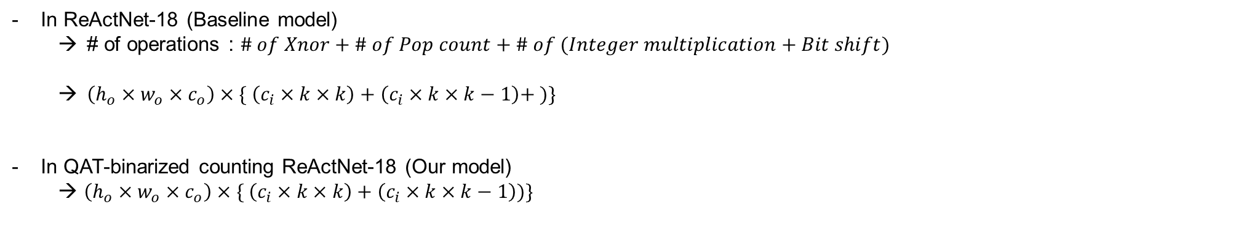
Progress
- Benefits for QAT-binarized counting
$$∗scaling factor$$
In ReActNet-18 (Baseline model)
# of operations : $\# of Xnor+\# of Pop count+\# of (Integer multiplication+Bit shift)$
$\left(h_{o}×w_{o}×c_{o}\right)×\{ \left(c_{i}×k×k\right)+\left(c_{i}×k×k−1\right)+ )\}$
In QAT-binarized counting ReActNet-18 (Our model)
→ $\left(h_{o}×w_{o}×c_{o}\right)×\{ \left(c_{i}×k×k\right)+\left(c_{i}×k×k−1\right))\}$

Slide 11
Binarized counting techniques

Slide 12





















Progress
- Structure for the PTQ-binarized counting
$$Scaling factor$$
$$Scaling factor$$
$$∑$$
$$y$$
$$β$$
$$×$$
$$γ$$
$$∑$$
$$×$$
$$⋮$$
$$α$$
$$1$$
$$⋮$$
$$α$$
$$δ$$
$$x$$
$$−1$$
$$Popcount$$
$$Sign$$
$$Mul$$
$$Popcount$$
$$Mul$$
Inference
Training
$$\left|α\right| ≤\left(channel_num × {kernel}^{2}\right)$$
$$β = ± 1$$
$$γ = ± scaling_factor$$
$$δ = ± (scaling_factor × channel_num × {kernel}^{2})$$

Slide 13
Progress
- PTQ-binarized counting’s results with CIFAR-10
Models | Top-1 Accuracy (%) | Top-5 Accuracy (%)
ReActNet-18 | 93.380 | 99.800
PTQ-binarized counting ReActNet-18 | 10.000 | 52.040
Bi-RealNet-18 | 88.770 | 98.250
PTQ-binarized counting Bi-RealNet-18 | 10.000 | 50.000

Slide 14















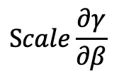









Progress
- Structure for the PTQ-binarized counting
: Inference model
$$Scaling factor$$
: Training model
$$∑$$
$$y$$
$$β$$
$$\left|α\right| ≤\left(channel_num × {kernel}^{2}\right)$$
$$α$$
$$1$$
$$×$$
$$γ$$
$$⋮$$
$$x$$
$$β = ± 1$$
$$−1$$
$$γ = ± scaling_factor$$
$$Popcount$$
$$Sign$$
$$Mul$$
$$Scaling_factor$$
$$∑$$
$$y$$
$$β$$
$$y$$
$$α$$
$$1$$
$$×$$
$$γ$$
$$×1$$
$$×\frac{1}{Scale}$$
$$⋮$$
$$x$$
$$⋮$$
$$x$$
$$−1$$
$$Popcount$$
$$Sign$$
$$Mul$$
$$\frac{∂Sign(α)}{∂α}$$
$$Scale\frac{∂γ}{∂β}$$
Forward
Backpropagation

Slide 15
Progress
- Simple QAT-binarized counting’s results with CIFAR-10
Models | Top-1 Accuracy (%) | Top-5 Accuracy (%)
ReActNet-18 | 93.380 | 99.800
Simple QAT-binarized counting ReActNet-18 | 84.930 | 99.250
Bi-RealNet-18 | 88.770 | 98.250
Simple QAT-binarized counting Bi-RealNet-18 | 30.070 | 79.690

Slide 16




















Progress
- Structure for the PTQ-binarized counting
$$division_num$$
$$Scaling_factor$$
$$∑$$
$$y$$
$$β$$
$$α$$
$$÷$$
$$δ$$
$$1$$
$$×$$
$$γ$$
$$⋮$$
$$x$$
$$−1$$
$$Popcount$$
$$Div$$
$$Approx$$
$$Sign$$
$$Mul$$
Forward in training
$$\left|α\right| ≤\left(channel_num × {kernel}^{2}\right)$$
$$β = ± 1$$
$$γ = ± scaling_factor$$
$$δ = ± (channel_num × {kernel}^{2} ÷division_num)$$
$$y$$
$$⋮$$
$$×1$$
$$× div$$
$$num$$
$$×\frac{1}{Scale}$$
$$x$$
$$−1$$
$$\frac{∂δ}{∂α∙div_num}$$
$$\frac{∂ApproxSign(δ)}{∂δ}$$
$$Scale\frac{∂γ}{∂β}$$
Backpropagation in training

Slide 17
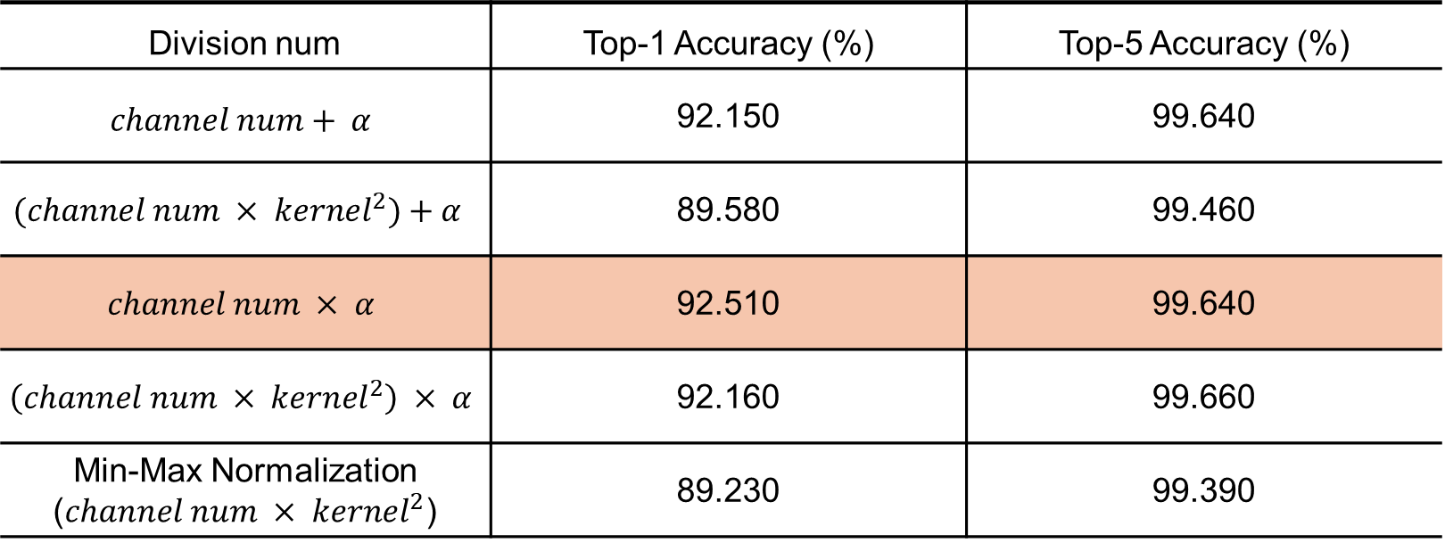
Progress
- QAT-binarized counting ReActNet-18’s results with CIFAR-10 along with division num
Division num | Top-1 Accuracy (%) | Top-5 Accuracy (%)
$$channel num+ α$$ | 92.150 | 99.640
$$(channel num × {kernel}^{2})+α$$ | 89.580 | 99.460
$$channel num × α$$ | 92.510 | 99.640
$$\left(channel num × {kernel}^{2}\right) × α$$ | 92.160 | 99.660
Min-Max Normalization ($channel num × {kernel}^{2}$) | 89.230 | 99.390

Slide 18
Progress
- QAT-binarized counting’s results with CIFAR-10
Models | Top-1 Accuracy (%) | Top-5 Accuracy (%)
ReActNet-18 | 93.380 | 99.800
Simple QAT-binarized counting ResNet-18 | 84.930 | 99.250
QAT-binarized counting ReActNet-18 | 92.510 | 99.640
Bi-RealNet-18 | 88.770 | 98.250
Simple QAT-binarized counting Bi-RealNet-18 | 30.070 | 79.690
QAT-binarized counting Bi-RealNet-18 | 87.660 | 98.720

Slide 19
Thank you

