Slide 1
2025/01/20
PopBin: Popcount Binarization for Lightweight Binary Neural Networks
Hyungdong Park, Inguk Yeo
Department of Computer Engineering

Slide 2
Contents
Background
BNNs (XNOR Net / BiReal Net / ReAct Net)
Post-Training Quantization (PTQ) and Quantization-Aware Training (QAT)
Challenges Induced by Popcount Results in BNNs
Integer Multiplication and Bit Shift Latency in BNNs
Analysis of Latency Issues
Optimization Opportunities
Popcount Binarization Strategies
PTQ-Popcount Binarization
Simple QAT-Popcount Binarization
QAT-Popcount Binarization
Latency Reduction through Popcount Optimization
Experiments
Datasets and Implementation Details
Optimization of Popcount Results
Latency Efficiency Analysis
Discussion
Potential for Majority Voter Design
Hierarchical and Approximate Majority Voter
Design

Slide 3
Background
Binary Neural Networks (BNNs)
XNOR Net
- XNOR operation-based binary neural network model. Description of its features and working principles.
BiReal Net
- The binarization technique used in BiReal Net and its performance improvements.
ReAct Net
- The role of binarization and activation functions in ReActNet, along with related optimization techniques.
Post-Training Quantization (PTQ) and Quantization-Aware Training (QAT)
Post-Training Quantization (PTQ)
- The basic concept of PTQ and its role in the binarization process of BNNs.
Quantization-Aware Training (QAT)
- Explanation of QAT techniques, differences from PTQ, and the advantages QAT provides for BNNs.

Slide 4

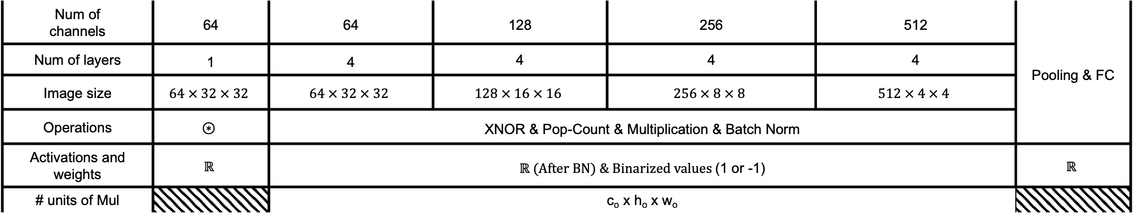



Background
- ReActNet-18 with CIFAR-10 using xnor & popcount
k
k
h_{i}
c_{i}
h_{o}
w_{i}
w_{o}
c_{i}
c_{o}
XNOR
$$≤num of$$
$$channel × 9$$
Batch Norm
$$⋮$$
$$⋮$$
Pop-count
$$× Scaling factor$$
$$⋯$$
$$⋯$$
Num of channels | 64 | 64 | 128 | 256 | 512 | Pooling & FC
Num of layers | 1 | 4 | 4 | 4 | 4
Image size | $$64 × 32 × 32$$ | $$64 × 32 × 32$$ | $$128 × 16 × 16$$ | $$256 × 8 × 8$$ | $$512 × 4 × 4$$
Operations | $$⊛$$ | XNOR & Pop-Count & Multiplication & Batch Norm
Activations and weights | $$ℝ$$ | $ℝ (After BN) \& Binarized values$(1 or -1) |  |  |  | $$ℝ$$
# units of Mul |  | c_{o} x h_{o} x w_{o}

Slide 5
Challenges Induced by Popcount Results in BNNs
Integer Multiplication and Bit Shift Latency in BNNs
- XNOR operation-based binary neural network model. Description of its features and working principles.
Analysis of Latency Issues
- Analyzing the latency impact that Popcount operations have on BNNs' performance.
Optimization Opportunities
- Exploring hardware optimization techniques to reduce latency caused by Popcount results.

Slide 6













Challenges Induced by Popcount Results in BNNs
- Analysis of latency Issues of ReActNet-18
16 bits
(Scaling factor)
16 bits
16 bits
N
$$⊙$$
$$=$$
$$×$$
$$⋰$$
$$⋰$$
$$⋰$$
$$⋰$$
$$⋯$$
$$⋯$$
$$⋯$$
3
3
$$popcount$$
3
3
$$Step 1$$
$$Step 2$$
$$Step 3$$
Operations | $$Xnor (⊙)$$ | $$Popcount$$ | $$Integer multiplication \& Bit shift$$
# operations | $$N × 3^{2}$$ | $$\left(N × 3^{2}\right)−1$$ | $$1 Integer multiplication \& 1 Bit shift$$

Slide 7
Challenges Induced by Popcount Results in BNNs
- Optimization opportunities
16 bits
(Scaling factor)
16 bits
16 bits
N
$$⊙$$
$$=$$
$$⋰$$
$$⋰$$
$$⋰$$
$$⋰$$
$$⋯$$
$$⋯$$
$$⋯$$
3
3
$$popcount$$
3
3
$$Step 1$$
$$Step 2$$
$$Step 3$$
Operations | $$Xnor (⊙)$$ | $$Popcount$$ | $$None$$
# operations | $$N × 3^{2}$$ | $$\left(N × 3^{2}\right)−1$$ | $$None$$

Slide 8
Popcount Binarization Strategies
PTQ-Popcount Binarization
- A PTQ-based binarization method aimed at minimizing the impact of Popcount results. It is easy to apply but leads to a significant drop in accuracy.
Simple QAT-Popcount Binarization
- A method that uses QAT to improve the Popcount issue. It improves accuracy, but still falls short of the original model's performance.
QAT-Popcount Binarization
- An advanced binarization technique using QAT. It maintains accuracy within 1% of the original model while optimizing performance.
Latency Reduction through Popcount Optimization
- An optimization strategy to address latency issues caused by Popcount operations, enhancing overall system efficiency.

Slide 9
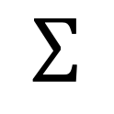






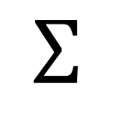













Popcount Binarization Strategies
PTQ-Popcount Binarization
$$Scaling factor$$
$$Scaling factor$$
$$∑$$
$$y$$
$$β$$
$$×$$
$$γ$$
$$∑$$
$$×$$
$$⋮$$
$$α$$
$$1$$
$$⋮$$
$$α$$
$$δ$$
$$x$$
$$−1$$
$$Popcount$$
$$Sign$$
$$Mul$$
$$Popcount$$
$$Mul$$
Inference
Training
$$\left|α\right| ≤\left(channel_num × {kernel}^{2}\right)$$
$$β = ± 1$$
$$γ = ± scaling_factor$$
$$δ = ± (scaling_factor × channel_num × {kernel}^{2})$$

Slide 10






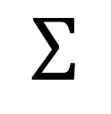








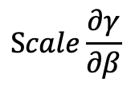








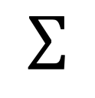
Popcount Binarization Strategies
Simple QAT-Popcount Binarization
: Inference model
$$Scaling factor$$
: Training model
$$∑$$
$$y$$
$$β$$
$$\left|α\right| ≤\left(channel_num × {kernel}^{2}\right)$$
$$α$$
$$1$$
$$×$$
$$γ$$
$$⋮$$
$$x$$
$$β = ± 1$$
$$−1$$
$$γ = ± scaling_factor$$
$$Popcount$$
$$Sign$$
$$Mul$$
$$Scaling_factor$$
$$∑$$
$$y$$
$$β$$
$$y$$
$$α$$
$$1$$
$$×$$
$$γ$$
$$×1$$
$$×\frac{1}{Scale}$$
$$⋮$$
$$x$$
$$⋮$$
$$x$$
$$−1$$
$$Popcount$$
$$Sign$$
$$Mul$$
$$\frac{∂Sign(α)}{∂α}$$
$$Scale\frac{∂γ}{∂β}$$
Forward
Backpropagation

Slide 11




















Popcount Binarization Strategies
QAT-Popcount Binarization
$$division_num$$
$$Scaling_factor$$
$$∑$$
$$y$$
$$β$$
$$α$$
$$÷$$
$$δ$$
$$1$$
$$×$$
$$γ$$
$$⋮$$
$$x$$
$$−1$$
$$Popcount$$
$$Div$$
$$Approx$$
$$Sign$$
$$Mul$$
Forward in training
$$\left|α\right| ≤\left(channel_num × {kernel}^{2}\right)$$
$$β = ± 1$$
$$γ = ± scaling_factor$$
$$δ = ± (channel_num × {kernel}^{2} ÷division_num)$$
$$y$$
$$⋮$$
$$×1$$
$$× div$$
$$num$$
$$×\frac{1}{Scale}$$
$$x$$
$$−1$$
$$\frac{∂δ}{∂α∙div_num}$$
$$\frac{∂ApproxSign(δ)}{∂δ}$$
$$Scale\frac{∂γ}{∂β}$$
Backpropagation in training

Slide 12


Popcount Binarization Strategies
Software Implementation of Popcount Binarization with CIFAR-10
k
k
h_{i}
c_{i}
h_{o}
w_{i}
w_{o}
c_{i}
c_{o}
XNOR
$$≤num of$$
$$channel × 9$$
Sign
$$1 or −1$$
Batch Norm
Pop-count
$$⋮$$
$$⋮$$
$$× Scaling factor$$
$$⋯$$
$$⋯$$
Num of channels | 64 | 64 | 128 | 256 | 512 | Pooling & FC
Num of layers | 1 | 4 | 4 | 4 | 4
Image size | $$64 × 32 × 32$$ | $$64 × 32 × 32$$ | $$128 × 16 × 16$$ | $$256 × 8 × 8$$ | $$512 × 4 × 4$$
Operations | $$⊛$$ | XNOR & Pop-Count & Multiplication & Batch Norm
Activations and weights | $$ℝ$$ | $ℝ (After BN) \& Binarized values$(1 or -1) |  |  |  | $$ℝ$$
# units of Mul |  | None

Slide 13




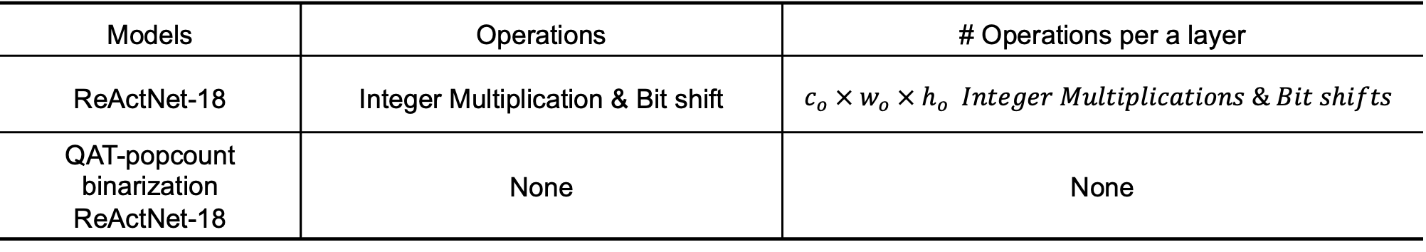



Popcount Binarization Strategies
Latency Reduction through Popcount Optimization (per a layer)
$$×$$
$$c_{i}$$
$$c_{o}$$
$$(Scaling Factor)$$
$$h_{i}$$
$$h_{o}$$
$$w_{o}$$
$$w_{i}$$
Xnor & Popcount operation in ReActNet-18
Models | Operations | # Operations per a layer
ReActNet-18 | Integer Multiplication & Bit shift | $$c_{o} × w_{o} × h_{o} Integer Multiplications \& Bit shifts$$
QAT-popcount binarization ReActNet-18 | None | None

Slide 14


Popcount Binarization Strategies
Latency Reduction through Popcount Optimization (per a model)
k
k
h_{i}
c_{i}
h_{o}
w_{i}
w_{o}
c_{i}
c_{o}
$$≤num of$$
$$channel × 9$$
$$\text{Scaling} \text{Factor} \text{Sign} \text{Adj}\text{.}$$
XNOR
Batch Norm
Pop-count
$$⋮$$
$$⋮$$
$$⋯$$
$$⋯$$
QAT-popcount binarization ReActNet-18
Models | Operations | # Operations
ReActNet-18 | Integer Multiplication & Bit shift | 557,056 Integer Multiplications & Bit shifts
QAT-popcount binarization ReActNet-18 | None | None

Slide 15
Experiments
Datasets and Implementation Details
- Description of datasets used in the experiments and implementation details.
Optimization of Popcount Results
- Comparison and analysis of various techniques to optimize Popcount results.
Latency Efficiency Analysis
- Analysis of latency efficiency after applying Popcount optimization techniques.

Slide 16
Experiments
Optimization of Popcount Results about PTQ-Popcount Binarization
Models | Top-1 Accuracy (%) | Top-5 Accuracy (%)
ReActNet-18 | 93.380 | 99.800
PTQ-binarized counting ReActNet-18 | 10.000 | 52.040
Bi-RealNet-18 | 88.770 | 98.250
PTQ-binarized counting Bi-RealNet-18 | 10.000 | 50.000

Slide 17
Experiments
Optimization of Popcount Results about Simple QAT-Popcount Binarization
Models | Top-1 Accuracy (%) | Top-5 Accuracy (%)
ReActNet-18 | 93.380 | 99.800
Simple QAT-popcount binarization ReActNet-18 | 84.930 | 99.250
Bi-RealNet-18 | 88.770 | 98.250
Simple QAT-popcount binarization Bi-RealNet-18 | 30.070 | 79.690

Slide 18
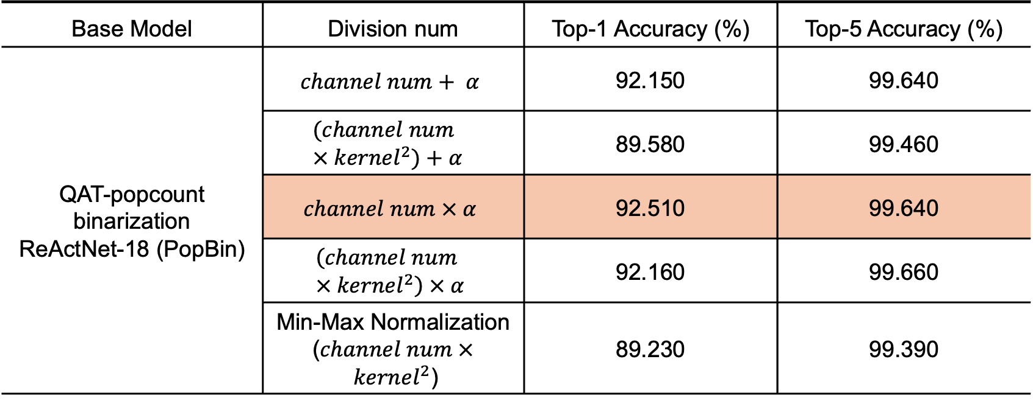
Experiments
Optimization of Popcount Results about QAT-Popcount Binarization depending on Division Num
Base Model | Division num | Top-1 Accuracy (%) | Top-5 Accuracy (%)
QAT-popcount binarization ReActNet-18 (PopBin) | $$channel num+ α$$ | 92.150 | 99.640
 | $$(channel num × {kernel}^{2})+α$$ | 89.580 | 99.460
 | $$channel num × α$$ | 92.510 | 99.640
 | $$\left(channel num × {kernel}^{2}\right) × α$$ | 92.160 | 99.660
 | Min-Max Normalization ($channel num × {kernel}^{2}$) | 89.230 | 99.390

Slide 19
Experiments
Optimization of Popcount Results about QAT-Popcount Binarization
Models | Top-1 Accuracy (%) | Top-5 Accuracy (%)
ReActNet-18 | 93.380 | 99.800
Simple QAT-popcount binarization ResNet-18 | 84.930 | 99.250
QAT-popcount binarization ReActNet-18 (PopBin) | 92.510 | 99.640
Bi-RealNet-18 | 88.770 | 98.250
Simple QAT-popcount binarization Bi-RealNet-18 | 30.070 | 79.690
QAT-popcount binarization Bi-RealNet-18 (PopBin) | 87.660 | 98.720

Slide 20
Discussion
Potential for Majority Voter Design
- Exploring the potential for hardware optimization using Majority Voter design to enhance performance.
Hierarchical and Approximate Majority Voter Design
- Analyzing the contribution of hierarchical and approximate Majority Voter designs to improving hardware efficiency.

Slide 21
Thank you

