Slide 1
2025/02/19
PopBin: Popcount Binarization for Lightweight Binary Neural Networks
Hyungdong Park, Inguk Yeo
Department of Computer Engineering

Slide 2
Contents
Background
BNNs (XNOR-Net / Bi-RealNet / ReActNet)
Post-Training Quantization (PTQ) and Quantization-Aware Training (QAT)
Challenges Induced by Popcount Results in BNNs
Analysis of Latency Issues
Optimization Opportunities
Popcount Binarization Strategies
PTQ-Popcount Binarization
Simple QAT-Popcount Binarization
QAT-Popcount Binarization
Latency Reduction through Popcount Optimization
Experiments
Datasets and Implementation Details
Optimization of Popcount Results
Latency Efficiency Analysis
Discussion
Potential for Majority Voter Design
Hierarchical and Approximate Majority Voter
Design

Slide 3
Background
Binary Neural Networks (BNNs)
XNOR-Net
- XNOR operation-based binary neural network model. Description of its features and working principles.
Bi-Real Net
- The binarization technique used in Bi-Real Net and its performance improvements.
ReActNet
- The role of binarization and activation functions in ReActNet, along with related optimization techniques.
Post-Training Quantization (PTQ) and Quantization-Aware Training (QAT)
Post-Training Quantization (PTQ)
- The basic concept of PTQ and its role in the binarization process of BNNs.
Quantization-Aware Training (QAT)
- Explanation of QAT techniques, differences from PTQ, and the advantages QAT provides for BNNs.

Slide 4

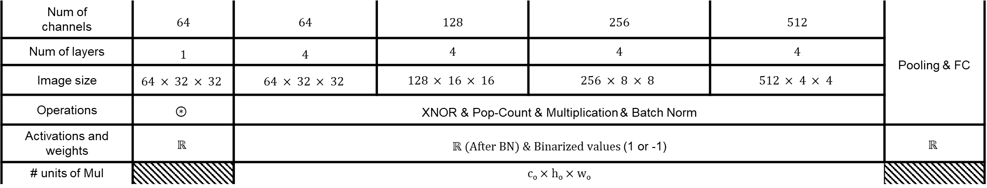



Background
- ReActNet-18 with CIFAR-10 using Xnor & Popcount
k
k
h_{i}
c_{i}
h_{o}
w_{i}
w_{o}
c_{i}
c_{o}
XNOR
$$≤num of$$
$$channel × 9$$
Batch Norm
$$⋮$$
$$⋮$$
Pop-count
$$× Scaling factor$$
$$⋯$$
$$⋯$$
Num of channels | 64 | 64 | 128 | 256 | 512 | Pooling & FC
Num of layers | 1 | 4 | 4 | 4 | 4
Image size | $$64 × 32 × 32$$ | $$64 × 32 × 32$$ | $$128 × 16 × 16$$ | $$256 × 8 × 8$$ | $$512 × 4 × 4$$
Operations | $$⊛$$ | XNOR & Pop-Count & Multiplication & Batch Norm
Activations and weights | $$ℝ$$ | $ℝ (After BN) \& Binarized values$(1 or -1) |  |  |  | $$ℝ$$
# units of Mul |  | c_{o} $×$ h_{o} $×$ w_{o}

Slide 5
Challenges Induced by Popcount Results in BNNs
Analysis of Latency Issues
- Analyzing the latency impact that Popcount results have on BNNs' performance.
Popcount Latency Optimization
- Exploring hardware optimization techniques to reduce latency caused by Popcount results.

Slide 6













Challenges Induced by Popcount Results in BNNs
- Analysis of latency issues
32 bits
(Scaling factor)
32 bits
32 bits
N
$$⊙$$
$$=$$
$$∑$$
$$×$$
$$⋰$$
$$⋰$$
$$⋰$$
$$⋰$$
$$⋯$$
$$⋯$$
$$⋯$$
3
3
3
3
$$Xnor (Step 1)$$
$$Popcount (Step 2)$$
$$Integer Mul (Step 3)$$
Operations | $$Xnor (⊙)$$ | $$Popcount$$ | $$Integer multiplication \& Bit shift$$
# operations | $$N × 3^{2}$$ | $$\left(N × 3^{2}\right)−1$$ | $$1 Integer multiplication \& 1 Bit shift$$

Slide 7

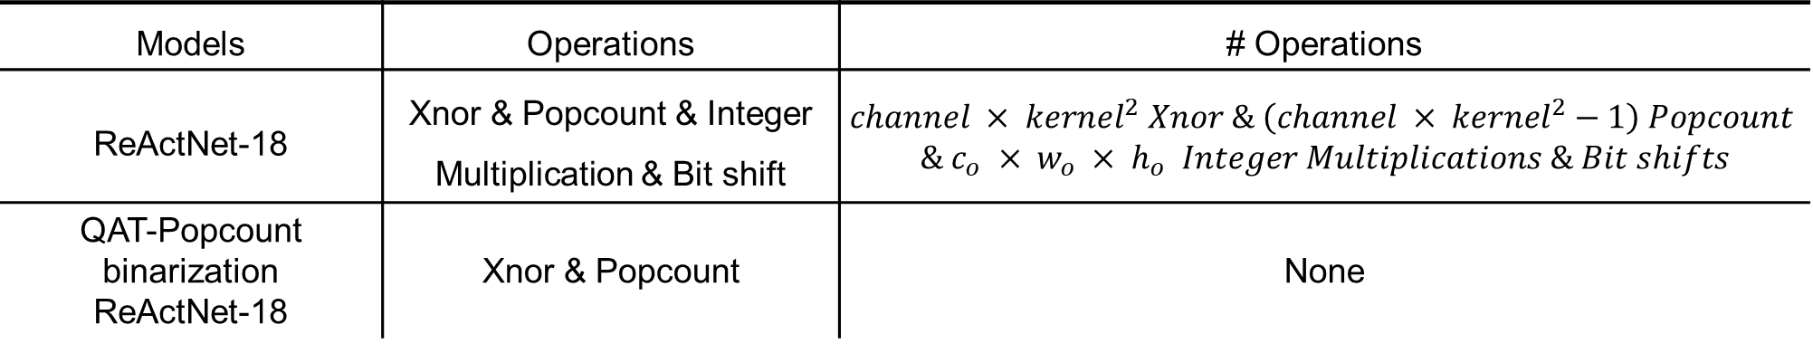





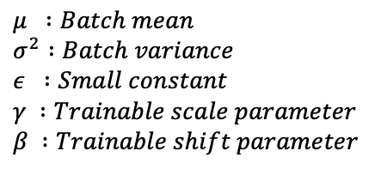
Challenges Induced by Popcount Results in BNNs
- Popcount Latency Optimization
k
Scaling factor
(32 bits)
32 bits
$$Xnor$$
$$=$$
$$⋯$$
$$⋯$$
$$∙$$
$$\frac{γ}{\sqrt{{|σ}^{2}+ε}|}+\left(β−\frac{γ∙μ}{\sqrt{|σ^{2}+ε}|}\right) =$$
h_{i}
k
h_{o}
c_{i}
$$Popcount$$
$$Sign Adj.$$
$$μ :Batch mean$$
$$σ^{2} :Batch variance$$
$$ε :Small constant$$
$$γ :Trainable scale parameter$$
$$β :Trainable shift parameter$$
w_{i}
w_{o}
c_{i}
c_{o}
Operations in QAT-Popcount binarization ReActNet-18
Models | Operations | # Operations
ReActNet-18 | Xnor & Popcount & Integer Multiplication & Bit shift | $$channel × {kernel}^{2} Xnor \& \left(channel × {kernel}^{2}−1\right) Popcount$$ $$\& c_{o} × w_{o} × h_{o} Integer Multiplications \& Bit shifts$$
QAT-Popcount binarization ReActNet-18 | Xnor & Popcount | None

Slide 8
Popcount Binarization Strategies
PTQ-Popcount Binarization
- A PTQ-based binarization method aimed at minimizing the impact of Popcount results. It is easy to apply but leads to a significant drop in accuracy.
Simple QAT-Popcount Binarization
- A method that uses QAT to improve the Popcount issue. It improves accuracy, but still falls short of the original model's performance.
QAT-Popcount Binarization
- An advanced binarization technique using QAT. It maintains accuracy within 1% of the original model while optimizing performance.
Latency Reduction through Popcount Optimization
- An optimization strategy to address latency issues caused by Popcount operations, enhancing overall system efficiency.

Slide 9
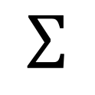






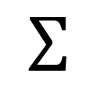













Popcount Binarization Strategies
- PTQ-Popcount Binarization
$$Scaling factor$$
$$\left|α\right| ≤\left(channel_num × {kernel}^{2}\right)$$
$$β = ± 1$$
$$γ = ± scaling factor$$
$$∑$$
$$y$$
$$δ = ± (scaling factor × channel_num × {kernel}^{2})$$
$$α$$
$$1$$
$$β$$
$$×$$
$$γ$$
$$⋮$$
$$x$$
$$−1$$
: Inference
$$Popcount$$
$$Sign$$
$$Mul$$
: Training
$$Scaling factor$$
$$∑$$
$$α$$
$$×$$
$$δ$$
$$⋮$$
$$Popcount$$
$$Mul$$

Slide 10




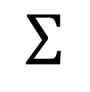










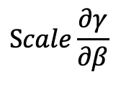








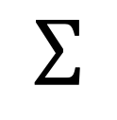
Popcount Binarization Strategies
- Simple QAT-Popcount Binarization
$$Scaling factor$$
: Inference
: Training
$$∑$$
$$y$$
$$β$$
$$α$$
$$1$$
$$×$$
$$γ$$
$$⋮$$
$$x$$
$$\left|α\right| ≤\left(channel_num × {kernel}^{2}\right)$$
$$−1$$
$$β = ± 1$$
$$Popcount$$
$$Sign$$
$$Mul$$
$$γ = ± scaling factor$$
$$Scaling factor$$
$$∑$$
$$y$$
$$β$$
$$y$$
$$α$$
$$1$$
$$×$$
$$γ$$
$$×1$$
$$×\frac{1}{Scale}$$
$$⋮$$
$$x$$
$$⋮$$
$$x$$
$$−1$$
$$Popcount$$
$$Sign$$
$$Mul$$
$$\frac{∂Sign(α)}{∂α}$$
$$Scale\frac{∂γ}{∂β}$$
Forward
Backpropagation

Slide 11





















Popcount Binarization Strategies
- QAT-Popcount Binarization
$$Scaling factor$$
$$\left|α\right| ≤\left(channel_num × {kernel}^{2}\right)$$
$$β = ± 1$$
$$γ = ± scaling factor$$
$$∑$$
$$y$$
$$δ = ± (channel num × {kernel}^{2} ÷division num)$$
$$α$$
$$1$$
$$β$$
$$×$$
$$γ$$
$$⋮$$
$$x$$
$$−1$$
: Inference
$$Popcount$$
$$Sign$$
$$Mul$$
: Training
$$division num$$
$$Scaling factor$$
$$∑$$
$$÷$$
$$δ$$
$$y$$
$$β$$
$$×$$
$$γ$$
$$⋮$$
$$α$$
$$1$$
$$x$$
$$−1$$
$$Popcount$$
$$Div$$
$$Approx$$
$$Sign$$
$$Mul$$
Forward
$$y$$
$$⋮$$
$$×1$$
$$× div$$
$$num$$
$$×\frac{1}{Scale}$$
$$x$$
$$−1$$
$$\frac{∂δ}{∂α∙div_num}$$
$$\frac{∂ApproxSign(δ)}{∂δ}$$
$$Scale\frac{∂γ}{∂β}$$
Backpropagation

Slide 12


Popcount Binarization Strategies
- Latency Reduction through Popcount Optimization (per a model)
k
k
h_{i}
c_{i}
h_{o}
w_{i}
w_{o}
c_{i}
c_{o}
$$≤num of$$
$$channel × 9$$
$$\text{Scaling} \text{Factor} \text{Sign} \text{Adj}\text{.}$$
XNOR
Batch Norm
Pop-count
$$⋮$$
$$⋮$$
$$⋯$$
$$⋯$$
QAT-Popcount binarization ReActNet-18
Models | Operations | # Operations
ReActNet-18 | Integer Multiplication & Bit shift | 491,520 Integer Multiplications & Bit shifts
QAT-Popcount binarization ReActNet-18 | None | None

Slide 13
Experiments
Datasets and Implementation Details
- Description of datasets used in the experiments and implementation details.
Optimization of Popcount Results
- Comparison and analysis of various techniques to optimize Popcount results.
Latency Efficiency Analysis
- Analysis of latency efficiency after applying Popcount optimization techniques.

Slide 14
Experiments
- Optimization of Popcount Results about PTQ-Popcount Binarization
Models | Top-1 Accuracy (%) | Top-5 Accuracy (%)
ReActNet-18 | 93.38 | 99.80
PTQ-Popcount binarization ReActNet-18 | 10.00 | 52.04
Bi-Real-18 | 88.77 | 98.25
PTQ-Popcount binarization Bi-Real-18 | 10.00 | 50.00
Experimental Settings
Dataset: CIFAR-10
Epoch: 128 for ReActNet-18, 256 for Bi-Real-18
Batch Size: 512

Slide 15
Experiments
- Optimization of Popcount Results about Simple QAT-Popcount Binarization
Models | Top-1 Accuracy (%) | Top-5 Accuracy (%)
ReActNet-18 | 93.38 | 99.80
Simple QAT-Popcount binarization ReActNet-18 | 84.93 | 99.25
Bi-Real-18 | 88.77 | 98.25
Simple QAT-Popcount binarization Bi-Real-18 | 30.07 | 79.69

Slide 16







Experiments
- Rescaling inputs
: Discarded inputs
$$−1$$
$$1$$
$$−1$$
$$1$$
$$−channel × {kernel}^{2}$$
$$channel × {kernel}^{2}$$
$$−channel × {kernel}^{2}$$
$$−1$$
$$1$$
$$channel × {kernel}^{2}$$
Distribution of inputs for applying ApproxSign in Bi-Real-18
$$−1$$
$$1$$
$$−1$$
$$1$$
$$÷division_num$$
$$−channel × {kernel}^{2}$$
$$channel × {kernel}^{2}$$
$$−\frac{channel × {kernel}^{2}}{division_num}$$
$$−1$$
$$1$$
$$\frac{channel × {kernel}^{2}}{division_num}$$
$$−\frac{channel × {kernel}^{2}}{division_num}$$
$$−1$$
$$1$$
$$\frac{channel × {kernel}^{2}}{division_num}$$
Distribution of inputs for applying ApproxSign in PopBin

Slide 17
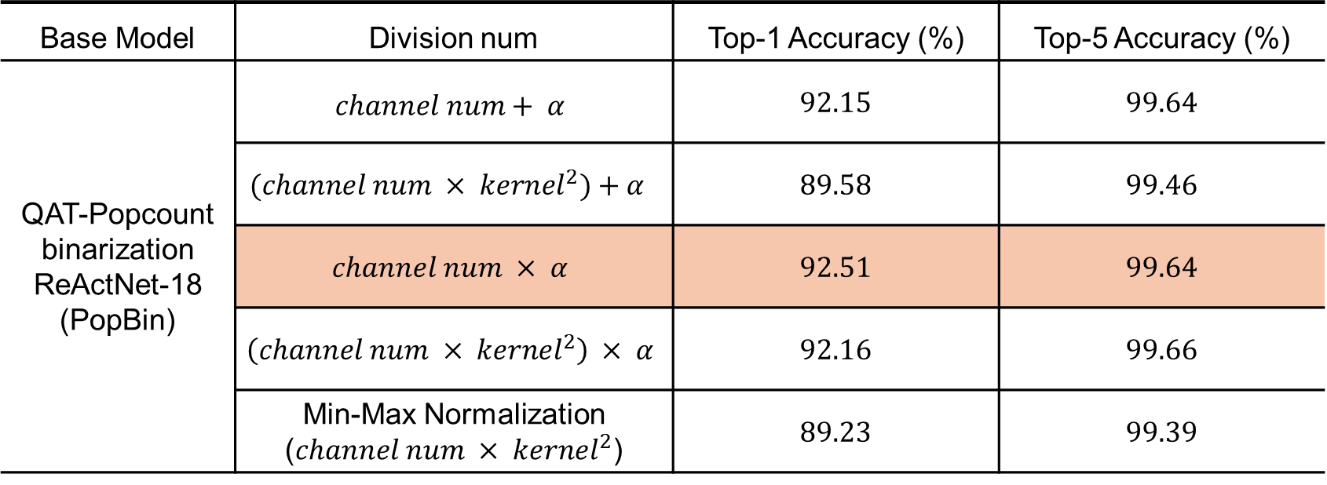
Experiments
- Optimization of Popcount Results about QAT-Popcount Binarization depending on Division Num
Base Model | Division num | Top-1 Accuracy (%) | Top-5 Accuracy (%)
QAT-Popcount binarization ReActNet-18 (PopBin) | $$channel num+ α$$ | 92.15 | 99.64
 | $$(channel num × {kernel}^{2})+α$$ | 89.58 | 99.46
 | $$channel num × α$$ | 92.51 | 99.64
 | $$\left(channel num × {kernel}^{2}\right) × α$$ | 92.16 | 99.66
 | Min-Max Normalization ($channel num × {kernel}^{2}$) | 89.23 | 99.39

Slide 18
Experiments
- Optimization of Popcount Results about QAT-Popcount Binarization
Models | Top-1 Accuracy (%) | Top-5 Accuracy (%)
ReActNet-18 | 92.31 | 99.80
Simple QAT-Popcount binarization ResNet-18 | 84.93 | 99.25
QAT-Popcount binarization ReActNet-18 (PopBin) | 92.51 | 99.64
Bi-Real-18 | 89.12 | 98.25
Simple QAT-Popcount binarization Bi-Real-18 | 30.07 | 79.69
QAT-Popcount binarization Bi-Real-18 (PopBin) | 89.34 | 98.38

Slide 19
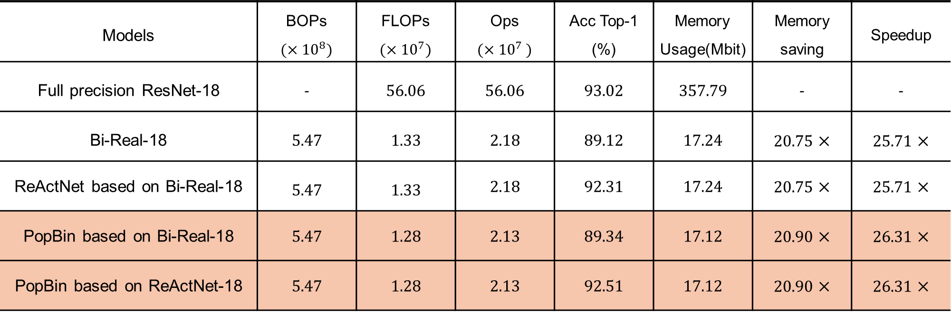
Experiments
- Latency Efficiency Analysis
Dataset : CIFAR-10
Models | BOPs $(×{10}^{8})$ | FLOPs $(×{10}^{7})$ | Ops $(×{10}^{7 })$ | Acc Top-1 (%) | Memory Usage(Mbit) | Memory saving | Speedup
Full precision ResNet-18 | - | 56.06 | 56.06 | 93.02 | 357.79 | - | -
Bi-Real-18 | 5.47 | 1.33 | 2.18 | 89.12 | 17.24 | 20.75 $×$ | 25.71 $×$
ReActNet based on Bi-Real-18 | 5.47 | 1.33 | 2.18 | 92.31 | 17.24 | 20.75 $×$ | 25.71 $×$
PopBin based on Bi-Real-18 | 5.47 | 1.28 | 2.13 | 89.34 | 17.12 | 20.90 $×$ | 26.31 $×$
PopBin based on ReActNet-18 | 5.47 | 1.28 | 2.13 | 92.51 | 17.12 | 20.90 $×$ | 26.31 $×$

Slide 20
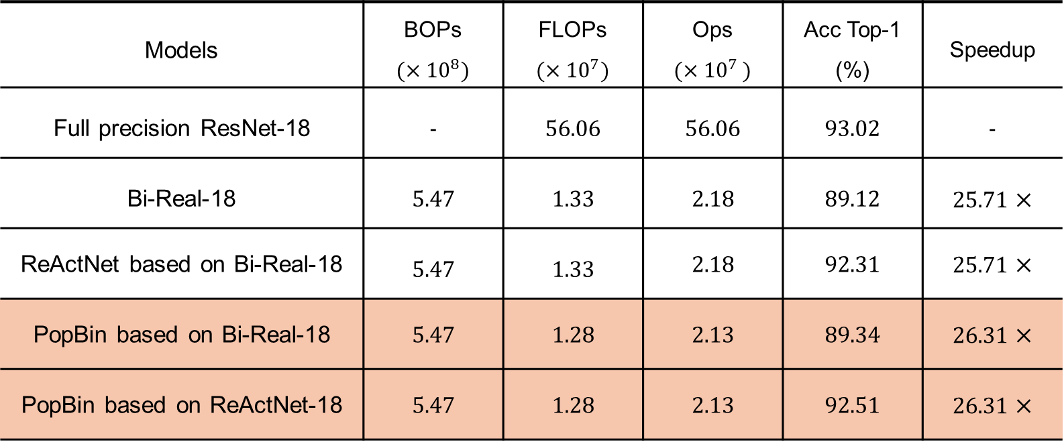
Experiments
- Efficiency Analysis
Dataset : CIFAR-10
Models | BOPs $(×{10}^{8})$ | FLOPs $(×{10}^{7})$ | Ops $(×{10}^{7 })$ | Acc Top-1 (%) | Speedup
Full precision ResNet-18 | - | 56.06 | 56.06 | 93.02 | -
Bi-Real-18 | 5.47 | 1.33 | 2.18 | 89.12 | 25.71 $×$
ReActNet based on Bi-Real-18 | 5.47 | 1.33 | 2.18 | 92.31 | 25.71 $×$
PopBin based on Bi-Real-18 | 5.47 | 1.28 | 2.13 | 89.34 | 26.31 $×$
PopBin based on ReActNet-18 | 5.47 | 1.28 | 2.13 | 92.51 | 26.31 $×$

Slide 21
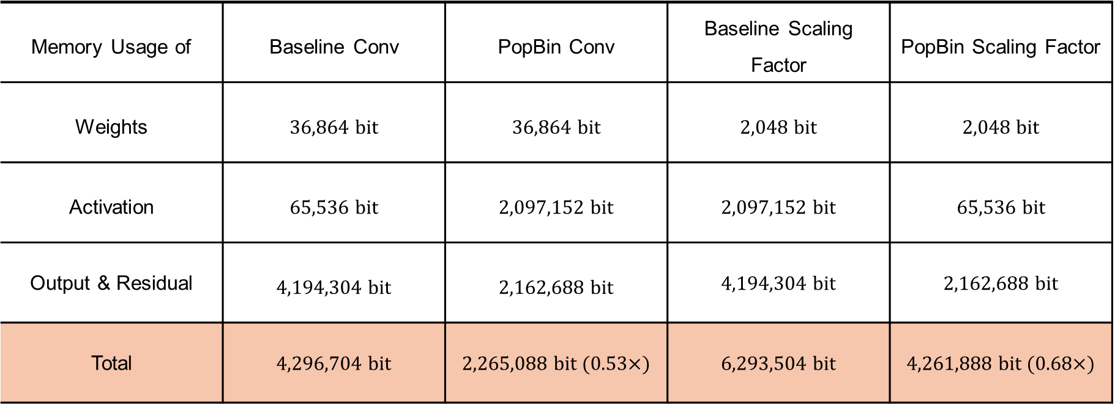
Experiments
- Memory Usage Analysis
Layer with 64 $×$ 32 $×$ 32
Dataset : CIFAR-10
Memory Usage of | Baseline Conv | PopBin Conv | Baseline Scaling Factor | PopBin Scaling Factor
Weights | 36,864 bit | 36,864 bit | 2,048 bit | 2,048 bit
Activation | 65,536 bit | 2,097,152 bit | 2,097,152 bit | 65,536 bit
Output & Residual | 4,194,304 bit | 2,162,688 bit | 4,194,304 bit | 2,162,688 bit
Total | 4,296,704 bit | 2,265,088 bit (0.53$×$) | 6,293,504 bit | 4,261,888 bit (0.68$×$)

Slide 22
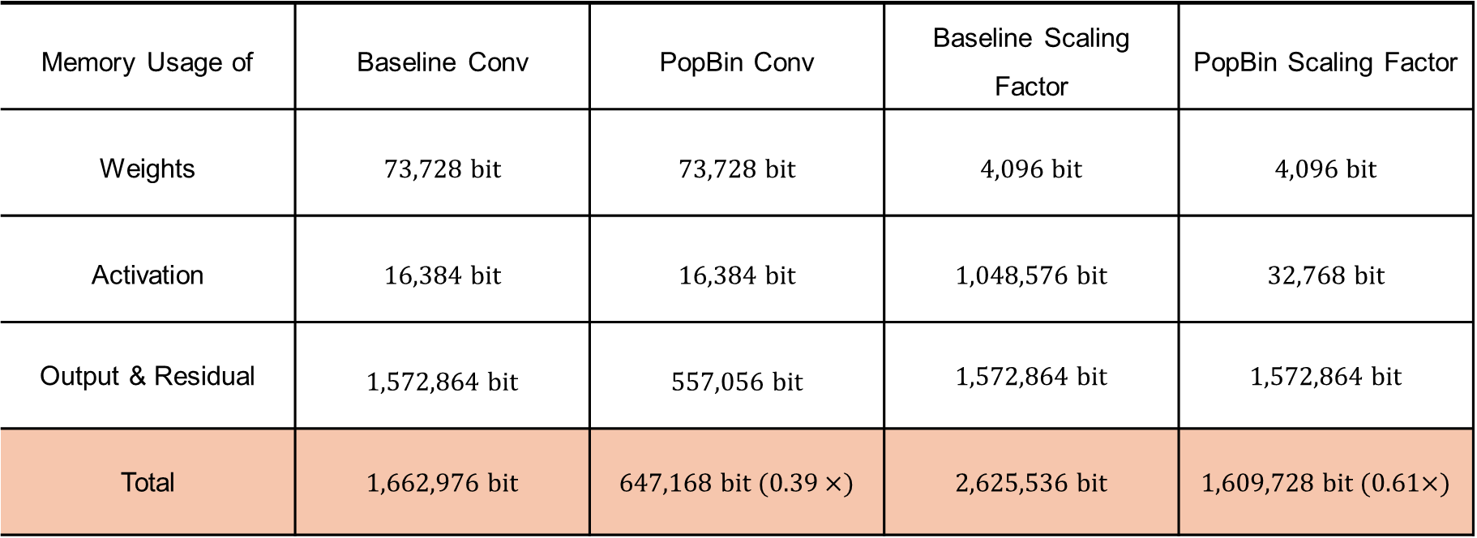
Experiments
- Memory Usage Analysis
First layer of group with 128 $×$ 16 $×$ 16
Dataset : CIFAR-10
Memory Usage of | Baseline Conv | PopBin Conv | Baseline Scaling Factor | PopBin Scaling Factor
Weights | 73,728 bit | 73,728 bit | 4,096 bit | 4,096 bit
Activation | 16,384 bit | 16,384 bit | 1,048,576 bit | 32,768 bit
Output & Residual | 1,572,864 bit | 557,056 bit | 1,572,864 bit | 1,572,864 bit
Total | 1,662,976 bit | 647,168 bit (0.39$×$) | 2,625,536 bit | 1,609,728 bit (0.61$×$)

Slide 23
Discussion
Potential for Majority Voter Design
- Exploring the potential for hardware optimization using Majority Voter design to enhance performance.
Hierarchical and Approximate Majority Voter Design
- Analyzing the contribution of hierarchical and approximate Majority Voter designs to improving hardware efficiency.

Slide 24
Thank you

Slide 25
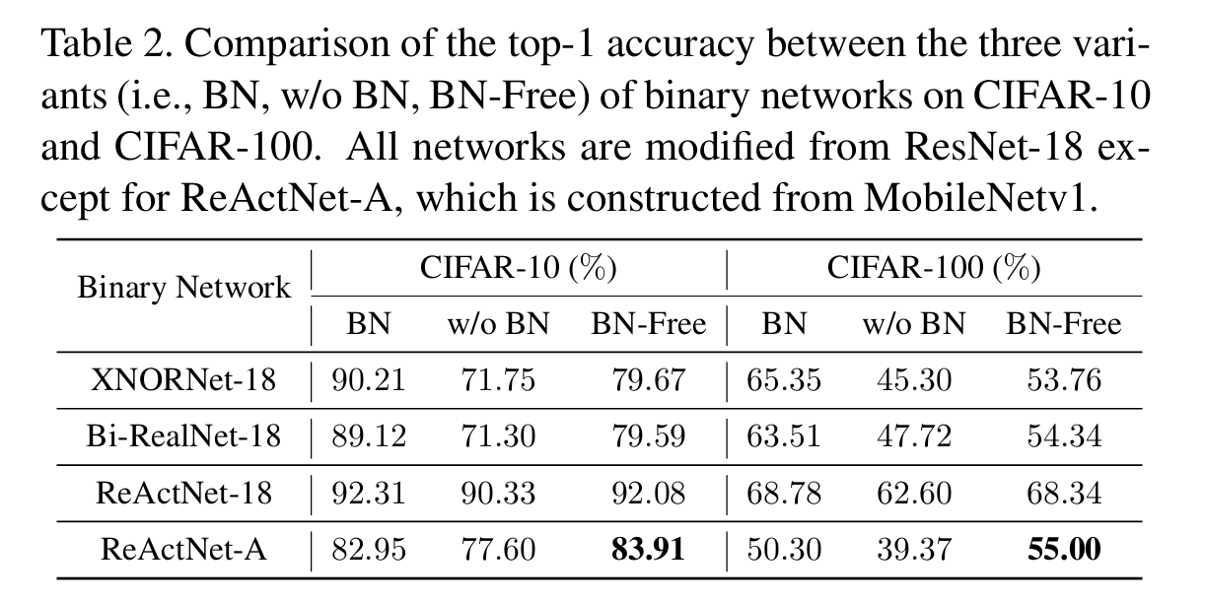
Appendix
Accuracy of Bi-RealNet-18 and ReActNet-18 on CIFAR-10
“BNN - BN = ?”: Training Binary Neural Networks without Batch Normalization (CPVR 2021)

Slide 26
Appendix
- Efficiency Analysis on layer with 64 × 32 × 32 (Baseline)
Binarization
1-bit Conv
Ci × k × k × Wo × Ho × Co = 37,748,736 (BOPs)
Ops = BOPs / 64 + FLOPs
= 720,896
Scaling Factor
Wo × Ho × Co = 65,536 (FLOPs)
Batch Norm
Wo × Ho × Co = 65,536 (FLOPs)
Add
0 (Ci and Co are equal)

Slide 27
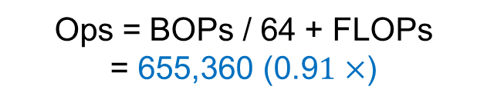
Appendix
- Efficiency Analysis on layer with 64 × 32 × 32 (PopBin)
Binarization
1-bit Conv
Ci × k × k × Wo × Ho × Co = 37,748,736 (BOPs)
Ops = BOPs / 64 + FLOPs
= 655,360 (0.9$1×$)
Scaling Factor
Wo × Ho × Co = 65,536 → 0
Batch Norm
Wo × Ho × Co = 65,536 (FLOPs)
Add
0 (Ci and Co are equal)

Slide 28
Appendix
- Memory Usage Analysis on layer with 64 × 32 × 32 (Baseline)
32-bit Activation (64*32*32)
2,097,152 bit
32-bit Features (64*32*32)
32-bit Activation (64*32*32)
4,194,304 bit
Binarization
32-bit Features (64*32*32)
32-bit Activation (64*32*32)
32-bit Zero points (64)
4,261,888 bit
1-bit Outputs (64*32*32)
32-bit Features (64*32*32)
1-bit Activation (64*32*32)
2,162,688 bit
1-bit Conv
1-bit Activation (64*32*32)
32-bit Features (64*32*32)
1-bit Weights (64*3*3*64)
4,296,704 bit
32-bit Output (64*32*32)
32-bit Features (64*32*32)
32-bit Activation (64*32*32)
24,194,304 bit
Scaling Factor
32-bit Activation (64*32*32)
32-bit Features (64*32*32)
32-bit Scaling Factor (64)
6,293,504 bit
32-bit Output (64*32*32)
32-bit Features (64*32*32)
32-bit Activation (64*32*32)
4,194,304 bit
Batch Norm
32-bit Activation (64*32*32)
32-bit Features (64*32*32)
32-bit Scale & Shift (64*2)
6,295,552 bit
32-bit Output (64*32*32)
32-bit Features (64*32*32)
32-bit Activation (64*32*32)
4,194,304 bit
Add
32-bit Features (64*32*32)
32-bit Activation (64*32*32)
6,291,456 bit
32-bit Output (64*32*32)
32-bit Activation (64*32*32)
2,097,152 bit

Slide 29



Appendix
- Memory Usage Analysis on layer with 64 × 32 × 32 (PopBin)
32-bit Activation (64*32*32)
2,097,152 bit
32-bit Features (64*32*32)
32-bit Activation (64*32*32)
4,194,304 bit
Binarization
32-bit Features (64*32*32)
32-bit Activation (64*32*32)
32-bit Zero points (64)
4,261,888 bit
1-bit Outputs (64*32*32)
32-bit Features (64*32*32)
1-bit Activation (64*32*32)
2,162,688 bit
1-bit Conv
1-bit Activation (64*32*32)
32-bit Features (64*32*32)
1-bit Weights (64*3*3*64)
2,265,088 bit
(0.53 $×$)
1-bit Output (64*32*32)
32-bit Features (64*32*32)
1-bit Activation (64*32*32)
2,162,688 bit (0.52 $×$)
Scaling Factor
1-bit Activation (64*32*32)
4,261,888 bit
(0.68 $×$)
32-bit Features (64*32*32)
32-bit Scaling Factor (64)
32-bit Output (64*32*32)
32-bit Features (64*32*32)
32-bit Activation (64*32*32)
4,194,304 bit
Batch Norm
32-bit Activation (64*32*32)
32-bit Features (64*32*32)
32-bit Scale & Shift (64*2)
6,295,552 bit
32-bit Output (64*32*32)
32-bit Features (64*32*32)
32-bit Activation (64*32*32)
4,194,304 bit
Add
32-bit Features (64*32*32)
32-bit Activation (64*32*32)
6,291,456 bit
32-bit Output (64*32*32)
32-bit Activation (64*32*32)
2,097,152 bit

