Slide 1
2024/10/22
Lightweight DNN with Majority Voter
Hyungdong Park, Inguk Yeo
Department of Computer Engineering

Slide 2
Contents
Motivation
Extreme Quantization: Binary Neural Networks (BNNs)
Approximate Majority Voter
Progress
Adapting Majority Voter to the 3 x 3 Depthwise Conv
Adapting Majority Voter to the ReActNet with Depthwise Conv
Subsequent Plans

Slide 3
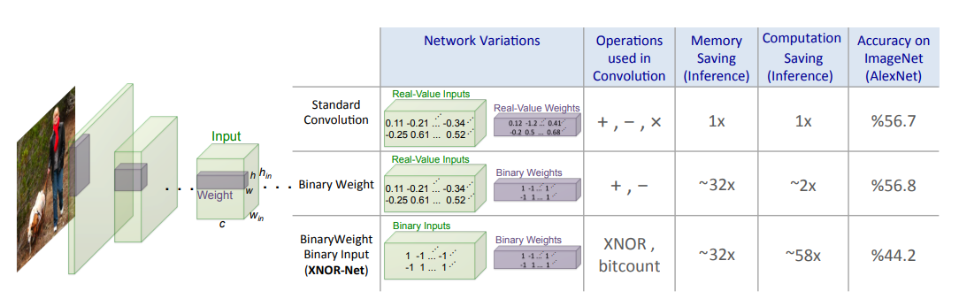
Motivation
- Extreme Quantization: Binary Neural Networks (BNNs)
XNOR-Net
- The method of binarization
XNOR-Net: ImageNet Classification Using Binary Convolutional Neural Networks

Slide 4
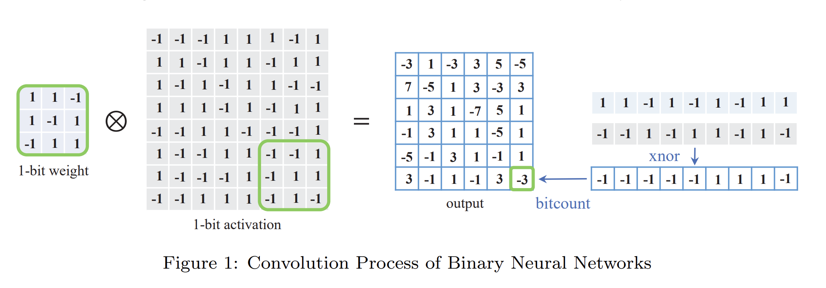
Motivation
- Extreme Quantization: Binary Neural Networks (BNNs)
Conv
Batch norm
Activation
XNOR-Net: ImageNet Classification Using Binary Convolutional Neural Networks

Slide 5
Motivation
- Extreme Quantization: Binary Neural Networks (BNNs)
Conv
Batch norm
Activation
Majority Voter
XNOR-Net: ImageNet Classification Using Binary Convolutional Neural Networks

Slide 6
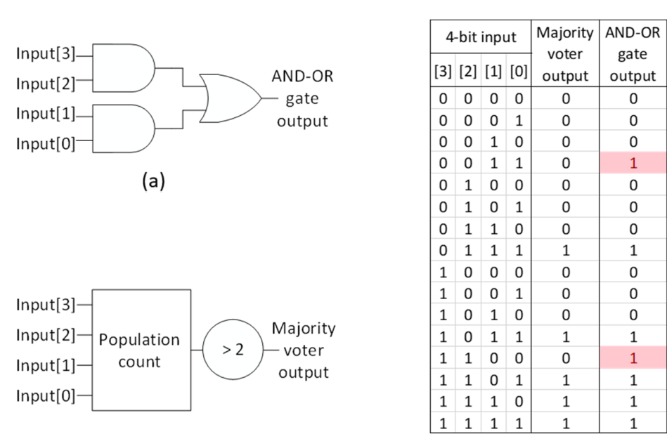
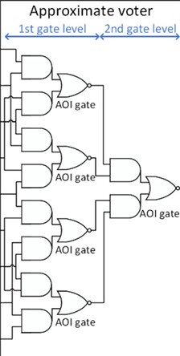
Motivation
- Approximate Majority Voter
4-bit voter
9-bit voter
In case of the 4-bit input, the results are the same as the majority voter except for two cases.
AND-OR is much faster than popcount.

Slide 7
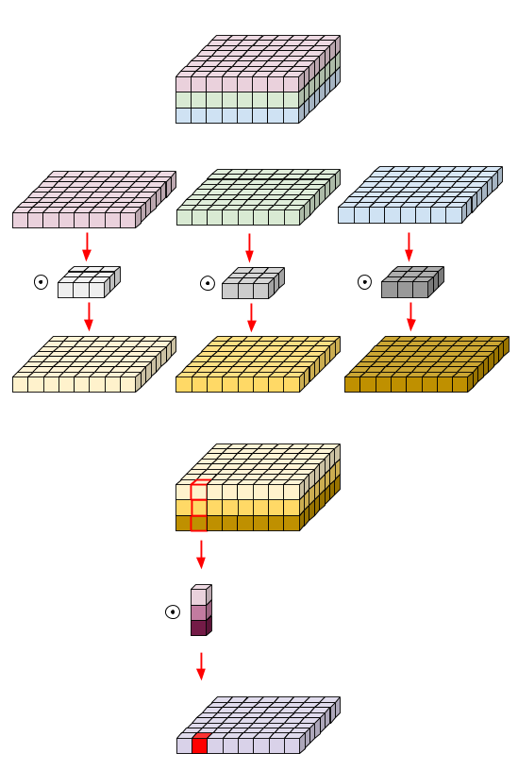
Progress
- Adapting Majority Voter to the 3 x 3 Depthwise Conv
Replacing Bitcount with Majority Voter
Adapting Majority Voter to the 3 x 3 Depthwise Conv
Given the feasibility of constructing an approximate majority voter with 9-bit input, we prioritize the application of the majority voter to a 3 x 3 depthwise conv.
Depthwise Conv

Slide 8
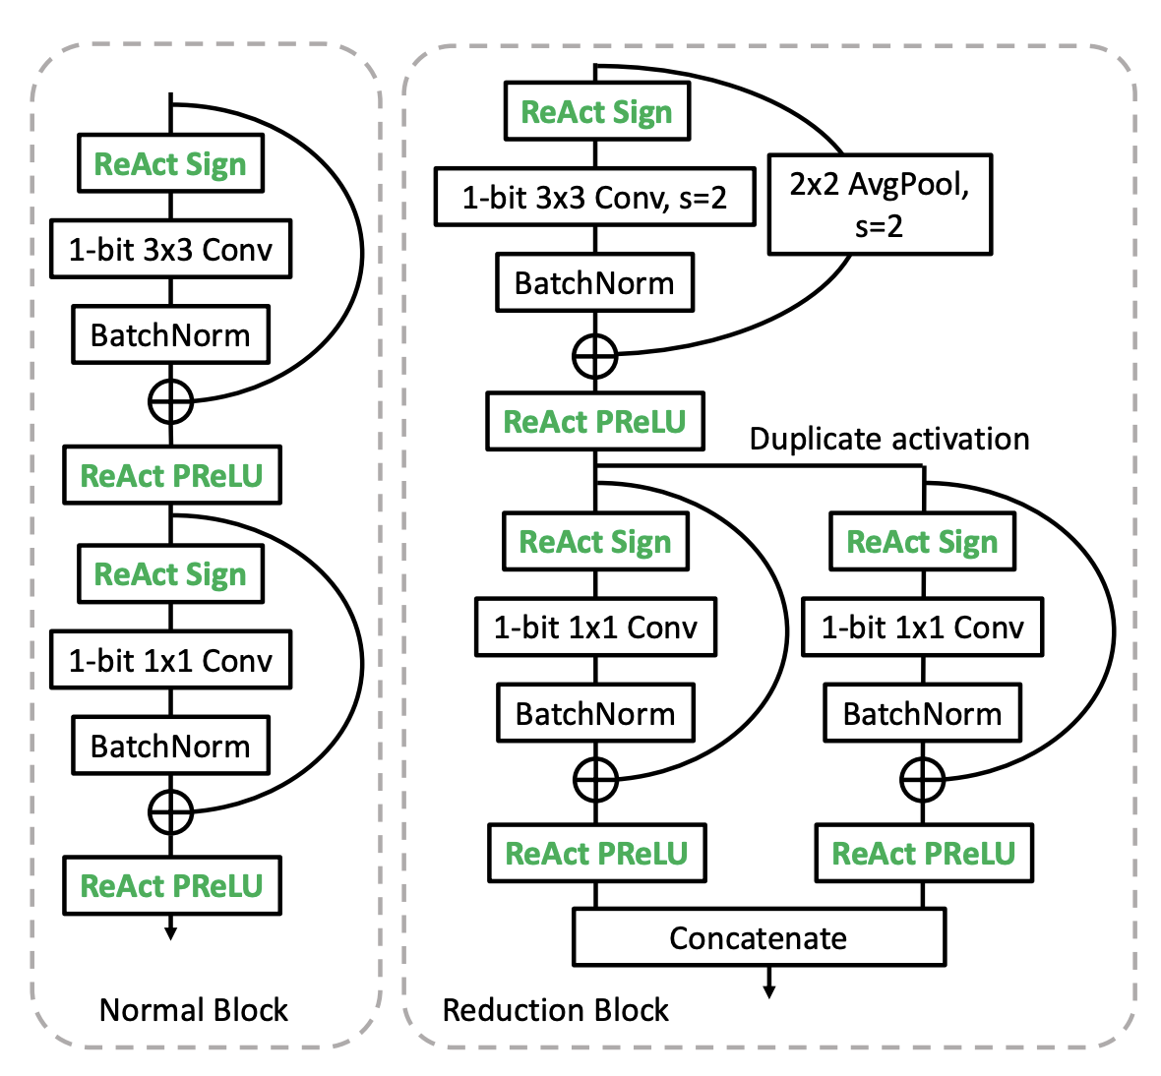
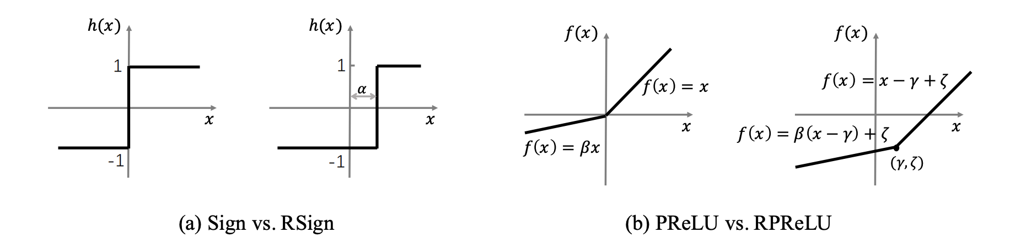
Progress
- Adapting Majority Voter to the ReActNet with Depthwise Conv
ReActNet
A network that modifies existing activation functions to find a more suitable distribution of activation functions within the neural network.
Why we adapt Majority Voter to ReActNet
It is one of the most recently developed Binary Neural Networks (BNNs).
It is easy to modify the structure.
ReActNet: Towards Precise Binary Neural Network with Generalized Activation Functions

Slide 9
Subsequent Plans
Constructing a neural network incorporating a majority voter to ReActNet based ResNet-18.
Applying the approximate majority voter to the neural network.
Applying the network to the real hardware (FPGA).

Slide 10
Thank you

Slide 11
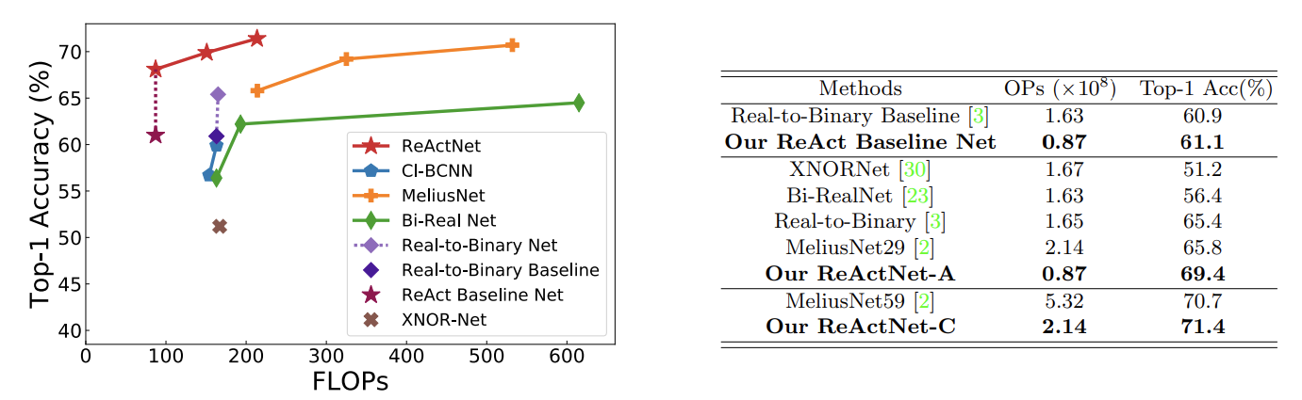
Appendix
-ReActNet
ReActNet: Towards Precise Binary Neural Network with Generalized Activation Functions

