Slide 1
2024/10/29
Lightweight DNN with Majority Voter
Hyungdong Park, Inguk Yeo
Department of Computer Engineering

Slide 2
Contents
Progress
Results of adapting majority voter to the ReActNet based on MobileNet-V1 & ResNet-18
Analysis of experimental results
Subsequent Plans

Slide 3
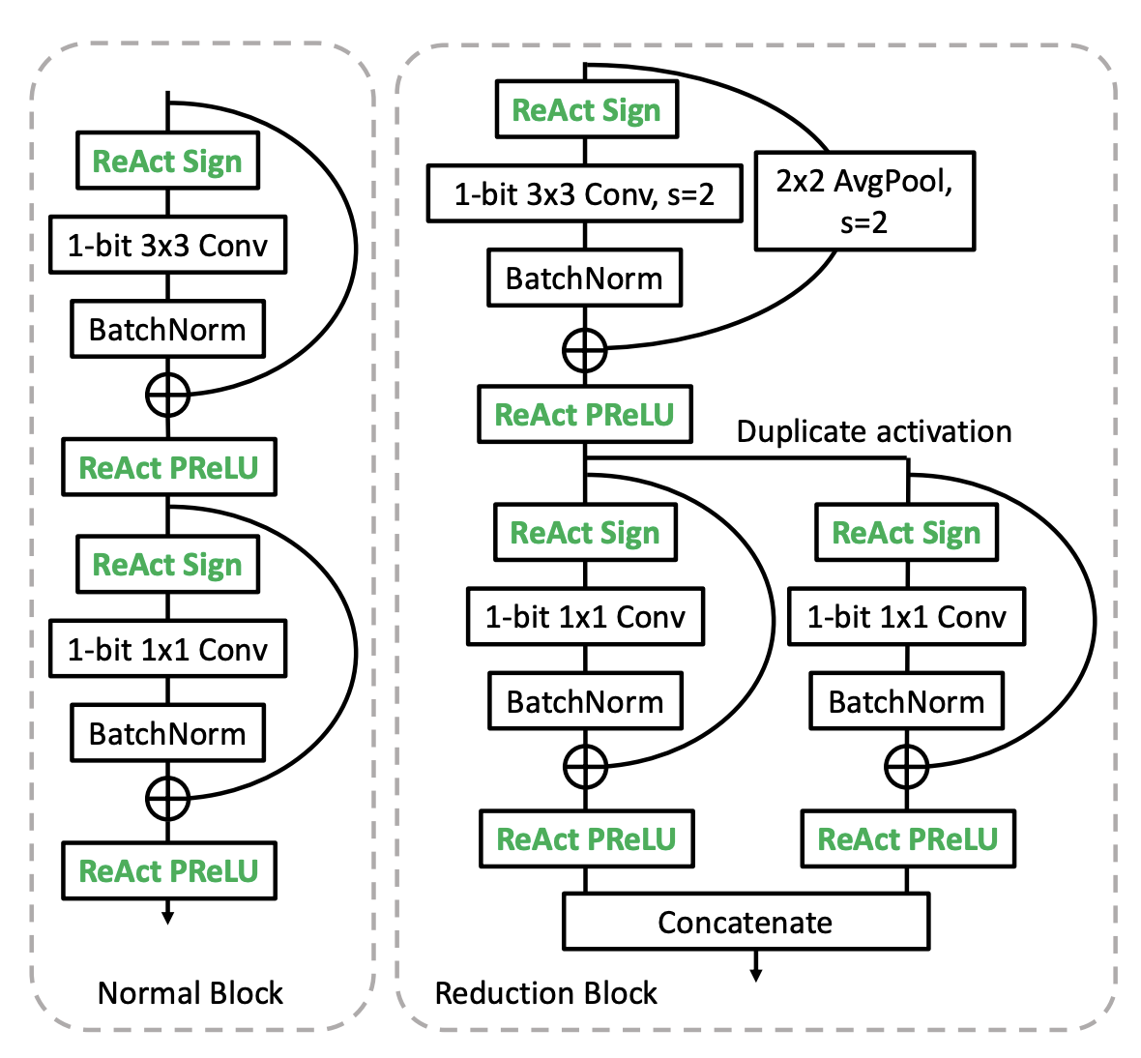
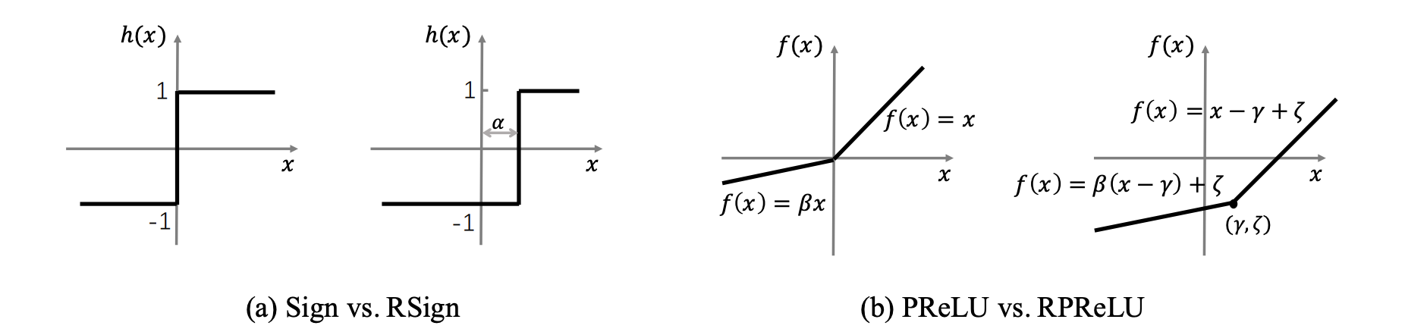
Progress
- Results of adapting Majority Voter to the ReActNet based on MobileNet-V1 & ResNet-18
ReActNet
A network that modifies existing activation functions to find a more suitable distribution of activation functions within the neural network.
ReActNet: Towards Precise Binary Neural Network with Generalized Activation Functions

Slide 4
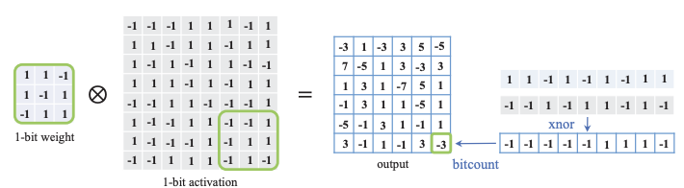
Progress
- Results of adapting Majority Voter to the ReActNet based on MobileNet-V1 & ResNet-18
Batch norm
Majority Voter
Step1) Standard conv → Depthwise conv.
Step2) Implement majority voter by torch.where() function
Step3) Remove Batch Norm
Top-1 Acc: about 10% on ReActNet based on MobileNet-V1 with majority voter
Top-1 Acc: about 35~40% on ReActNet based on ResNet-18 with majority voter
ReActNet: Towards Precise Binary Neural Network with Generalized Activation Functions

Slide 5
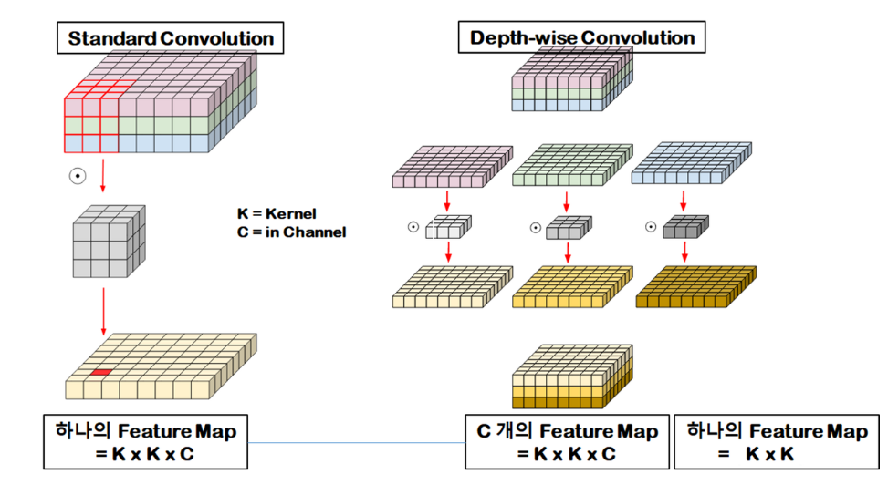
Progress
-Analysis of experimental results
Assumption of the accuracy decline issue : Reduction in the number of weight parameters
Suppose we want [in channel, out channel, kernel size, kernel size]
in a layer somewhere
in channel: 10
out channel: 10
both of the Kernels’ size: 3
In standard conv, the num of weights is 10 x 10 x 3 x 3
In depthwise conv, the num of weights is 10 x 1 x 3 x 3

Slide 6
Subsequent Plans
- Find other models that have depthwise conv and apply majority voter.
- Apply majority voter to standard convolution for ReActNet based on ResNet-18.

Slide 7
Thank you

Slide 8
Appendix
- Binarized MobileNet
- Binarizing MobileNet via Evolution-based Searching (CVPR, 2020)
- MoBiNet: A Mobile Binary Network for Image Classification (WACV, 2020)
ReActNet: Towards Precise Binary Neural Network with Generalized Activation Functions

Slide 9


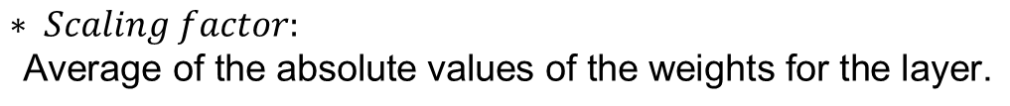


Appendix
-Analysis of experimental results
Assumption of the accuracy decline issue: Rearranging the structure from origin
Binarized
inputs
Binarized
inputs
Binarized
weights
Binarized
weights
$$⊛$$
$$× Scaling factor$$
$$⊛$$
$$× Scaling factor$$
$$∗ Scaling factor\text{:}$$
$$\text{Average} \text{of} \text{the} \text{absolute} \text{values} \text{of} \text{the} \text{weights} \text{for} \text{the} \text{layer}\text{.}$$

Slide 10
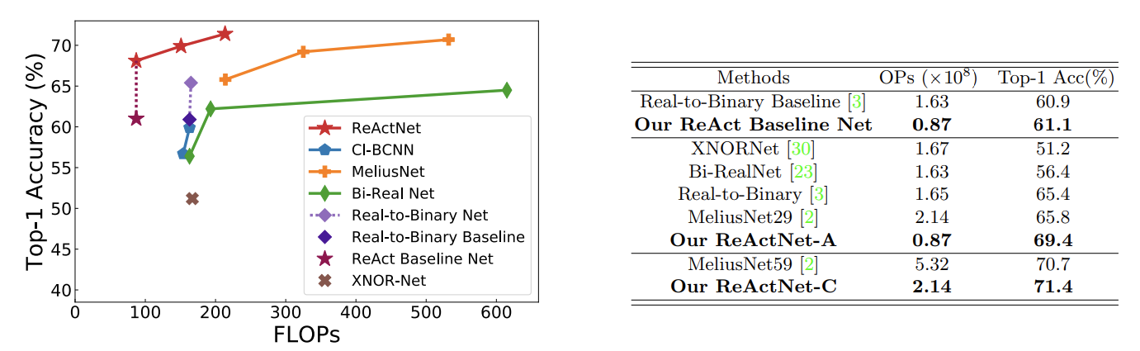
Appendix
-ReActNet
ReActNet: Towards Precise Binary Neural Network with Generalized Activation Functions

