Slide 1
2024/11/05
Lightweight DNN with Majority Voter
Hyungdong Park, Inguk Yeo
Department of Computer Engineering

Slide 2






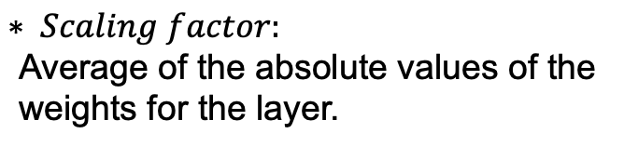
Progress
- HardBinaryConv in ReActNet
Real
inputs
Binarized
inputs
<initial values>
- Real_weights_range : [0, 0.001]
- Binarized_inputs : [-1 or 1]
- Binarized_weights : [-1 or 1]
- Channel_range : [0,512]
$$sign$$
Real
weights
Binarized
weights
Binarized
inputs
$$sign$$
Binarized
weights
$$⊛$$
$$× Scaling factor$$
Real
weights
$$mean$$
$$Scaling factor$$
$$∗ Scaling factor\text{:}$$
$$\text{Average} \text{of} \text{the} \text{absolute} \text{values} \text{of} \text{the} \text{weight}\text{s} \text{for} \text{the} \text{layer}\text{.}$$

Slide 3



Progress
- Basic Block
[-1 + $α$ , 1 + $α$ ]
Binarizing
Activation
Batch norm
Activation
func (RPReLU)
Real
inputs
Binarized
inputs
Binarized
weights
$$⊛$$
$$× Scaling factor$$
[-1 or 1]
[-1 , 1]
[-1 , 1]

Slide 4



Progress
- Our Basic Block
Binarizing
Activation
Majority
Voter
Batch norm
Activation
func (RPReLU)
Real
inputs
Binarized
inputs
Binarized
weights
$$Xnor$$
&
popcount
$$× Scaling factor$$
[-1 or 1]
[-4608 , 4068] after standard conv
[-1 or 1]
[-1 , 1]
[-1 + $α$ , 1 + $α$ ]

Slide 5
Thank you

Slide 6
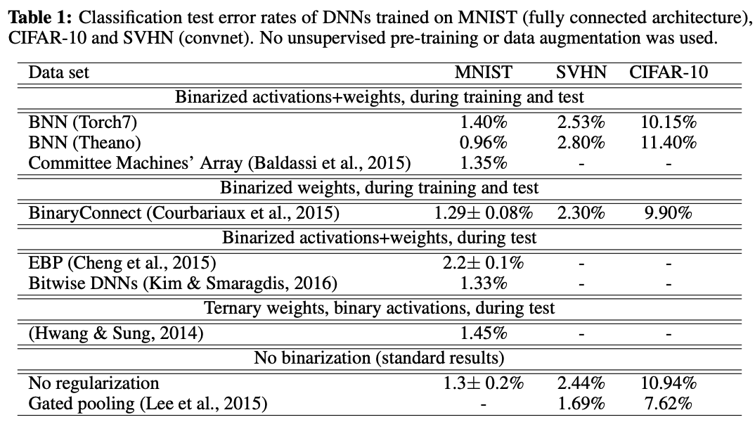
Appendix
- Binarized Neural Networks
Binarized Neural Networks (Advances in neural information processing systems, 2016)

Slide 7
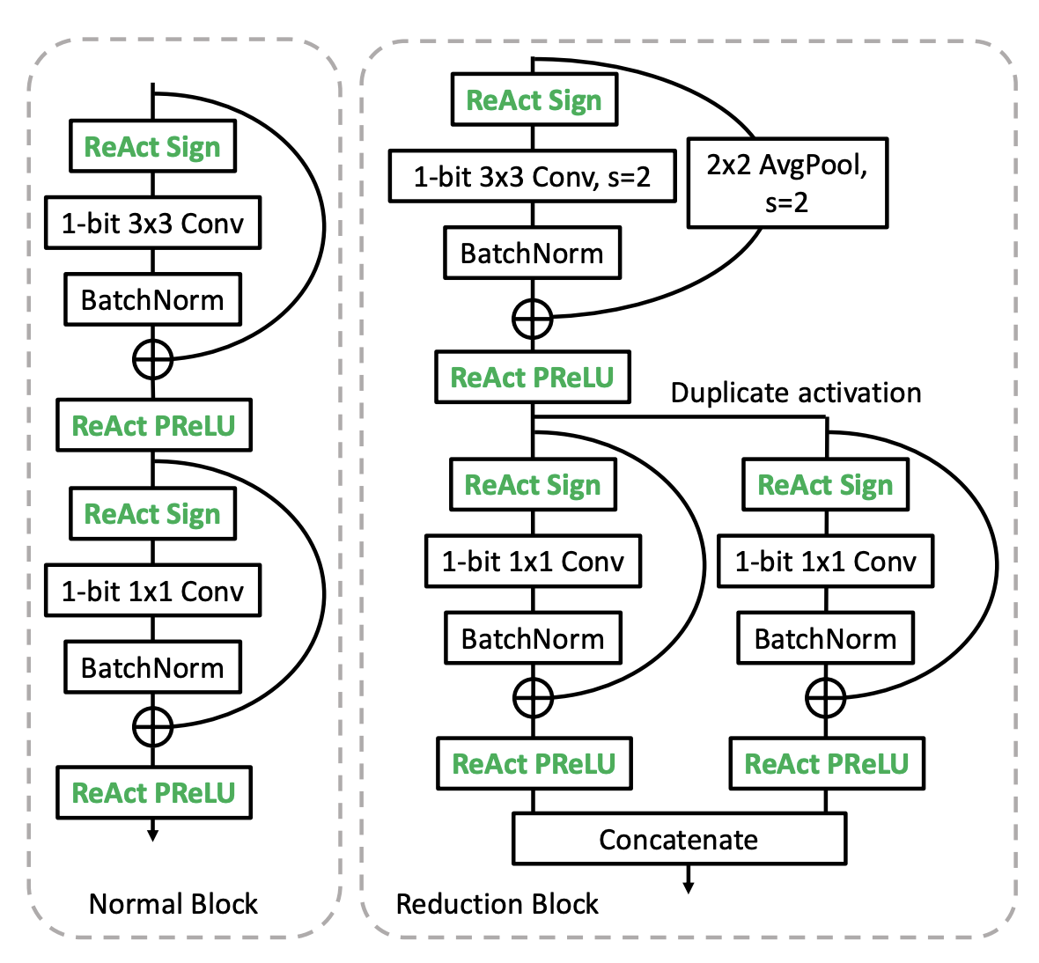
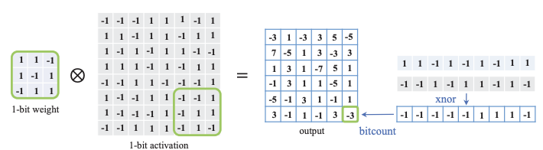
Progress
- Results of Adapting Majority Voter to the ReActNet based on ResNet-18
Batch norm
Majority Voter
Step1) Standard conv → Depthwise conv.
Step2) Implement majority voter by torch.where() function
Step3) Remove Batch Norm
Top-1 Acc: about 61% (when epoch is 74) on ReActNet based on ResNet-18 with majority voter
ReActNet: Towards Precise Binary Neural Network with Generalized Activation Functions

