Slide 1
2024/11/07
Lightweight DNN with Majority Voter
Hyungdong Park, Inguk Yeo
Department of Computer Engineering

Slide 2






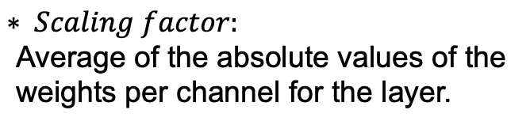
Progress
- HardBinaryConv in ReActNet
Real
inputs
Binarized
inputs
<initial values>
- Intial Real_weights_range : [0, 0.001]
- Binarized_inputs : [-1 or 1]
- Binarized_weights : [-1 or 1]
- Channel_range : [0,512]
$$sign$$
Real
weights
Binarized
weights
Binarized
inputs
$$sign$$
Binarized
weights
$$⊛$$
$$× Scaling factor$$
Real
weights
$$mean$$
$$Scaling factor$$
$$∗ Scaling factor\text{:}$$
$$\text{Average} \text{of} \text{the} \text{absolute} \text{values} \text{of} \text{the} \text{weight}\text{s} \text{per} \text{channel} \text{for} \text{the} \text{layer}\text{.}$$

Slide 3



Progress
- ReActNet block (ResNet18 + binarized) / Top-1 Accuracy : 65.9%
[-1 + $α$ , 1 + $α$ ]
Binarizing
Activation
Batch norm
Activation
func (RPReLU)
Real
inputs
Binarized
inputs
Binarized
weights
$$⊛$$
$$× Scaling factor$$
[-1 or 1]
[-1 , 1]
[-1 , 1]

Slide 4
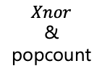

Progress
- Our block in training / Top-1 Accuracy : 59.62%
[-1 + $α$ , 1 + $β$ ]
Binarizing
Activation
Batch norm
Activation
func (RPReLU)
Real
inputs
Binarized
inputs
Binarized
Weights
$$Xnor$$
&
popcount
$$× Scaling factor$$
[-1 or 1]
[-1 , 1]
[-1 , 1]

Slide 5



Progress
- Our block in testing / Top-1 Accuracy : 62.648%
Binarizing
Activation
Majority
Voter
Batch norm
Activation
func (RPReLU)
Real
inputs
Binarized
inputs
Binarized
Weights
$$Xnor$$
&
popcount
$$× Scaling factor$$
[-1 or 1]
[-4608 , 4068] after standard conv
[-1 or 1]
[-1 , 1]
[-1 + $α$ , 1 + $β$ ]

Slide 6
Thank you

