Slide 1
2024/11/12
Lightweight DNN with Majority Voter
Hyungdong Park, Inguk Yeo
Department of Computer Engineering

Slide 2


Progress
- ReActNet block (ResNet18 + binarized) / Top-1 Accuracy : 65.9%
Binarizing
activation
Batch norm
Activation
func (RPReLU)
Real activation
Binarized
activation
Binarized
weights
$$⊛$$
$$× Scaling factor$$
{-1 or 1}
[-1 , 1]
{A certain range}
{A certain range}

Slide 3
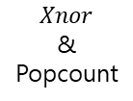
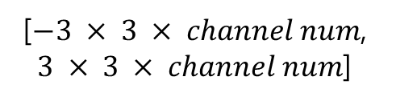

Progress
- Our block in training (retrain) / Top-1 Accuracy : 61.43%
Binarizing
activation
Batch norm
Activation
func (RPReLU)
Real activation
Binarized
activation
Binarized
weights
$$Xnor$$
&
Popcount
$$× Scaling factor$$
[$−3 × 3 × channel num$, $3 × 3 × channel num$]
{-1 or 1}
{A certain range}
{A certain range}
{A certain range}

Slide 4
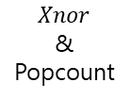


Progress
- Our block in inference / Top-1 Accuracy : 64.394%
Binarizing
activation
Majority
voter
Batch norm
Activation
func (RPReLU)
Real
activation
Binarized
activation
Binarized
weights
$$Xnor$$
&
Popcount
$$× Scaling factor$$
{-1 or 1}
[$−3 × 3 × channel num$, $3 × 3 × channel num$]
{-1 or 1}
{A certain range}
{A certain range}
{A certain range}

Slide 5
Thank you

Slide 6






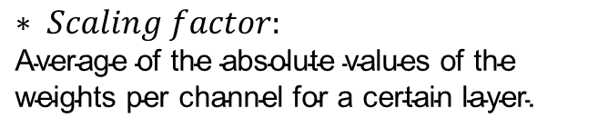
Appendix
- HardBinaryConv in ReActNet Block
Real
activation
Binarized
activation
<initial values>
- Initial_real_weights_range : [0, 0.001]
- Binarized_inputs : [-1 or 1]
- Binarized_weights : [-1 or 1]
- Channel_range : [0,512]
$$sign$$
Real
weights
Binarized
weights
Binarized
activation
$$sign$$
Binarized
weights
$$⊛$$
$$× Scaling factor$$
Real
weights
$$mean$$
$$Scaling factor$$
$$∗ Scaling factor\text{:}$$
$$\text{Average} \text{of} \text{the} \text{absolute} \text{values} \text{of} \text{the} \text{weight}\text{s} \text{per} \text{channel} \text{for} \text{a} \text{certain} \text{layer}\text{.}$$

