Slide 1
2024/11/19
Lightweight DNN with Majority Voter
Hyungdong Park, Inguk Yeo
Department of Computer Engineering

Slide 2
Convolutional Layer of BNN
Example) c_{i} = c_{out} = 64 / w = h = 64 / k = 3
 | # units | # inputs per unit | Output type
XNOR | (c_{i} x k x k) x (c_{out} x h_{o} x w_{o}) | 2 | Binary
Popcount | c_{out} x h_{o} x w_{o} | c_{i} x k x k | Integer

Slide 3


Progress
- ReActNet block (ResNet18 + binarized)
Binarizing
Activation
Batch norm
Activation
func (RPReLU)
Real
inputs
Binarized
inputs
Binarized
weights
$$⊛$$
$$× Scaling factor$$
{-1 or 1}
[-1 , 1]
{A certain range}
{A certain range}

Slide 4
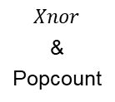


Progress
- Our block (ReActNet block + Majority voter)
Binarizing
Activation
Majority
Voter
Batch norm
Activation
func (RPReLU)
Real
inputs
Binarized
inputs
Binarized
Weights
$$Xnor$$
&
Popcount
$$× Scaling factor$$
{-1 or 1}
[$−3 × 3 × channel num$, $3 × 3 × channel num$]
{-1 or 1}
[-1 , 1]
{A certain range}
{A certain range}

Slide 5
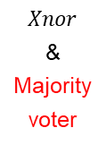

Progress
- Final our block
Binarizing
Activation
Batch norm
Activation
func (RPReLU)
Real
inputs
Binarized
inputs
Binarized
Weights
$$Xnor$$
&
Majority
voter
$$× Scaling factor$$
{-1 or 1}
[-1 , 1]
{A certain range}
{A certain range}
{A certain range}

Slide 6
Subsequent Plans
- PyTorch Modeling
BNN based on XNOR and Popcount
- Implementing actual XNOR and Popcount operations within hardware(GPU) using PyTorch and CUDA
BNN based on XNOR and Majority Voter
- Apply majority voter to standard convolution.
BNN based on XNOR and Hierarchical Majority Voter
- Example) M512 ~= M4 (M128, M128, M128, M128)

Slide 7
Thank you

Slide 8
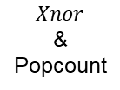
Progress
- BNN based XNOR and Popcount
Binarizing
Activation
Batch norm
Activation
func (RPReLU)
Real
inputs
Binarized
inputs
Binarized
Weights
$$Xnor$$
&
Popcount
$$× Scaling factor$$
{-1 or 1}
[-1 , 1]
{A certain range}
{A certain range}
{A certain range}

Slide 9






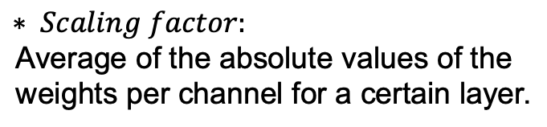
Progress
- HardBinaryConv in ReActNet Block
Real
inputs
Binarized
inputs
<initial values>
- Intial Real_weights_range : [0, 0.001]
- Binarized_inputs : [-1 or 1]
- Binarized_weights : [-1 or 1]
- Channel_range : [0,512]
$$sign$$
Real
weights
Binarized
weights
Binarized
inputs
$$sign$$
Binarized
weights
$$⊛$$
$$× Scaling factor$$
Real
weights
$$mean$$
$$Scaling factor$$
$$∗ Scaling factor\text{:}$$
$$\text{Average} \text{of} \text{the} \text{absolute} \text{values} \text{of} \text{the} \text{weight}\text{s} \text{per} \text{channel} \text{for} \text{a} \text{certain} \text{layer}\text{.}$$

