Slide 1
2024/11/26
Lightweight DNN with Majority Voter
Hyungdong Park, Inguk Yeo
Department of Computer Engineering

Slide 2

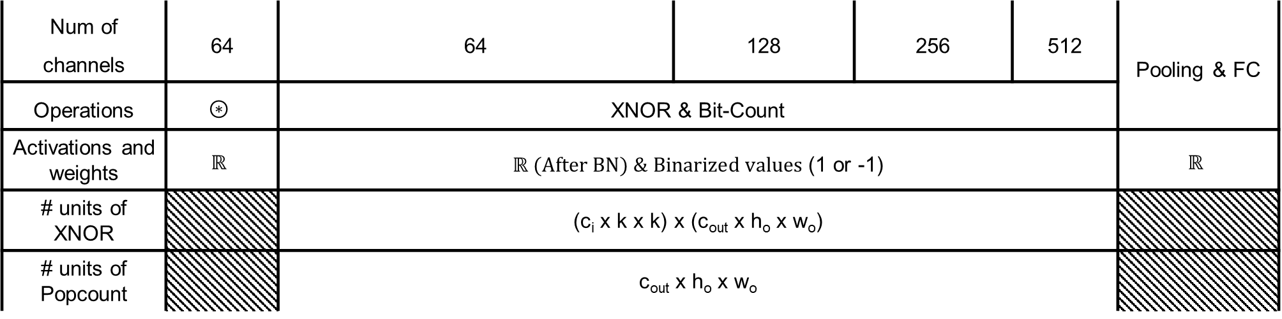



Overview per layer
Progress
- Overview of ReActNet-18 with CIFAR-10
$$⋯$$
$$⋰$$
$$⋰$$
$$⋰$$
$$⋰$$
$$⋯$$
Num of channels | 64 | 64 | 128 | 256 | 512 | Pooling & FC
Operations | $$⊛$$ | XNOR & Bit-Count
Activations and weights | $$ℝ$$ | $ℝ (After BN) \& Binarized values$(1 or -1) |  |  |  | $$ℝ$$
# units of XNOR |  | (c_{i} x k x k) x (c_{out} x h_{o} x w_{o})
# units of Popcount |  | c_{out} x h_{o} x w_{o}

Slide 3


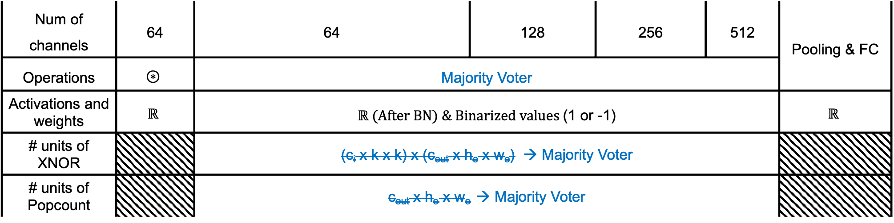

Progress
- Overview of ours with CIFAR-10
$$≤3 × 3 ×$$
$$num of$$
$$channels$$
$$1 or −1$$
Majority Voter
$$⋮$$
$$⋯$$
$$⋰$$
$$⋰$$
$$⋰$$
$$⋰$$
$$⋯$$
Num of channels | 64 | 64 | 128 | 256 | 512 | Pooling & FC
Operations | $$⊛$$ | Majority Voter
Activations and weights | $$ℝ$$ | $ℝ (After BN) \& Binarized values$(1 or -1) |  |  |  | $$ℝ$$
# units of XNOR |  | (c_{i} x k x k) x (c_{out} x h_{o} x w_{o}) → Majority Voter
# units of Popcount |  | c_{out} x h_{o} x w_{o} → Majority Voter

Slide 4
Progress
- Results with CIFAR-10
Models | Top-1 Accuracy (%) | Top-5 Accuracy (%)
ReActNet-18 | 93.380 | 99.800
ReActNet-18 with Majority Voter | 84.930 | 99.250
Bi-RealNet-18 | 88.770 | 98.250
Bi-RealNet-18 with Majority Voter | 30.070 | 79.690

Slide 5
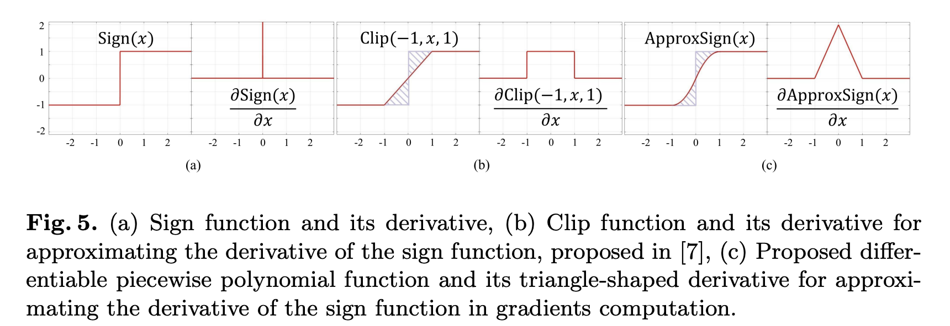
Progress
- Our strategy for retraining to increase accuracy…1
- A straightforward application of the Majority Voter results in a decline in accuracy. Therefore, to achieve our goal of enhancing inference speed, additional techniques must be incorporated.
- Our Majority Voter employs the same functionality as the Sign function used in ReActNet. Hence, we will leverage techniques such as the Straight-Through Estimator (STE) and ApproxSign()
Bi-Real Net: Enhancing the Performance of 1-bit CNNs With Improved Representational Capability and Advanced Training Algorithm

Slide 6
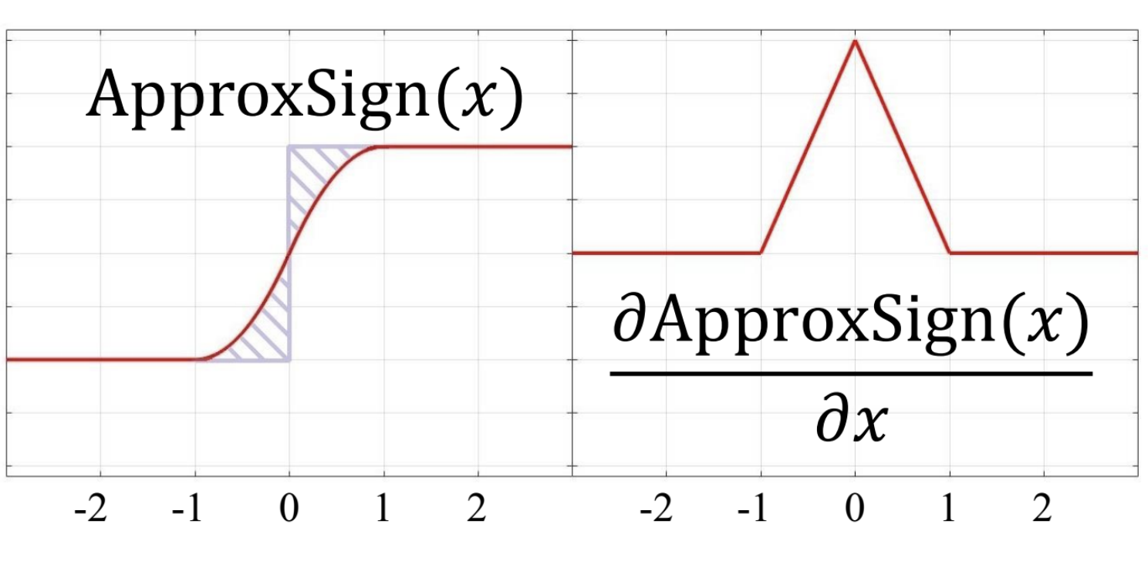
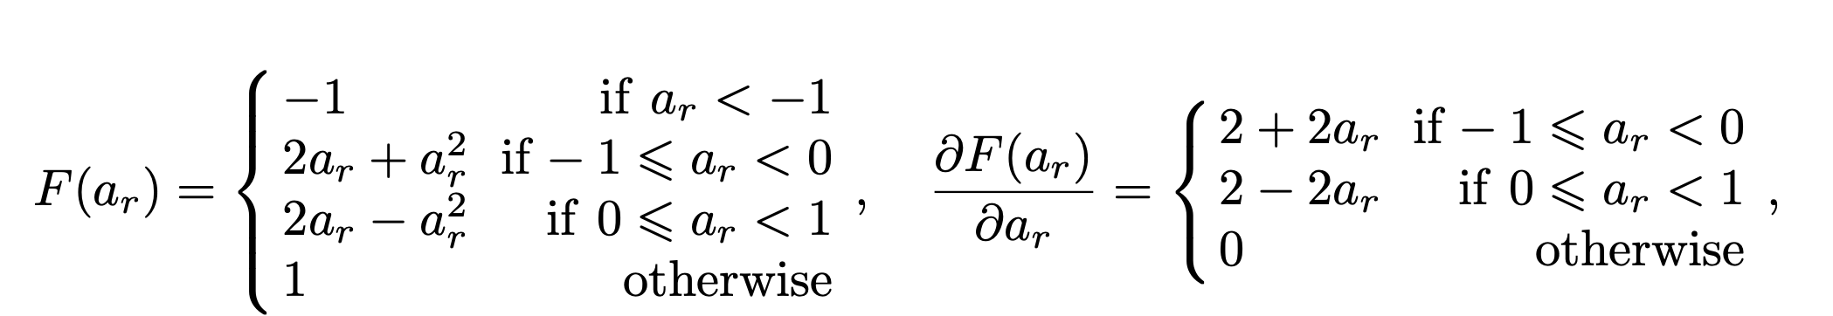



Progress
- Our strategy for retraining to increase accuracy…2
$$≤3 × 3 ×$$
$$num of$$
$$channels$$
$$1 or −1$$
Majority Voter
$$⋮$$
Foward
Backpropagation

Slide 7
Progress
- Results with CIFAR-10
Models | Top-1 Accuracy (%) | Top-5 Accuracy (%)
ReActNet-18 | 93.380 | 99.800
ReActNet-18 with Majority Voter | 84.930 | 99.250
Our RaActNet-18 | 92.090 | 99.610
Bi-RealNet-18 | 88.770 | 98.250
Bi-RealNet-18 with Majority Voter | 30.070 | 79.690
Our Bi-RealNet-18 | 87.660 | 98.720

Slide 8
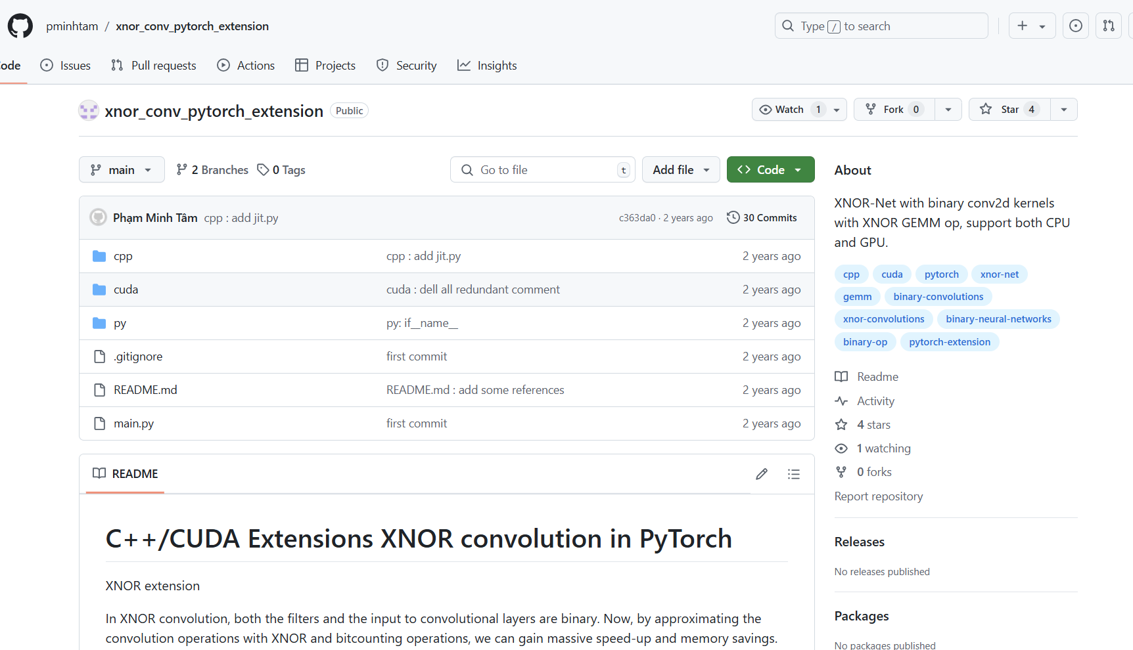
Update about plans
- PyTorch Modeling

Slide 9
Update about plans
- PyTorch Modeling
BNN based on XNOR and Popcount
- Implementing actual XNOR and Popcount operations within hardware (GPU) using PyTorch and CUDA
BNN based on XNOR and Majority Voter
- Apply majority voter to standard convolution.
BNN based on XNOR and Hierarchical Majority Voter
- Example) M512 ~= M4 (M128, M128, M128, M128)

Slide 10
Thank you

Slide 11
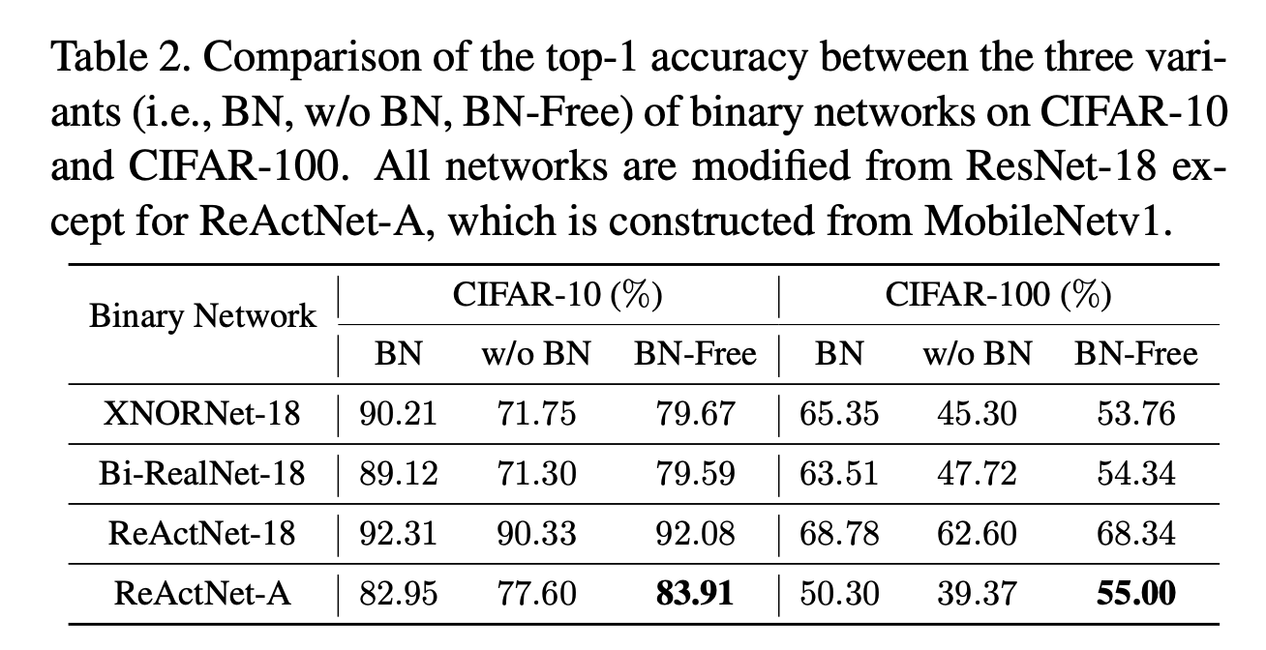
Progress
- Appendix
“BNN - BN = ?”: Training Binary Neural Networks without Batch Normalization

