Slide 1

2024년 7월 1일
XNOR-NET
B815133 이성현

Slide 2
목차
XNOR-NET 정의와 구조
LeNet-5 code 분석(XNOR-Net 적용)
XNOR-Net: ImageNet Classification Using Binary Convolutional Neural Networks). Mohammad Rastegari† , Vicente Ordonez† , Joseph Redmon∗ , Ali Farhadi†∗ Allen Institute for AI† , University of Washington∗ https://arxiv.org/abs/1603.05279

Slide 3
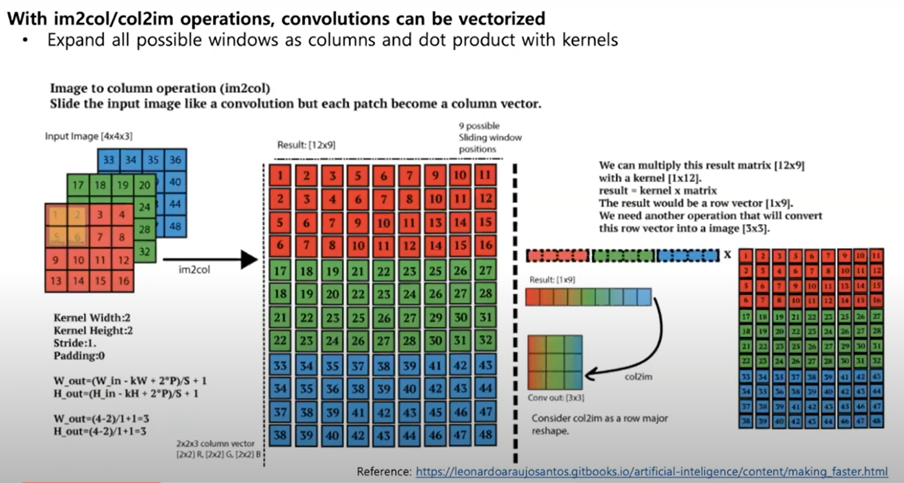
Convolution
하나의 window를 길게 펄쳐서(im2col)

Slide 4
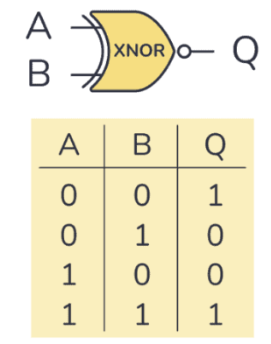
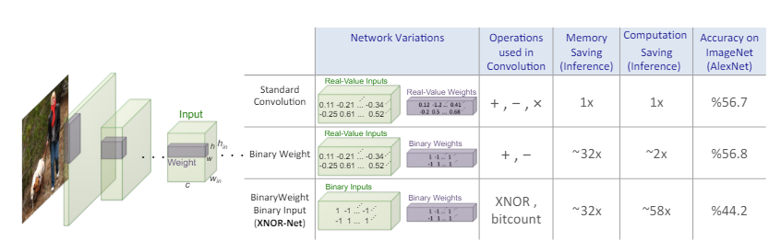
XNOR-Net이란?
CNN-based recognition systems need large amount of memory and computational power
Binarize the weights and the inputs values, so convolutions can be estimated by only addition and subtraction(without multiplication)
XNOR | -1 | 1
-1 | 1 | -1
1 | -1 | 1

Slide 5



Binary-Weight-Networks
W : the real-value weight filter, B: binary filter B ∈{+1,-1}c*w*h, α : scaling factor
A convolutional can be approximated by
indicates a convolution without any multiplications
Estimating binary weights
We can find optimal W and a(alpha) by minimizing
B=
( sign(Wi )는 0보다 크거나 같으면 Bi=1, 0보다 작으면 Bi=-1)
α=
(Weights 절대값의 총합/ weights의 수)

Slide 6

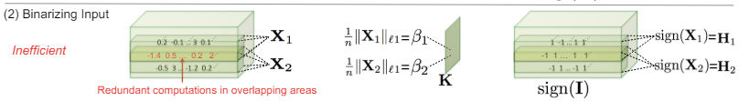
Binarize both weight and input
Approximation of X=βH and W=αB where H,B ∈{+1,-1}^n
We can find optimal α ,B, β and H by minimizing
(Approximation is done with the independency between Xi and the Wi)

Slide 7
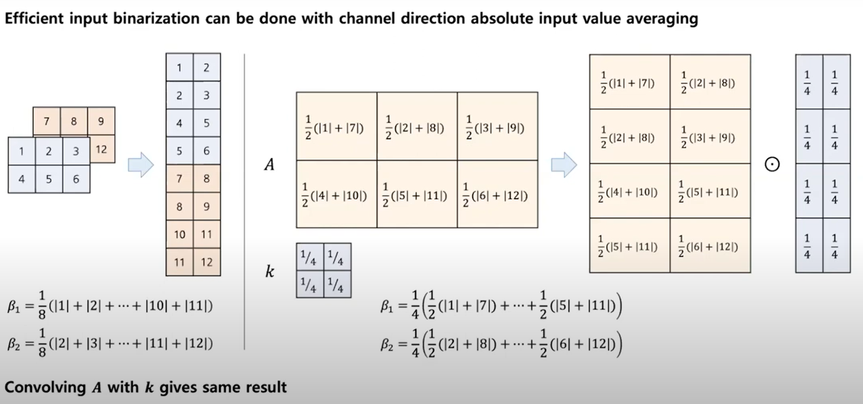
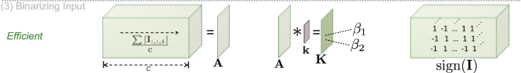
XNOR-Networks
Multiplications이 늘어나지만 Sums을 많이 줄일 수 있디.

Slide 8
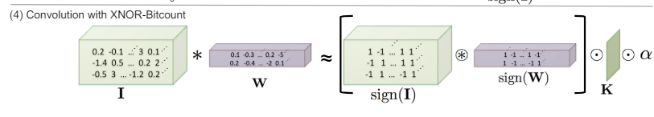

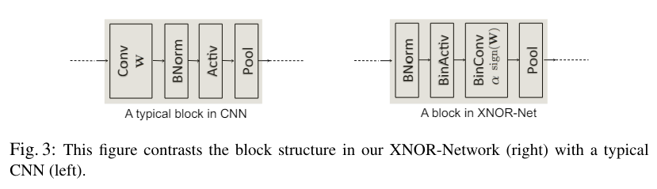
Now, we can approximate the convolution between I and W mainly using binary operations
Binary inputs를 pooling layer에 들어가게 되면 정보 손실을 야기합니다. 예를 들면, max pooling를 거치면 대부분의 요소가 +1이 됩니다.
BinActiv layer에 K와 sign(I)를 계산합니다
Binconv layer에 주어진 K와 sign(I)를 binary convolution를 진행합니다.

Slide 9
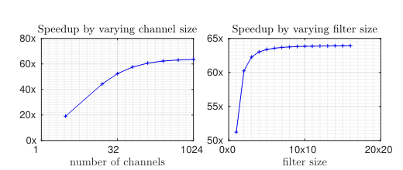
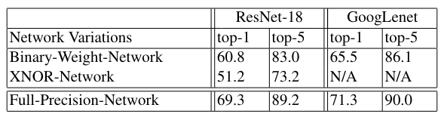
Evaluation
Compare to ResNet, 58x speed up is achieved
Vs ResNet-18 & GoogLenet

Slide 10
LeNet-5(XNOR-net 적용)
1. BinActive
class BinActiv(Function):
def forward(ctx,input):
input=input.sign() #input을 -1또는 1로 이진화
return input
def Mean(cls,input): .
return torch.mean(input.abs(),1,keepdim=True) #입력의 절대값을 채널 차원에 따라 평균을 계산
def backward(ctx,grad_output)
grad_input=grad_output.clone()
grad_input[input.ge(1)]=0 #input.ge(1)는 input 텐서의 각 요소가 1보다 크거나 같은지를 판단(조건을 만족하면 True)
grad_input[input.le(-1)]=0 #input.le(-1)는 input 텐서의 각 요소가 -1보다 작거나 같은지를 판단(조건을 만족하면 True)
return grad_input
https://github.com/CBNU-AILAB/XNOR-Net/blob/main/main.py

Slide 11
LeNet-5(XNOR-net 적용)
2. BinConv2d
class BinConv2d(nn.Module):
def __init__(self,in_channels,out_channels,kernel_size,stride=1,padding=1):
...
self.conv=nn.Conv2d(in_channels,out_channels,kernel_size=kernel_size)
def forward(self,x):#block structure is BatchNorm->BinActiv->BinConv->Relu->MaxPool
x=self.bn(x) #BatchNorm
A=BinActiv().Mean(x) #입력을 channel 기준으로 평균
x=BinActive(x) #BinActiv
k=torch.ones(1,1,self.kernel_size,self.kernel_size).mul(1/(self.kernel_size**2)) #out_channels and in_channels are both 1.constrain kernel
K=F.conv2d(A,k) #A conv k=K
x=self.conv(x)
x=torch.mul(x,K)
x=self.relu(x)#Relu
output=self.pool(x)#MaxPool
return output

Slide 12

class WeightOperation:
def __init__(self,model):
...
def WeightSave(self): #Real Value 가진 Weights 저장
...
def WeightBinarize(self): #Weights 이진화
with torch.no_grad():
for index in range(self.count_group_weights):
n=self.weight[index][0].nelement() #n은 텐서의 모든 요소의 개수
dim_group_weights=self.weight[index]].size()
if len(dim_group_weights)==4: #4D 텐서 [out_channels,in_channels,kernel_heights,kernel_width]
alpha=self.weight[index].norm(1,3,keepdim=True).sum(2,keepdim=True).sum(1, keepdim=True).div(n).expand(dim_group_weights)
self.weight[index]=self.weight[index].sign()*alpha #sign(W)*alpha 의미
def WeightRestore(self):#Real Value 가진 Weights 복원
...
def WeightGradient(self): # 가중치를 업데이트하기전에 수행, 즉 이진화된 가중치로 계산한 그래디언트를 수정한 단계
for index in range(self.count_group_weights):
…
alpha[self.weight[index].le(-1.0)]=0
alpha[self.weight[index].ge( 1.0)]=0
with torch.no_grad():
self.weight[index].grad=self.weight[index].grad/n+self.weight[index].grad*alpha

Slide 13
Training
model = LeNet5_Bin()
WeightOperation = WeightOperation(model)
for epoch in range(params['epochs']):
# training
for batch_idx, (train_inputs, train_labels) in enumerate(train_loader):
optimizer.zero_grad()
WeightOperation.WeightSave()
WeightOperation.WeightBinarize()
predicted = model(train_inputs)
loss = loss_fn(predicted, train_labels)
loss.backward() #graident계산
WeightOperation.WeightRestore()
WeightOperation.WeightGradient()
optimizer.step() # weights update

Slide 14
Evaluation
LeNet_5
Network variation | Top-1 | Top-5
XNOR-Network | 97.00% | 99.96%
Full-Precision Network | 98.46% | 99.99%

