Slide 1
Rowhammer on ECC
박형동

Slide 2
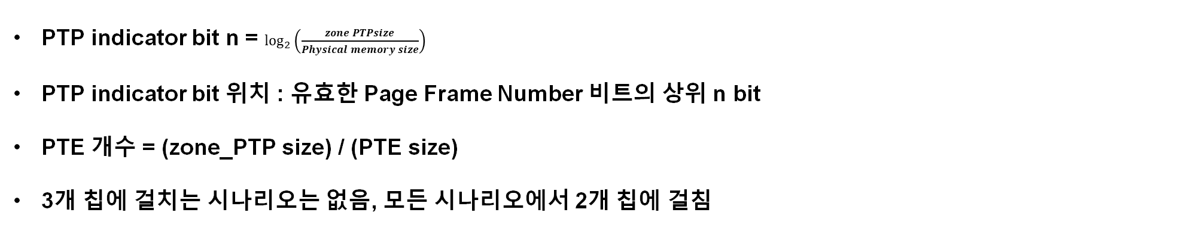
Rowhammer on ECC
 | 32 MB | 64 MB
8 GB | PTP indicator bit n = 8, 유효 PFN = [32:12], PTP indicator bit 위치 = [32:25], PTE 개수 = 4,194,304 | PTP indicator bit n = 7, 유효 PFN = [32:12], PTP indicator bit 위치 = [32:26], PTE 개수 =8,388,608
16 GB | PTP indicator bit n = 9, 유효 PFN = [33:12], PTP indicator bit 위치 = [33:25], PTE 개수 = 4,194,304 | PTP indicator bit n = 8, 유효 PFN = [33:12], PTP indicator bit 위치 = [33:26], PTE 개수 =8,388,608
32 GB | PTP indicator bit n = 10, 유효 PFN = [34:12], PTP indicator bit 위치 = [34:25], PTE 개수 = 4,194,304 | PTP indicator bit n = 9, 유효 PFN = [32:12], PTP indicator bit 위치 = [34:26], PTE 개수 =8,388,608
PTP indicator bit n = $\log_{2}\left(\frac{zone PTPsize}{Physical memory size}\right)$
PTP indicator bit 위치 : 유효한 Page Frame Number 비트의 상위 n bit
PTE 개수 = (zone_PTP size) / (PTE size)
3개 칩에 걸치는 시나리오는 없음, 모든 시나리오에서 2개 칩에 걸침

Slide 3
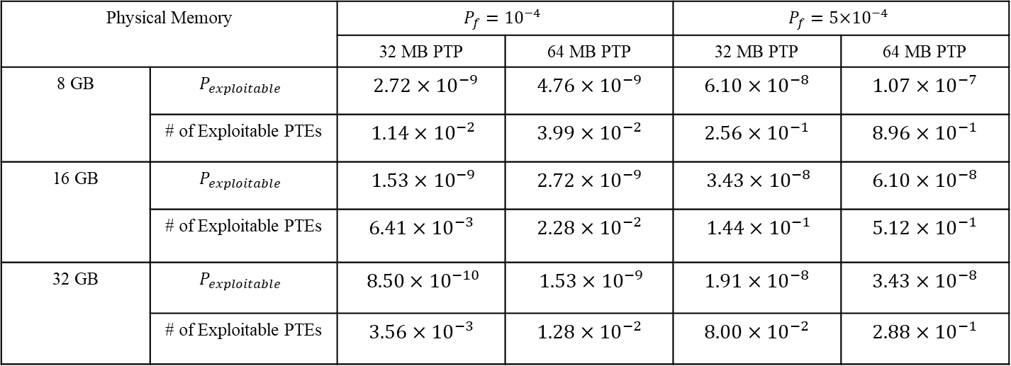
Rowhammer on ECC
Physical Memory |  | $$P_{f}={10}^{−4}$$ |  | $$P_{f}={5\text{×}10}^{−4}$$
 |  | 32 MB PTP | 64 MB PTP | 32 MB PTP | 64 MB PTP
8 GB | $$P_{exploitable}$$ | 2.72 × ${10}^{−9}$ | 4.76 × ${10}^{−9}$ | 6.10 × ${10}^{−8}$ | 1.07 × ${10}^{−7}$
 | # of Exploitable PTEs | 1.14 × ${10}^{−2}$ | 3.99 × ${10}^{−2}$ | 2.56 × ${10}^{−1}$ | 8.96 × ${10}^{−1}$
16 GB | $$P_{exploitable}$$ | 1.53 × ${10}^{−9}$ | 2.72 × ${10}^{−9}$ | 3.43 × ${10}^{−8}$ | 6.10 × ${10}^{−8}$
 | # of Exploitable PTEs | 6.41 × ${10}^{−3}$ | 2.28 × ${10}^{−2}$ | 1.44 × ${10}^{−1}$ | 5.12 × ${10}^{−1}$
32 GB | $$P_{exploitable}$$ | 8.50 × ${10}^{−10}$ | 1.53 × ${10}^{−9}$ | 1.91 × ${10}^{−8}$ | 3.43 × ${10}^{−8}$
 | # of Exploitable PTEs | 3.56 × ${10}^{−3}$ | 1.28 × ${10}^{−2}$ | 8.00 × ${10}^{−2}$ | 2.88 × ${10}^{−1}$
Random H matrix 로 계산한 Table

Slide 4
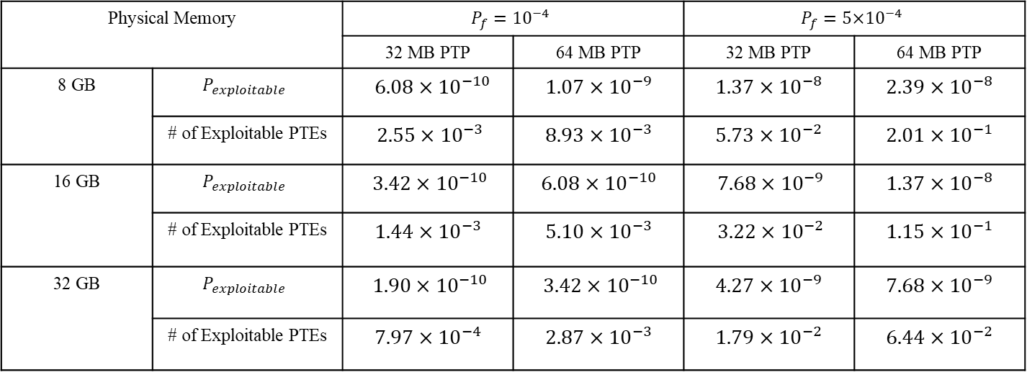
Rowhammer on ECC
Physical Memory |  | $$P_{f}={10}^{−4}$$ |  | $$P_{f}={5\text{×}10}^{−4}$$
 |  | 32 MB PTP | 64 MB PTP | 32 MB PTP | 64 MB PTP
8 GB | $$P_{exploitable}$$ | 6.08 × ${10}^{−10}$ | 1.07 × ${10}^{−9}$ | 1.37 × ${10}^{−8}$ | 2.39 × ${10}^{−8}$
 | # of Exploitable PTEs | 2.55 × ${10}^{−3}$ | 8.93 × ${10}^{−3}$ | 5.73 × ${10}^{−2}$ | 2.01 × ${10}^{−1}$
16 GB | $$P_{exploitable}$$ | 3.42 × ${10}^{−10}$ | 6.08 × ${10}^{−10}$ | 7.68 × ${10}^{−9}$ | 1.37 × ${10}^{−8}$
 | # of Exploitable PTEs | 1.44 × ${10}^{−3}$ | 5.10 × ${10}^{−3}$ | 3.22 × ${10}^{−2}$ | 1.15 × ${10}^{−1}$
32 GB | $$P_{exploitable}$$ | 1.90 × ${10}^{−10}$ | 3.42 × ${10}^{−10}$ | 4.27 × ${10}^{−9}$ | 7.68 × ${10}^{−9}$
 | # of Exploitable PTEs | 7.97 × ${10}^{−4}$ | 2.87 × ${10}^{−3}$ | 1.79 × ${10}^{−2}$ | 6.44 × ${10}^{−2}$
Minimal H matrix 로 계산한 Table
Random H matrix 대비 약 77프로 감소

