Slide 1
DNAS-SNN Loss Function
2026년 04월 01일
Sunghyun Lee
Department of Computer Engineering

Slide 2

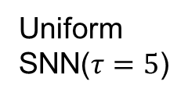
Goal
BNN
Uniform
SNN($τ=5$)
Proposed
(DNAS-SNN)
1.31
MB
0.73
MB
?
storage
(MB)
smaller
1.8x
1.677G
0.501G
?
Bit-OPs
(G)
3.3x
smaller
65.7
%
62.1
%
Similar
or
Better
Imagenet1K
$$≤$$
Accuracy
(%)
Sub-bit Neural Networks: Learning to Compress and Accelerate Binary Neural Networks

Slide 3
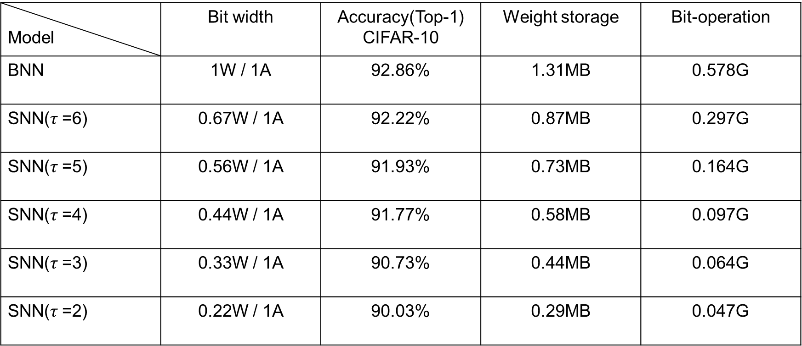
baseline
Model | Bit width | Accuracy(Top-1) CIFAR-10 | Weight storage | Bit-operation
BNN | 1W / 1A | 92.86% | 1.31MB | 0.578G
SNN($τ$=6) | 0.67W / 1A | 92.22% | 0.87MB | 0.297G
SNN($τ$=5) | 0.56W / 1A | 91.93% | 0.73MB | 0.164G
SNN($τ$=4) | 0.44W / 1A | 91.77% | 0.58MB | 0.097G
SNN($τ$=3) | 0.33W / 1A | 90.73% | 0.44MB | 0.064G
SNN($τ$=2) | 0.22W / 1A | 90.03% | 0.29MB | 0.047G

Slide 4



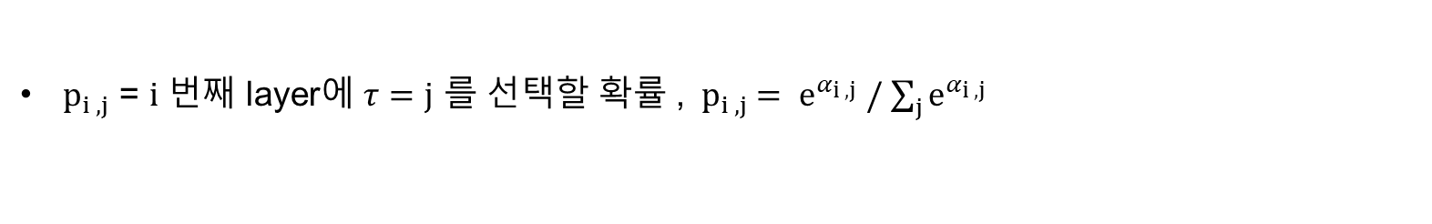














Remind Parameter
16 layers
ResNet 18
candidates $τ =\{3,4,5,6\}$
각 layer에 이 중에 하나를 선택
$α_{i , j}$ = $i$ 번째 layer에 $τ=j$ 인 각 선택지의 중요도 가중치
$p_{i , j}$ = $i$ 번째 layer에 $τ=j$ 를 선택할 확률 ,${ p}_{i , j} = e^{α_{i , j}} /$ $\sum_{j}{e^{α_{i , j}}}$
layer 1
layer 2
layer 16
$$τ=3$$
$$p_{1 , 3}$$
$$p_{2 , 3}$$
$$p_{16 , 3}$$
$$τ=4$$
$$p_{1 , 4}$$
$$p_{3 , 4}$$
…
$$p_{16 , 4}$$
$$τ=5$$
$$p_{1 , 5}$$
$$p_{4 , 5}$$
$$p_{16 , 5}$$
$$τ=6$$
$$p_{1 , 6}$$
$$p_{5 , 6}$$
$$p_{16 , 6}$$

Slide 5
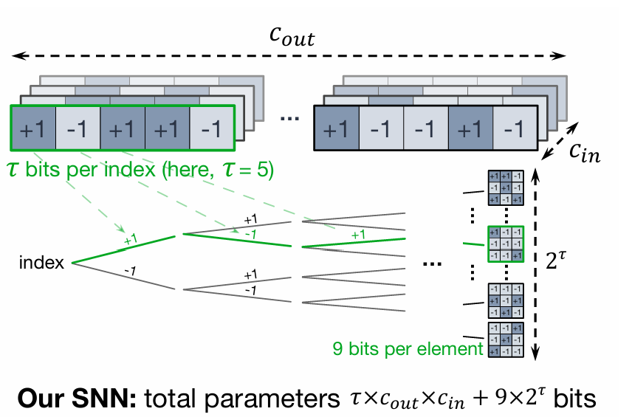
Remind Weight Storage

Slide 6
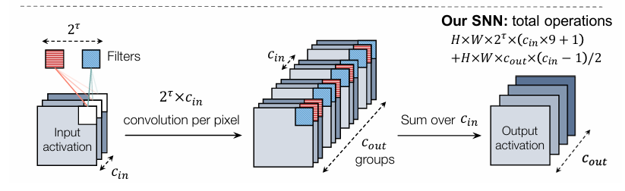
Remind BitOPs

Slide 7
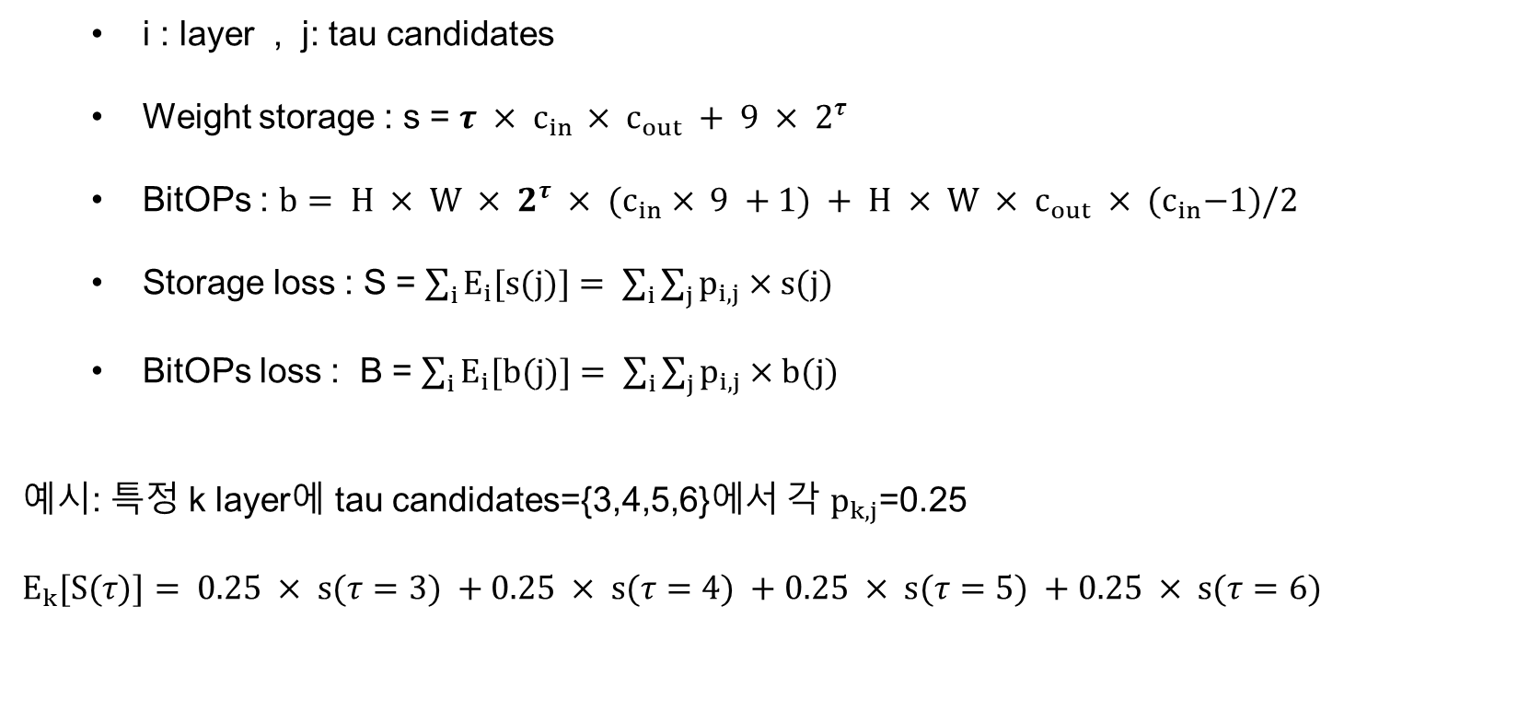
How to calculate Loss function
i : layer , j: tau candidates
Weight storage : s = $τ × c_{in }× c_{out} + 9 × 2^{τ}$
BitOPs : $b= H × W × 2^{τ} × {(c}_{in} × 9 +1) + H × W × c_{out} × {(c}_{in}−1)/2$
Storage loss : S = $\sum_{i}{E_{i}[s(j)]}= \sum_{i}{\sum_{j}{p_{i,j}}×s(j) }$
BitOPs loss : B = $\sum_{i}{E_{i}[b(j)]}= \sum_{i}{\sum_{j}{p_{i,j}}×b(j) }$
예시: 특정 k layer에 tau candidates={3,4,5,6}에서 각 $p_{k,j}$=0.25
$E_{k}[S(τ)]= 0.25 × s(τ=3) +0.25 × s(τ=4) +0.25 × s(τ=5) +0.25 × s(τ=6)$

Slide 8
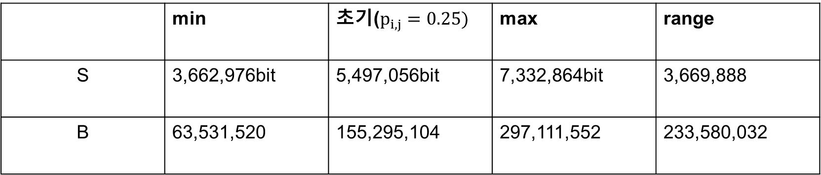
range
 | min | 초기($p_{i,j}=0.25)$ | max | range
S | 3,662,976bit | 5,497,056bit | 7,332,864bit | 3,669,888
B | 63,531,520 | 155,295,104 | 297,111,552 | 233,580,032
Notes:
S 3백만~7백만
B 6천만~2억9천만

Slide 9
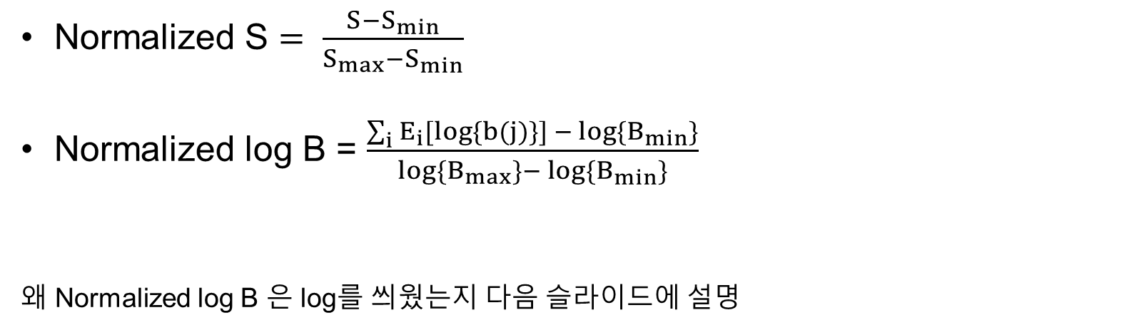
Min-Max Normalize
Normalized S $= \frac{S−S_{min}}{S_{max}−S_{min}}$
Normalized log B = $\frac{\sum_{i}{E_{i}[log\{b(j)\}] − }log{\{B}_{min}\}}{log{\{B}_{max}\}− log{\{B}_{min}\}}$
왜 Normalized log B 은 log를 씌웠는지 다음 슬라이드에 설명

Slide 10
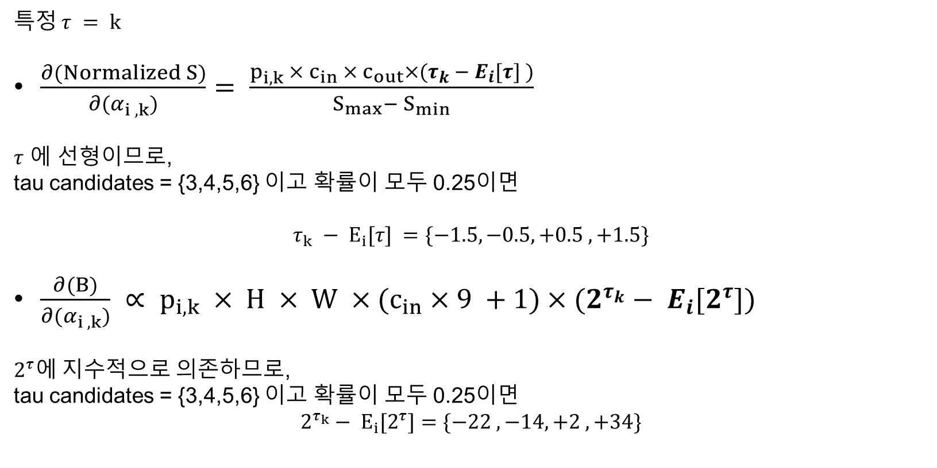
gradient
특정 $τ = k$
$\frac{∂(Normalized S)}{∂(α_{i ,k})}= \frac{p_{i,k} × c_{in} × c_{out}×(τ_{k} − E_{i}[τ] )}{S_{max}− S_{min}}$
$τ$ 에 선형이므로,
tau candidates = {3,4,5,6} 이고 확률이 모두 0.25이면
$$τ_{k} − E_{i}[τ] =\{−1.5, −0.5, +0.5 , +1.5\}$$
$\frac{∂(B)}{∂(α_{i ,k})} ∝ p_{i,k} × H × W ×(c_{in}×9 +1)×(2^{τ_{k}}− E_{i}[2^{τ}])$
$2^{τ}에$ 지수적으로 의존하므로,
tau candidates = {3,4,5,6} 이고 확률이 모두 0.25이면
$$2^{τ_{k}}− E_{i}[2^{τ}]=\{−22 , −14, +2 , +34\}$$

Slide 11
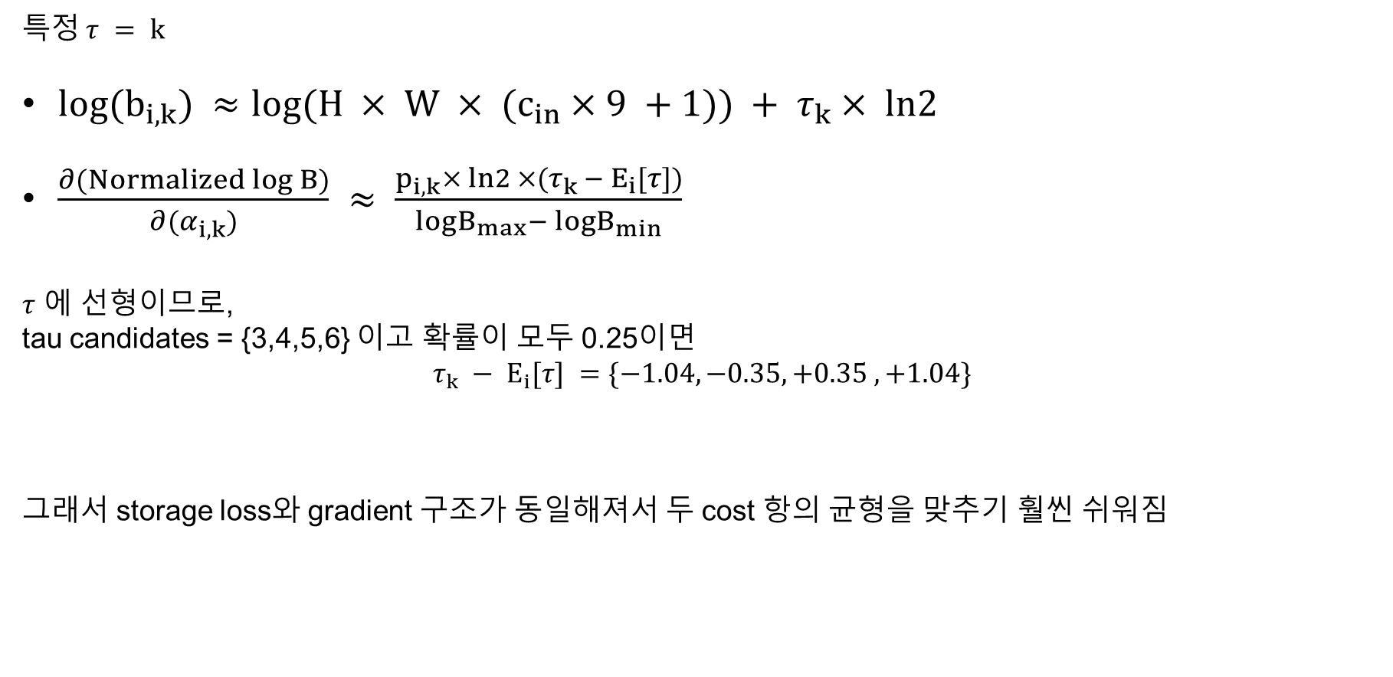
Log gradient
특정 $τ = k$
$log(b_{i,k}) ≈log(H × W × (c_{in}×9 +1)) + τ_{k}× ln2$
$\frac{∂(Normalized log B)}{∂(α_{i,k})} ≈ \frac{p_{i,k}× ln2 ×(τ_{k }− E_{i}[τ])}{logB_{max}− logB_{min}}$
$τ$ 에 선형이므로,
tau candidates = {3,4,5,6} 이고 확률이 모두 0.25이면
$$τ_{k} − E_{i}[τ] =\{−1.04, −0.35, +0.35 , +1.04\}$$
그래서 storage loss와 gradient 구조가 동일해져서 두 cost 항의 균형을 맞추기 훨씬 쉬워짐

Slide 12
BitOPs Loss

Slide 13
Total loss
$$total loss = Accuracy loss + θ ×\{a×Normalized S + (1−a) × Normalized log B\}$$

Slide 14
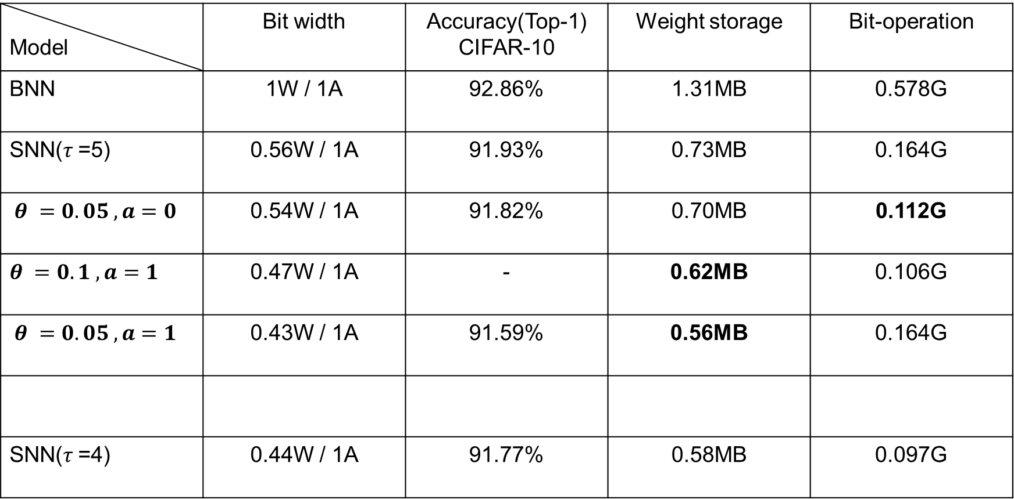
Loss data
$$total loss = Accuracy loss + θ ×\{a×Normalized S + (1−a) × Normalized log B\}$$
Model | Bit width | Accuracy(Top-1) CIFAR-10 | Weight storage | Bit-operation
BNN | 1W / 1A | 92.86% | 1.31MB | 0.578G
SNN($τ$=5) | 0.56W / 1A | 91.93% | 0.73MB | 0.164G
$θ =0.05 , a=0$ | 0.54W / 1A | 91.82% | 0.70MB | 0.112G
$θ =0.1 , a=1$ | 0.47W / 1A | - | 0.62MB | 0.106G
$θ =0.05 , a=1$ | 0.43W / 1A | 91.59% | 0.56MB | 0.164G
SNN($τ$=4) | 0.44W / 1A | 91.77% | 0.58MB | 0.097G

Slide 15
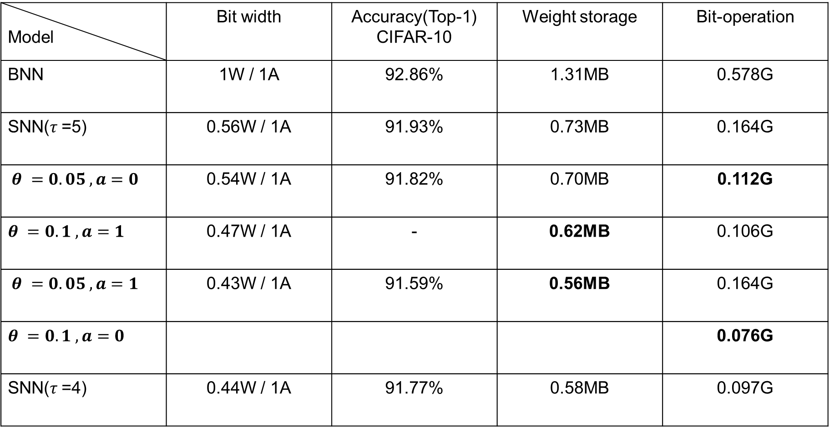
Model | Bit width | Accuracy(Top-1) CIFAR-10 | Weight storage | Bit-operation
BNN | 1W / 1A | 92.86% | 1.31MB | 0.578G
SNN($τ$=5) | 0.56W / 1A | 91.93% | 0.73MB | 0.164G
$θ =0.05 , a=0$ | 0.54W / 1A | 91.82% | 0.70MB | 0.112G
$θ =0.1 , a=1$ | 0.47W / 1A | - | 0.62MB | 0.106G
$θ =0.05 , a=1$ | 0.43W / 1A | 91.59% | 0.56MB | 0.164G
$θ =0.1 , a=0$ |  |  |  | 0.076G
SNN($τ$=4) | 0.44W / 1A | 91.77% | 0.58MB | 0.097G

