Slide 1
XNOR-Net & XNOR-Net++
2024년 7월 29일
B815133 이성현
전자전기공학부

Slide 2
목차
XNOR-Net와 XNOR-Net++ Review
ResNet18의 구조
Review code
Conclusion

Slide 3
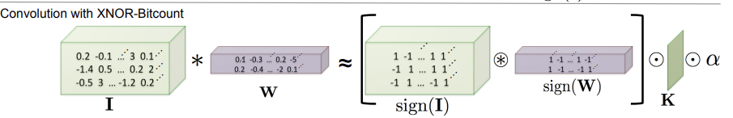
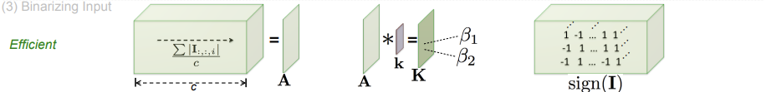

XNOR-Net
$α$ = $\frac{1}{n}$ ${|\left|W\right||}_{l1}$ (Using single scale $α$ for whole weight tensor)
n: weights의 수, ||W||: 가중치 절대값의 합, $W_{lk}$ : $k^{th}$ weight filter in the $l^{th}$ layer of the CNN
K= A*k ( Convolve A with a 2D filter k)
A=$\frac{\sum{| I:,:,i|}}{c}$ (i는 across input channel), k$∈R^{w X h}$ where $∀i$,j $k_{ij}=\frac{1}{w X h}$ (i는 across width, j는 across height)
3. W $∈$ $R^{c X w X h}$ , I $∈$ $R^{c X win X hin}$
Source: XNOR-Net: ImageNet Classification Using Binary Convolutional Neural Networks

Slide 4
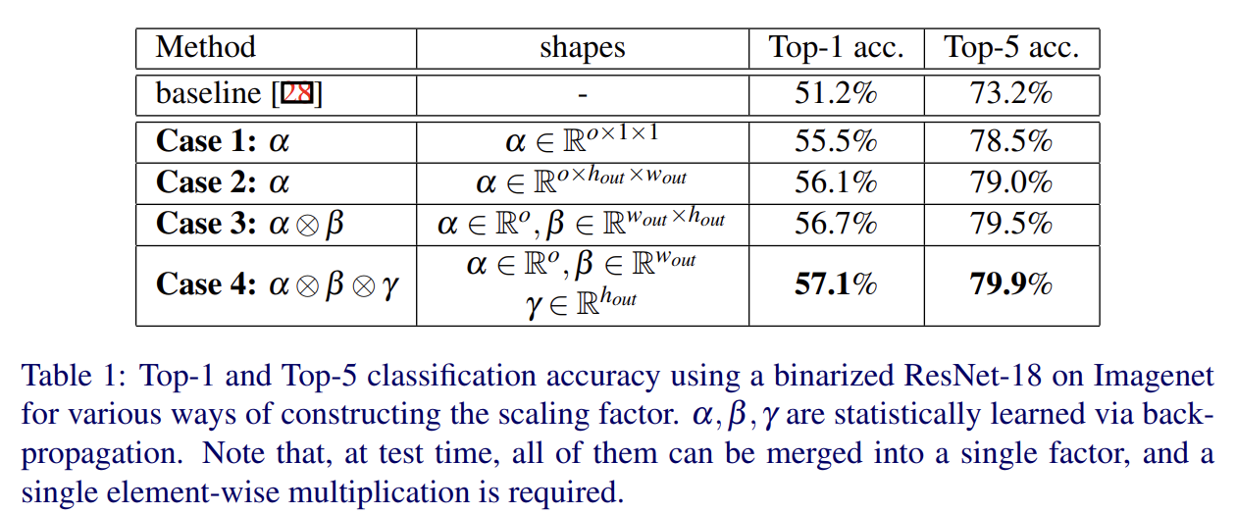

XNOR-Net++
Computing the scaling factor with respect to the features is relatively expensive and need to be done for every new input
Construct the scaling factor $α,β,γ$ . They are statistically learned via back-propagation. That means $α,β,γ$ are parameters like weights.
Source: XNOR-Net++: Improved Binary Neural Networks

Slide 5
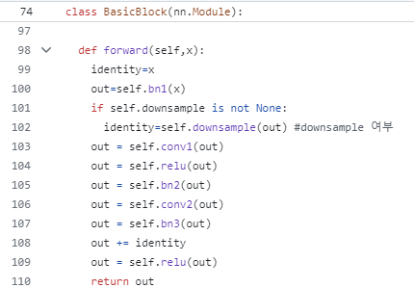
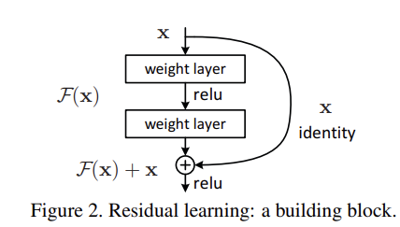
ResNet18
Deeper neural networks are more difficult to train.
Residual networks are easier to optimize, and can gain accuracy from considerably increased depth.
The formulation of F(x)+x can be realized by feedforward neural networks with “shortcut connections”.
Source: Deep Residual Learning for Image Recognition(CVPR 2016)

Slide 6
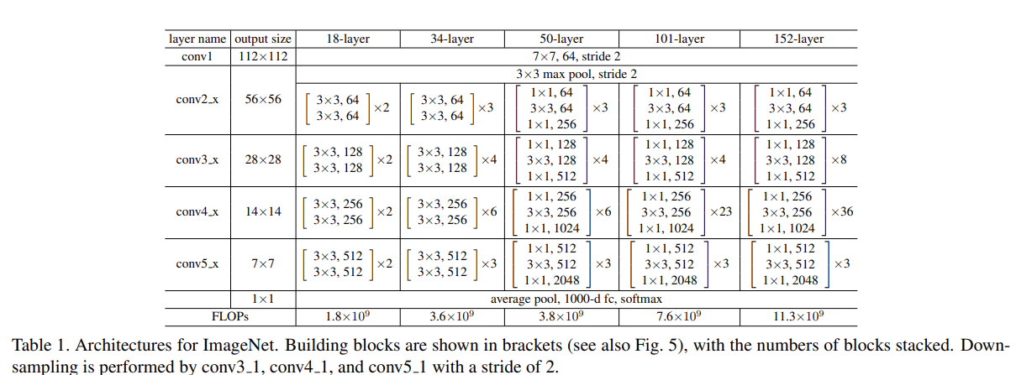
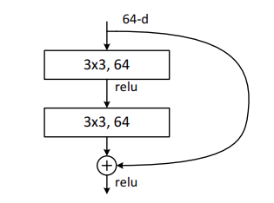
ResNet18

Slide 7
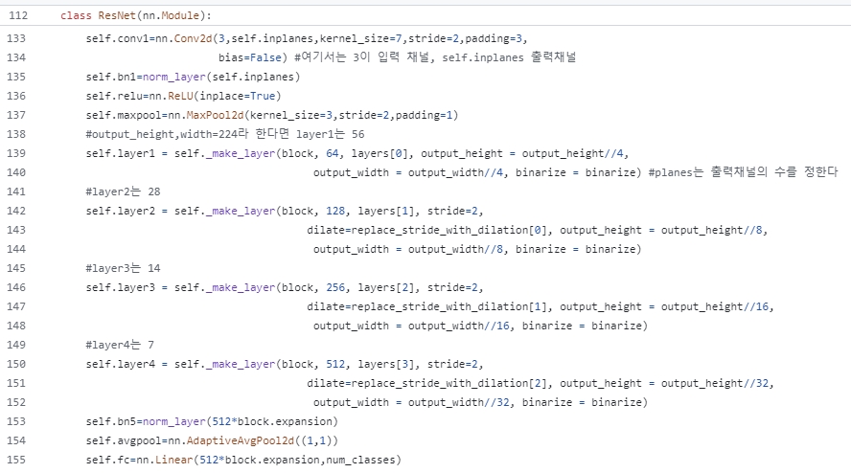
ResNet18

Slide 8
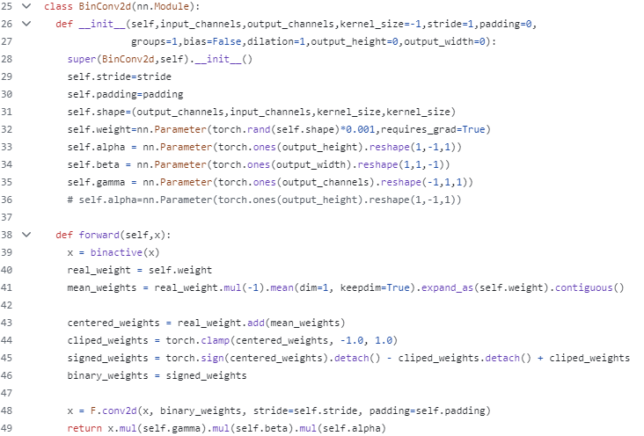
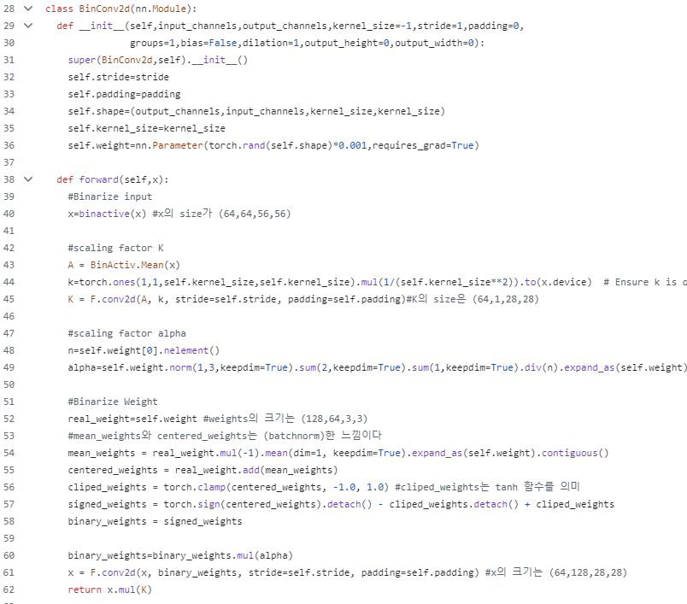
XNOR-Net++ VS XNOR-Net code
XNOR-Net++(case4)
XNOR-Net

Slide 9
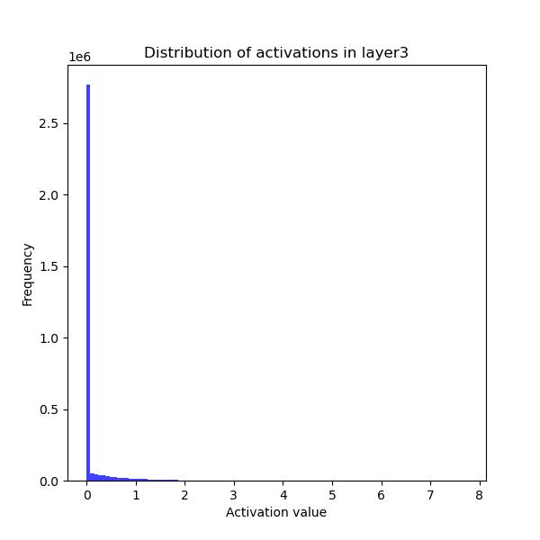
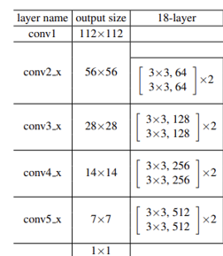
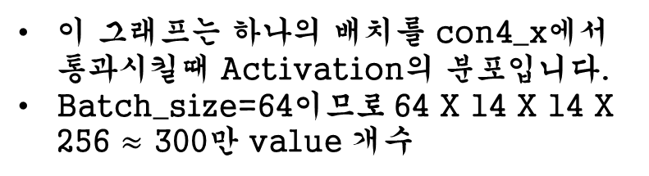
Conclusion
이 그래프는 하나의 배치를 con4_x에서 통과시킬때 Activation의 분포입니다.
Batch_size=64이므로 64 X 14 X 14 X 256 $≈$ 300만 value 개수

Slide 10
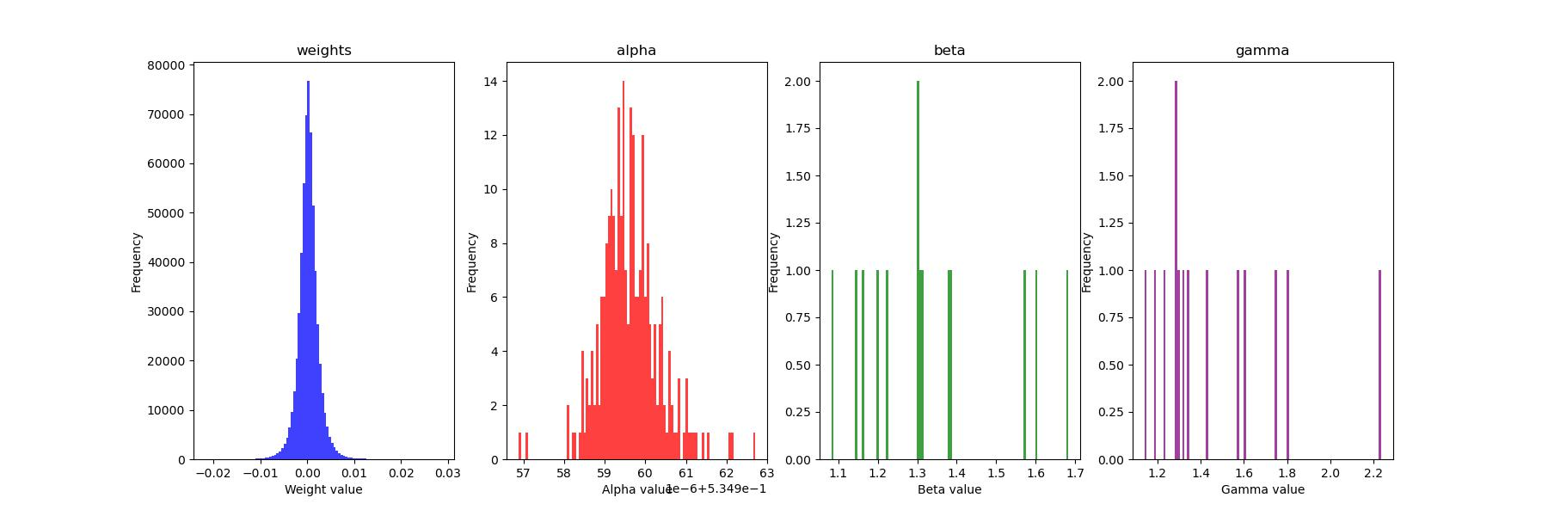
Conclusion
Layer conv4_x에서 첫번째 block의 2번째 3x3,256 conv 분포 그래프입니다.
(Epoch: 80, lr=1e-1, batch_size=64)

Slide 11
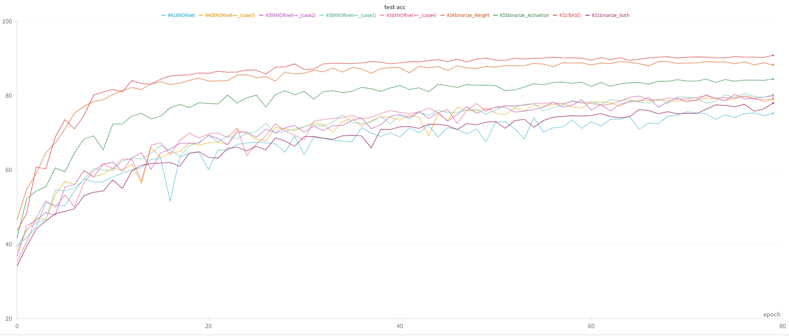
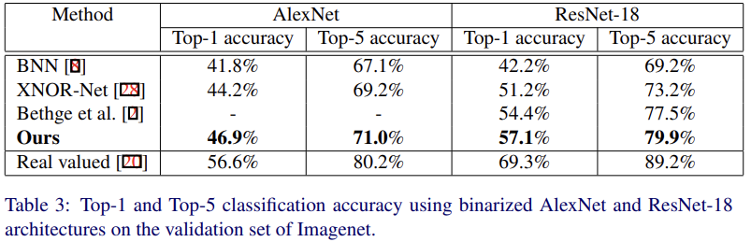
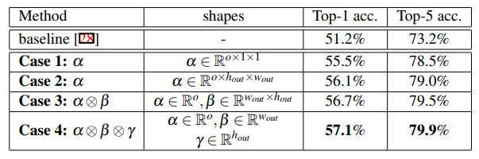
Conclusion

