Slide 1
BERT ANE Results
2026년 5월 20일
Suhyeon Lee
Department of Computer Engineering

Slide 2
목표 및 진행사항
목표 (~6월)
ANE(Apple Neural Engine) friendly transformer workbench
진행사항
BERT 모델의 sequence length별 prediction time 비교
Sequence length: 128/256/512
model: google-bert/bert-uncased

Slide 3
"Deploying Transformers on the ANE", 2022 - 원리
1. Picking the Right Data format
Linear 레이어를 모두 Conv2d 레이어로 교체
(B, S, C) → (B, C, 1, S)
2. Chunking Large Intermediate Tensors
Multi Head Attention에서 query, key, value 텐서를 head 단위로 분리
3. Minimizing Memory Copies
Reshape과 transpose 연산 최소화 - einsum 공식 활용
4. Handling Bandwidth-Boundness
배치 크기 증가 or 파라미터 텐서 크기 감소
Apple ML Research, "Deploying Transformers on the ANE", 2022

Slide 4
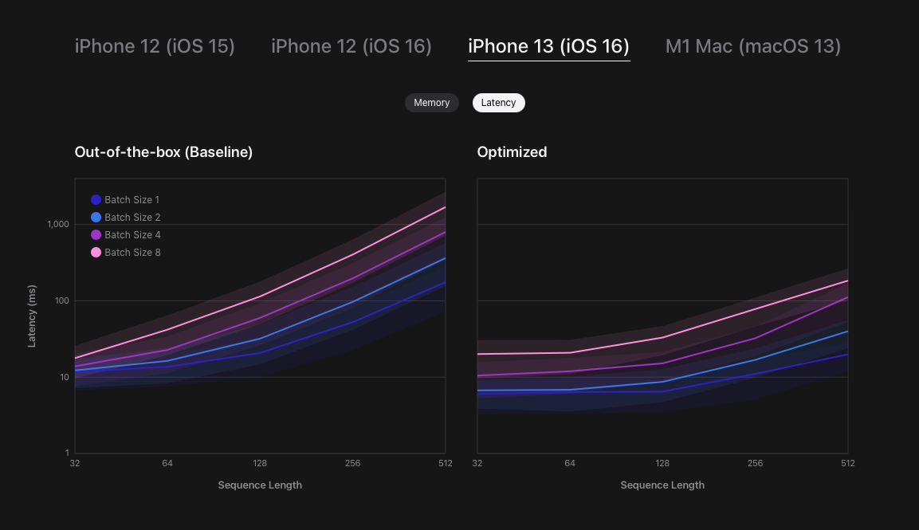
"Deploying Transformers on the ANE", 2022 – 결과
Figure 2: Performance curves (latency, memory) for Hugging Face distilbert on various Apple devices and operating system versions. Shaded ranges indicate performance under varying power consumption.

Slide 5
Models tested in Researches
1. “Deploying Transformers on the Apple Neural Engine”
Benchmarked models:
DistilBERT / distilbert-base-uncased-finetuned-sst-2-English
2. “Deploying Attention-Based Vision Transformers to Apple Neural Engine”
Benchmarked models:
DeiT/16-tiny, Tiny-MOAT-1, third-party Tiny-MOAT-1
Main architecture: MOAT
CNN block + attention block을 결합한 hybrid architecture

Slide 6
Models tested
1. ViT
model size: small/base/large
input 224/384/512 (small x)
2. Swin Transformer
model size: small/base/large
input 224
3. BERT
model size: small/base/large
Sequence length 128/256/512
4. EoMT

Slide 7
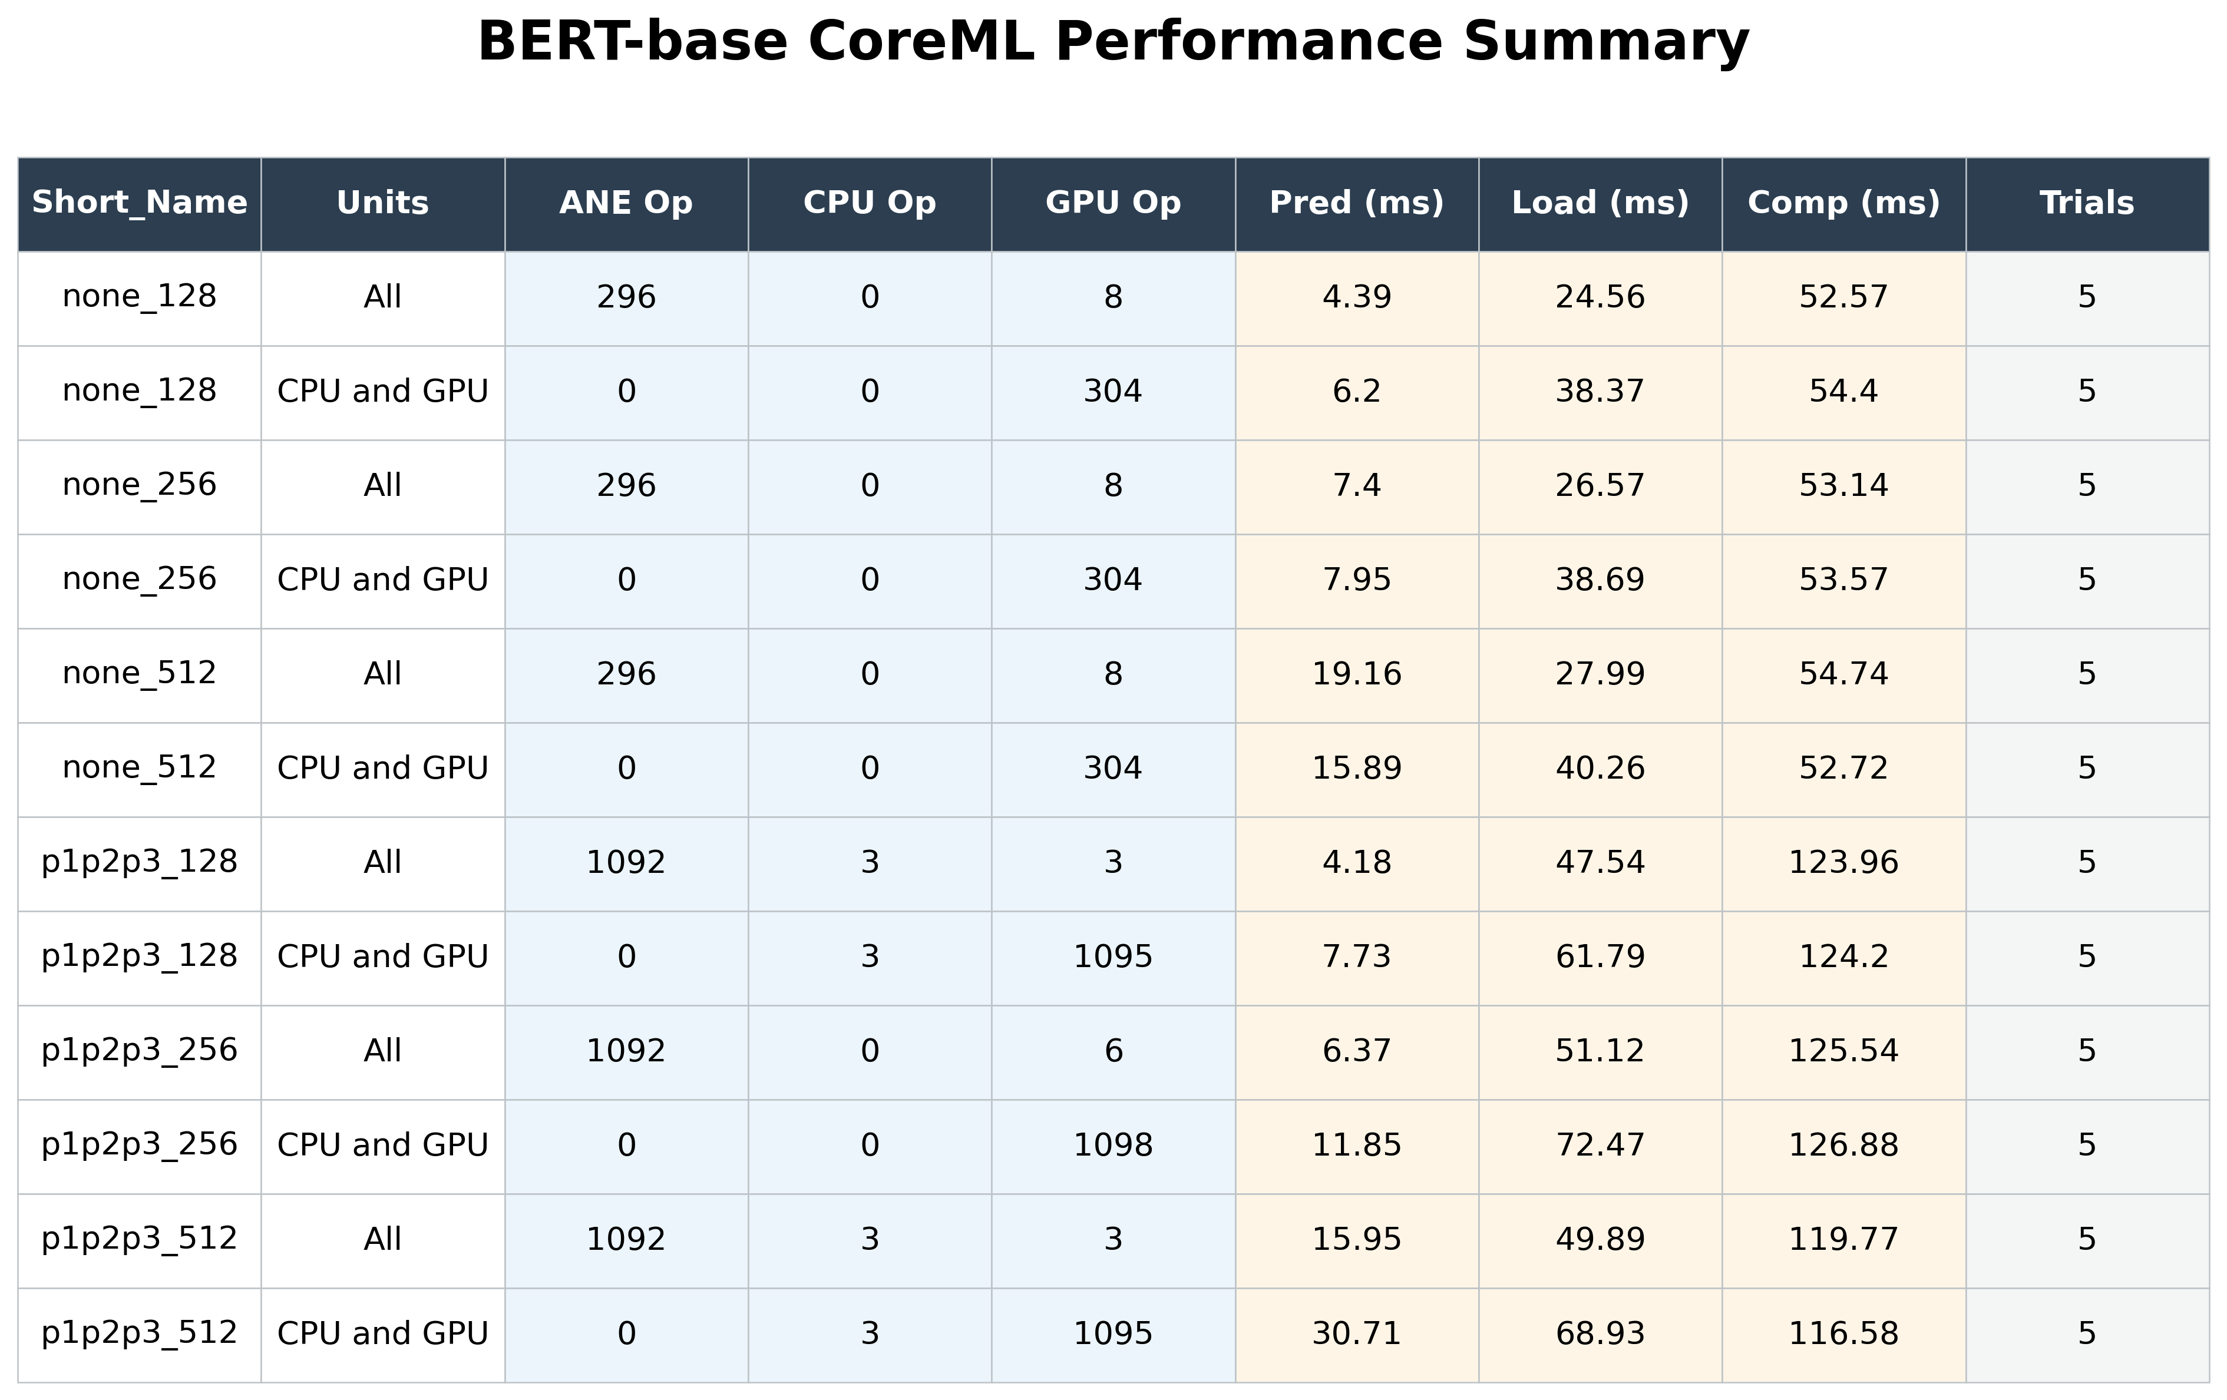
BERT 모델 비교 – base

Slide 8
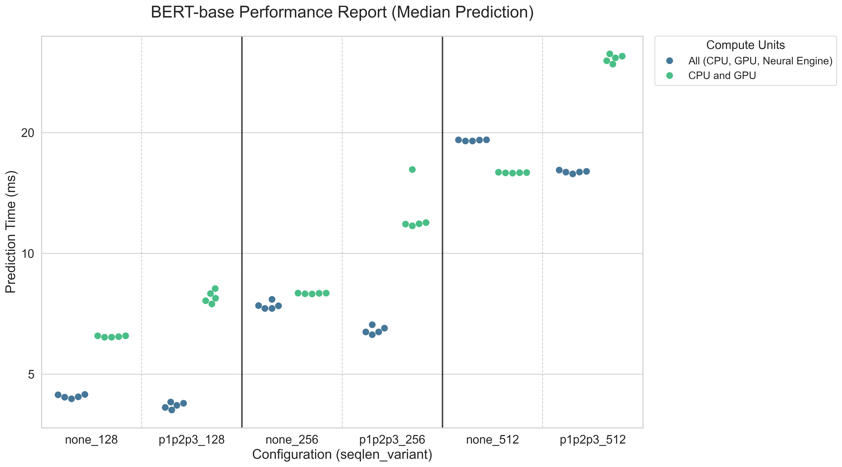
BERT 모델 비교 - base

Slide 9
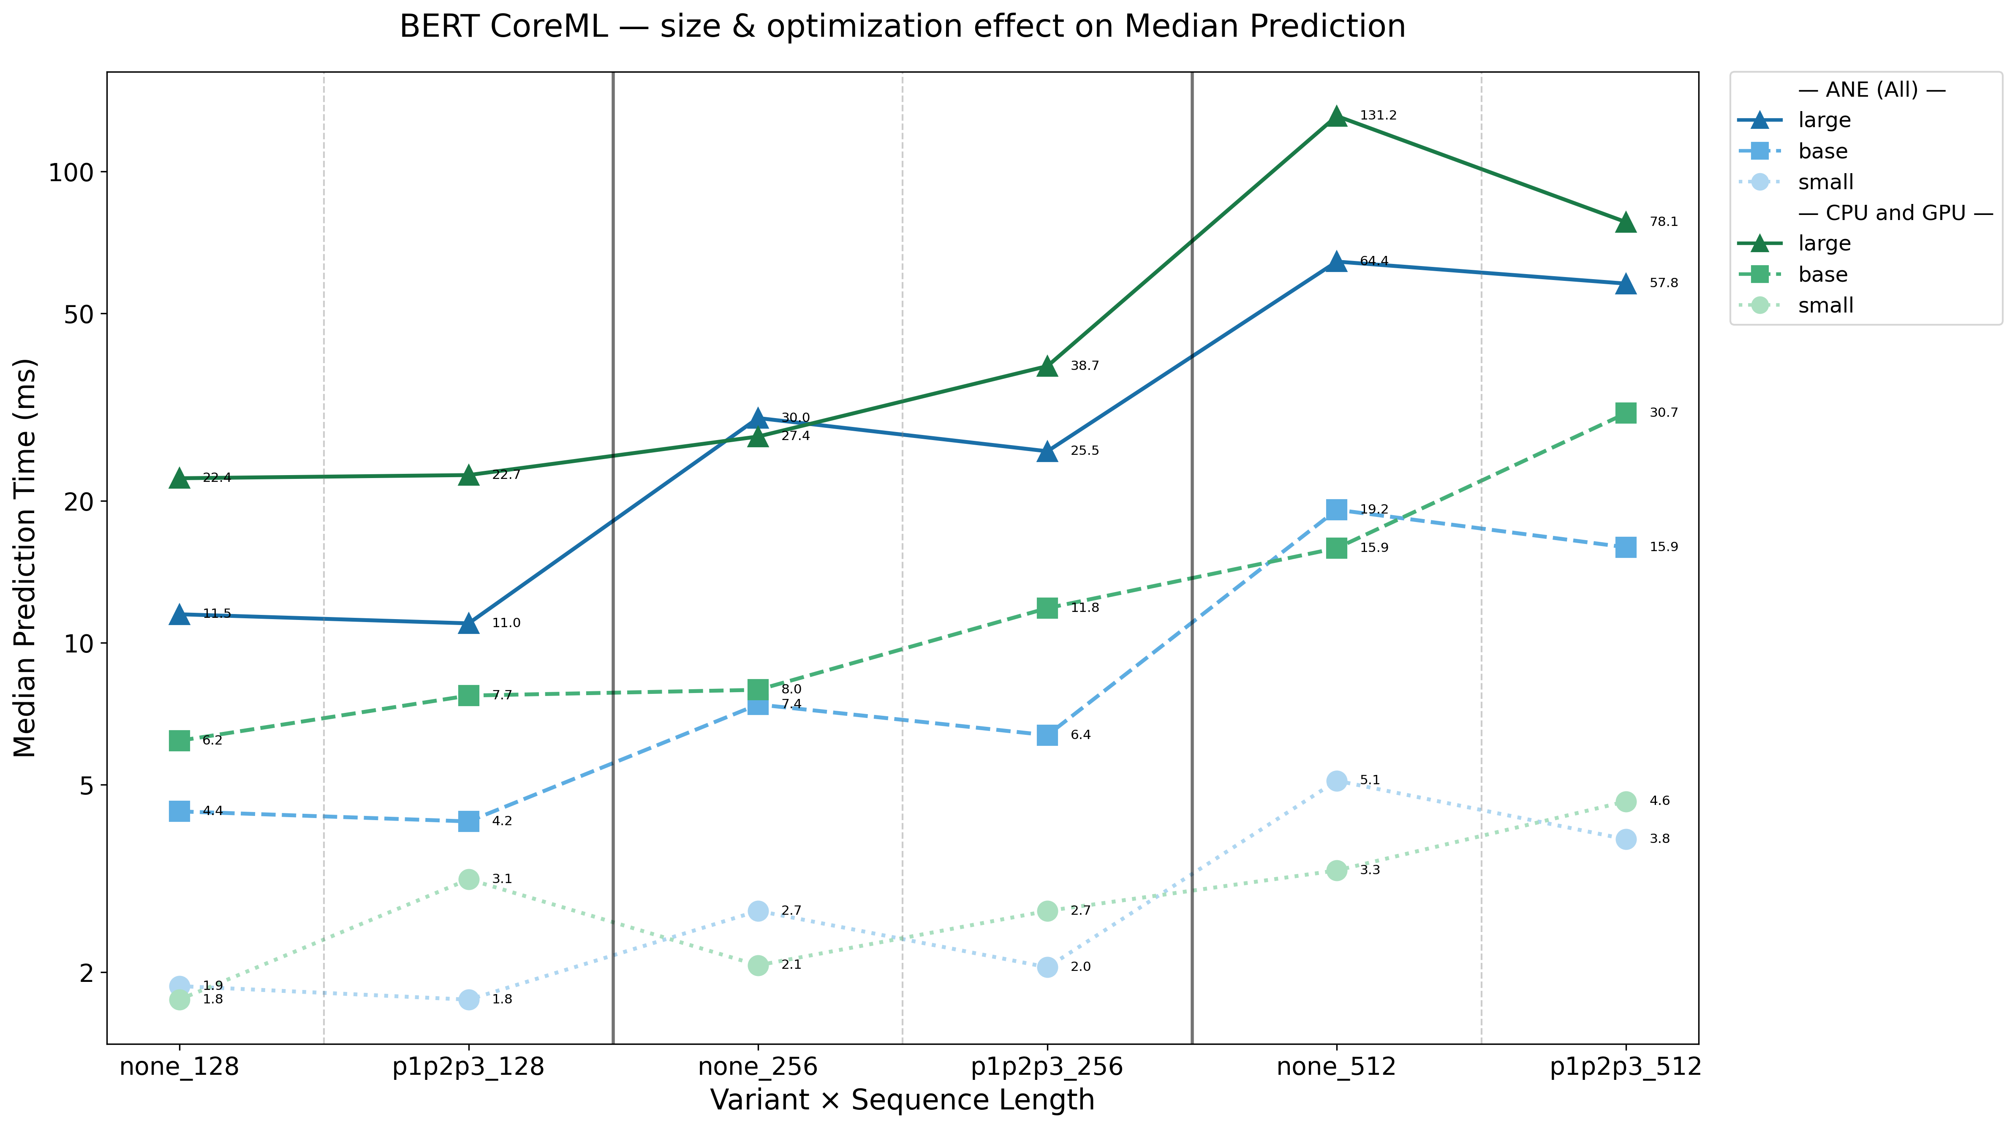
BERT 모델 비교 - small/base/large

