Slide 1
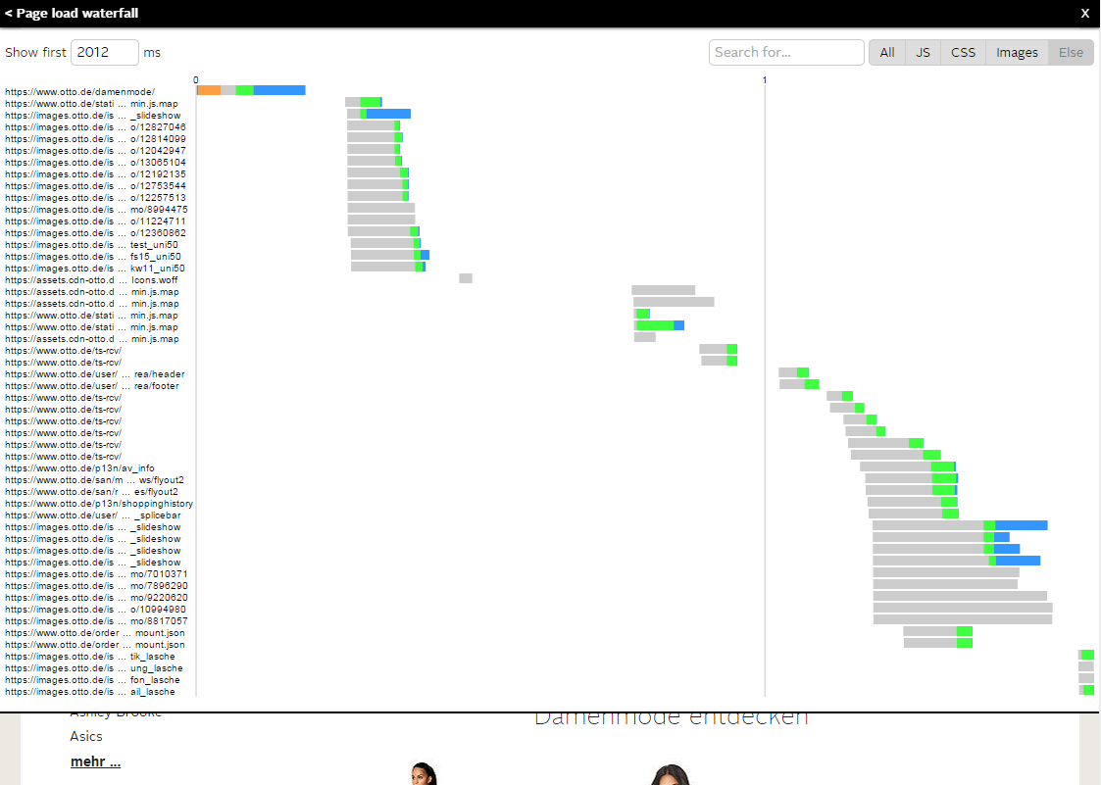
Control the time span of the resources you want to show. Will be pre-filled with the right time to show all ressources of the first page load
Control the time span of the resources you want to show. Will be pre-filled with the right time to show all ressources of the first page load

