Slide 1
CSCI
BIOLOGICAL CONDITION (healthy or impacted)
ASCI
OVERALL SQI
TN
TP
Conductivity
Chem index
(pChem)
STRESS CONDITION (Probability of Impacts)
CRAM metrics
IPI metrics
Habitat index
(pHab)

Slide 2
Biological condition
 | CSCI high | CSCI low
ASCI high | Healthy | Impacted for CSCI
ASCI low | Impacted for ASCI | Impacted for CSCI and ASCI
Overall SQI
 | Unstressed | Stressed
Biology Healthy | Healthy and unstressed | Healthy and resilient
Biology Impacted | Impacted by unknown stress | Impacted and stressed
Stress condition
 | Chemistry stress low | Chemistry stress high
Habitat stress low | Low stress | Stressed by chemistry degradation
Habitat stress high | Stressed by habitat degradation | Stressed by chemistry and habitat degradation
Stressed by low levels of chemistry or habitat degradation

Slide 3
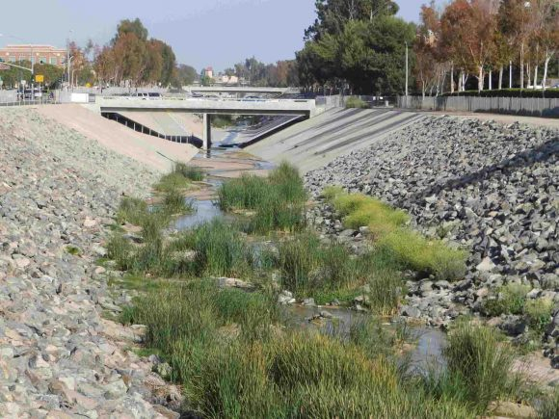
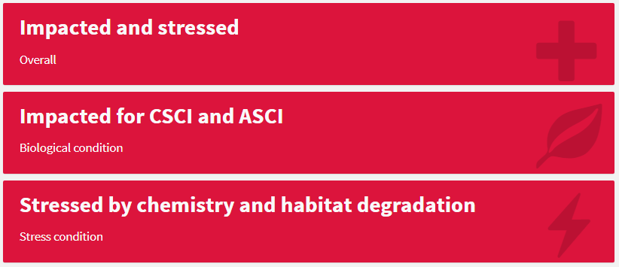
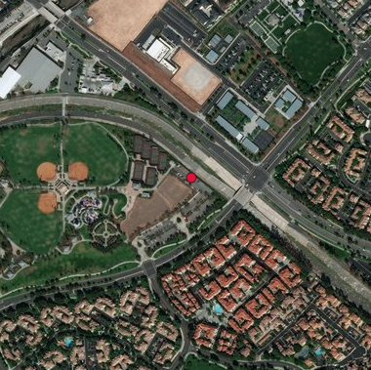
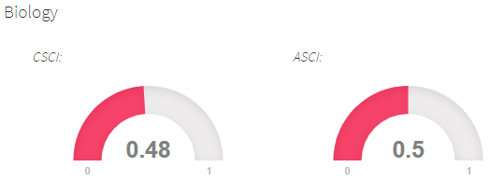
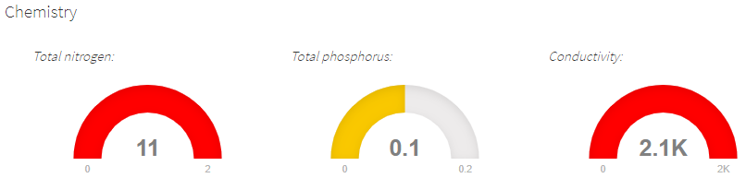
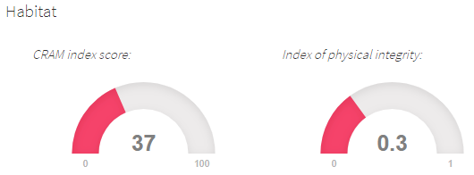
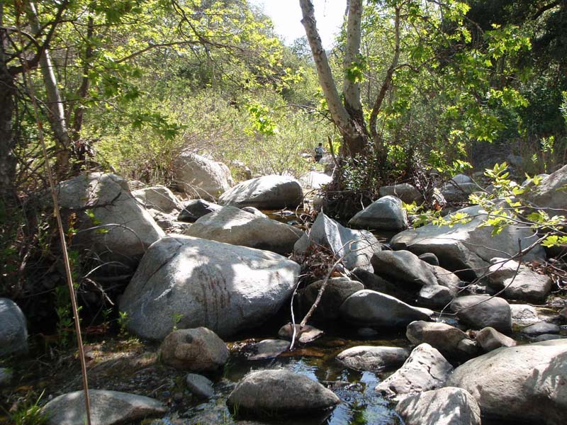
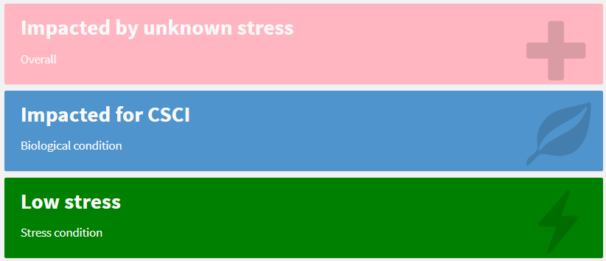
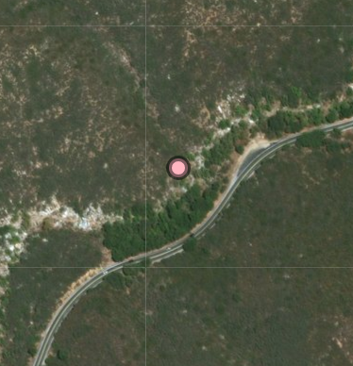
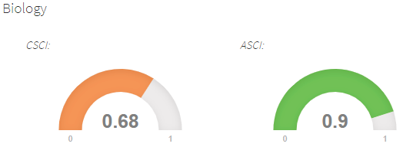
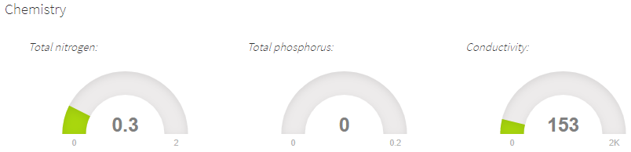
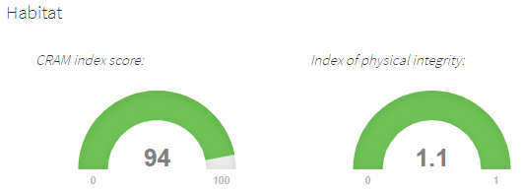
(a) San Diego Creek
(b) San Juan Creek

Slide 4
