Slide 1
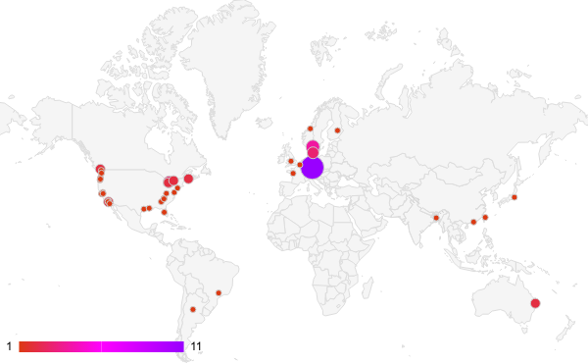
A
Number of Participants
B

