Slide 1
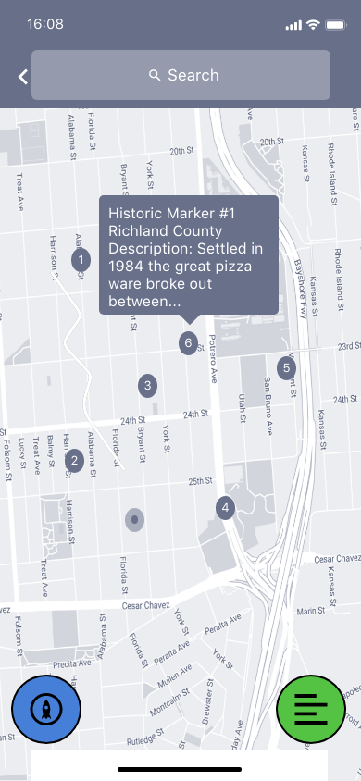
The home screen is mostly an interactive map like the google maps application. The user can zoom in and out, click on a marker for a MARKER Preview. We wanted to keep the app simple and focused, so there are only 2 buttons: MENU and MARKER LIST
Search feature will implement googles SDK for maps.
Tapping this takes the user to the MARKER LIST. This is a textual representation of the markers on the map.
This is the icon to expand the MENU.

