Slide 1


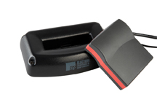
Philip Conrad
Xander Jordan
Myndert Papenhuyzen

Slide 2
Overview
Fall’s Accomplishments
Spring’s Accomplishments
Attack Vectors
Future Work
Notes:
Myndert

Slide 3


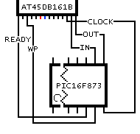
Fall’s Accomplishments
Took hardware inventory
PEB: PIC16 micro-controller
iVotronic: Intel i386 processor
Got equipment for testing
PICKit 3 for PEB
BusPirate
Got Intel hex dump off of PEB & Reader
Notes:
Myndert
Inventory – Chips and datasheets
Equipment – PICKit 3 and Bus Pirate
Hex Dump – Talk about MPLABX

Slide 4
Spring’s Accomplishments
PEB Memory Dump
SPI & UART protocols
Discovered one PEB was dead
Bus Pirate / Signal Eavesdropping
iVotronic JTAG
Machine’s circuitry is not conducive
Missing connections
Notes:
Philip
SPI/UART – Mention what they are
Dead PEB – Some pins weren’t putting out voltage
iVo – Wiring is too complicated and lack equipment to check for continuity

Slide 5
Attack Vectors
PEB – Based Attacks
Changing Votes
Discarding Votes
iVotronic – Based Attacks
Denial of Service
Arbitrary Code Execution
Viral Infection
Notes:
Xander
Changing votes – aware/unaware voter
Discarding votes – use of fleeing voter
Denial of service – bad flash card sends iVotronic into bootloop
Arbitrary code execution – buffer overflow on a stack, can set return address anywhere we want

Slide 6
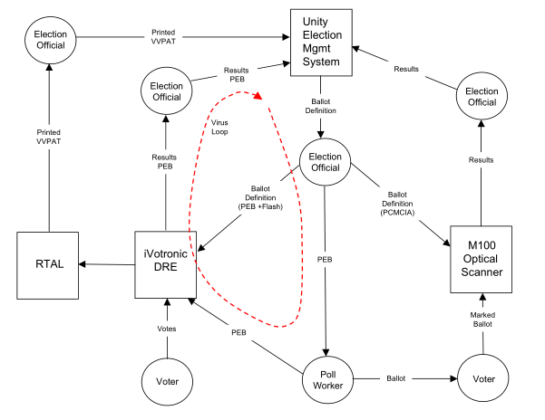

Attack Vectors – Viral Infection
Notes:
Xander
ES&S environment forms one big loop
Unity Election Management System configures PEB, Flash, and PCMCIA cards
These are necessary in calibrating the voting equipment
If we can sneak in a bad flash card and PEB, it is possible to create a ‘Viral Infection’
Infect iVos through bad PEBs
Bad iVos create bad PEBs
Bad PEB returns to Unity, infecting Unity
All media created from Unity will now be bad, compromising the election

Slide 7
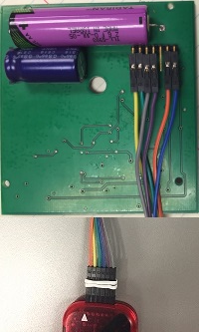
Knowledge for Future Groups
PEB programming pin configuration
PICKit 3 wiring configuration
Programming Environment
Steps for future groups to take
IrDA Stack / Flashing I/O Pins
Rev. Engineer PEB-iVotronic comms.
iVotronic memory modules
Notes:
Phillip
IRDa protocol stack
Reverse Engineering protocol between PEB and iVo
Working with memory modules on the iVotronic

