Slide 1

Philip Conrad
Zac Hughes
Xander Jordan
Myndert Papenhuyzen

Slide 2
Introduction to Project Omaha
Disassembly of ES&S iVotronic voting machine
Goals:
Documentation of all hardware
Includes finding chip datasheets
Hex dump of iVotronic ROM
Hex dump of PEB (Personalized Electronic Ballot)
Stretch Goals:
Look for vulnerabilities in iVotronic/PEB
Decode hex dumps
Notes:
Project Omaha is a collective effort to attempt to fully disassemble an iVotronic machine developed by ES&S (Election Systems & Software) in 1996. The iVotronic is what is known as a Direct Recording Electronic voting machine, or a DRE voting machine, for short.
These systems are notorious for being both extremely vulnerable and buggy. If you google iVotronic bad, multiple results will be returned to you where votes were flipped, not recorded, or just lost entirely.

Slide 3
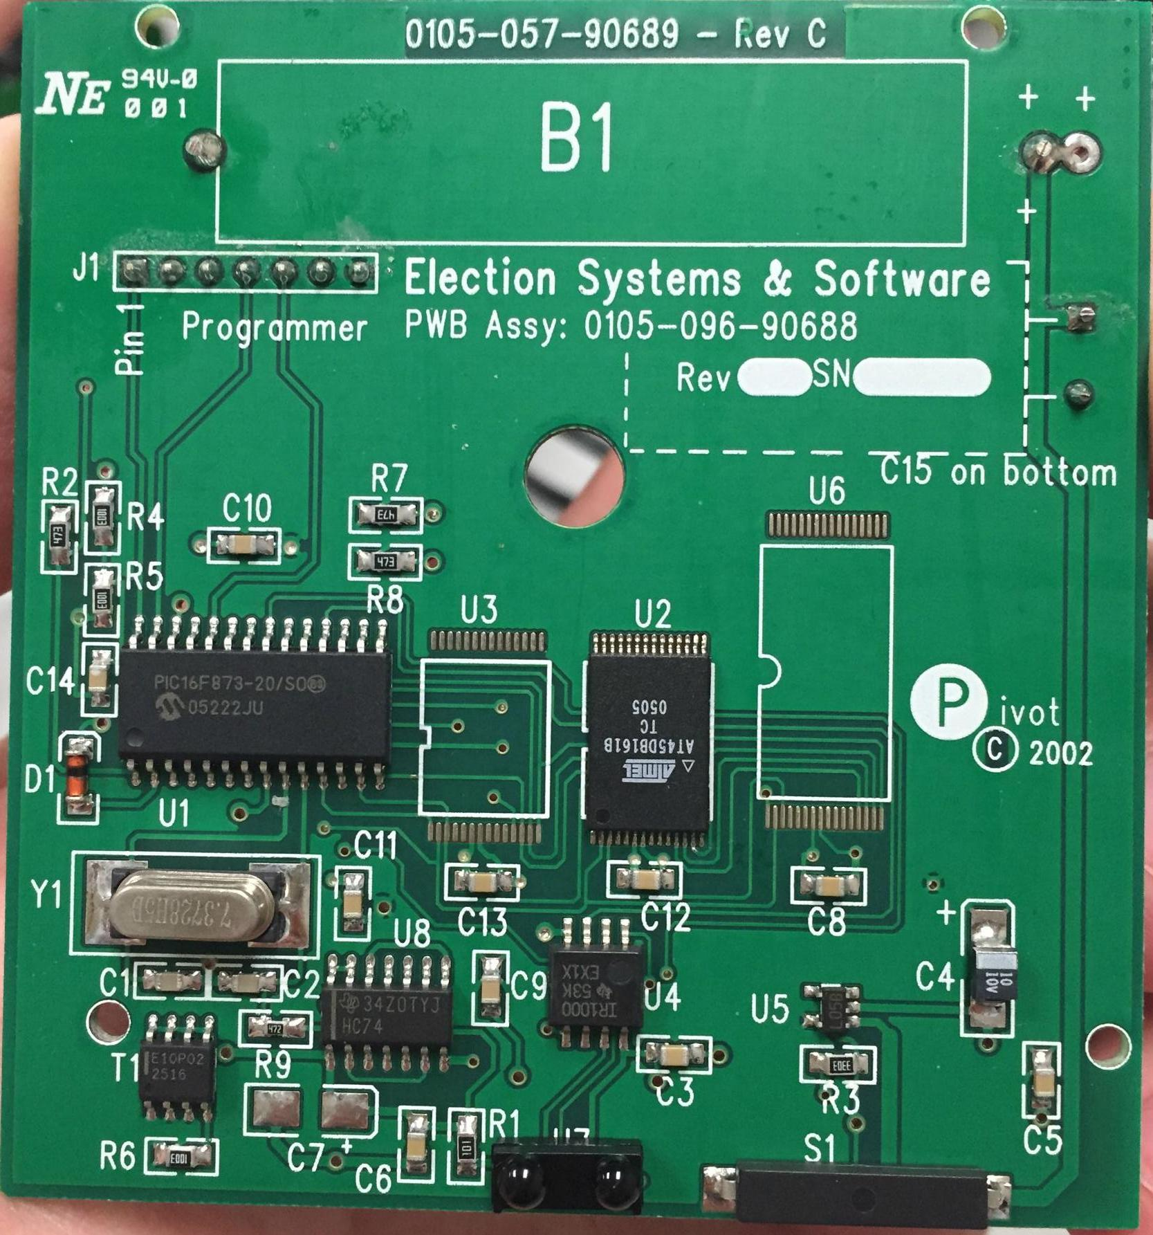
Disassembly (PEB)

Slide 4
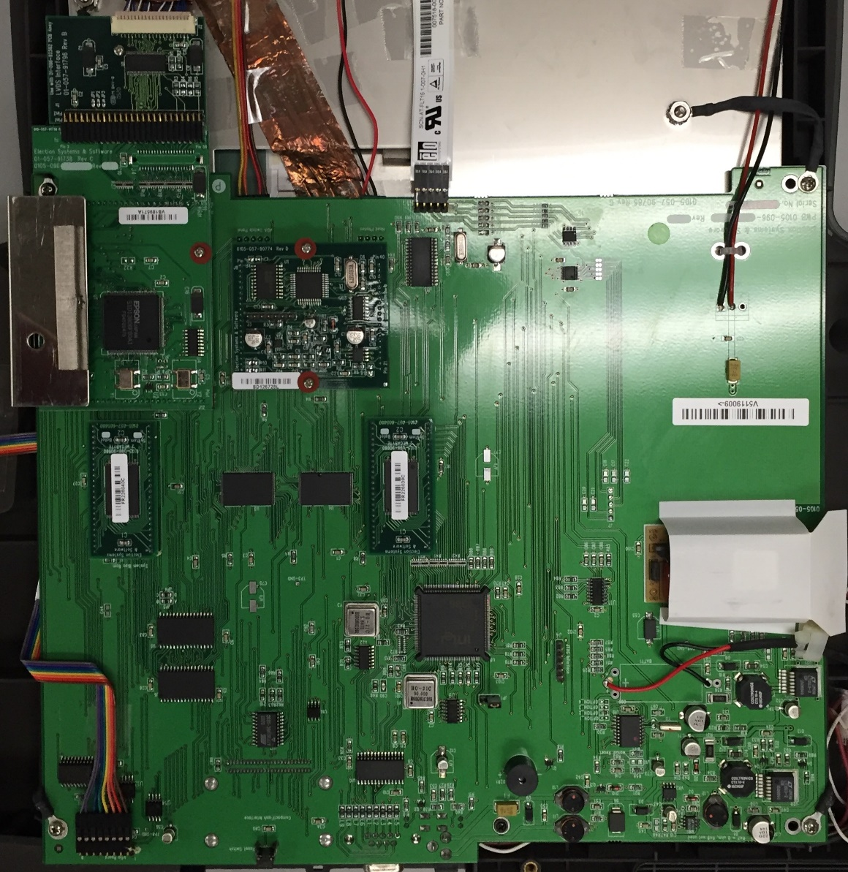
Disassembly (iVotronic)

Slide 5
Hex Dump (PEB)
Hardware used: PICKit3
Software used: MPLab X
Dirty workarounds had to be used
Currently in progress
F00F
What does it mean??
Notes:
Sacrificed first born son

Slide 6
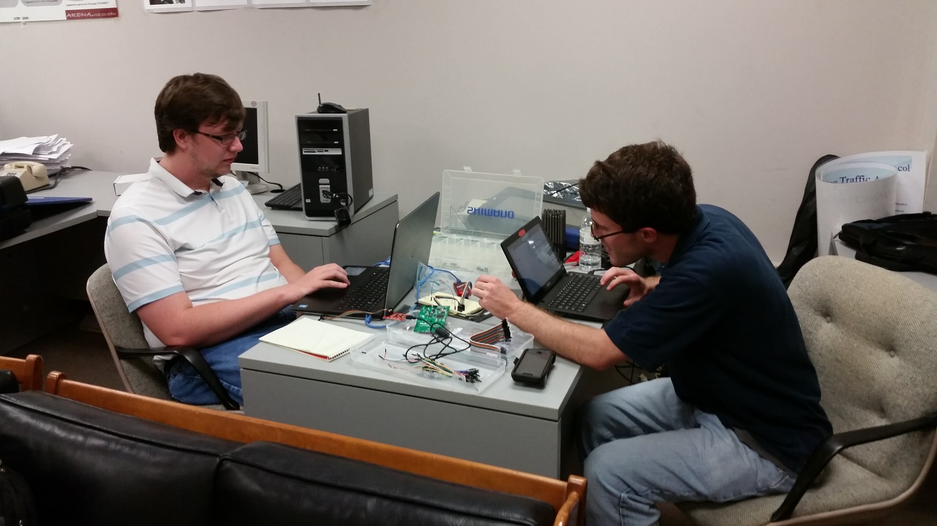
PEB Hacking

Slide 7
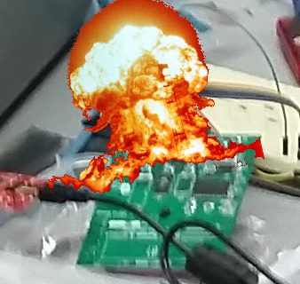
PEB Hacking(?)

Slide 8
iVotronic Hex Dump
Hardware planning to be used: Bus Pirate
Software planning to be used: TBD
JTAG Port will be used to obtain

Slide 9
Progression of Goals
Complete hardware inventory ~(95%)
PEB hex dump ~(60%)
iVotronic hex dump ~(5%)

