Slide 1


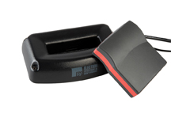
Philip Conrad
Zac Hughes
Xander Jordan
Myndert Papenhuyzen

