Slide 1

Philip Conrad
Zac Hughes
Xander Jordan
Myndert Papenhuyzen

Slide 2
Introduction to Project Omaha
Disassembly of ES&S iVotronic voting machine
Goals:
Documentation of all hardware
Includes finding chip datasheets, gh-pages branch
Hex dump of iVotronic ROM
Hex dump of PEB (Personalized Electronic Ballot)
Stretch Goals:
Look for vulnerabilities in iVotronic/PEB
Decode hex dumps
Notes:
##Xander
Who here votes?
Keep hand raised if voting security is important to you
P.O. stands to disassemble a DRE (Direct Recording Electronic) machine known as the iVotornic from ES&S (Election Systems & Software)
These machines are a security nightmare
Documentation of all hardware: mainly ICs, gh-pages branch (github project website) is dedicated to this
Main Goal: Dump the ROM and PEB in order to look for passwords, vulnerabilities, etc.
If things go better than planned: Stretch Goals

Slide 3
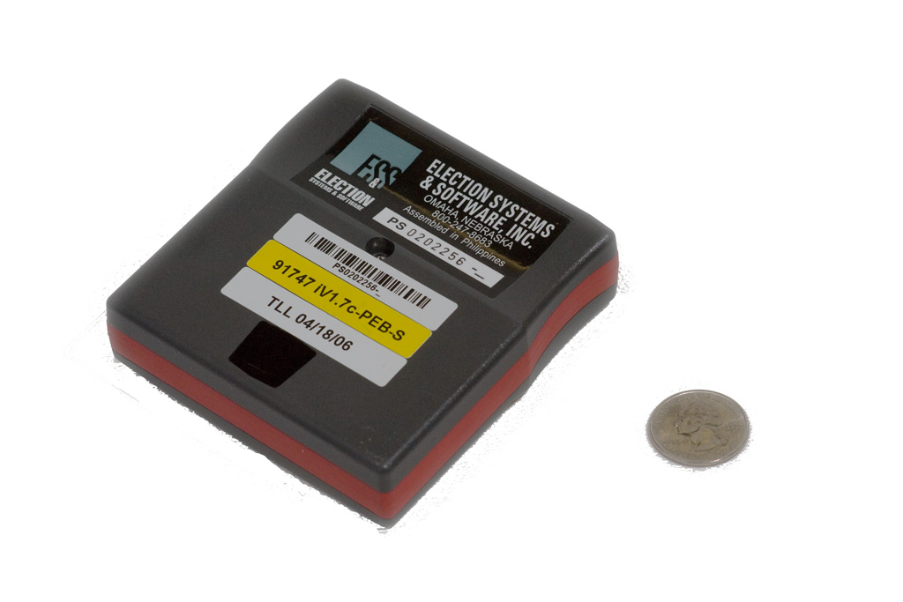
Disassembly (PEB)
Notes:
##Myndert
This is what a PEB looks like, you may have seen a poll worker slot this into the voting machine
Contains poll/election data
IR is used to communicate with the iVotronic

Slide 4
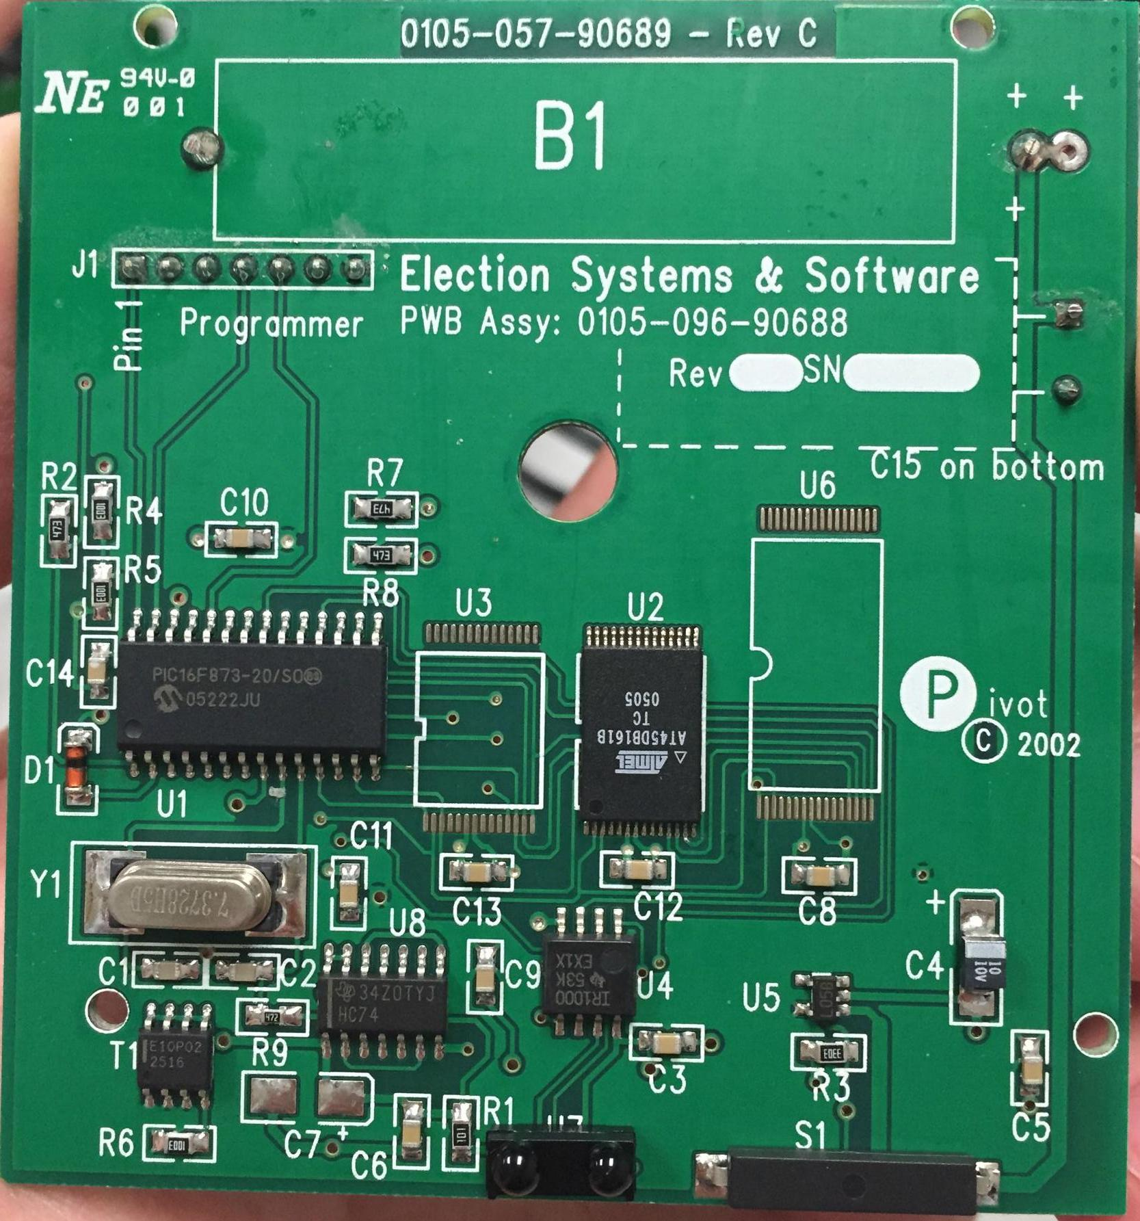
Disassembly (PEB)
Notes:
##Myndert
Inside of a PEB

Slide 5
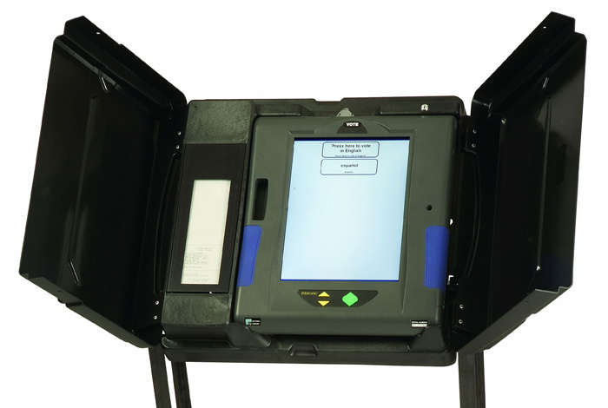
Disassembly (iVotronic)
Notes:
##Zac
This is the iVotronic machine, what you probably have used to vote on in the state of SC

Slide 6
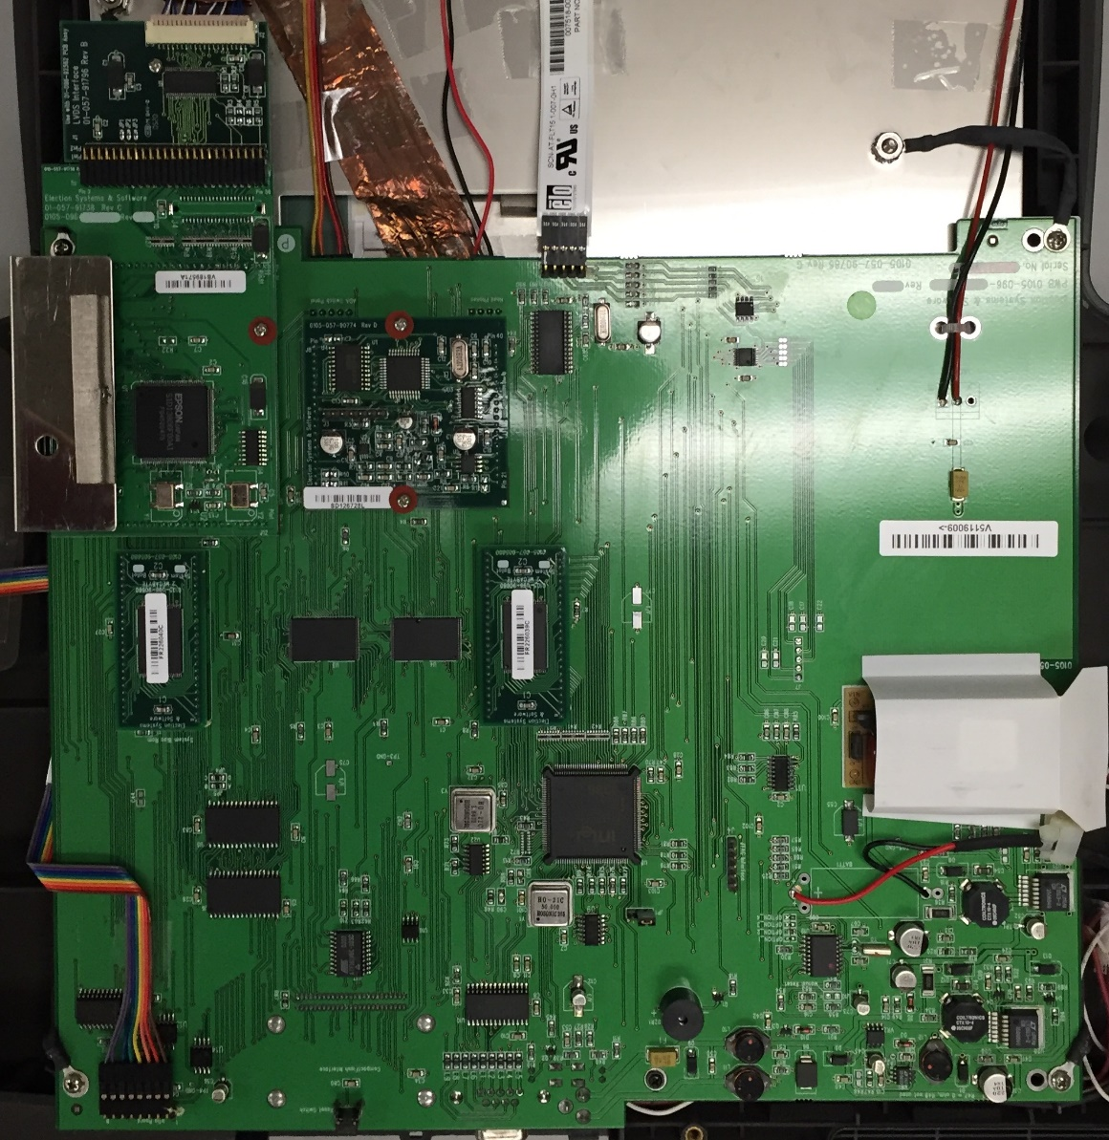
Disassembly (iVotronic)
Notes:
##Zac
Main board of iVotronic

Slide 7
Hex Dump (PEB)
Hardware used: PICKit3
Software used: MPLab X
Dirty workarounds had to be used
Currently in progress
F00F
What does it mean??
Notes:
##Philip

Slide 8
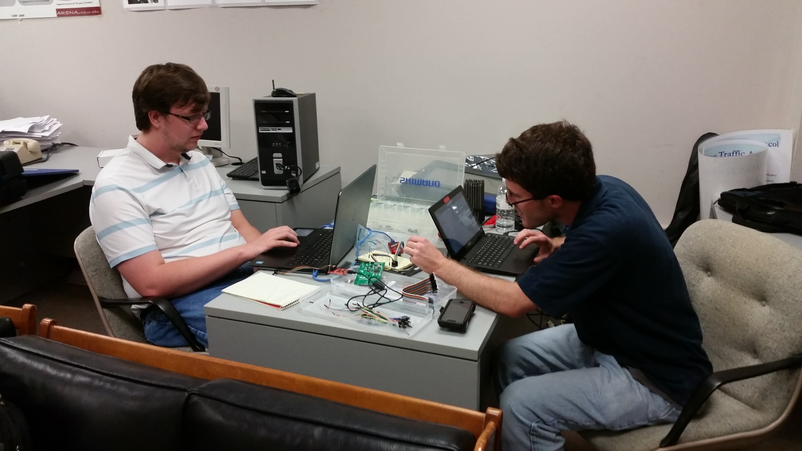
PEB Hacking
Notes:
##Philip

Slide 9
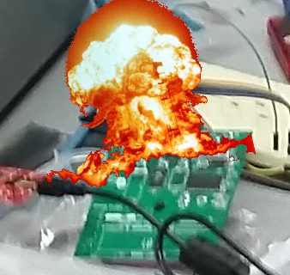
PEB Hacking(?)
Notes:
##Philip

Slide 10
iVotronic Hex Dump
Hardware planning to be used: Bus Pirate
Software planning to be used: TBD
JTAG Port will be used to obtain data
Notes:
##Philip

Slide 11
Progression of Goals
Complete hardware inventory ~(95%)
PEB hex dump ~(60%)
iVotronic hex dump ~(5%)
Notes:
##Zac

