Slide 1
Home Energy Digital Twin
Professional walkthrough: model, results, UX, and operational flow
Date: 2026-02-08

Slide 2
Presentation scope
1. Digital twin from first principles
2. Data architecture and offline-first runtime
3. Controller logic and physical constraints
4. Detailed results and graph diagnostics
5. Tesla-style energy and money flow visuals
6. Deployment and upgrade path

Slide 3
First principles model
Per 5-minute interval:
- Baseline cost = load x price
- Scenario cost = import x price - export x price + degradation
- Savings = baseline - scenario
Physical layers:
- PV output from irradiance and temperature
- Battery SoC dynamics with power and reserve constraints
- Dispatch controller selects charge/discharge/export actions

Slide 4
Assumptions used
PV assumptions:
- 10 kW nameplate, PR 0.82
- Temp coefficient -0.004 / degC
Battery assumptions:
- 10 kWh capacity, 1 kWh reserve, initial 5 kWh
- 5 kW charge/discharge/export limits
- 90% round-trip efficiency
- Degradation term 0.02 AUD/kWh discharged

Slide 5
Data and runtime architecture
Inputs:
- Amber usage/prices (SQLite cache + Supabase history)
- Open-Meteo irradiance near Vaucluse NSW
Execution:
- backtest mode and 5-minute live mode
- writes simulation_intervals + simulation_runs to SQLite
Dashboard APIs:
- /api/simulation/status
- /api/simulation/intervals
- /api/simulation/flow

Slide 6
Controller comparison summary
Latest cached run highlights:
- Optimizer: today +0.0576 AUD, MTD +0.2538 AUD, next24h +0.0394 AUD
- Rule: today +0.0000 AUD, MTD -0.1903 AUD, next24h +0.0030 AUD
Interpretation:
- Optimizer captures price spreads better in this window
- Rule thresholds are easier to interpret but less adaptive

Slide 7
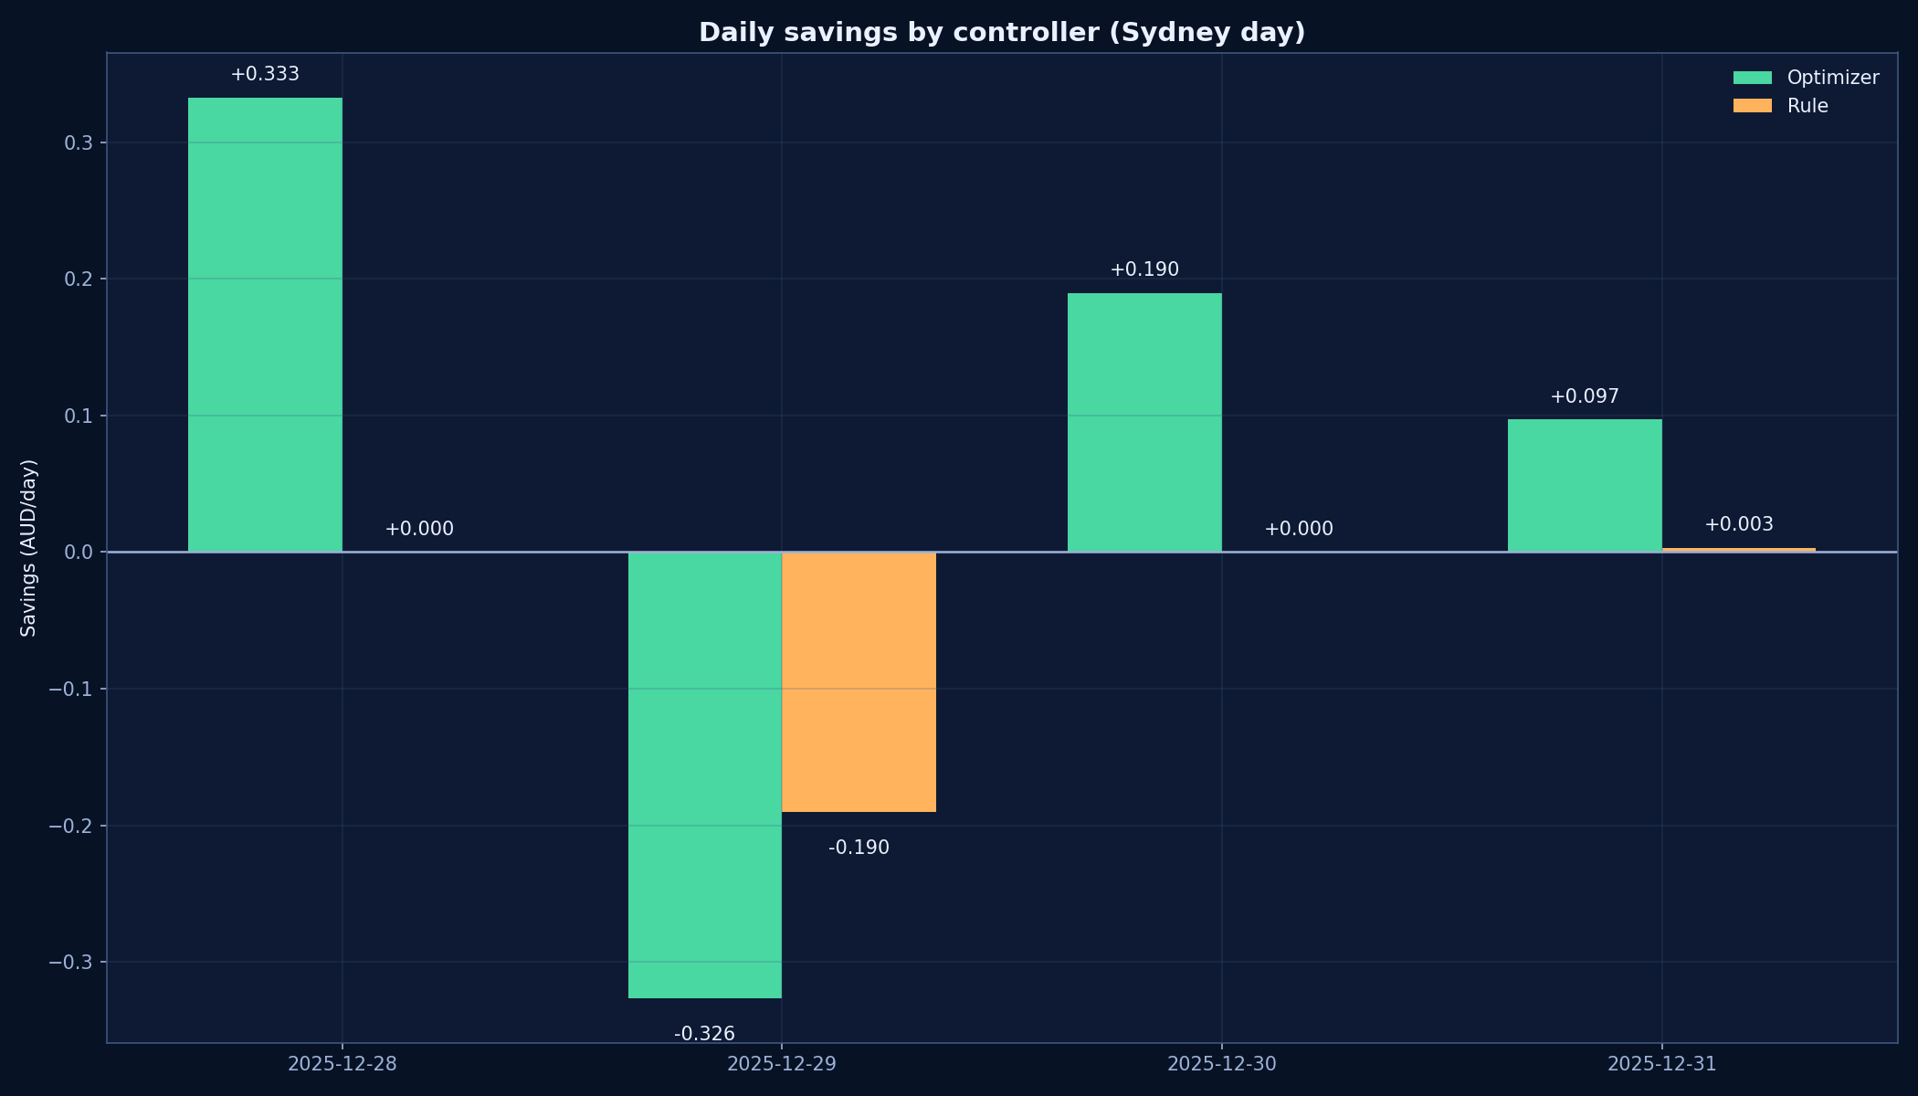
Daily savings by controller
Sydney-day aggregate view of interval savings.

Slide 8
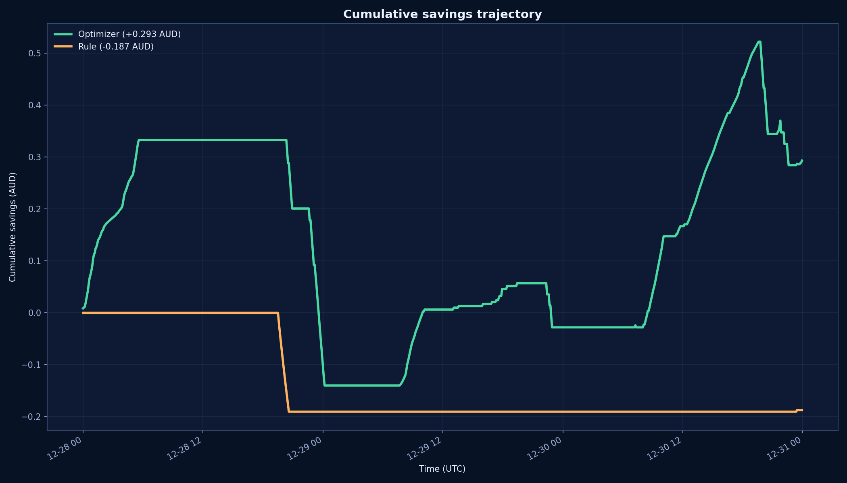
Cumulative savings trajectory
Running savings total over the backtest window.

Slide 9
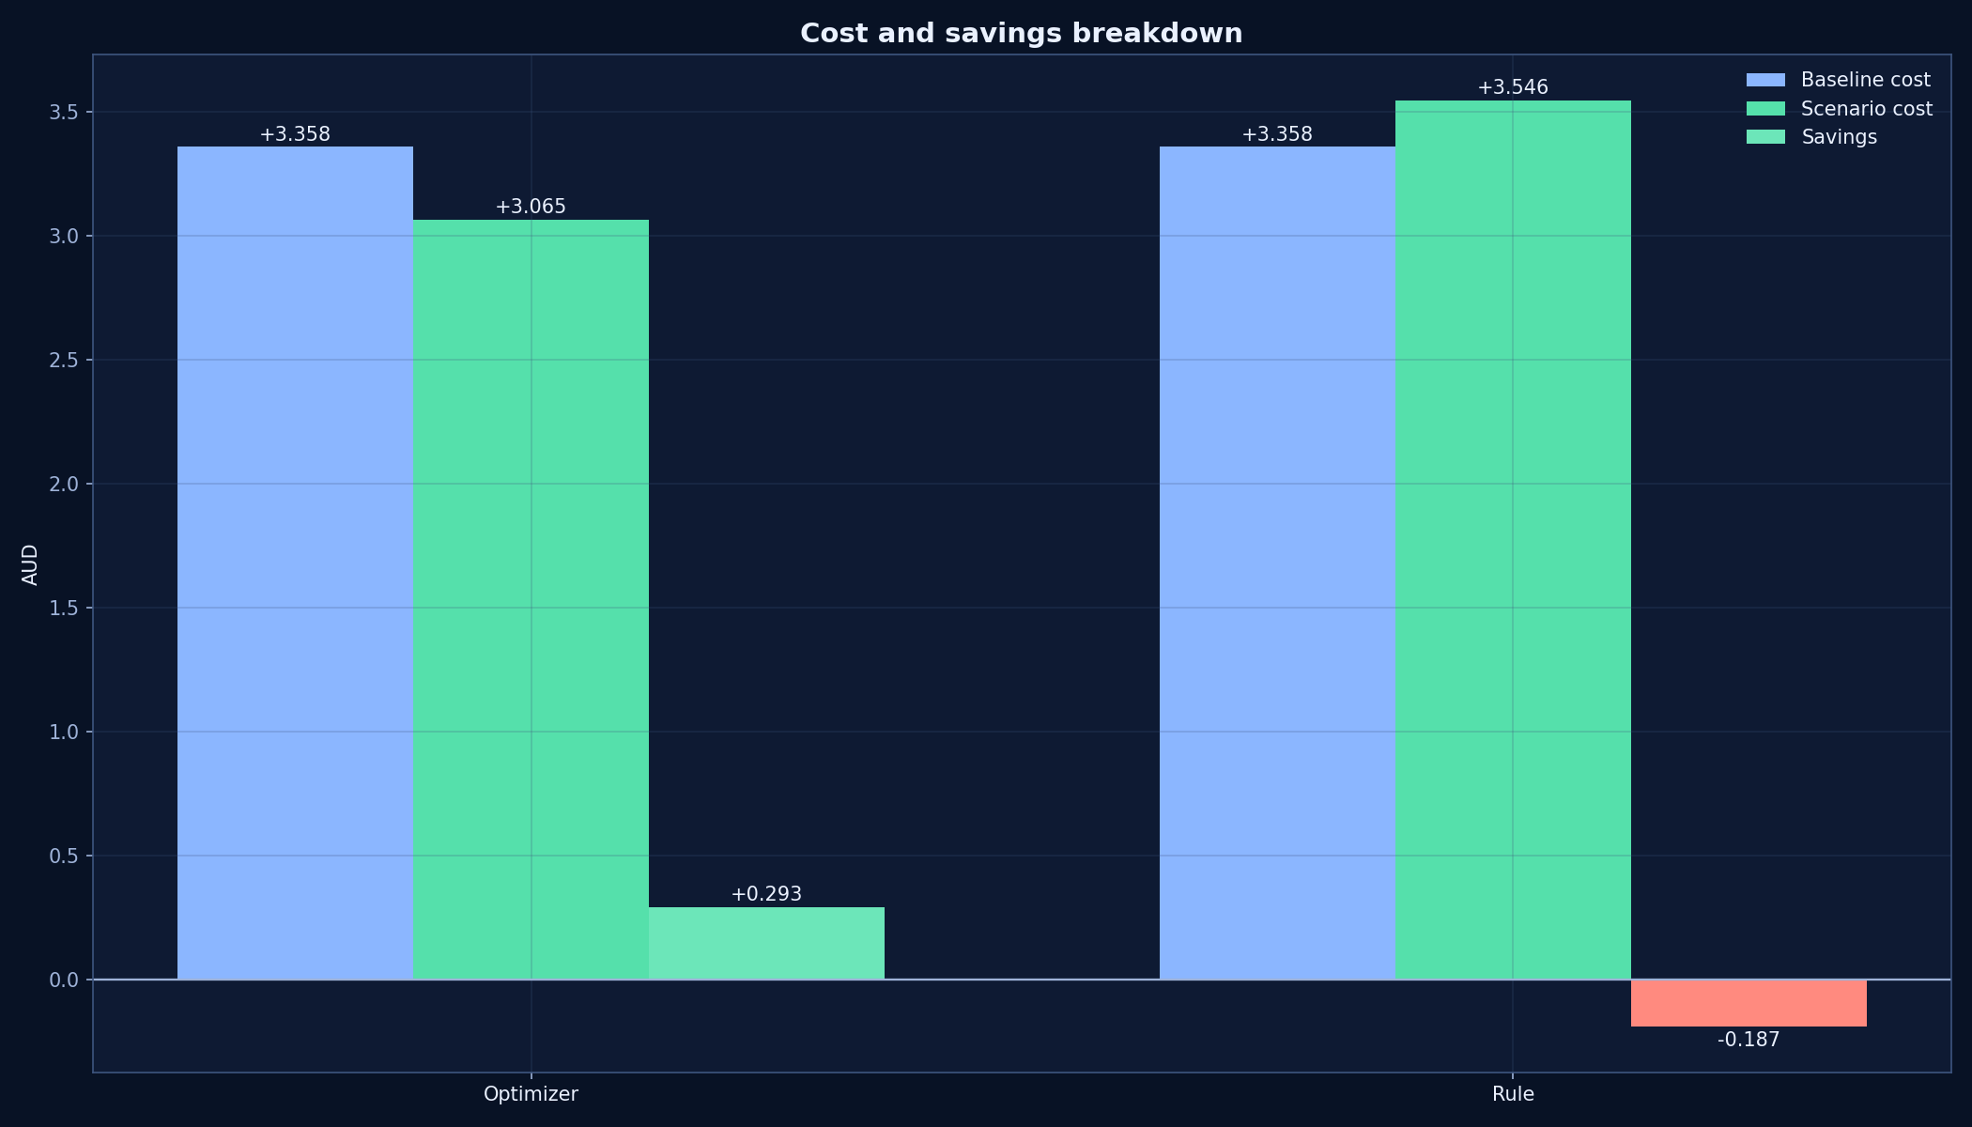
Cost and savings breakdown
Baseline vs scenario cost and resulting net savings.

Slide 10
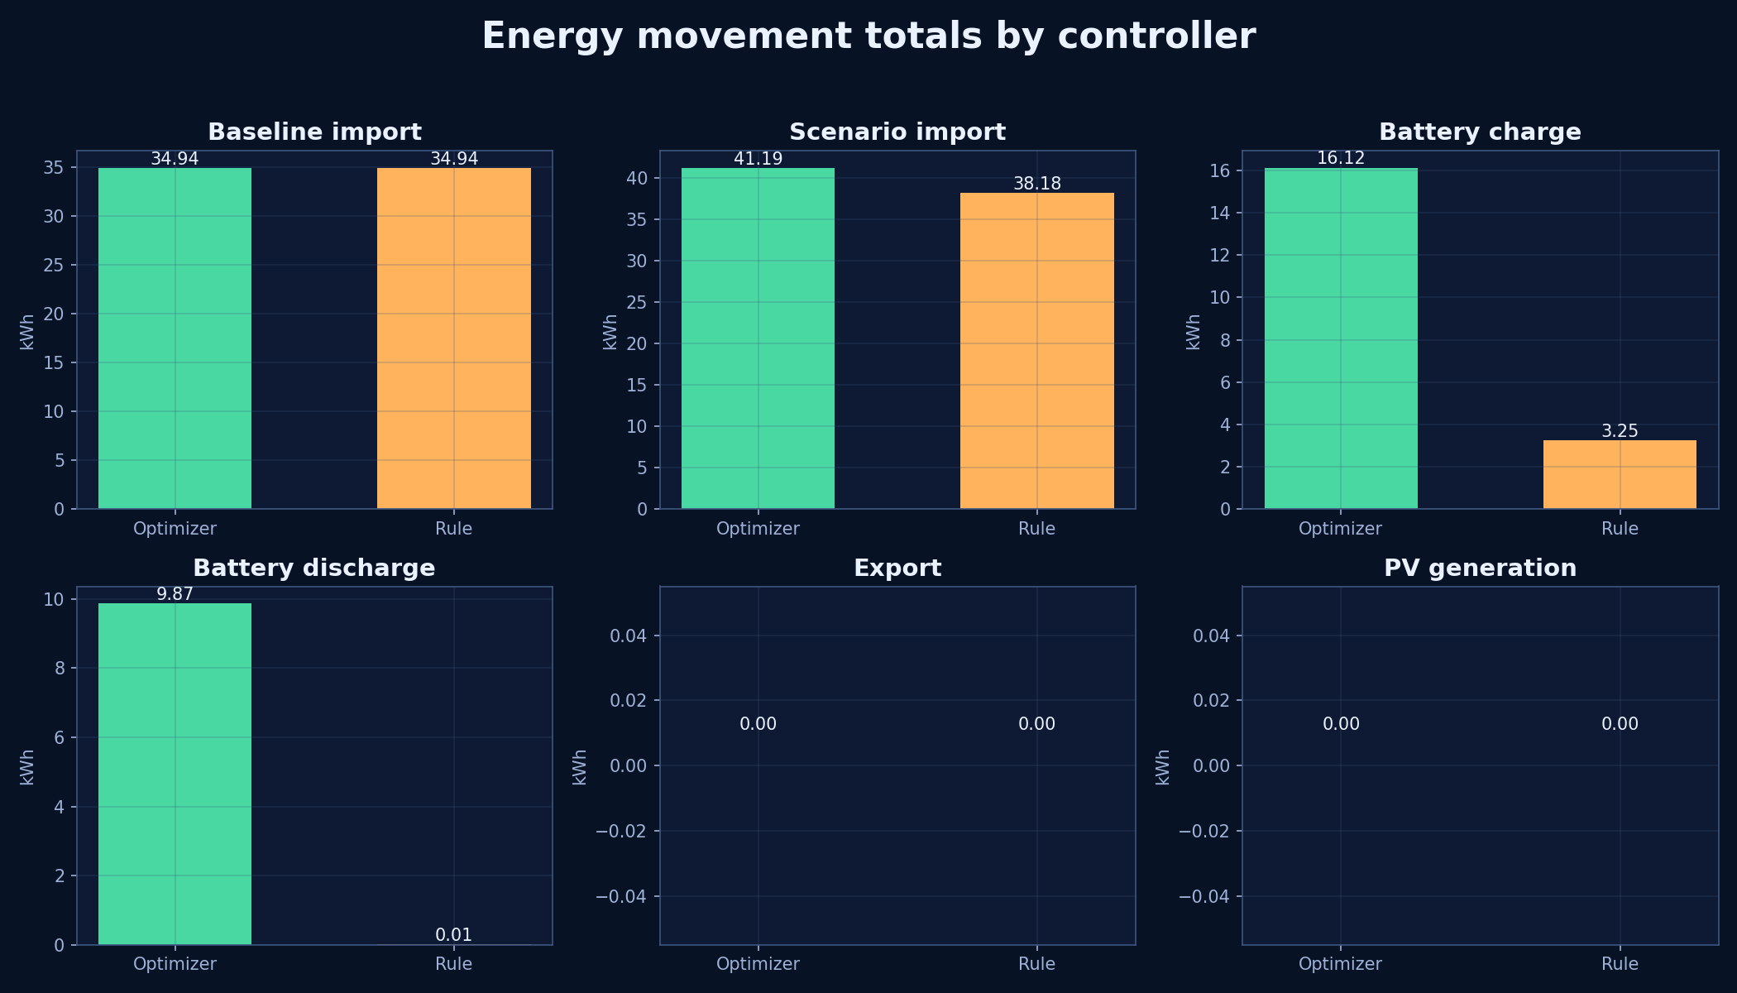
Energy movement totals
Import, charge, discharge, export and PV totals by controller.

Slide 11
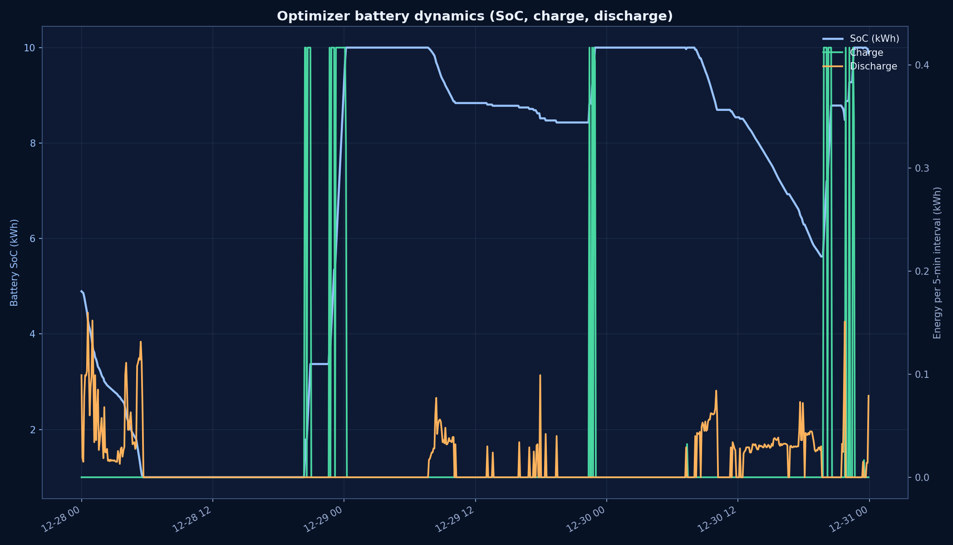
Battery dynamics (optimizer)
State-of-charge and interval charge/discharge behavior.

Slide 12
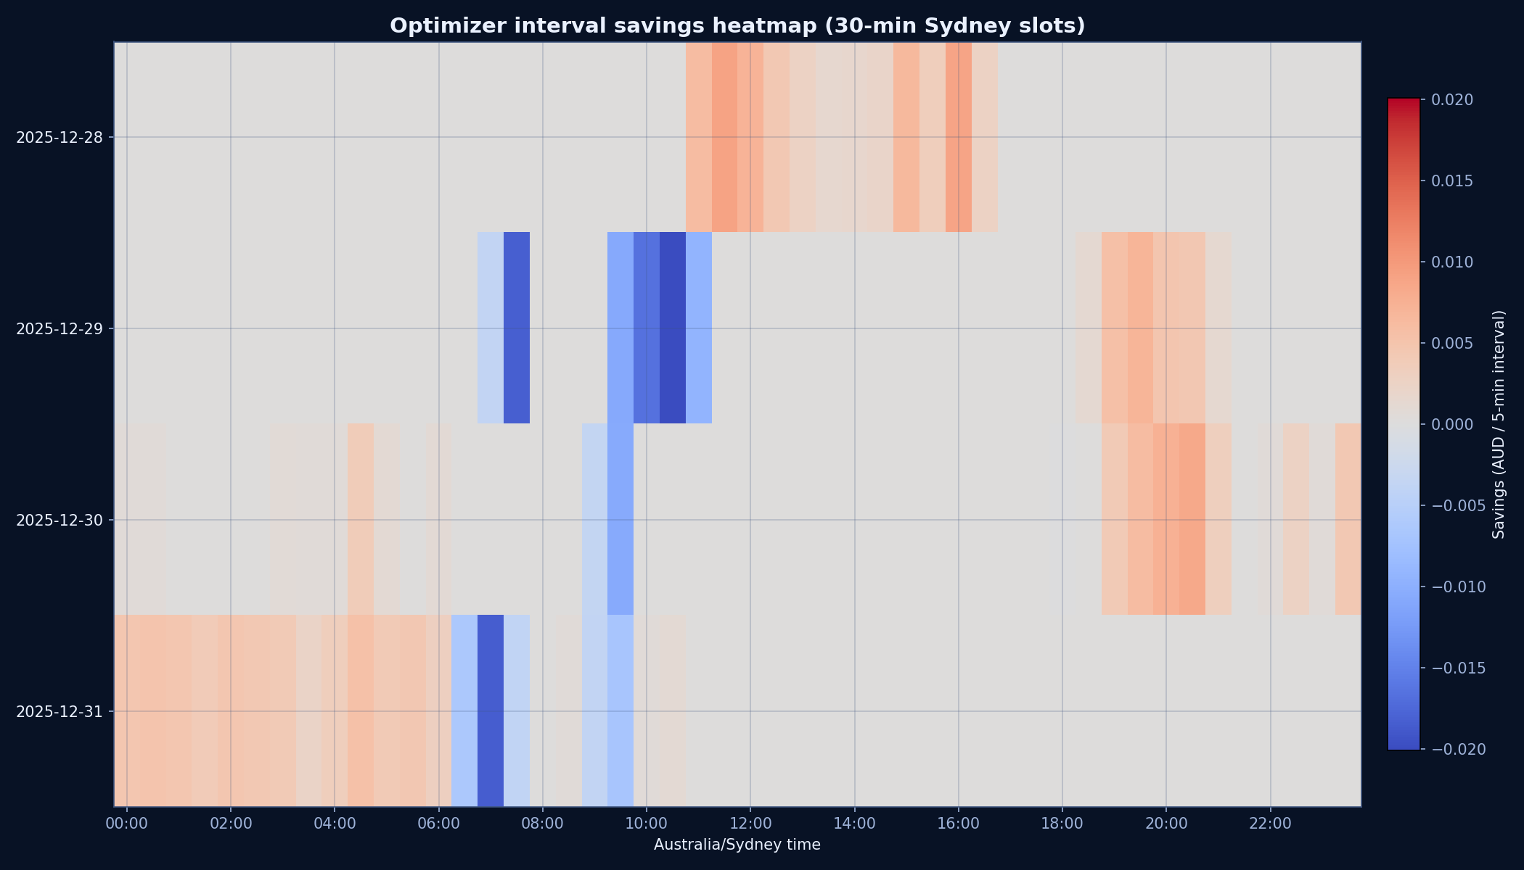
Interval savings heatmap
Optimizer interval savings by Sydney 30-minute slot.

Slide 13
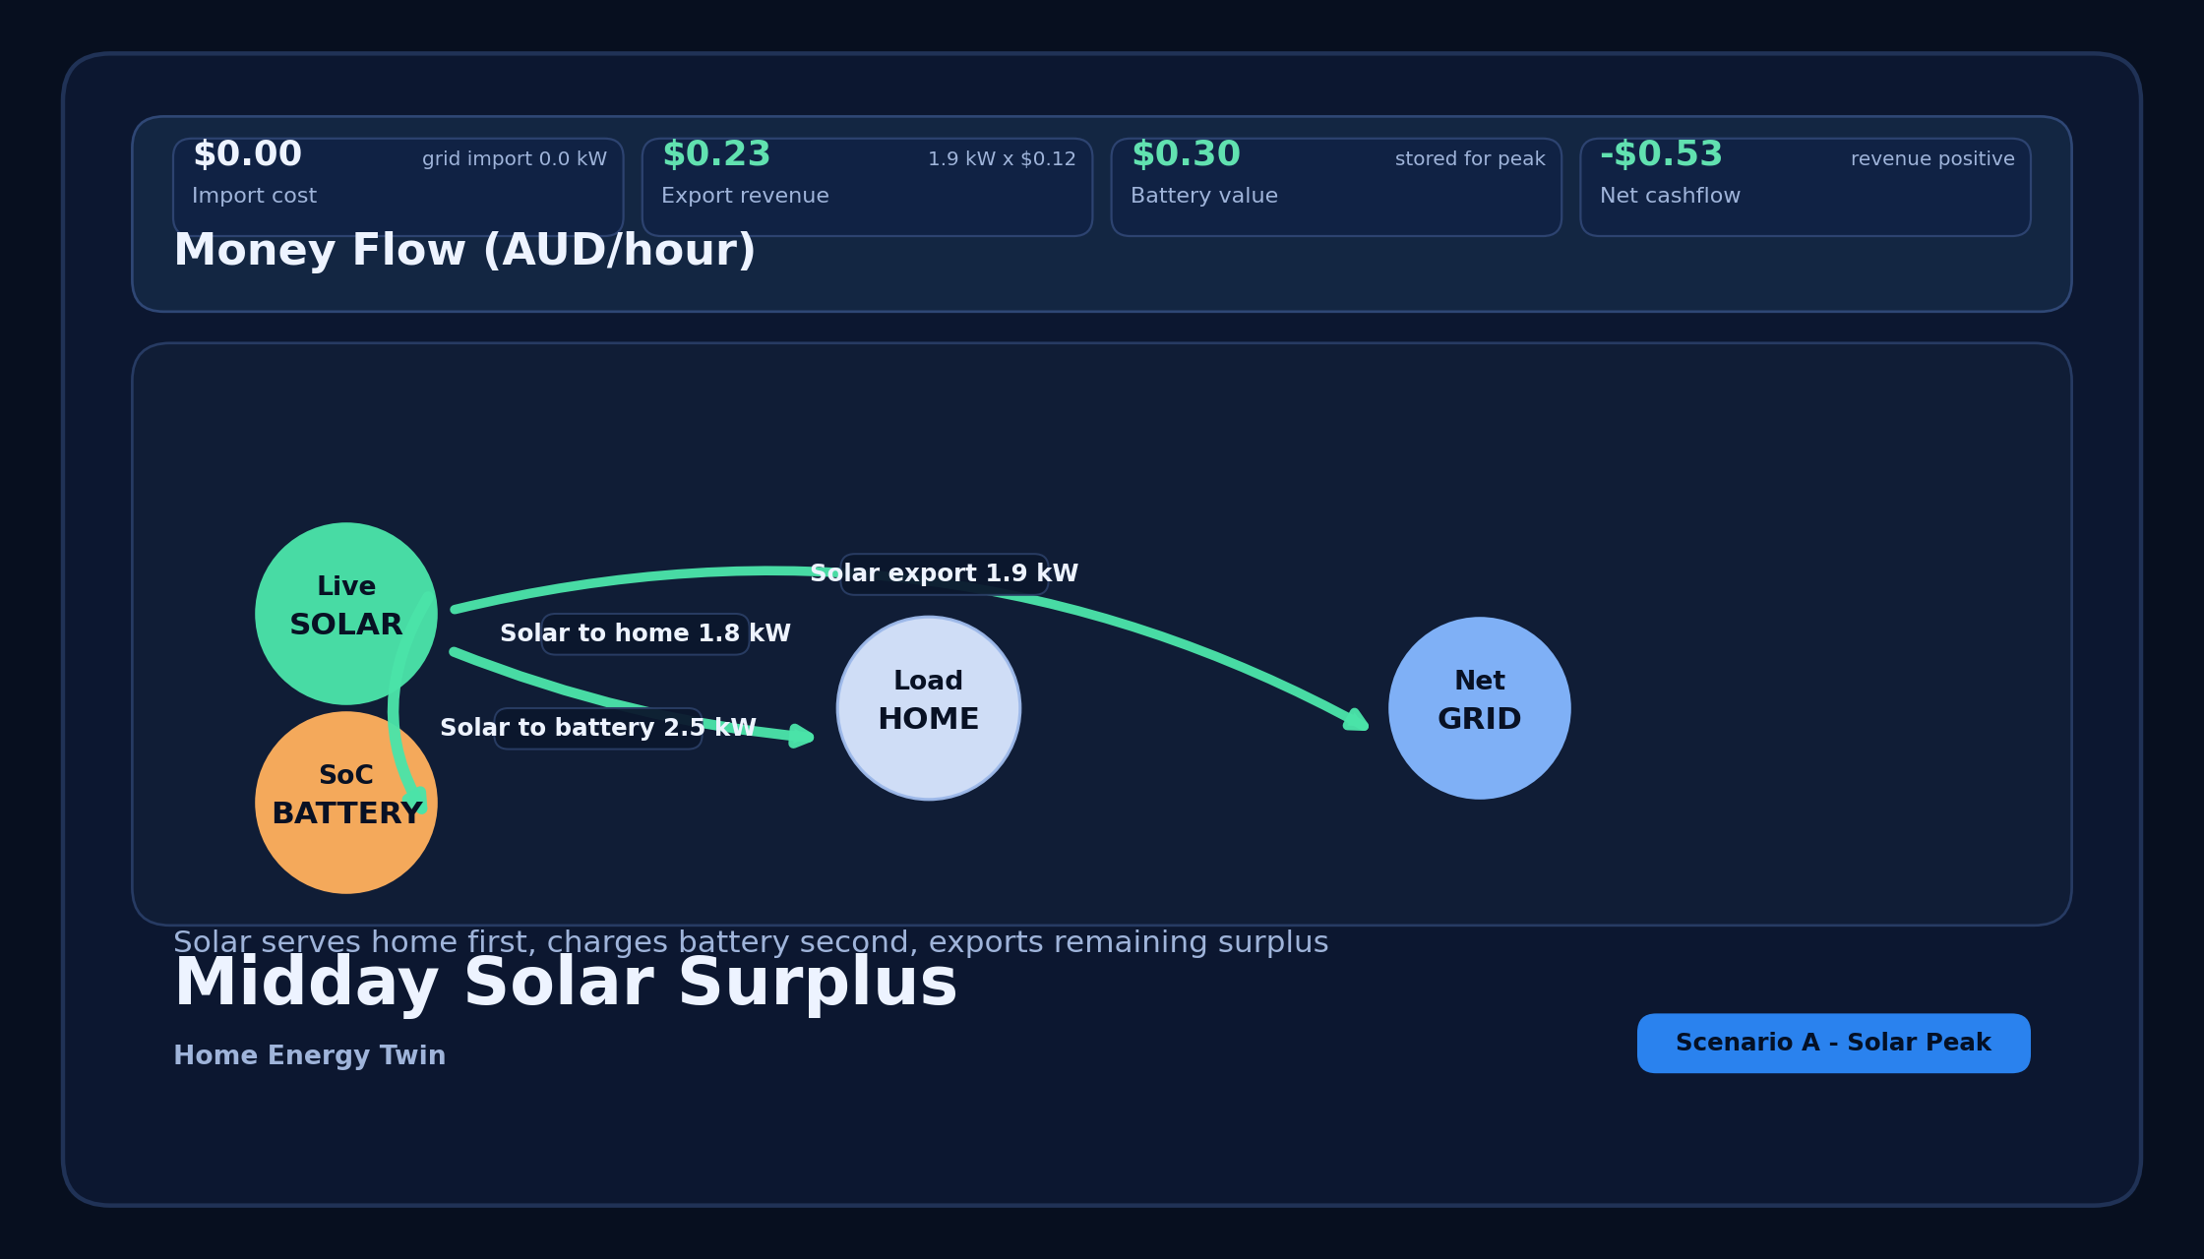
Flow mockup: midday solar surplus
Design objective from Tesla/Home Assistant references:
- separate connection ports to avoid ambiguous center crossings
- directional energy arrows + dedicated money row

Slide 14
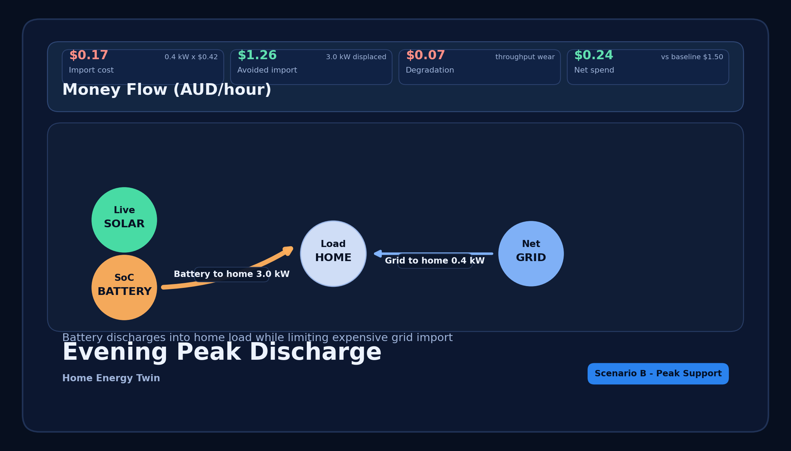
Flow mockup: evening peak support
Battery-to-home path dominates while grid top-up is explicitly smaller.

Slide 15

Flow mockup: overnight arbitrage charge
Grid-to-battery charging path is isolated from grid-to-home path for clarity.

Slide 16
Dashboard UX changes delivered
Main dashboard:
- stronger hierarchy, premium card styling, clearer status chips
- simulation status integrated in Data Status panel
Simulation dashboard:
- Tesla-style live flow board
- money flow cards (import/export/net/savings)
- stale indicators and as_of surfaced in header

Slide 17
Operational behavior
Live simulation job:
- run_simulation_live.py every 5 minutes
- cache-first writes to SQLite simulation tables
API behavior:
- always includes as_of and stale flags
- supports offline dashboard reads
- avoids blocking UI when upstream APIs are unavailable

Slide 18
Recommended next upgrades
1. Deterministic weather fallback (clear-sky + cached blend)
2. Optional LP/MILP optimization backend
3. Network tariff and feed-in asymmetry modeling
4. EV/V2H coupling scenarios
5. Automated reconciliation report to validate savings confidence

Slide 19
Reproducibility commands
.venv/bin/python scripts/run_scenario_simulation.py --mode backtest --controller optimizer --site-id 01J061Q7Q883JF26YMGZVVTMV9 --start 2025-12-28T00:00:00Z --end 2025-12-31T00:00:00Z
.venv/bin/python scripts/run_scenario_simulation.py --mode backtest --controller rule --site-id 01J061Q7Q883JF26YMGZVVTMV9 --start 2025-12-28T00:00:00Z --end 2025-12-31T00:00:00Z
MPLBACKEND=Agg MPLCONFIGDIR=/tmp .venv/bin/python scripts/generate_simulation_presentation_pngs.py
.venv/bin/python scripts/generate_flow_mockup_pngs.py
.venv/bin/python scripts/export_simulation_pptx_with_keynote.py

