Slide 1
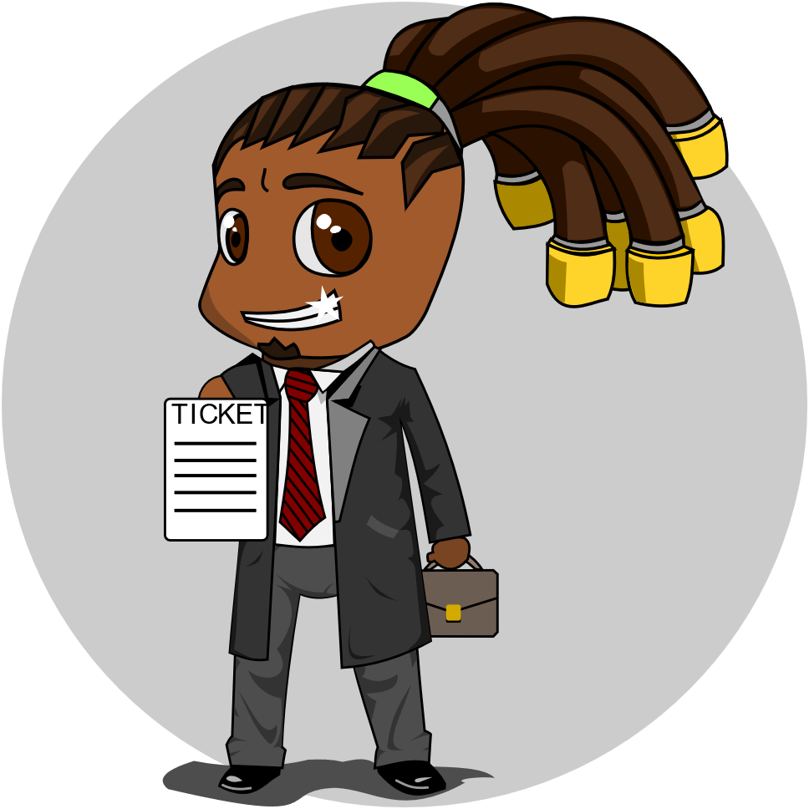
TicketMan®
Support Tickets Database Manager System

Slide 2
Personnel:
Ivan Rubinson - Lead programmer ,Designer
Ilan Kroter - Lead QA ,Programmer
Stav Lobel - Documentation ,Programmer ,QA
Alon Gabay - Documentation
Ron Shokoury – Programmer ,QA
Ilan Tulepov - Programmer
Lidor Zaguri – Programmer ,QA
Itay Kalaf - Documentation

Slide 3
Purpose:
In many organizations which have a technical support department, there needs to be a management and control system that could handle the vast information of many technical problems they are in charge of, this system is rooted on the company workers and their ability to use this kind of information to solve their problems in the best possible way.

Slide 4
Requirements:
Our product had a lot of requirements that we was needed to address .
Some of this requirements we will show to you in the next slide .

Slide 5
Requierment No.1 - Log-in & Authentication
In this requirement we needed to create a Login system that will restrict the product only for the client's workers and also for documentation of the ticket’s creator contact details .
To answer that , we have created a database that will contain all the user's information and contact details for the tickets creation as also to authenticate the user when log in with username and password that are saved in the database .

Slide 6
Requierment No.2 - Create service call
For the support tickets database manager system we need of course ,Tickets .
So we created after the login phase a service call creation system that can be accessed through the client’s workers and also by the IT team of the client .

Slide 7
Requierment No.3 - Update tickets
We know that every service ticket need to be handle and eventually be closed .for that ,A ticket needs to be updated ,edited ,changed and in the end closed .
So we have created an update system for our system that can do all of these ,like update the ticket stakeholders ,adding notes ,changing contact details and of course ,update the ticket status and close it .

Slide 8
Data Flow Diagram
For us to show you an overall view of the system and how it works ,we have created a data flow diagram to demonstrated it …

Slide 9

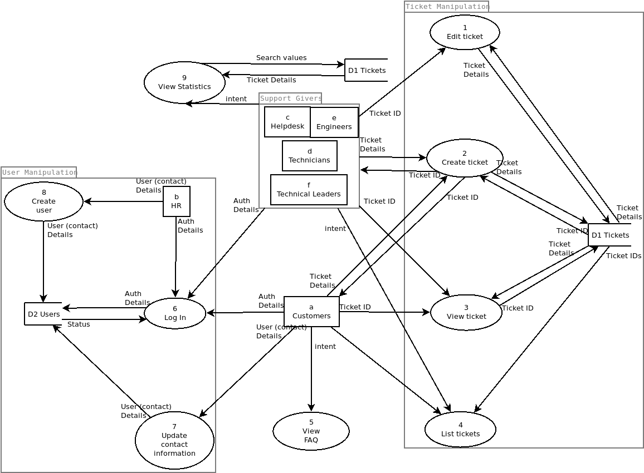

Slide 10
Main challenges in the testing phase
How to address all the parts of the product and be sure we have covered 100% of it ?
The developers were also the testers ,So how can we know we’ve tested the program objectively ?
The size of the QA group was small ,So how can we manage to split the work between all of the group ?
There are many subsystem in the product that are relay on each over (like the user’s database and the login feature) ,So how can we test one subsystem without interfere the other subsystem ?

Slide 11
Unresolved Issues
We didn’t complete a GUI interface ,Thing that cost us in the UI experience .
The lack of GUI has also cost us in the statistics and analyze feature without allowing us display graphs and charts to the user .
The System cannot work online .Which mean that the system isn’t capable to work within separate users at the same time .

Slide 12
Risks in Develop
Checking all the time that we are work with the requirements of the customer (working with the SRS doc) .
Be able to communicate with all the develop group and check that we are synced with each other and know on what everyone is working on.
Running on tight Schedule is a catalyst to mistakes and skipping important steps ,So we needed to check all the time on our working process that is done correctly .

Slide 13
The End of the presentation .
And now we move to the demonstration …

