Slide 1

Latha Muddu-29
Pallavi Ramineni-49
Rajaramya Janagama-17
Swetha Chandra Karroti-21

Slide 2
Motivation
The motive of this application is to share books among registered users.
With just one touch the user could select the desired book and request the users for the same.
Our basic idea for selecting this project is to utilize time effectively and increase the accessibility of the books.
Based on the various features available, user can select the best book he needs in an easy way.

Slide 3









Features
Register & login
Forgot Password and Reset
Dash Board
-Add New Book
-My Books
-Notifications
-Invite Contacts
Wish List
Book Central
Book Reviews
Account
-Change Password

Slide 4
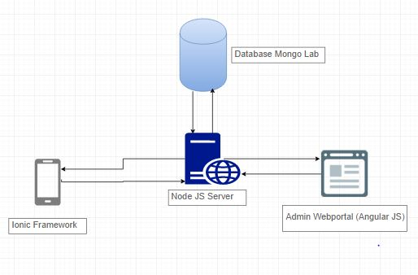
System Architecture

Slide 5
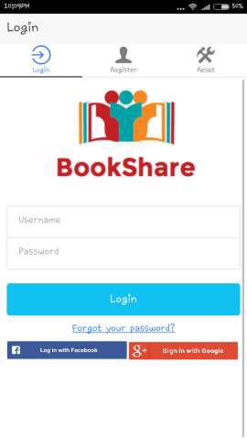
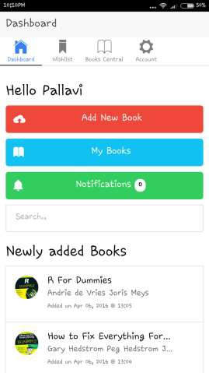
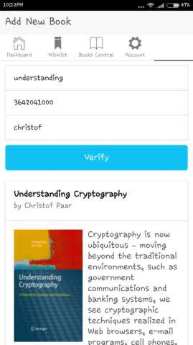
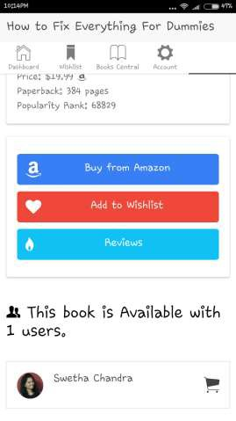
Screenshots

Slide 6
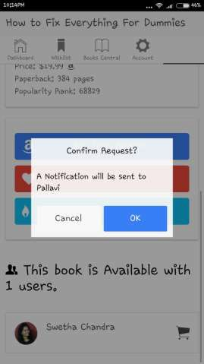
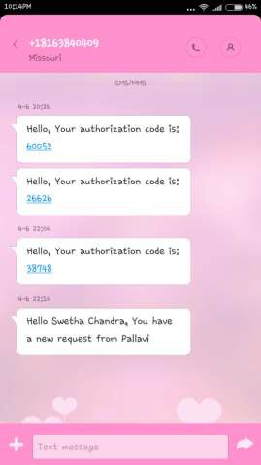
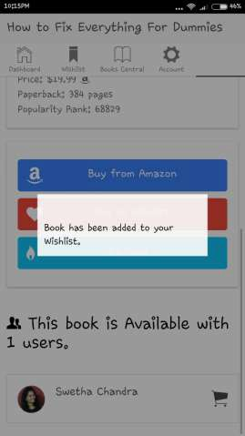
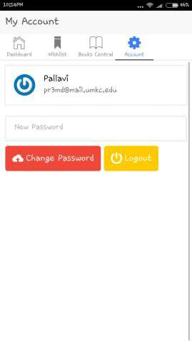
Screenshots(Cont..)

Slide 7

Any Queries?

Slide 8


