Slide 1
HEARTFIT
By
Harshini Medikonda - 14
Abhiram Ampabathina - 1
Hirenbhai Harshadbhai Shah - 27
Dinesh Reddy - 19

Slide 2
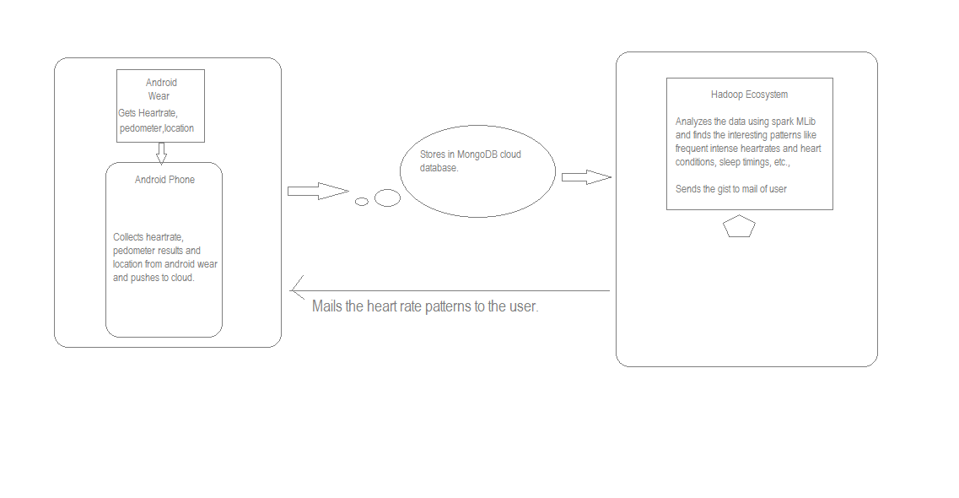

Slide 3
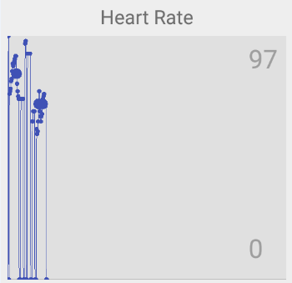
DATASET:
Heart Rate | Step count | Timestamp | Geolcation
80 | 123 | TS | Kansas city, MO
76 | 453 | TS
87 | 324 | TS
67 | 125 | TS
76 | 453 | TS

Slide 4
WORKFLOW:
Collect heart, rate, step count, time stamp
STORE in mongolab
Analyze with ML algorithms
Recommend user with exercises, diet
Graphical representation

