Slide 1
HEARTFIT
By
Harshini Medikonda - 14
Abhiram Ampabathina - 1
Hirenbhai Harshadbhai Shah - 27
Dinesh Reddy - 19

Slide 2
FEATURES:
Notifying the health conditions using smart watch and smart phone
Recommend diet and exercises to be done by the user
Have a medical record, convenient and cost efficient
Can notify abnormal heart rate immediately.
Can notify sleeping, cardio activities and anxiety patterns to the user.

Slide 3
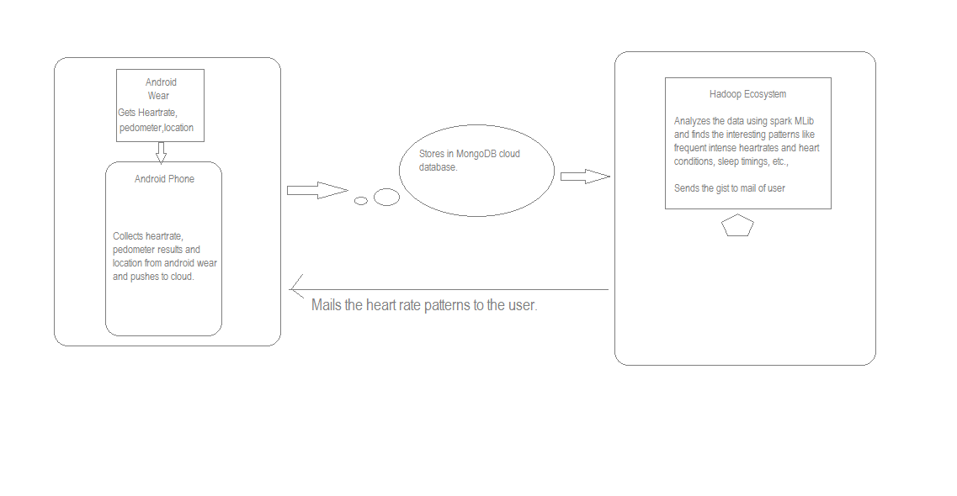

Slide 4
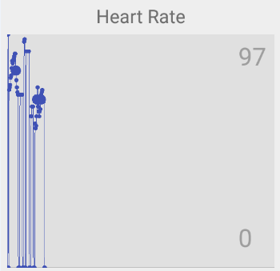
DATASET:
Heart Rate | Step count | Timestamp | Geolcation
80 | 123 | TS | Kansas city, MO
76 | 453 | TS
87 | 324 | TS
67 | 125 | TS
76 | 453 | TS

Slide 5
WORKFLOW:
Collect heart, rate, step count, time stamp
STORE in mongolab
Analyze with ML algorithms
Recommend user with exercises, diet
Graphical representation

