Slide 1
HeartFit
Abhiram (ClassId 1)
Hiren Shah (ClassID 27)
Harshini (ClassID 14)
Dinesh Paduru (ClassID 19)

Slide 2
Features
Monitoring Heart rate per hour to indicate any abnormal behavior
Sleeping pattern Mining, to monitor how well user is sleeping by collecting accelerometer events
Recommending matching food item having similar nutrient

Slide 3
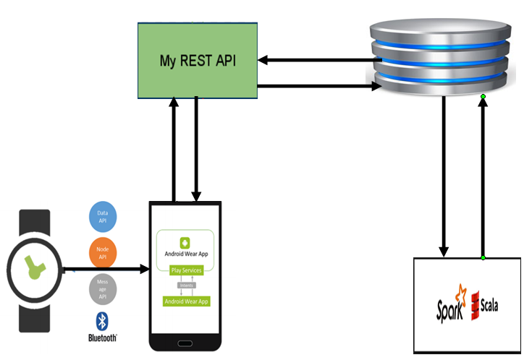
Architecture

Slide 4
Data Collection
Two types: Real time and Static
Real Time Sensorial data : Heart rate and accelerometer sensors
National Nutrient Database for Standard Reference : for matching nutrient food recommendation.
Its Static database for now. Need to update when their library gets updated.

Slide 5
ML Algorithms
Spark MLlib Apriori for frequent pattern : FP growth inbuild algoritham in Spark Mllib.
For finding the frequent heart pattern for previous hour heart rate data and representing them as a chart.
The purpose is to provide number of occurrence of particular heart bit in an hour cycle.

Slide 6



ML Algorithms
Cosine Similarity : Content/feature based collaborative filtering for recommending food items having similar nutrition.

Slide 7
Referenaces
http://www.ars.usda.gov/Services/docs.htm?docid=8964
ftp://ftp.tik.ee.ethz.ch/pub/students/2010-HS/SA-2010-26.pdf
http://www.ceng.metu.edu.tr/~e1395557/foodRecSys.pdf
https://bioinformatics.oxfordjournals.org/content/suppl/2009/10/24/btp613.DC1/bioinf-2008-1835-File004.pdf
http://blog.echen.me/2012/02/09/movie-recommendations-and-more-via-mapreduce-and-scalding/

