Slide 1
ROBOCARE
Big Data Analytics and Applications (CS5542)
GROUP 4
Dara Venkata Sai Sandeep - 5
Khandelwal Shuchita - 10
Podili Venkata Krishna - 23
Sawant Anuja Ajay - 25

Slide 2
Features:
Facial recognition technique to authenticate the user
Data collection from the user inputs in different forms
Diagnose the disease
Suggest nearest doctor
Notify the user

Slide 3
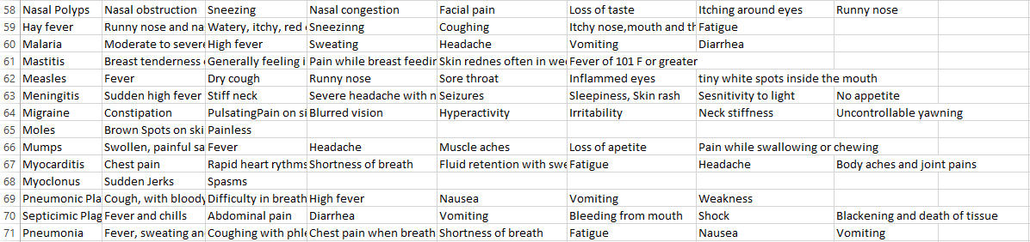
Dataset:
Fig. Instance of the diseases.csv

Slide 4
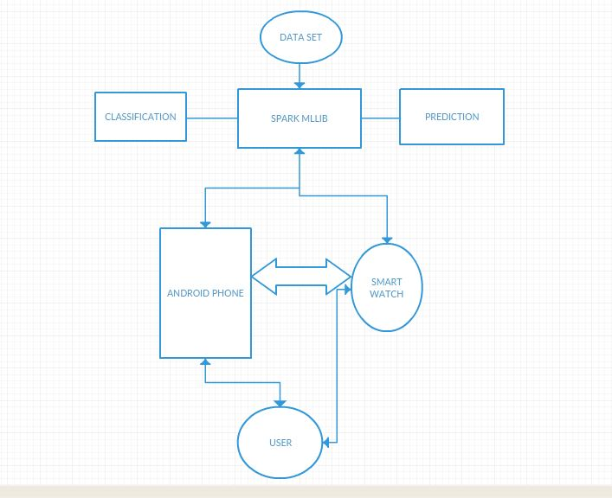
Workflow:

Slide 5
Thank You !!!!

