Slide 1


BaymaxDuo
Ting Xia 30
Wei Huang 9
Mohamed Gharibi 7
Vipin Reddy 24

Slide 2
Overview
In our project we have created an application which collect the pictures from Instagram along with the sentiment analysis and run the machine learning algorithms on these collected pictures over Spark. Moreover, after we have done this we make the recommendations based on our results. After that, we get another pictures and compare it with our results to check whether the image category and the recommendations are the same or not.
Moreover, we are collecting the streaming tweets form Twitter and make the sentiment analysis over these tweets. As the previous part, the main point here is to make the recommendation after having the sentiment analysis results.
Note: The main idea of the project is that making a common interests of a user according to his activities' in Twitter and Instagram.

Slide 3
Tools we used | Machine Learning Libraries/algorithms
Android Studio | Naïve Bayes
IDE Intellij | K-means
Spark | Stanford.nlp
 | ALS

Slide 4
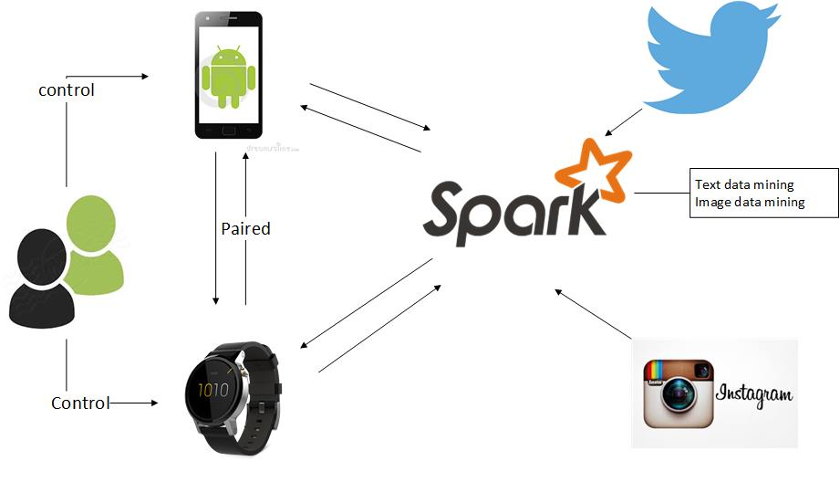
Architecture

Slide 5
This work was done in partial fulfillment of the requirements of CS5542: Big Data Analytics and Apps, CSEE Department, University of Missouri – Kansas City (Spring 2016). Instructor: Dr. Yugyung Lee, TAs: Mayanka Chandrashekar, Feichen Shen.

Slide 6
Thank You!

