Slide 1
Baymax due
Team 2
Gharibi Mohamed: 7
Huang Wei: 9
Sattineni Vipin Reddy: 24
XiaTing: 30

Slide 2
Features
Communication between smartwatch and phone
Image/object recognition
Heart Rate detection and diagnosis
Common interests recommendation for users
Audio data mining

Slide 3
Data Sets
Heart rata collected from smartwatch
Text data collected from Tweets
Image data collected from Instagram
Audio data

Slide 4
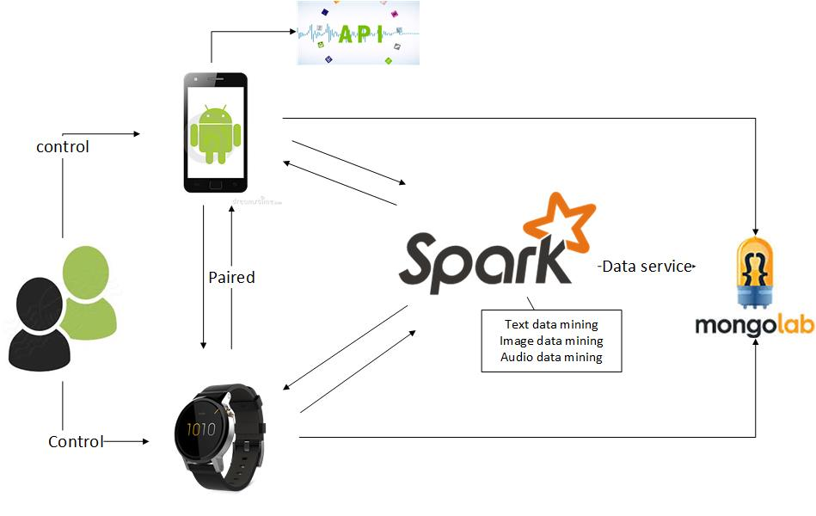
Work flow

