Slide 1


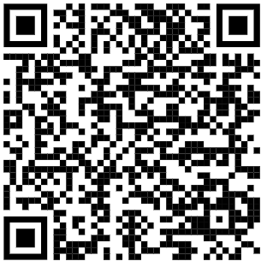
Golang

Slide 2
ต้นกำเนิดของ Golang
A lot of others people help to bring go from prototype to reality
Starts to have adoption by other programmers
2007
2008
2009
2010
Started and built by Robert Griesemer,
Rob Pike and Ken Thompson
as a part-time project.
Go became a public Open Source project.

Slide 3
จุดเด่นของ Go
- compilation เร็ว
- การจัดการ package ที่ง่าย
- การทำงานพร้อมๆกัน
- ใช้ interface แทนการสืบทอด
- สามารถสร้าง libalry ใช้งานเองได้

Slide 4

จุดเด่นของ Go
simplifies, minimizes the amount of code we need to solve the problems we are working on
optimized for correctness, not performance
easy to read and understand

Slide 5
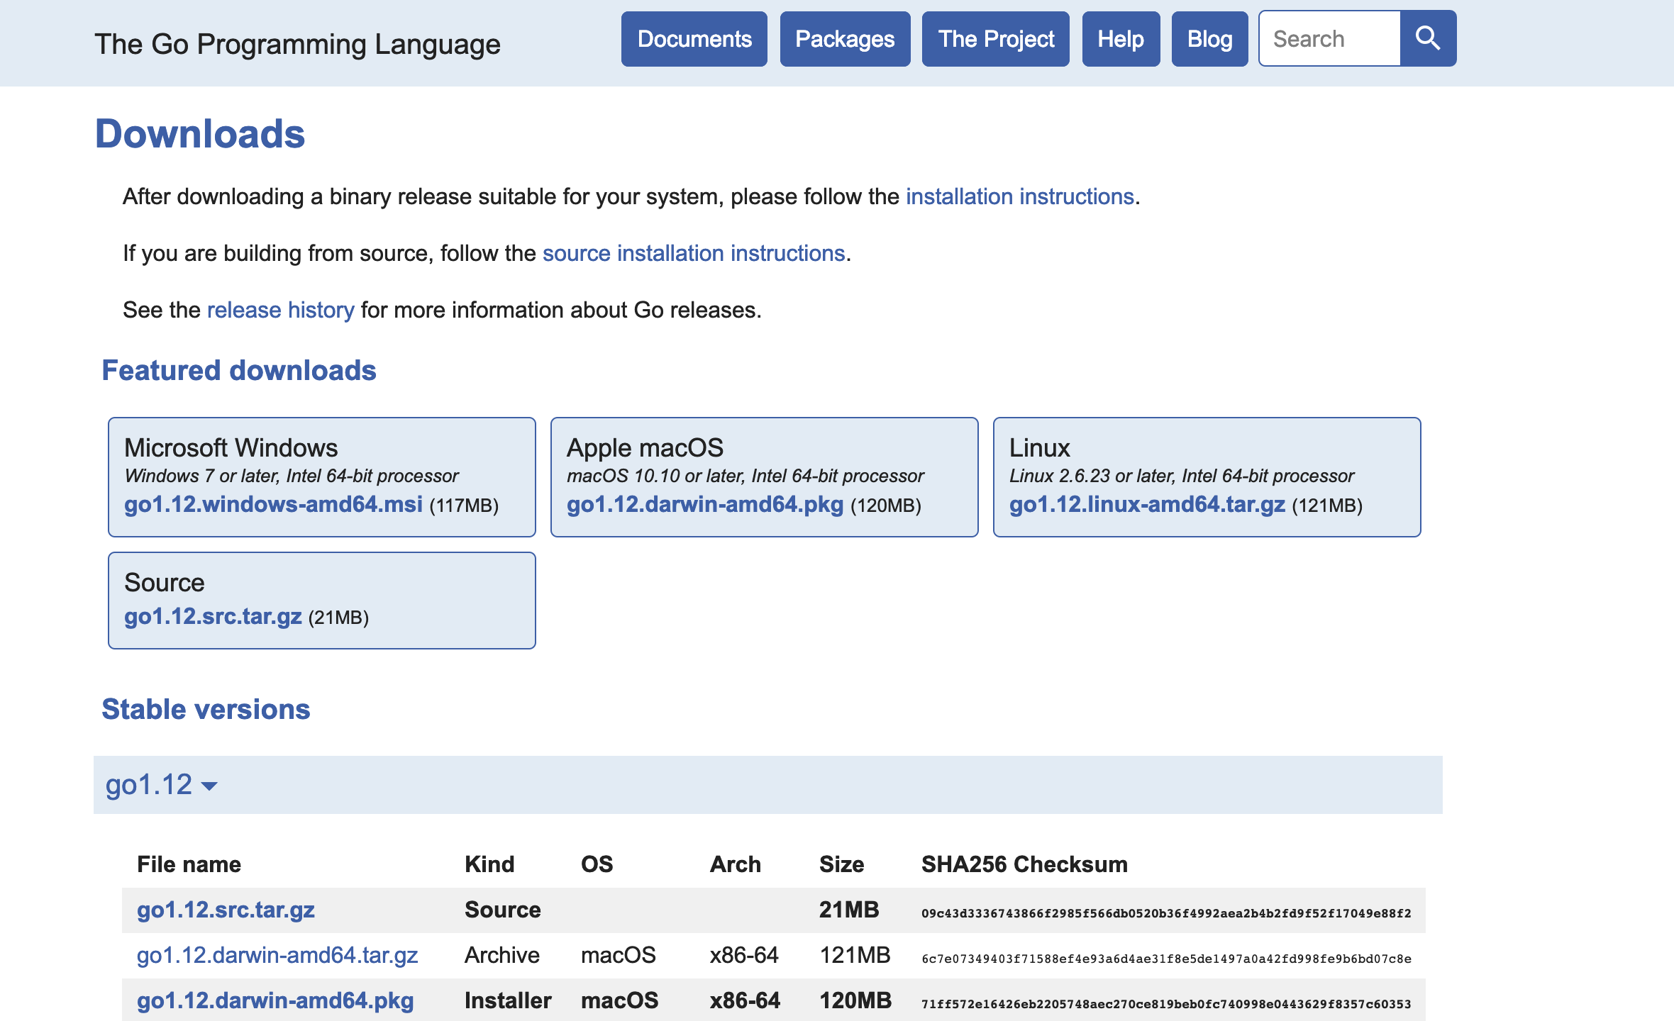
Download
https://golang.org/dl

Slide 6
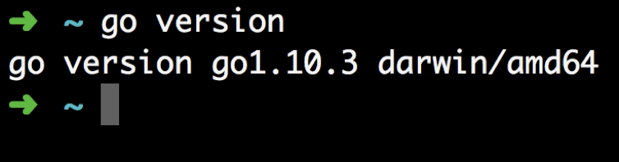
go installation

Slide 7
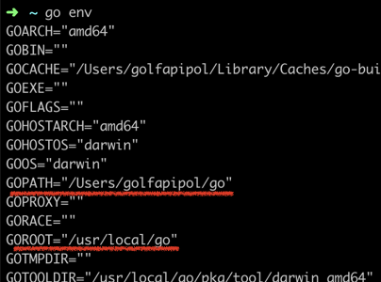
Understand Go workspace
Notes:
Whenever Go program hits import statement, it looks for package(s) in Go’s standard library ($GOROOT/src). If package is not present there, then Go refers to system's environment variable GOPATH which is path to Go workspace directory and looks for packages in $GOPATH/src directory

Slide 8
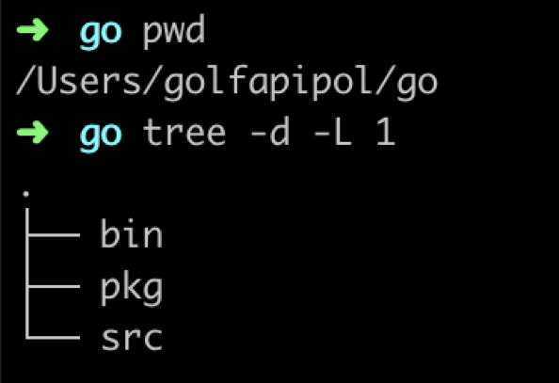
Understand Go workspace
Notes:
Src -> source code
Pkg -> compiled version of original package source code and they have .a file extension (a stands for archived)
Bin -> binary

Slide 9
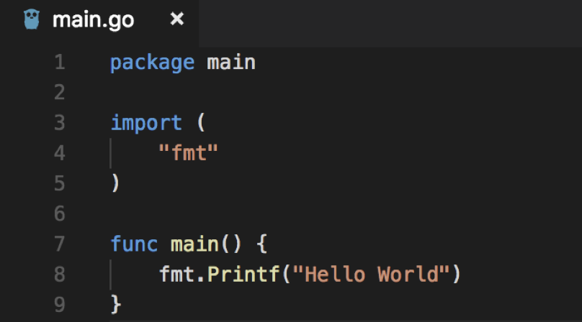
Hello World
Notes:
Src -> source code
Pkg -> compiled version of original package source code and they have .a file extension (a stands for archived)
Bin -> binary

Slide 10
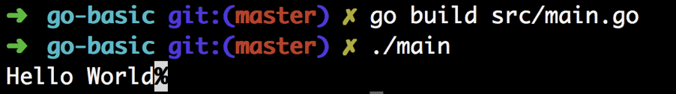
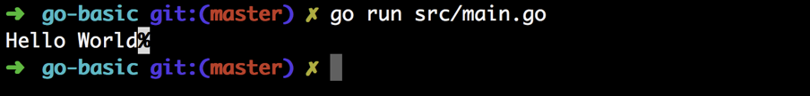
Hello World
run on the fly
Compile & RUN
Notes:
Src -> source code
Pkg -> compiled version of original package source code and they have .a file extension (a stands for archived)
Bin -> binary

Slide 11

Variables
Type : int
var zero int
Represent: 0
Storage
32bit (4 bytes)
64bit (8 bytes)

Slide 12


Variables
Type : string
var text string
Represent: “”
Storage
length

Slide 13
Variables
Type : float 64 bit
var price float64
Represent: 0.00
Storage
8 bytes

Slide 14

Variables
Type : int
ten := 10
Represent: 10
Storage

Slide 15


Variables
Type : string
hello := “hello”
Represent: “hello”
Storage
length

Slide 16
Exercise
Declare variables that are set to their zero value.
Display the value of those variables.
Declare variables and initialize.
Using the short variable declaration operator.
Display the value of those variables.
Perform a type conversion.
Display the value of that variable.

Slide 17
Struct
เป็นการจัดเก็บข้อมูลในรูปแบบโครงสร้างเก็บแบบเป็น Fields สามารถเก็บข้อมูล Type ต่างกันได้

Slide 18
Struct
การประกาศ type Struct

Slide 19
Struct
var e1 example
flag
count
pi
1 byte
2 byte
4 byte

Slide 20
Struct
การประกาศแบบ zero value
การประกาศแบบ set default value
สร้าง Object จาก Struct

Slide 21
Struct
การเข้าถึง value fields ด้วย “ . ”
การประกาศแบบ public , private

Slide 22
Struct
Struct Tag

Slide 23
Exercise
- Declare variable of type user and init using a struct literal.
- Display the field values.
- Declare a variable using an anonymous struct.
- Display the field values.

Slide 24
Array
var fruits [5]string
nil
nil
nil
nil
nil
“”
“”
“”
“”
“”
fruits[0] = “Apple”
*
A
p
p
l
e
5

Slide 25

Array
number := [5]int{20,15,4,9,2}
เข้าถึง Array ด้วย Loop

Slide 26
Slices
number := make([]string,5,8)
*
5
length
8
capacity
nil
nil
nil
nil
nil
“”
“”
“”
“”
“”
length
capacity

Slide 27
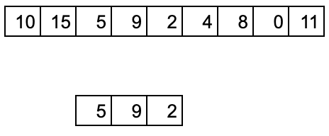
Slices
number2 := number[5:]
number[start:end]
start = index
end = index - 1
number2 := number[2:5]
number2 := number[:4]

Slide 28
Slices
number := append(number, 4)
copy(number3,number2)

Slide 29
ความแตกต่าง Array กับ slices

Slide 30
Exercise
- Declare a nil slice of integers.
- Append numbers to the slice.
- Display each value in the slice.
- Declare a slice of strings and populate the slice with names.
- Display each index position and slice value.
- Take a slice of index 1 and 2 of the slice of strings.
- Display each index position and slice values for the new slice.

Slide 31
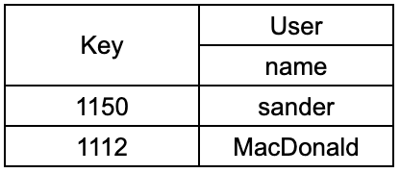
Map
users := make(map[string]user)
users[“1150”] = User{
Name: “Sander”
}
users[“1112”] = User{
Name: “MacDonald”
}

Slide 32
Map
delete(users,”1150”)
user, ok := users[“1150”]

Slide 33
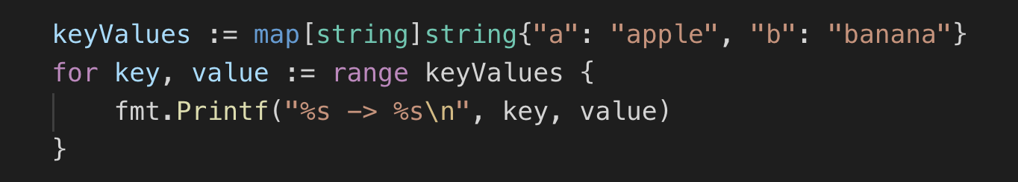
Map
Map จะไม่เรียงลำดับเหมือนกันทุกครั้ง

Slide 34
Exercise
- Declare and make a map of integer type values.
var departments map[string]int
- Display each value in the slice.
- Initialize some data into the map.
- Display each key/value pair.

Slide 35
Function
Input
Output
a: 2
Add
c: 5
b: 3

Slide 36
Function
Input
Output
getDateTime
dateTime: DateTime{}
date: “2019-10-04”
error: nil

Slide 37
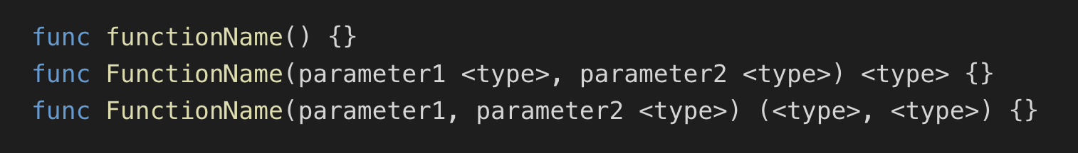
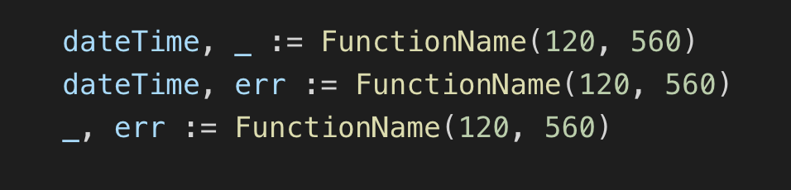
Function
Declaration
Usage

Slide 38
Function
Can return multiple values and error value
The blank identifier can be used to ignore return values
Should be checks error
u, err1 := getUser()
if err1 != nil {
return
}

Slide 39
Exercise
user represents a user in the system.
newUser creates and returns pointers of user type values.
Create a value of type user.
Display the value.
Call the function and just check the error on the return.

Slide 40
Method
Give data the ability to exhibit behavior
type User struct {
Name string
Email string
}
func (u User) Notify() error {}
func (u *User) ChangeEmail(newEmail string){}

Slide 41
Exercise
Average calculates the batting average for a player.
Create a few players.
Display the batting average for each player.

Slide 42
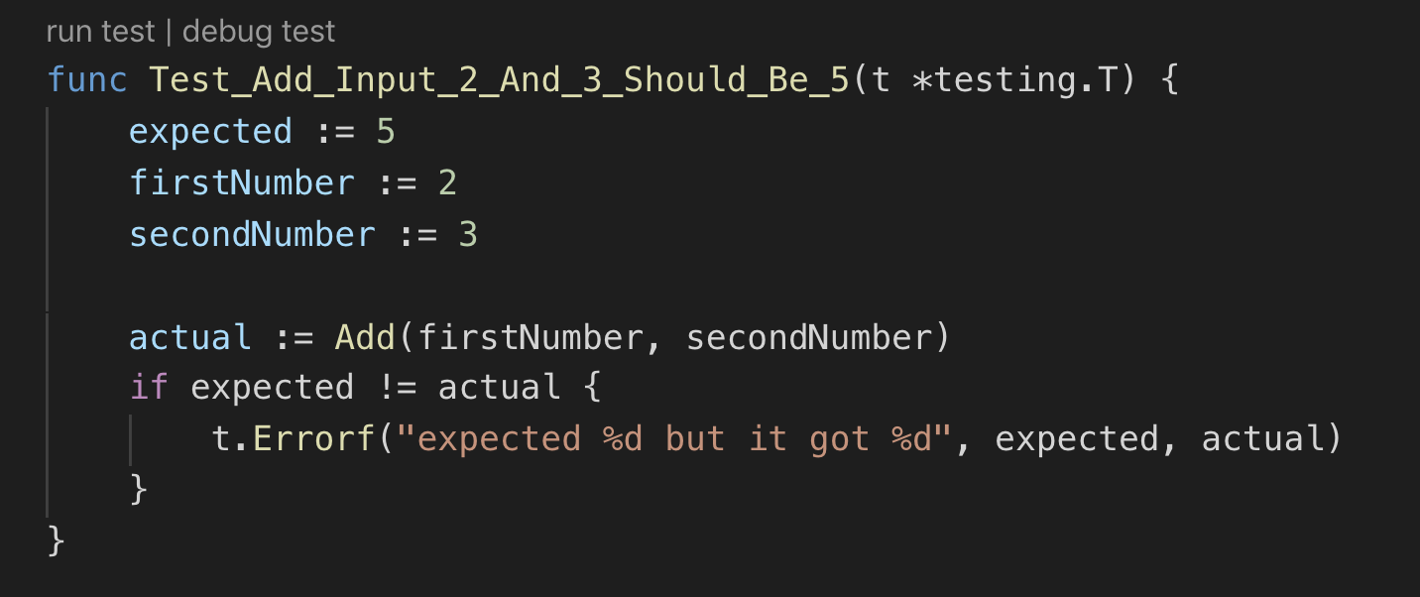
Unit testing

Slide 43
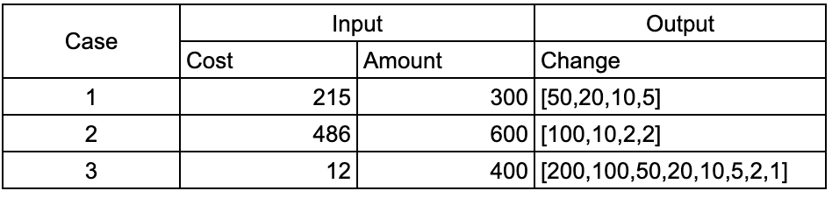
Quiz
Machine Change Calculator
Calculate the change (coins) to return to a customer when they buy something.

