Slide 1
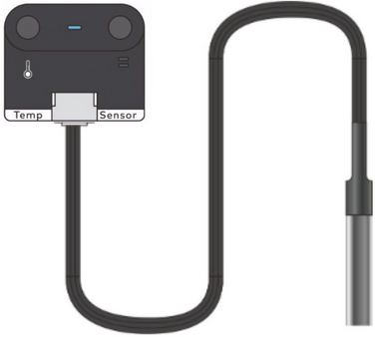
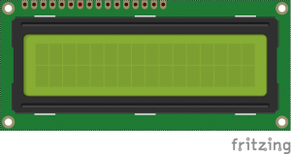


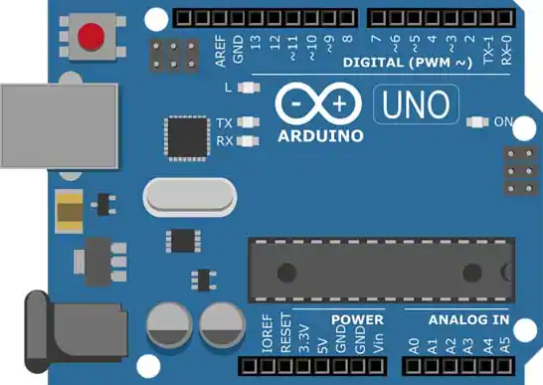
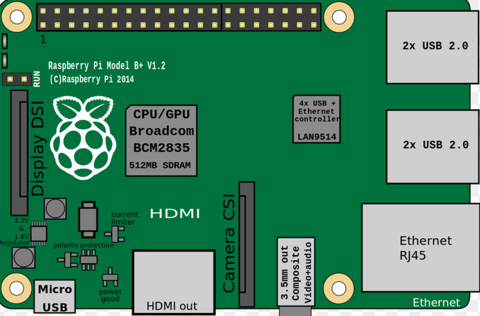





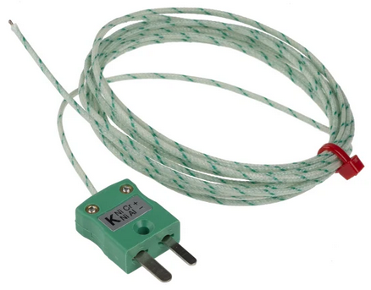
Overview of Architecture

Slide 2

HARDWARE ON PHYSICAL SITE
I2C
I2C
I2C
I2C
I2C
SERIAL
HARDWIRE RELAY
SERIAL
HARDWIRE RELAY
HARDWIRE RELAY
HARDWIRE RELAY

