Slide 1
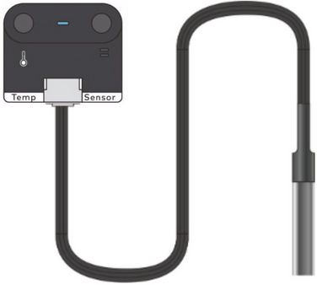
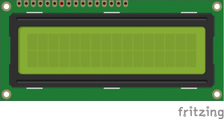

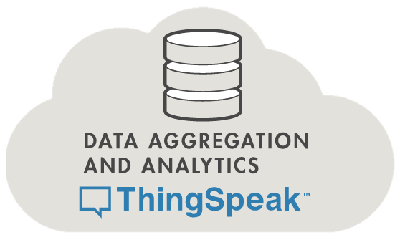
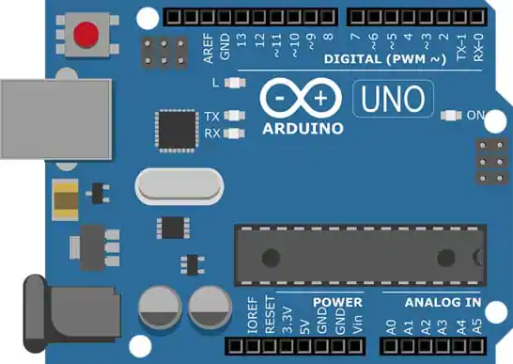
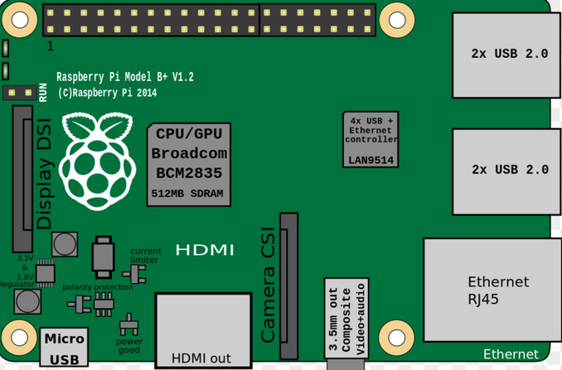
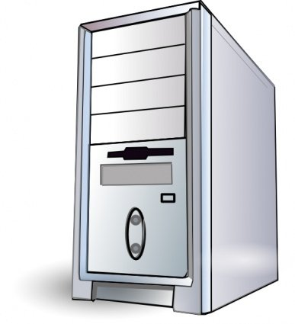




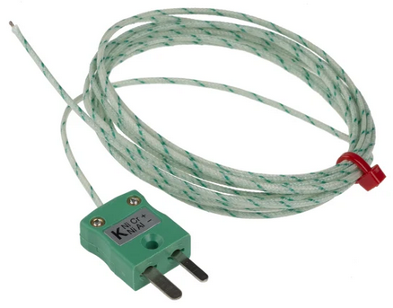
Overview of Architecture
sensors
display
Actuator outputs
sensors

Slide 2
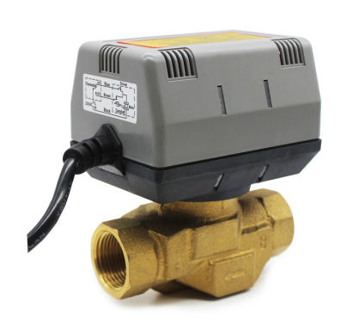
HARDWARE ON PHYSICAL SITE
I2C
I2C
I2C
I2C
I2C
SERIAL
HARDWIRE RELAY
SERIAL
HARDWIRE RELAY
HARDWIRE RELAY
HARDWIRE RELAY

Slide 3
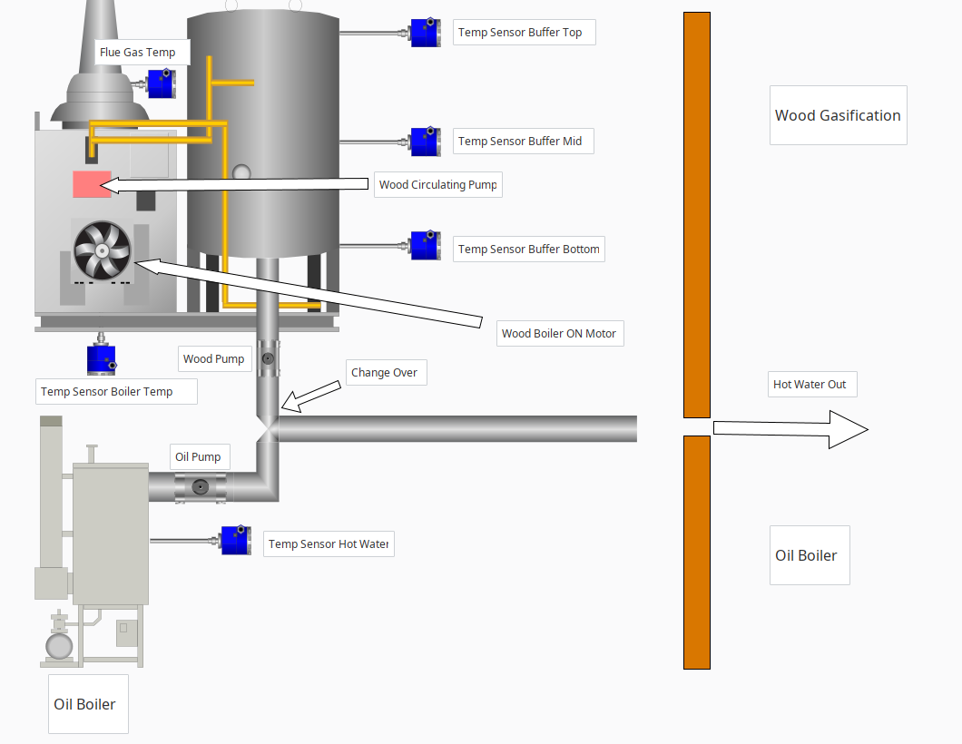
Process physical layout and sensor and switched output locations

Slide 4
The heating control system has been created on an Arduino Uno. This controller receives sensor values and actuates process pumps valves and fans through relays.
A raspberry Pi controls communication, receives sensor values and states from control Arduino and sends data via MQTT to a local server to store data. Raspberry Pi also syncs data with Blynk app for easy monitoring and switching of process controls remotely. Raspberry Pi also sends external control signals back down to control Arduino via serial connection based on remote inputs from Blynk app.
Remote server receives data from Raspberry Pi at remote location and stores data to MySql server for future analysis. Server also sends data to thingspeak for remote storage and monitoring if required.
Thingspeak has a React set up to send a tweet if data has not been received for more than 60 mins, this will alert user that the system is offline and not sending data. Also a react is sent if the temperature of the buffer tank drops below 60 degrees, so user can light gasification boiler in time to get up to heat to prevent system switching over to oil fired heating.
Blynk app displays critical values to user, has a notification set to alert user if temperature of the buffer tank drops below a threshold in order for user to light fire for gasification boiler. Also a notification to notify user if hardware goes offline to signal communication issues with Raspberry Pi or other problems which may cause communication loss i.e. power loss, network loss or hardware failure.

