Slide 1
Computer Architecture Experiment
Lab2
College of Computer Science & Engineering
Zhejiang University

Slide 2
Topics
0、Lab instroduction
Lab 1). Warmup Run you single-cycle CPU on 3E board and try to add instructions to support 18 MIPS instructions.
Lab 2). 5-stage pipelined CPU with 18 MIPS instructions (only required to execute program in pipeline correctly implementing "stall" when have hazards.
Lab 3). Implementing “forwarding paths” and “predict-not-taken” to make your CPU run faster.
Lab 4). Implementing interruption in your CPU
Lab 5) Implementing a memory hierarchy with multi-cycle memory and cache.

Slide 3
Outline
Experiment Purpose
Experiment Task
Basic Principle
Operating Procedures
Precaution

Slide 4
Experiment Purpose 1
Understand the principles of Pipelined CPU
Understand the basic units of Pipelined CPU
Understand the working flow of 5-stages
Master the method of simple Pipelined CPU
Master the method of Pipelined CPU Stalls Detection and Stall the Pipeline.
master methods of program verification of simple Pipelined CPU

Slide 5
Experiment Task
Design the CPU Controller, and the Datapath of 5-stages Pipelined CPU
  5 Stages
  Register File
  Memory (Instruction and Data)
  other basic units
Implementing “stall” when have hazards
Verify the Pipelined CPU with program and observe the execution of program

Slide 6
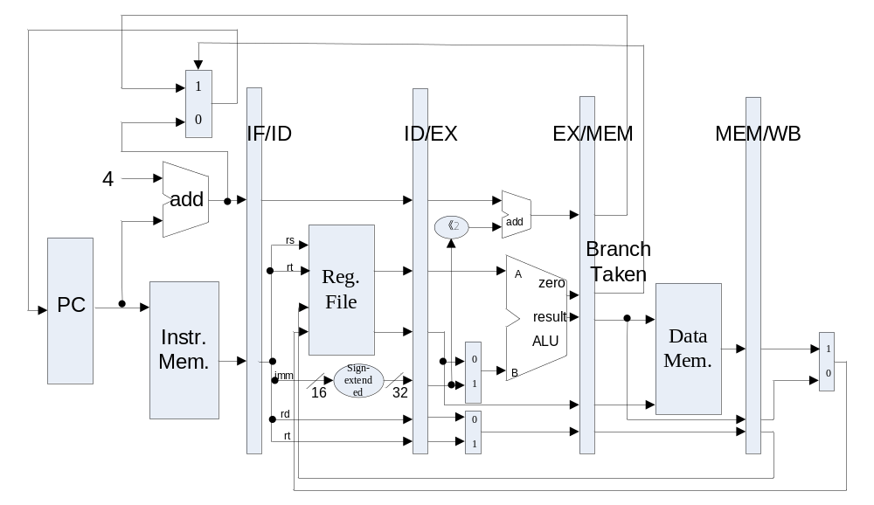
Datapath of 5-stages Pipelined CPU

Slide 7
How to implement Pipelined CPU
Separate your single-cycle CPU into 5 stages, each stage with its own function units.
Add Latches with a synchronize clock
  Control sigals, intermedia data, test signals
Add hazards detect units (combinational logic) to find whether there exist control hazard or data hazard
Stall the pipeline when have hazards
  Keep some of the latches unchanged
  Push a bubble forward

Slide 8
Structural hazards －resource conflicts
Structural hazards arise from resource conﬂicts when the hardware cannot support all possible combinations of instructions in simultaneous overlapped execution.
  Memory conflicts
  Register File conflicts
  Other units conflicts

Slide 9
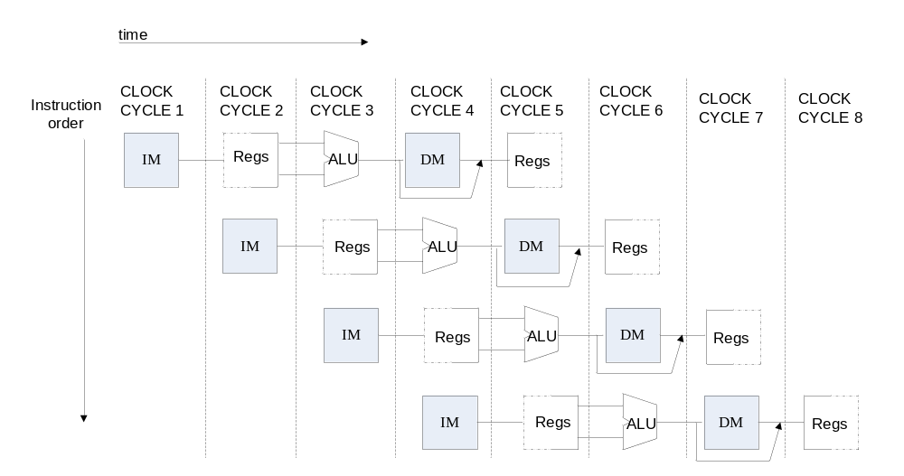
How to resolve Structural hazards

Slide 10
Register File
Register File
  Positive edge for transfer data for stages
  Negative edge for write operation
  Low level for read operation

Slide 11
Memory
Instruction Memory
  Single Port Block Memory
  Read only, Width:32
  Falling Edge Triggered
Data Memory
  Single Port Block Memory
  Read and write, Width:32
  Falling Edge Triggered

Slide 12
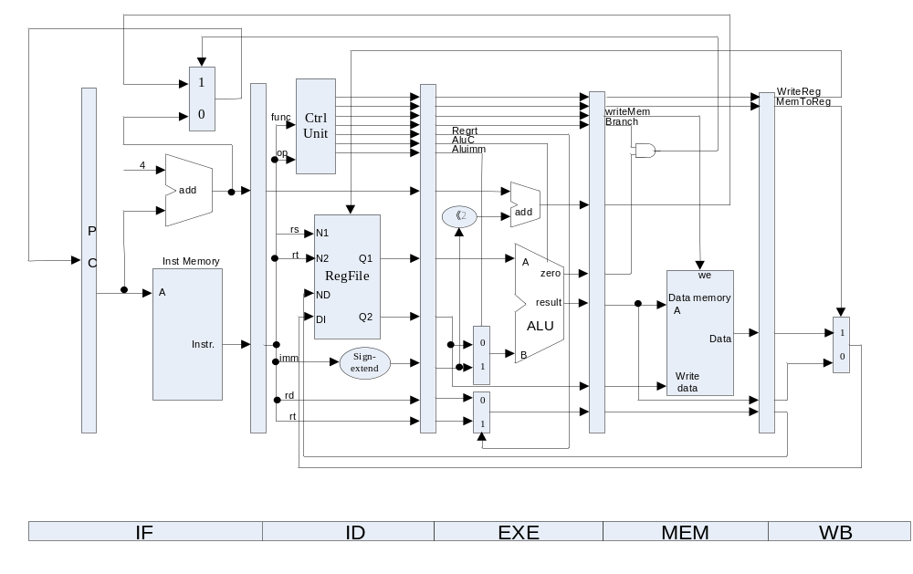
The principle of Pipelined CPU－with CPU controller

Slide 13
Output of CPU Controller(not limited)
 | Output Signal | Meaning When 1 | Meaning When 0
1 | Cu_branch | Branch Instr. | Non-Branch Instr.
2 | Cu_shift | sa | Register data1
3 | Cu_wmem | Write Mem. | Not Write Mem.
4 | Cu_Mem2Reg | From Mem. To Reg | From ALUOut To Reg
5 | Cu_sext | Sign-extend the imm. | No sign extended the imm.
6 | Cu_aluc | ALU Operation
7 | Cu_aluimm | Imm. | Register data2
8 | Cu_wreg | Write Reg. | Not Write Reg.
9 | Cu_regrt | rt | rd

Slide 14
Units of Pipelined-cycle CPU
IF Stage (Instr. Mem.)
ID Stage (CPU Ctl. And R.F.)
EX Stage (ALU)
Mem Stage (Data Mem.)
WB Stage

Slide 15
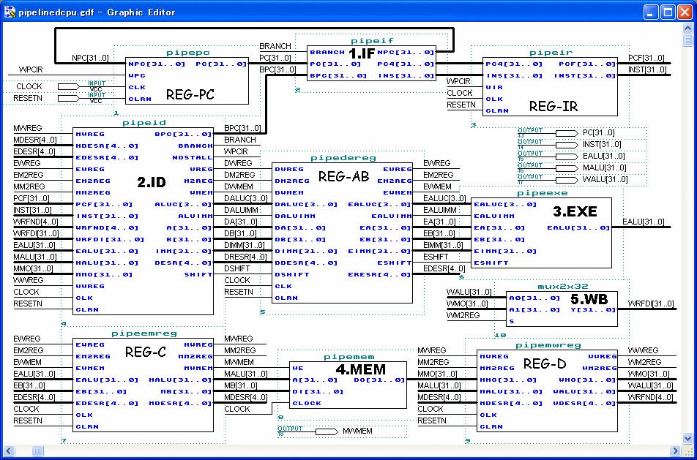

Slide 16
Pipelined CPU Top Module
module top (input wire CCLK, BTN3, BTN2, input wire [3:0]SW, output wire LED, LCDE, LCDRS, LCDRW, output wire [3:0]LCDDAT);
assign pc [31:0] = if_npc[31:0];
if_stage x_if_stage(BTN3, rst, pc, mem_pc, mem_branch, …
IF_ins_type, IF_ins_number,ID_ins_type,ID_ins_number);
id_stage x_id_stage(BTN3, rst, if_inst, if_pc4, wb_destR,…
ID_ins_type, ID_ins_number, EX_ins_type, EX_ins_number..);
ex_stage x_ex_stage(BTN3, id_imm, id_inA, id_inB, id_wreg, ..
EX_ins_type, EX_ins_number, MEM_ins_type, MEM_ins_number);
mem_stage x_mem_stage(BTN3, ex_destR, ex_inB, ex_aluR, …
MEM_ins_type, MEM_ins_number, WB_ins_type, WB_ins_number);
wb_stage x_wb_stage(BTN3, mem_destR, mem_aluR, …
WB_ins_type, WB_ins_number,OUT_ins_type, OUT_ins_number);

Slide 17
Data Hazard Definition
Data Hazards arise when an instruction depends on the results of a previous instruction in a way that is exposed by the overlapping of instructions in the pipeline.
When inst. i executes before instr. j, there are data hazards:
RAW, i.e. instr. j read a source before instr. i writes it.
WAW, i.e. instr. j write an operand before instr. i writes it.
WAR, i.e. instr. j write a destination before instr. i read it.

Slide 18
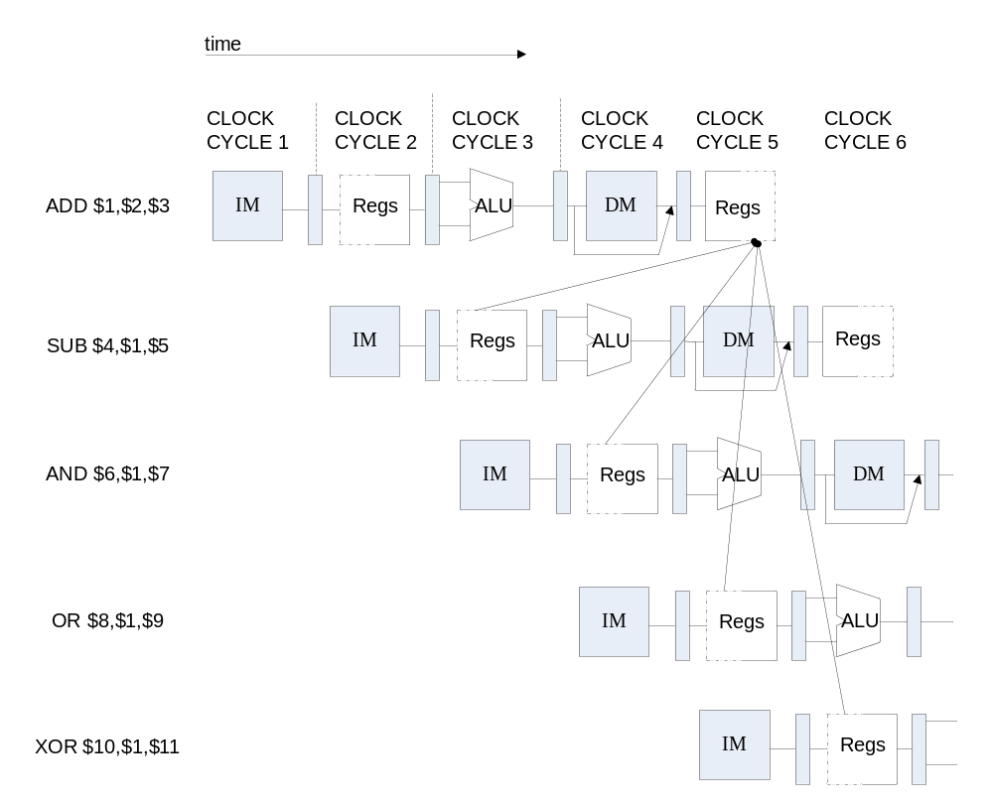
Instruction Demo

Slide 19
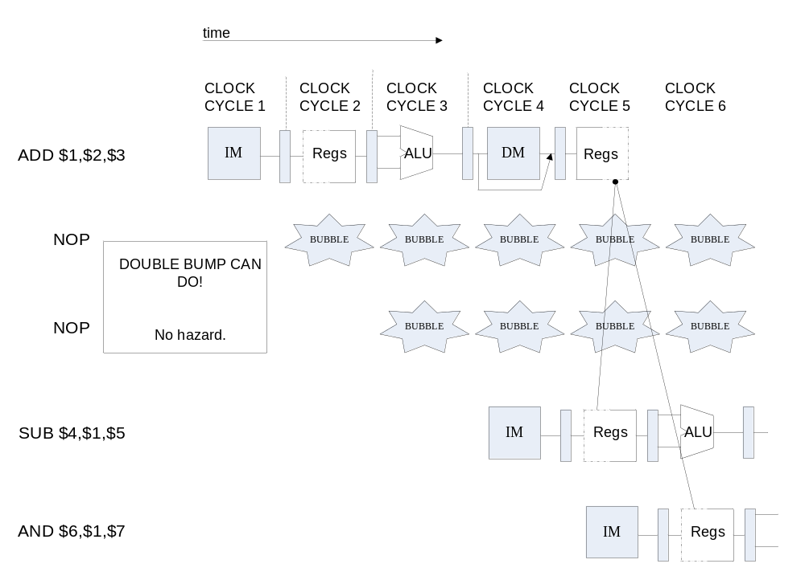
Data Hazard Causes Stalls

Slide 20
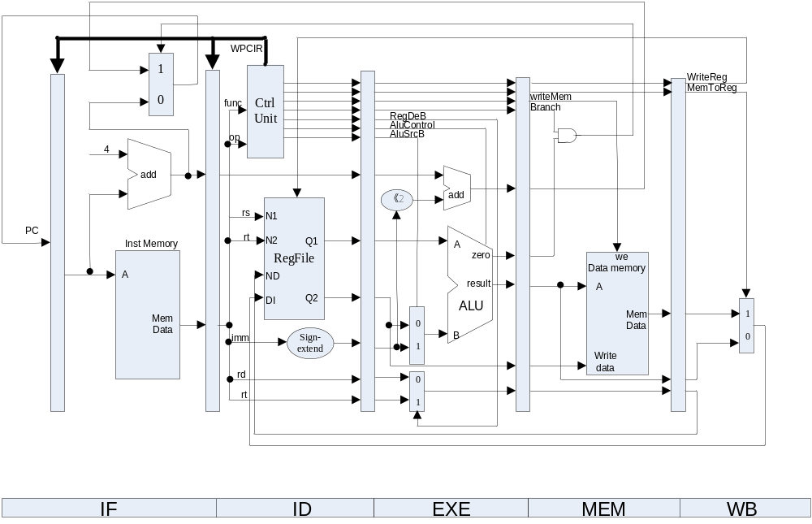
How to Stall the Pipeline

Slide 21
In Which Conditions it Causes Stall
PC IF/ID ID/EX EX/MEM MEM/WB
M.Inst
D.Inst
E.Inst
F.Inst
Bubble
Bubble
Branch
Branch
Wreg
Wreg
Rd
Rd
Stall control logic
Rs
Rt
How to detect data hazard ?
How and where to detect control hazard ?
stall
To produce a stall signal. If stall ==1 then
Use stall to disable writing PC and IF/ID latch.
Push a bubble into next stage.
  Bubble = 1 and disable control signal Wreg and Wmem.

Slide 22
Controller Module
if_instr: if stage instruction
Instr: id stage instruction
ex_instr: ex stage instruction
mem_instr: mem stage instruction
wb_instr: wb stage instruction
assign cu_wpcir = stall;

Slide 23
Note:
You might need to implement the “interlock” separately for Data hazards and control hazards.

Slide 24
Observation Info
Input
  One Button: Step execute
  One Button: Reset
  One Button + 4 Switches : Register Index
Output (Led screen)
  0-7 Character of First line: Instruction Code at IF-stage
  8-15 of Character of First line : Register Value
  Second line : F D06 | E03 | M07 | W0A (06/03/07/0A：inst. No.)

Slide 25
Prepare for checking
Test code for /Lab2 can be downloaded from the material directory on course website.
Do understand what you have implemented.
  Prepare to answer questions on your results (Verilog code, logical graph, UCF…).

Slide 26
Precaution
1. Add Anti-Jitter for buttons.
2. Modified your code based on your lab1 code.
3. Debug method: Output whatever signal to Led lamp or LCD Display.
4. Understand the principle of pipelined CPU and check the logic of circuit carefully, understand the sample code, then write code and synthesize the project, because it takes you a few minutes…

Slide 27
Something Important ! ! !
1、The number and type tells the information of the instruction that is to be executed in the stage.
2、How to verify the result? Pls. check the result of WB stage for R-type and LW instructions, while check the result of EXEC stage for BEQ instruction.
3、If you want to execute the test code and get the right result on your pre-pipelined CPU, how should you modify the test code ?
4、Why the initial value of PC is FFFFFFFF, not 0?
5、Why we should pull the slide button after step execution to refresh the result? And instruction refresh is delayed by 1 clock-cycle? How to refresh automatically?

Slide 28
Thanks!

