Slide 1
Computer Architecture Experiment
Jiang Xiaohong
College of Computer Science & Engineering
Zhejiang University

Slide 2
Topics
0、Lab instroduction
Lab 1). Warmup Run you single-cycle CPU on 3E board and try to add instructions to support 18 MIPS instructions.
Lab 2). 5-stage pipelined CPU with 18 MIPS instructions (only required to execute program in pipeline correctly implementing "stall" when have hazards.
Lab 3). Implementing “forwarding paths” and “predict-not-taken” to make your CPU run faster.
Lab 4). Implementing interruption in your CPU
Lab 5) Implementing a memory hierarchy with multi-cycle memory and cache.

Slide 3
Outline
Experiment Purpose
Experiment Task
Basic Principle
Operating Procedures
Precaution

Slide 4
Experiment Purpose 1
Understand the principles of Pipelined CPU Bypass Unit
Master the method of Pipelined Pipeline Forwarding Detection and Pipeline Forwards.
Master the Condition In Which Pipeline Forwards.
Master the Condition In Which Bypass Unit doesn’t Work and the Pipeline stalls.
master methods of program verification of Pipelined CPU with forwarding

Slide 5
Experiment Task
Design the Bypass Unit of Datapath of 5-stages Pipelined CPU
Modify the CPU Controller
  Conditions in Which Pipeline Forwards.
  Conditions in Which Pipeline Stalls.
Verify the Pipeline CPU with program and observe the execution of program

Slide 6
Data Hazard Stalls
Minimizing Data Hazard Stalls by Forwarding： In most cases, the problem can be resolved by forwarding, also called bypassing, short-circuiting.
Data Hazards Requiring Stalls: In some cases, data hazards can not be handled by bypassing.

Slide 7
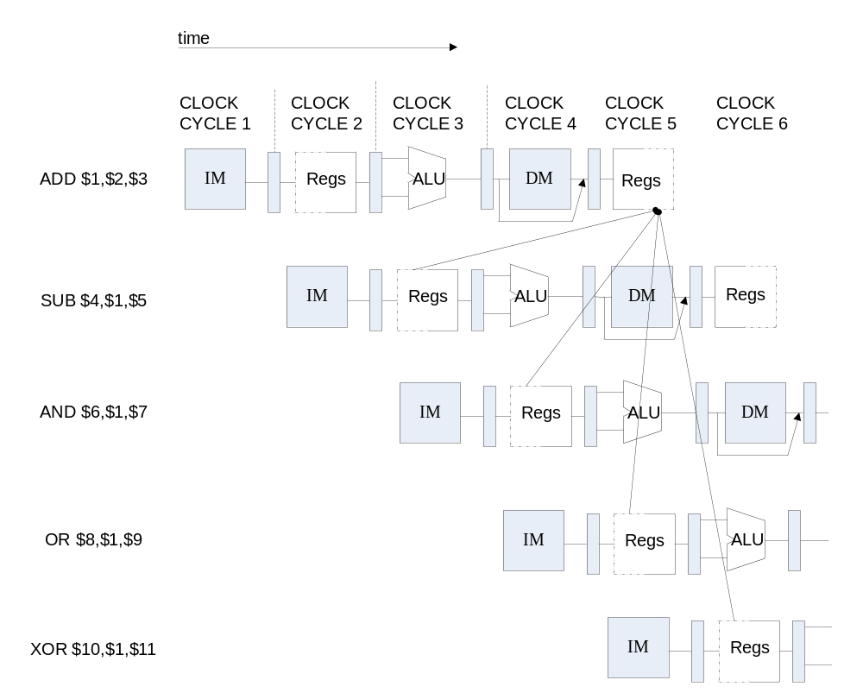
Instruction Demo

Slide 8
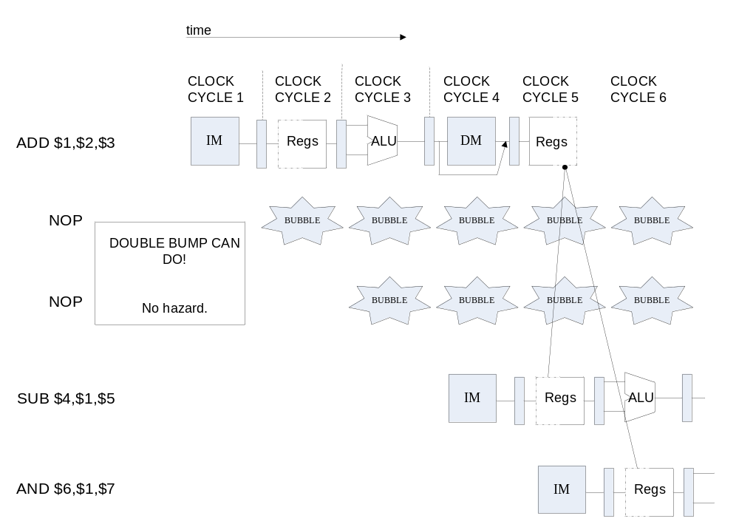
Data Hazard Causes Stalls

Slide 9

Pipeline Forward to Avoid the Data hazard

Slide 10
Setup forwarding path
Adding forwarding path for your pipelined CPU implemented in Lab2.
Notes:
  The graph on the following page is only for your reference. You can implement the forwarding paths in other way, say in the EXE stage. (Draw the graph in your lab report.)
  You need to set up ALL the “forwarding paths” not only those go to “input ports” of ALU, but also go to “data input port” of Data Memory, or “branch equal judger unit” in your pipeline.
  You still need the “stall” signal and the “interlock” unit to insert stalls in some cases.

Slide 11
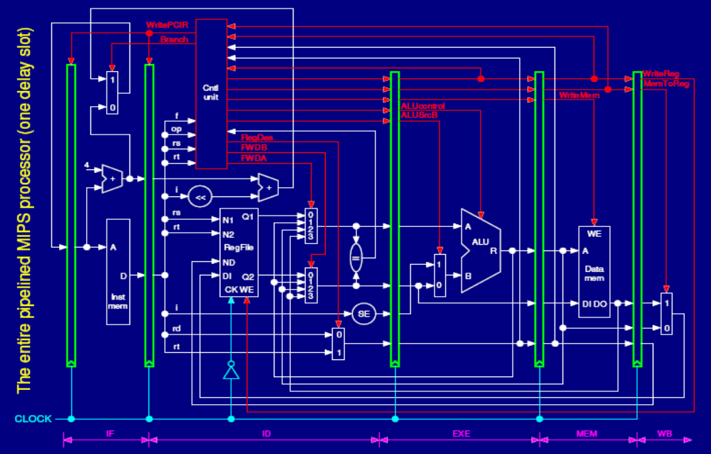
What we can do ?
Move the Forwarding path to ID stage
Move the forwarding control logic to ID stage

Slide 12
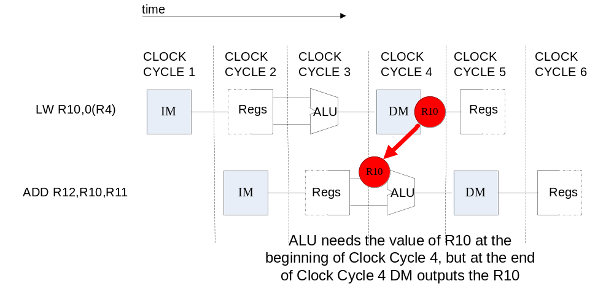
Condition in Which Bypass Unit doesn’t work

Slide 13
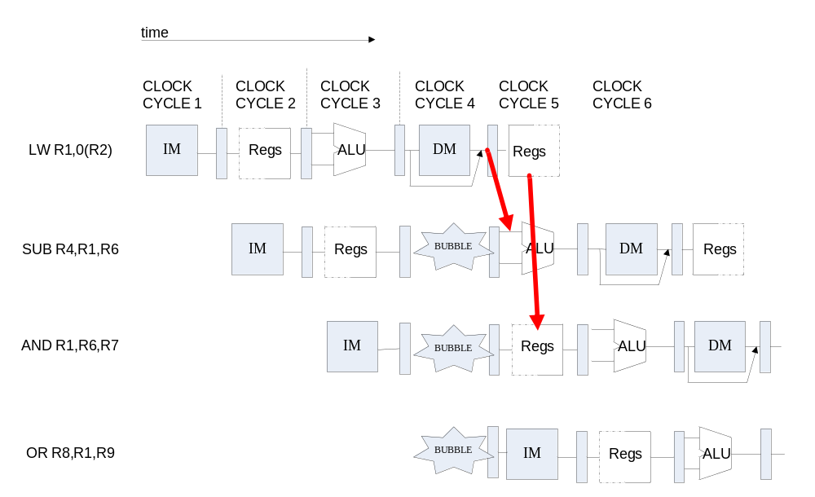
Pipeline Stalls

Slide 14
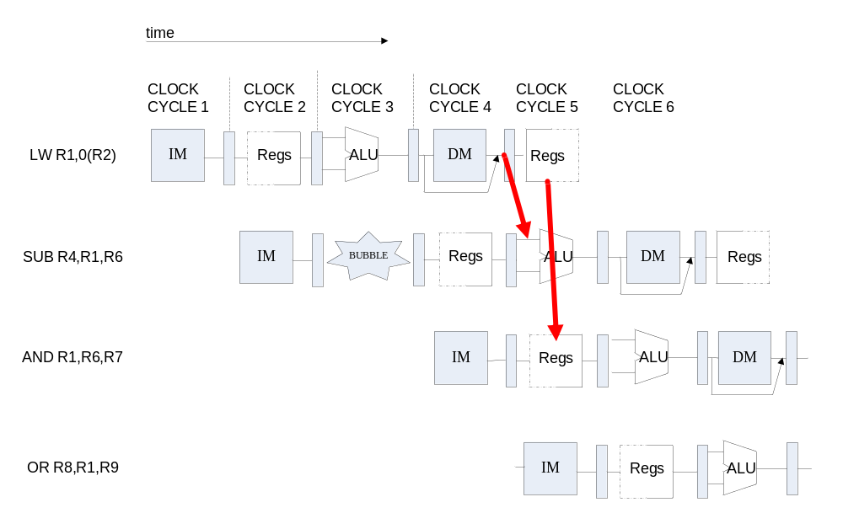
Pipeline stalls at ID Stage

Slide 15
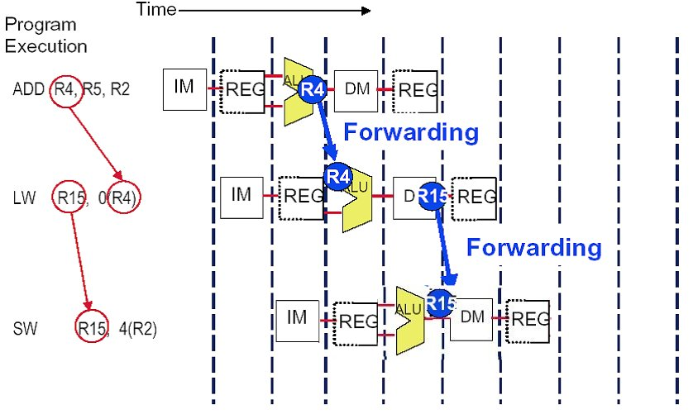
You have to also handle this
MEM/WB.LDMR→ DM data write port

Slide 16
Pipelined CPU Top Module
module top (input wire CCLK, BTN3, BTN2, input wire [3:0]SW, output wire LED, LCDE, LCDRS, LCDRW, output wire [3:0]LCDDAT);
assign pc [31:0] = if_npc[31:0];
if_stage x_if_stage(BTN3, rst, pc, mem_pc, mem_branch, id_wpcir, …
IF_ins_type, IF_ins_number,ID_ins_type,ID_ins_number);
id_stage x_id_stage(BTN3, rst, if_inst, if_pc4, wb_destR,…,
EX_ins_type, EX_ins_number, id_FWA, id_FWB);
ex_stage x_ex_stage(BTN3, id_imm, id_inA, id_inB, id_wreg, ..
id_FWA, id_FWB,mem_aluR, wb_dest, … , MEM_ins_number);
mem_stage x_mem_stage(BTN3, ex_destR, ex_inB, ex_aluR, …
mem_aluR, ... , WB_ins_type, WB_ins_number);
wb_stage x_wb_stage(BTN3, mem_destR, mem_aluR, …
wb_dest, …, OUT_ins_type, OUT_ins_number);

Slide 17
Experiment Purpose 2
Understand why and when Control Hazards arise
Master the methods of resolving Control Hazards
  Freeze or flush
  Predict-not-taken
  Predict-taken
  Delayed-branch
Implement the predict-not-taken scheme in your pipelined CPU. ( you can resolve the branch in ID or MEM, please do specify your scheme in report. )
  If the branch is not taken then no stall at all.
  If the branch is taken then have to kill the instructions have been pre-executed in the pipeline.

Slide 18
Observation Info
Input
  West Button: Step execute
  South Button: Reset
  4 Slide Button: Register Index
Output
  0-7 Character of First line: Instruction Code at IF-stage
  8-15 of Character of First line : Register Value
  Second line : F D06 | E03 | M07 | W0A (06/03/07/0A：Say F D06 | Ess | M06 | W0A (ss means stall)

Slide 19
Test code
Test code can be downloaded in the material directory on course website.

Slide 20
Submission
Lab report 5 named as StID_name_Lab3.doc ( or pdf)
All your verilog code, coe file, testing file, etc., in your project directory compacted as StID_name_lab3.rar

Slide 21
Thanks!

