Slide 1
Computer Architecture Experiment 4
Jiang Xiaohong

Slide 2
Outline
Experiment Purpose
Experiment Task
Basic Principle
Operating Procedures
Precaution
Checkpoints

Slide 3
Experiment Purpose
Understand the principle of CPU Interrupt and its processing procedure.
Understand the function of CP0 coprocessor.
Master the design methods of pipelined CPU supporting simple interrupt.
master methods of program verification of Pipelined CPU supporting interrupt.

Slide 4
Experiment Task
Design of Pipelined CPU supporting Interrupt.
Design co-processor CP0
Design CPU Controller
Design datapath
Verify the Pipelined CPU with program and observe the execution of program

Slide 5
What jobs does CP0 do?
CPU conﬁguration
Cache control
Exception/interrupt control
Memory management unit control
Miscellaneous
Notes:
select major features of the CPU (such as its endianness) or alter the way the system interface works
One or more internal registers provide control and visibility of these options.
There’s always more: timers, event counters, parity error detection.

Slide 6
Exception/interrupt control
How to handle Interrupt
New Instructions for interrupt/exception
Simple interrupt control
Some Mechanisms
Simple CP0 design
Code Example

Slide 7
MIPS Exception
0: Interrupt, （all peripheral interrupt are interrupts, others exception)
1: TLB Modified
2: TLB Miss Load
3: TLB Miss Store
4: Address Error Load,
5: Address Error Store
6: Instruction Bus Error（ iCache）
7: Data Bus Error,（dCache）
8: Syscall,
9: Break Point
12: Overflow
13: Trap,
15: Float Point Exception,
．．．．．

Slide 8
How to handle Interrupt
Check interrupt request at commitment (just before WB)
If there is Interrupt request，then stop the pipeline and cancel all the instructions in stages from IF to MEM. (let the instruction in WB keep on execution)
Save the PC of the instruction in MEM stage to EPC, so that can return back from interrupt handler.
Close interrupt to avoid any other intervention in interrupt handling. Entering kernel mode (supervisor mode).
Transfer to interrupt handler via setting PC to EHB
Protect processor state: save all GPRs to stack; Save EPC and interrupt cause register to stack using MFC.
Handling the interrupt ……
Restore processor state: restore all GPRs from stack.
Return back to the interrupt point （ERET)： open interrupt, set PC to EPC ) , back to user mode.

Slide 9
Where is interrupt handler ?
In system area
MIPS， Int0 entry: 0x8045F200
Other entries:
0x8045f200 + i * 0x100
In our lab, you are required to implement Int0, its entry can be at one higher address at instruction memory.

Slide 10
Registers in CP0
Register 0: Index，作为MMU的索引用
Register 2, EntryLo0，访问TLB Entry偶数页中的地址低32Bit
Register 3, EntryLo1，访问TLB Entry奇数页中的地址低32Bit
Register 4, Context，用以加速TLB Miss异常的处理。
Register 5, PageMask，用以在MMU中分配可变大小的内存
Register 8, BadVAddr，
Register 9, Count，计数频率是系统主频的1/2。
Register 10，EntryHi，这个寄存器同EntryLo0/1一样，用于MMU中
Register 11，Compare，配合Count使用。
Register 12，Status，用于处理器状态的控制。
Register 13，Cause，这个寄存器体现了处理器异常发生的原因
Register 14，EPC，这个寄存器存放异常发生时，系统正在执行的指令的地址。

Slide 11
Cause Register
In our lab, use switch to simulate interrupts
8 switch will represent 8 peripheral interrupt request.
So the lower 8 bits of Course register will indicate which peripheral device raise an interrupt request.

Slide 12
Privileged instructions for supporting interrupt
Privileged instructions can be only used at kernel mode ( supervisor mode )
MTC0 -- Move one GPR to one of CP0 register
MFC0 –Move one of the CP0 register to one GPR.
ERET – return back to interrupt point from interrupt handler. (open interrupt, set PC to EPC )

Slide 13



Privileged instructions
Format: MFC rt, rd, sel
Function: GPR[rt] = CPR[0, rd, sel]
Format: MTC rt, rd, sel
Function: CPR[0, rd, sel] = GPR[rt]
ERET

Slide 14
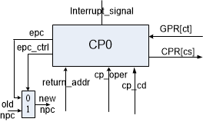
Simple interrupt control (1)

Slide 15
Simple CP0 design
Interrupt register file
Exception Handler Base Register (EHB)
Exception Program Counter Register (EPC)
Cause register ( CAUSE )
MTC: Write Interrupt register file
MFC: Read Interrupt register file
Interrupt is detected: jump to EHBR (External signal)
ERET: jump to EPCR (From CPU controller)

Slide 16
Code Example (only for your reference)
module cp0 (
input wire clk, // main clock
// debug
`ifdef DEBUG
input wire [4:0] debug_addr, // debug address
output reg [31:0] debug_data, // debug data
`endif
// operations (read in ID stage and write in EXE stage)
input wire [1:0] oper, // CP0 operation type
input wire [4:0] addr_r, // read address
output reg [31:0] data_r, // read data
input wire [4:0] addr_w, // write address
input wire [31:0] data_w, // write data
// control signal
input wire rst, // synchronous reset
input wire ir_en, // interrupt enable
input wire ir_in, // external interrupt input
input wire [31:0] ret_addr, // target instruction address to store when interrupt occurred
output reg jump_en, // force jump enable signal when interrupt authorised or ERET occurred
output reg [31:0] jump_addr // target instruction address to jump to
);

Slide 17
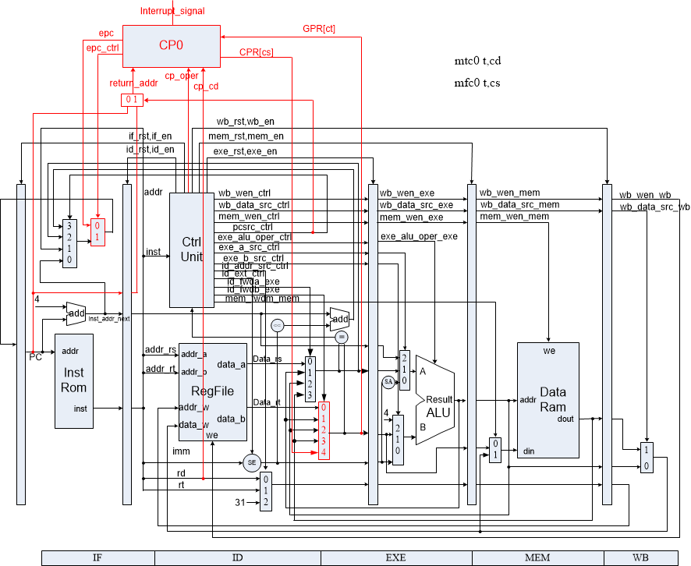
Datapath of CPU ( need move cp0 to WB stage)

Slide 18
Instr. Mem.(3)
0: 3c010000 lui R1,0x0 //main entry
4: 24210020 addiu R1,R1,32 //interrupt handler at 0x32
8: 40811800 mtc R1, R3 //simulate OS set EHB
c: 00001020 add R2,R0,R0
10: 00001820 add R3,R0,R0
14: 20420001 addi R2,R2,1 //loop
18: 08000005 j 14
1c: 00000000 nop
20: 40041000 mfc R4,R2 //interrupt handler
24: 20630001 addi R3,R3,1
28: 42000018 eret
2c: 00000000 nop

Slide 19

Simulation (1)

Slide 20
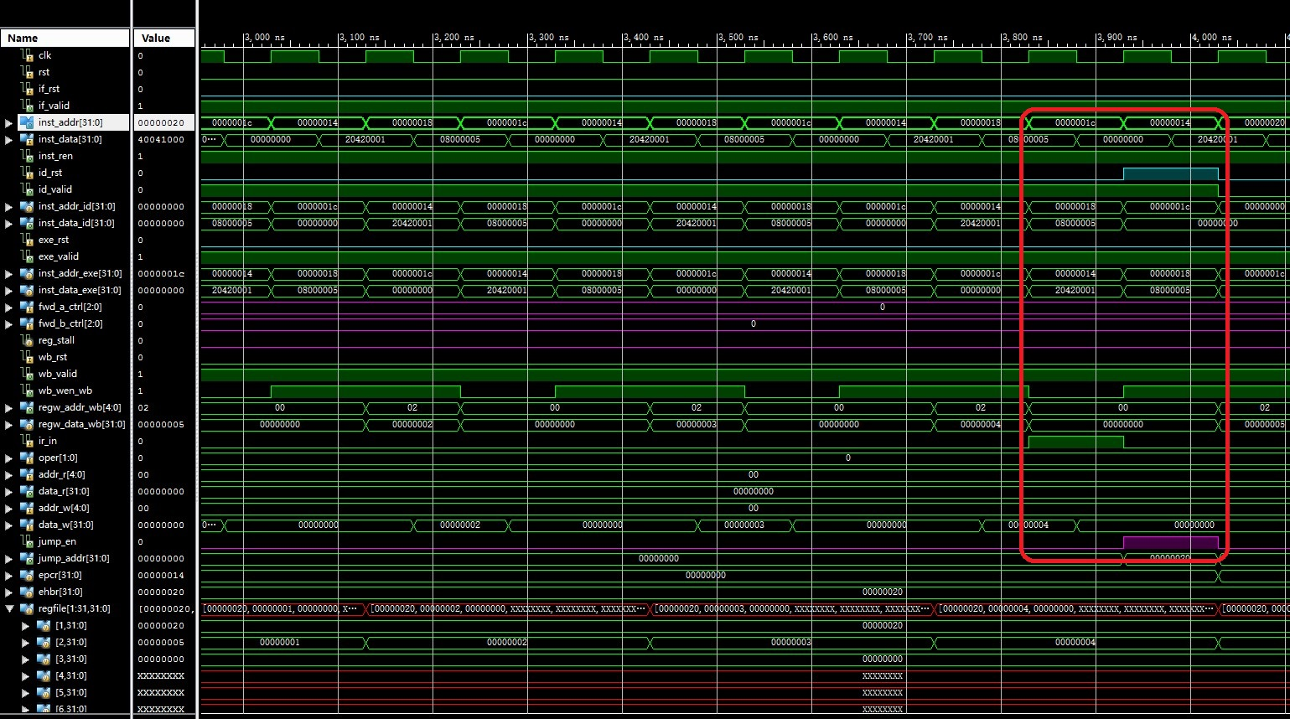
Simulation (2)

Slide 21
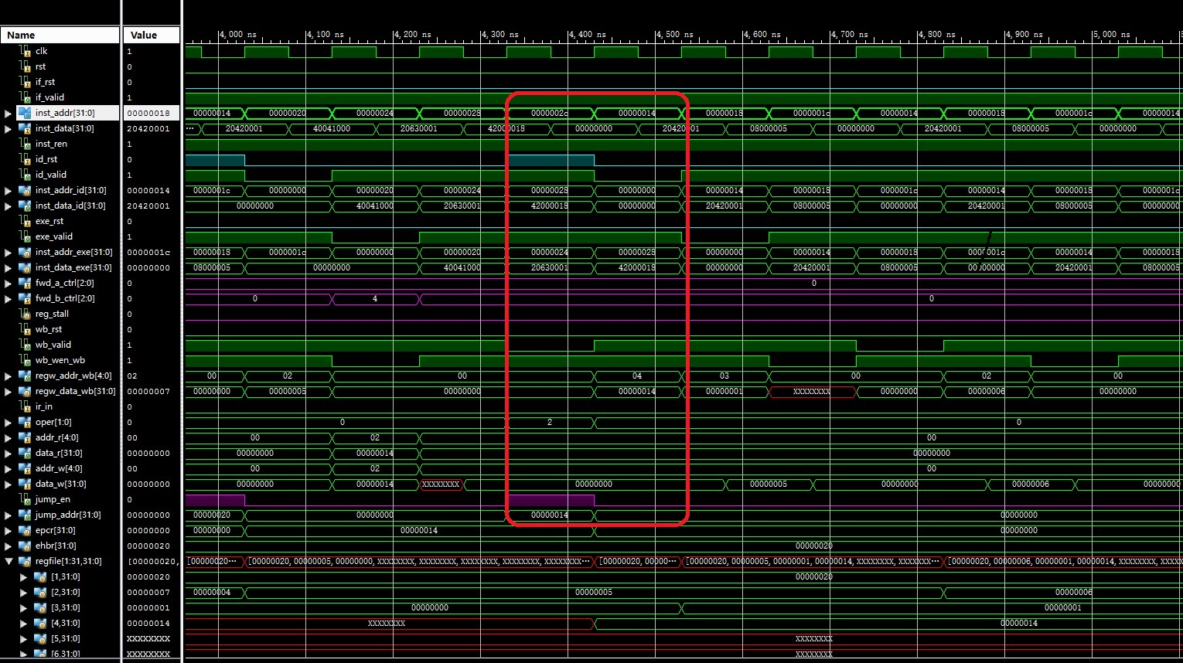
Simulation (3)

Slide 22
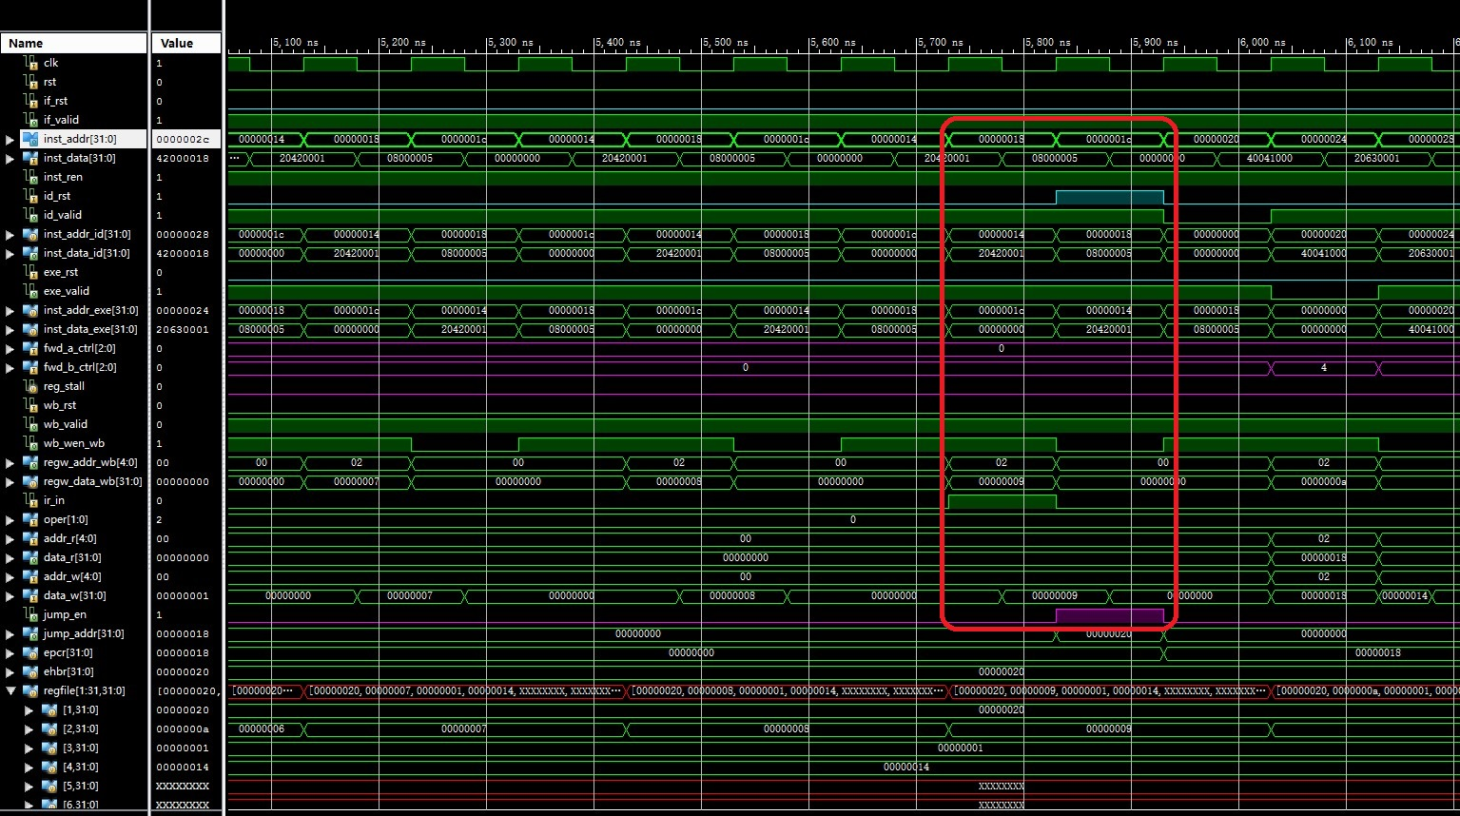
Simulation (4)

Slide 23
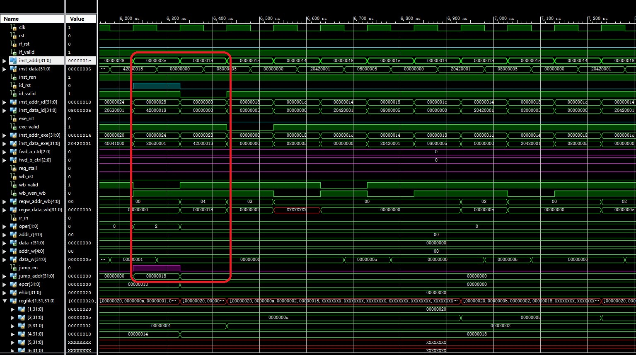
Simulation (5)

Slide 24
Checkpoints
CP 1:
Waveform Simulation of the Pipelined CPU with the verification program
CP 2:
FPGA Implementation of the Pipelined CPU with the verification program

Slide 25
Thanks!

