Slide 1
Computer Architecture Experiment
Lab 1: Warmup
Xiaohong Jiang

Slide 2
Outline
Experiment Purpose
Experiment Task
Basic Principle
Operating Procedures
Precaution

Slide 3
Experiment Purpose
Warmup with what you have learned in the course of Computer Organization
Try to use the ISE environment skillfully
Read the user guide of Sparten-3E board, especially the part of LCD displayer.

Slide 4
Experiment Task
Update your Verilog code in Computer Organization to implement and test the single cycle CPU on SP3E board.
Extend your single-cycle CPU (in Org) to support 18 instructions and run on SP3E.

Slide 5
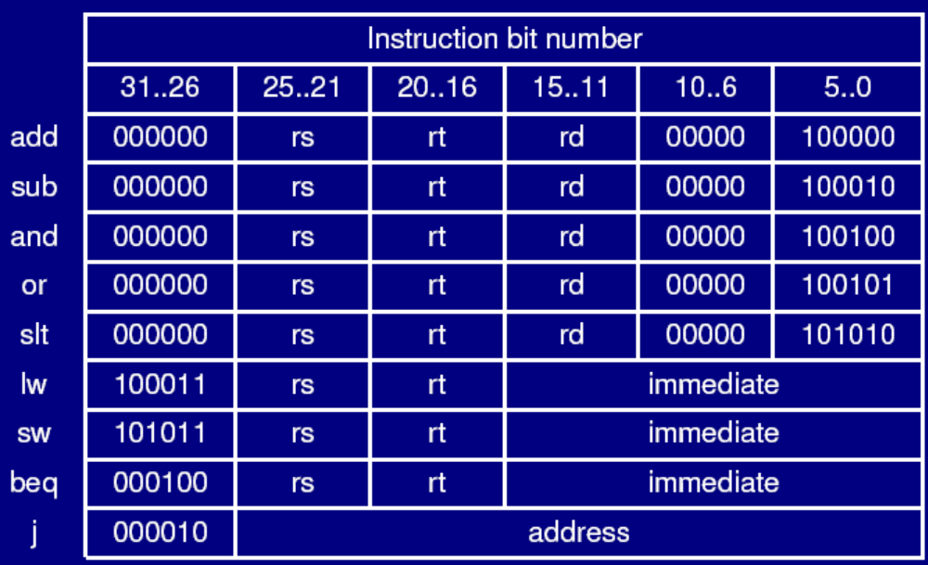
The 9 MIPS instructions（ORG lab)

Slide 6
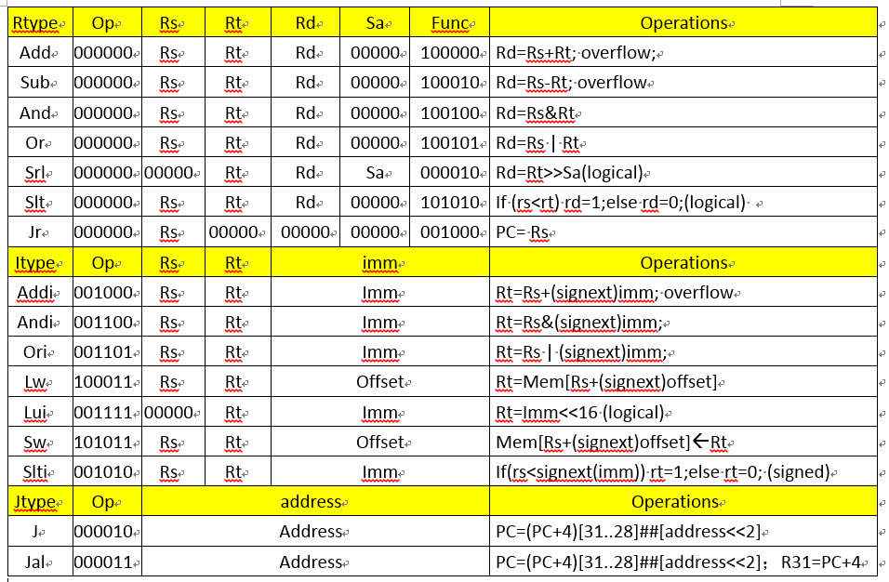
18 common used MIPS instructions
（Add, Sub, And, Or, Srl, Addi, Andi, Ori, Lw, Lui, Sw, Slt, Slti, Beq, Bne, J, Jal, Jr）

Slide 7
Lab steps:
Get warmup with Verilog, ISE and SP3E.
Implement to show results on LCD instead of segment or LEDs (LCD code can be found in course website. ) including PC, current Instruction，32 Register Value , Clock-cycles
Update your CPU to implement 18 instructions. (Draw the logical graph first )
Design a test assembler program (both in Assemble code and hexadecimal code) to check every kind of instruction.
Run the test code and show the results.
  Step-by-step mode (must) / Execute through (selective)
Displaying results
  PC, instruction code, register values (32), clock-cycles

Slide 8
Prepare for checking
Do understand what you have implemented.
  Show your testcode ( both in assembler code and machine code when you present your result.
  Prepare to answer questions on your results (Verilog code, logical graph, UCF…).
Show how your CPU execute the test code on LCD.
  PC
  Current instruction in hexadecimal code
  Register Value
  Clock cycles

Slide 9
Report Submission
All reports should be submitted to course website.
Submision file should be named as: “StID_Name_lab1.rar”, including StID_name_Lab1.doc (report) and your project directory containing your test code and the files ending with .v, .sch, .ucf, .coe, .bit, and.
Report should be rewritten according to the report template. ( Must include the logical graph for your single cycle CPU supporting 18 MIPS instructions.)

Slide 10
Thanks!

